Slide 1
Cognitive Development
Britney Del Solar | PSY 620 | February 18, 2025
Del Solar
Notes:
Hi everyone, today I’ll be continuing our discussion on cognitive development, specifically in the study of intelligence and cognitive ability

Slide 2
Topics: Intelligence/Cognitive Ability
Measurement
Genes AND environment (Tucker-Drob studies)
Intervention
Education and intelligence (Ritchie & Tucker-Drob, 2018)
Del Solar
Notes:
Here are the topics we’ll be covering for today, starting with… and ending with the article we all read
First bullet point
Assessments versus/and standardized tests
Predicting mathematics ability (Lauer & Lourenco, 2016)

Slide 3
Definitions
Intelligence: the ability to derive information, learn from experience, adapt to the environment, understand, and correctly utilize thought and reason
Intelligence quotient (IQ): a standard measure of an individual’s intelligence level based on psychological tests
APA Dictionary of Psychology
Del Solar
Notes:
But first let’s breakdown what intelligence means. According to the APA Dictionary of Psychology, intelligence is defined as…. And IQ is defined as…

Slide 4

Q: What do you think are some key factors that contribute to or are used to assess intelligence across different developmental stages?
Del Solar
Notes:
Participation link: https://www.menti.com/alepg5oug8g8
My link: https://www.mentimeter.com/app/presentation/al3rf7s4ppemp74jedunuv3m6csvz1o2/edit?question=22ji5i5ptps5
Examples: Habituation, novelty scores, processing speed
We’ll talk about some of these in today’s class, but…
Q: Would anyone like to elaborate on their answer?

Slide 5
Measurement
Del Solar
Notes:
So let’s get start with measurement, both in terms of assessments and standardized tests

Slide 6

Lab-based assessments of intelligence
Fagan Test of Infant Intelligence
Del Solar
Notes:
One lab-based assessment is the Fagan Test of Infant Intelligence
It assesses cognitive development in infancy by using a habituation-dishabituation task and measuring the amount of time spent fixating on novelty stimuli compared to the familiar stimuli
It is correlated with scores of standard intelligence tests at 3 years of age, showcasing predictive validity
This test is used for research studies as an index of the relative level of “functioning” in the group being studied
This video will display a similar habituation/dishabituation task using eye tracking. The original study had an experimenter look through a peephole and time the amount of time spent looking
Start at 1:30
Q: Do you see any problems with measuring intelligence in this way ONLY? Is there something missing?

Slide 7

Del Solar
Notes:
In a similar manner, this is a study that uses a similar task, but focuses on spatial processing skills at infancy and how this may continue through childhood as well as predict math aptitude

Slide 8
Study Aims
01
02
To characterize the extent of continuity in the processes associated with mental transformations across early childhood
To determine whether spatial processing ability in infancy predicts math aptitude at 4 years of age
Del Solar
Notes:
So, the authors had study aims. The first was to characterize….and the second was to determine…

Slide 9
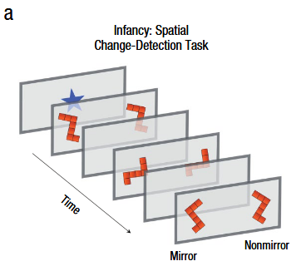
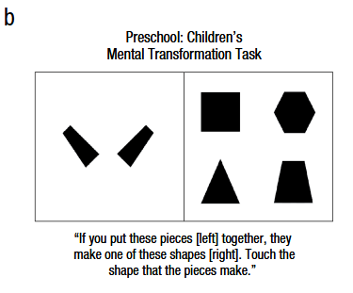
Methods
Participants
Procedure
53 children (25 females) participated as:
Infants (6-13 months) – n = 63
Preschoolers (4 years) – n = 53
84% of families from original infant sample agreed to participate
Infants were presented with a spatial change-detection task designed to assess mental transformation ability
At 4 years of age, they completed a battery of cognitive tasks:
Spatial tasks: Children’s Mental Transformation Task (CMTT) & others
Quantitative measures
Nonspatial & nonquantitative tasks (general cognitive abilities)
Del Solar
Notes:
Procedure 1st bullet point: two image streams appeared simultaneously on opposing sides (Figure 1A)
The shape appeared in different randomly selected orientation along the picture plane with each successive image presentation (both images were in the same orientation)
But on every 3rd presentation, mirror image of shape was presented in one stream (mirror stream) while original shape was presented in the other (nonmirror stream)
Performance measured as proportion of total looking time toward mirror stream (mirror/(mirror + non-mirror)
Procedure 2nd bullet point:
Spatial tasks included mental-transformation measure (CMTT)
Children were presented with 2 pieces of target shape (Figure 1B) & 4 choice shapes
Instructed to select shape that 2 pieces could combine to make
Performance measured by proportion of items answered correctly
Other spatial tasks included visualization/reorientation within a larger navigable environment
Quant measures assessed symbolic-math achievement AND nonsymbolic number processing
General cognitive abilities = working memory, vocab, etc.

Slide 10
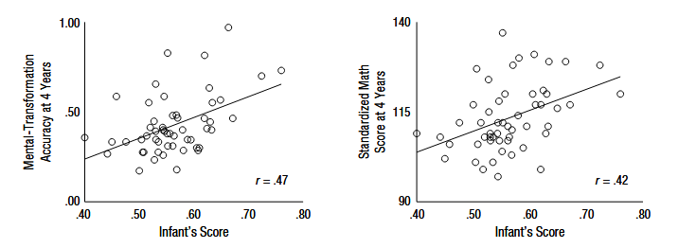
Infants’ scores on the spatial change-detection task significantly predicted their preschool performance on CMTT and symbolic math-test (controlling for general cognitive ability, age, and spatial STM)
Del Solar
Notes:
Result:
Showing considerable stability in spatial aptitude across early development and that superior spatial processing early in life may play a role in scaffolding math development
*Note:
CMTT = Children’s Mental Transformation Task
Spatial STM = spatial short-term memory (has been found to contribute to interindividual variability in mental rotation performance & spatial/quant tasks in this sample, so they controlled for it

Slide 11

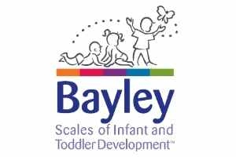

Normed assessments of cognitive development in infancy
Del Solar
Notes:
Some examples of normed assessments of cognitive development are the Bayley, Mullen, and Battele tests
These tests measure similar cognitive and mental ability skills such as: language, motor skills, visual reception skills, socio-emotional skills, etc.
Bayley: Adaptive behavior, Cognitive, Language, Motor, Social-Emotional
Mullen: Receptive/expressive language, fine/gross motor skills, visual reception skills
Battelle: Communication, social emotional, adaptive, motor, cognitive
They have been used extensively in research to identify infants at risk for developmental delays (exposure, prematurity, autism risk, ZIKA) in order to provide early intervention services

Slide 12
Discussion Questions
What are some strengths and/or weaknesses that you can point out about these assessments?
Do these tests accurately measure intelligence across different cultures and backgrounds?
What are some other factors that might affect intelligence test results?
How might these tests capture the construct of intelligence and how might they not?
Given that some of these tests are used to identify children at risk for developmental delays, how might misclassification impact individuals?
Del Solar
Notes:
4th bullet point: Think construct validity and the nomological net
How might these tests capture the construct of intelligence and how might they not?

Slide 13
Genes and the Environment
Del Solar
Notes:
Now let’s jump in to talking about genes and the environment and how these two factors shape intelligence in early childhood

Slide 14
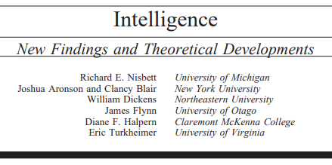
Genes and the Environment
Heritability of IQ is between .4 and .8 (less for children)
Large genome study found only 6 genetic markers associated with cognitive ability
  Only one remained statistically significant when critical values were adjusted for multiple tests
  They only explain 1% of the variance in general cognitive ability
  Proven difficult to do – trait is polygenic
G/E contribution to IQ varies by SES
Del Solar
Notes:
To provide a quick lay of the land, I want to discuss some key findings discussed in this review by Nisbett et al.
2nd bullet point: Because the trait is polygenic (many genes contribute) finding genes has been proven difficult
Last bullet point: We’ll get more into this last piece here with two Tucker-Drob studies on this interaction between Genes and SES

Slide 15

Del Solar
Notes:
The first one, published in 2011, is titled…

Slide 16
Study Aims
01
02
03
Examine SES-related disparities in phenotypic (i.e., observed) mental ability
Examine the population-average contribution of genes & environment to mental ability at 10 mo & to change in mental ability between 10 mo & 2 years
Test whether SES interacts with genetic & environmental contributions to mental ability at 10 mo and to change in mental ability between 10 mo & 2 years
Del Solar

Slide 17
Methods
Participants
Procedure
750 pairs of twins drawn from the Early Childhood Longitudinal Study, Birth Cohort (ECLS-B)
1st wave: 10 months old
2nd wave: 2 years old
Sampled from a range of locations, ethnicities, & incomes
61% Caucasian
16% African-American
16% Hispanic
2% Asian
<1% Pacific Islander, Native American, or Alaska Native
4% Mixed Race
Observed zygosity
25% were MZ
35% were same-sex DZ
40% were opposite-sex DZ
At both waves, administered Bayley Short Form-Research Edition (BSF-R) – Mental Scale Only
SES obtained through parental report at 1st wave
Paternal/Maternal education
Paternal/Maternal occupation
Family income
Del Solar
Notes:
They had 750 twin pairs as part of the ECLS-B study that were brought in for two waves of data collection, the first at 10 months and the second at 2 years of age
The children were sampled from…and this is the breakdown by racial group
Zygosity = the degree of genetic similarity between two or more people or organisms
Observers responded to 6 questions about similarity of same-sex twins (hair color/texture, complexion, facial appearance, earlobe shape)
Classified twin pairs as MZ or DZ
Bayley also has a Motor scale that was not used for this study
SES was obtained via 5 variables

Slide 18
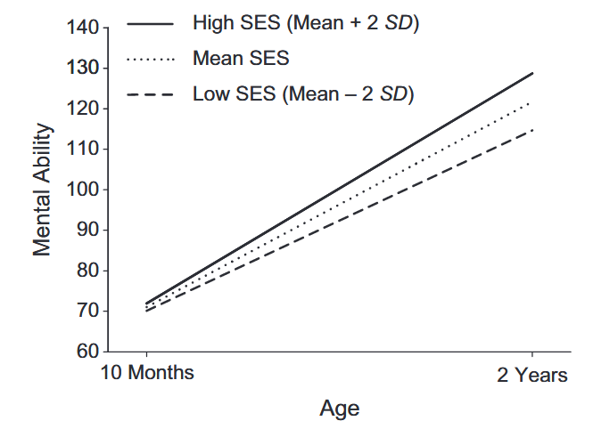
Model 1: SES was unrelated to mental ability at 10 months, but related to change in mental ability between 10 months and 2 years
Del Solar
Notes:
Result #1:
Such that higher SES children experience more rapid developmental gains in mental ability than lower SES children, such that SES-related disparities in mental ability are evident by the time they are 2 years of age
Each SD of SES was associated with approx. 1/3 of a SD of mental ability

Slide 19
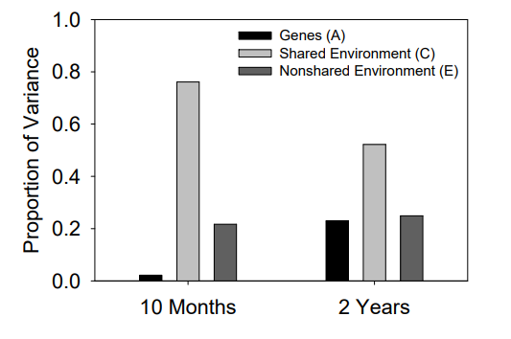
Model 2: At the population level, genes began to play a role in the development of mental ability between 10 months and 2 years
Del Solar
Notes:
Result #2:
Model 2 estimated contributions of genes, shared environment, and nonshared environments to infants' mental ability at 10 months and 2 years. They found that…
The heritability of mental ability at 10 months was 2% (p = .67), and the heritability at 2 years was 23% (p = .001)
Heritability in change in mental ability between 10 months and 2 years was 23% (p = .003)
Thus, the effect of genes on mental ability increases over infant development

Slide 20
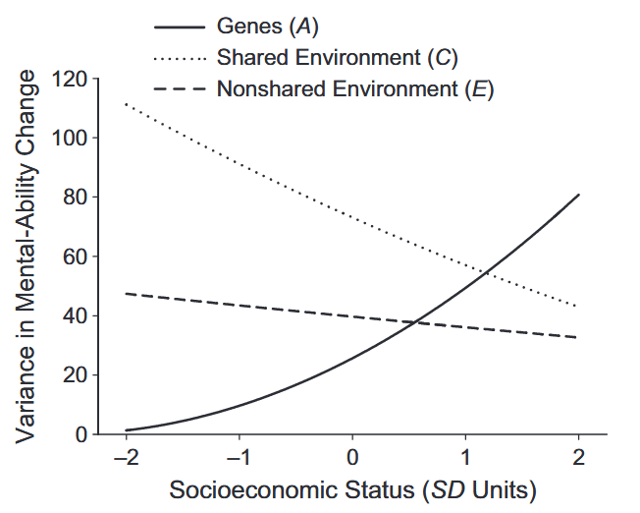
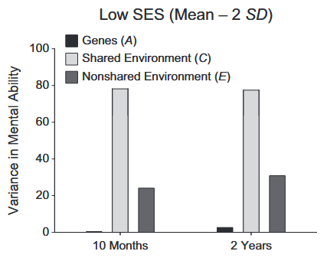
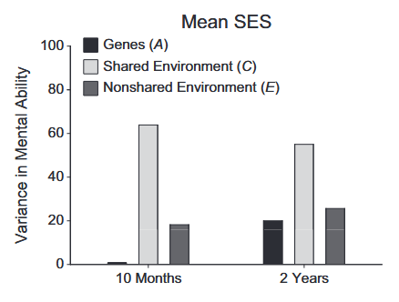
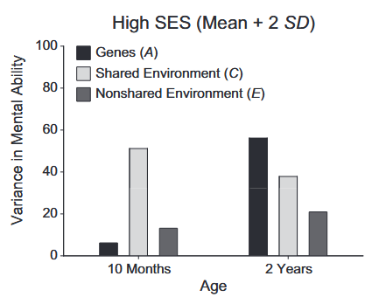
Model 3: Genetic influences on mental ability were larger for children in higher-SES homes than for children in lower-SES homes (by 2 years of age)
Del Solar
Notes:
Result #3:
Model 3 tested whether additive influences from genes, shared, and unshared environment on change in mental ability were moderated by SES
Overall, they found that…(read title)
The 1st figure shows that:
For low SES children, almost all change is due to the shared environment & genes play a negligible role in development of mental ability
For higher SES children, genes play a substantial role in development of mental ability, whereas less change is due to the shared environment
Additionally, these 3 smaller figures to the right show these amounts of variance accounted for at ages 10 months and 2 years, such that at:
At 10 months, very little genetic variance in mental ability at any level of SES
At 2 years, SES differences in genetic influences on mental ability were larger

Slide 21

Del Solar
Notes:
To extend the previous study, this study, also by Tucker-Drob, looked to see if this gene x SES interaction extended to participants in non-US contexts

Slide 22
Study Aims
01
02
03
Does the range of studies from the U.S. support a positive estimate of Gene x SES interaction on achieved IQ?
Do studies on participants outside the U.S. show a similar greater-than-zero Gene x SES effect?
Can a single estimate adequately account for all of the observed effect sizes, or are separate estimates necessary to represent effect sizes from the U.S. and from Western Europe and Australia?
Del Solar

Slide 23
Method
Conducted meta-analysis of world’s literature on Gene x SES interaction effects on cognitive ability to:
  Determine true effect size
  Examine bias in reporting
  Examine moderators including age, nation (U.S. vs non-U.S.), test type (achievement/knowledge test vs intelligence test), SES assessment, and year of publication
Inclusion criteria:
  Intelligence/achievement continuously measured with objective test
  Genetic influence measured with siblings/twins
  Zygosity diagnosed through physical similarity ratings or genotyping
  Ordered categorical or continuous measure of family SES during childhood
  No study sampling decisions due to IQ, diagnoses, etc.
14 independent studies → 43 effect sizes → 24,926 pairs of twins/siblings
Del Solar
Notes:
This was a meta-analysis of tests of the Gene x SES interaction on intelligence and academic-achievement test scores to…
They had 5 inclusion criteria:
Intelligence/achievement had to be continuously measured using an objective performance-based test
Inference of genetic influence had to be made using siblings (preferably twins) with varying degrees of genetic relatedness
The degree of genetic relatedness had to be known to a high degree of certainty (zygosity for twins)
An ordered categorical or continuous measure of family SES during childhood had to have been examined as a moderator of genetic variance in intelligence or achievement
Participants could not have been specifically selected on the basis of their psychiatric or medical diagnoses, patient status, or intelligence or achievement test scores
In total, their dataset included…

Slide 24
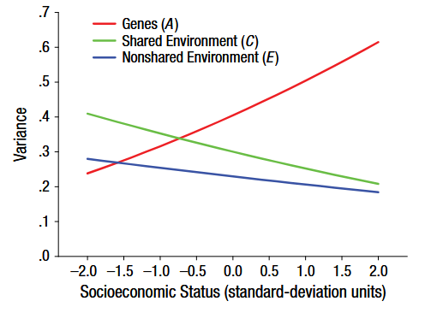
Studies from the U.S. supported a moderately sized Gene x SES interaction on intelligence and academic achievement
Del Solar
Notes:
Result #1:
This figure shows this interaction, similar to the one we saw in the previous study
For low SES children, almost all change is due to the shared environment & genes play a negligible role in development of mental ability
For higher SES children, genes play a substantial role in development of mental ability, whereas less change is due to the shared environment

Slide 25
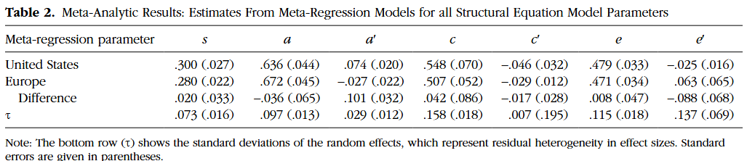
In studies conducted outside the U.S. (Western Europe & Australia), there was a nonsignificant and negative Gene x SES effect on intelligence and academic achievement
Del Solar
Notes:
Result #2:
Additionally, the difference in magnitude of the Gene x SES effect between the U.S. and the non-US studies was itself significant
There was also no evidence of moderation on the Gene x SES effects beyond nation
Thus, these results indicate that the Gene x SES effects are not uniform but can take positive, zero, or even negative values depending on factors that differ at the national level

Slide 26
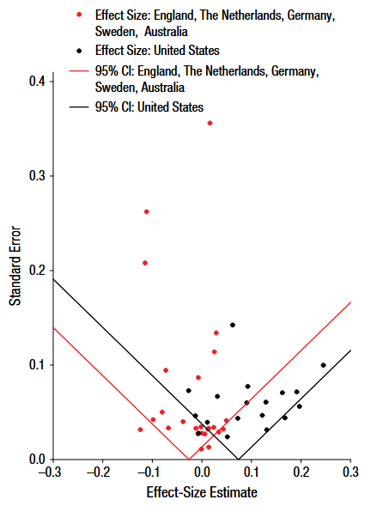
No evidence of publication bias, p-hacking or selective reporting
Robustness checks did not meaningfully change presence of effects
Del Solar
Notes:
Result #3:
The authors also probed for publication bias using funnel plots, p-curve analysis, and robustness checks such that they found no evidence of…
Funnel plot = most of the effect sizes fall within the inverted triangle-shaped region, with greater horizontal spread around estimates with higher standard errors, which is the case in this figure
Additionally, their robustness checks looked to see if excluding certain effect sizes or disproportionately large samples affected the results. They did not.

Slide 27
Discussion Questions
How do these studies contribute to our nativist vs. constructivist debate from last class?
For the second study, what might explain the cross-national differences in the G x E effect on intelligence/achievement? What national factors might be at play?
Given that genetic influence on mental ability did not begin to play a role until 2 years of age, what does this tell us about intervention strategies?
Del Solar

Slide 28
Intervention
Del Solar

Slide 29
The Abecedarian Project: Overview
Children born between 1972 and 1977 were randomly assigned as infants to either the early educational intervention group or the control group
  Experimental group: full-time, high-quality educational intervention in a childcare setting from infancy through age 5
    Educational “games” throughout day
  Monitored their progress over time (1 – 35 years of age!)
Del Solar
Notes:
One such intervention program was the Abecedarian Project
I’m going to show you all a video of this project, but to provide a little overview on what it is. Essentially, the Abecedarian project was an intervention program designed to provide positive, long-term effects of high-quality early care and education
Children born in…

Slide 30

Del Solar
Notes:
Q: Thoughts? Comments?
Q: How do the findings from the Abecedarian Project relate to our G x E interaction on intelligence discussion?

Slide 31
Education and Intelligence
Del Solar
Notes:
Okay, let’s shift to the article we all read for today’s class…

Slide 32

Del Solar
Notes:
Titled….

Slide 33
Study Aims
01
02
03
Do increases in normal-range educational duration after early childhood have positive effects on student’s later intelligence?
What factors moderate the effect of education on intelligence?
To what extent is there publication bias in this literature, such that the meta-analytic effects might be biased by a disproportionate number of positive results?
Del Solar

Slide 34
Methods
Procedure
Analyzed results from 3 most quasi-experimental methods
Minimizes selection processing effects
Del Solar
Notes:
The authors analyzed results from 3 most prominent quasi-experimental methods for testing the effects of education on intelligence (note: defined intelligence as score on a cognitive test)

Slide 35
Three Types of Studies
Control prior intelligence
  Longitudinal study
  Cognitive testing data collected before and after variation in education duration
Policy change
  Studies in which education duration changes because of some broader factor not specific to the individual (e.g., 1960s education reform in Norway)
School-age cutoff
  Regression-discontinuity analysis used to study impact of school district date-of-birth cutoffs for school entry
Del Solar
Notes:
The three types of study designs were:
First, control prior intelligence studies are longitudinal in nature in which cognitive testing data is collected before and after some variation in the duration of education
Controlling for participant’s early ability level!
The second design was policy change studies in which education duration changed because of some broader factor not specific to the individual
For example, one study used data from a 1960s educational reform in Norway that increased mandated education by 2 years, staggered across different districts in the country
This allowed the researchers to look at the effect of an additional year of education on later intelligence test
Finally, the 3rd design was the school-age cutoff studies that used a regression-discontinuity analysis to study the impact of school district date-of-birth cutoffs for school entry

Slide 36
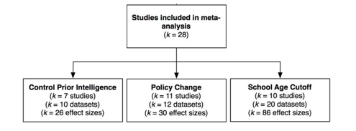
Methods
Procedure
Analyzed results from 3 most quasi-experimental methods
Minimizes selection processing effects
Inclusion Criteria:
Objective and continuous outcome cognitive measures
Variation in education after age 6
Population studied generally health & neurotypical
Fit into 1 of the 3 study design types
28 studies → 42 datasets → 142 effect sizes → 615,812 individuals
Statistical Analysis
Rescaled each effect size into the # of IQ point units, on the standard IQ scale (M = 100, SD = 15), associated with 1 additional year of education
Used random-effects meta-analytic structural equation modeling
Tested moderators (age at outcome test, outcome test category, age at early test or at policy change, sex, design)
Tested for publication bias
Del Solar
Notes:
They included data from both published and unpublished works that met 4 criteria as follows…
The outcome cognitive measures had to be objective and continuous
The variation in education had to be after age 6 (no preschool interventions!)
The population under study had to be generally health and neurotypical
Studies had to be fit into one of the three study design types
Using a variety of databases, they ended up with…and here is a figure that breaks down these numbers by study
For their statistical analysis, they rescaled…

Slide 37
For all three study designs, longer educational duration is associated with increased intelligence test scores
Study Design | Effect Size | SE | p
Control Prior Intelligence | 1.197 | 0.203 | <.001
Policy Change | 2.506 | 0.583 | <.001
School-Age Cutoff | 5.229 | 0.530 | <.001
Total (Average) | 3.394 | 0.503 | <.001
The effect of 1 additional year of education was estimated at approx. 1 to 5 standardized IQ points
Del Solar
Notes:
Result #1:
Due to the fact that these designs implemented a different approach for limiting endogeneity confounds resulting from selection processes, the results support a causal relationship between education and intelligence test scores
Such that…(bring out text box at bottom)
Additionally, the effect size for school-age cutoff method was significantly larger than that for control prior intelligence and for policy change
Due to significant heterogeneity for each design and for the overall model, they explored which moderators might explain the heterogeneity

Slide 38
Moderator Analyses
Control prior intelligence
Age at early test – not significant
Time lag between tests – significant
  Smallest age gap (5 years) – 2.398 IQ points
  Largest age gap (72.44) – 0.317 IQ points
Policy-change design
Age at change – not significant
Del Solar
Notes:
Result #2 & #3:
For the control prior intelligence studies, they tested whether the age at which participants had taken the initial (control) cognitive test, or the gap between the early test and the outcome test, moderated the effect size.
Their findings show that the age at early test was not significant, but the time lag between tests was, such that the smallest age gap had an effect size of…and the largest age gap had an effect size of…
For the policy change design studies, they tested to see whether age at which the educational policy change produced an increment in mandated schooling moderated the effect size, in which case it did not

Slide 39
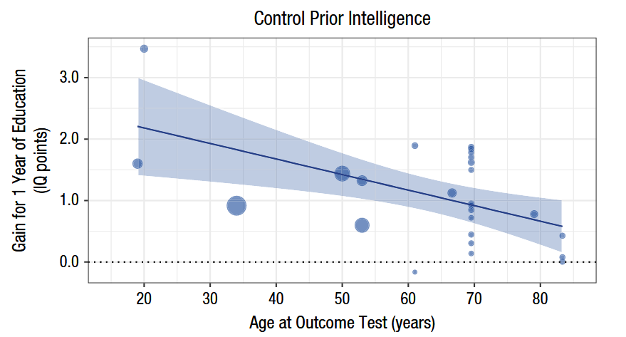
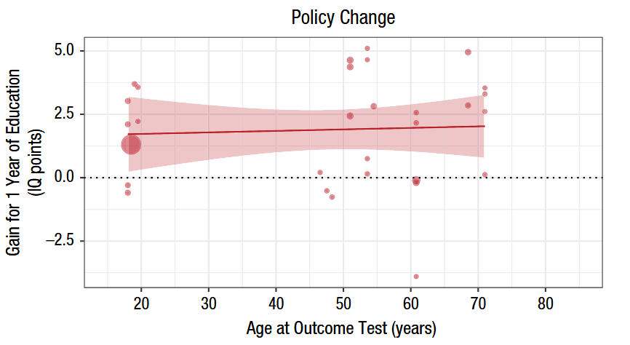
Outcome age was a significant moderator for control prior intelligence studies, but not for the other two study designs
Age 18:
2.154 IQ points gained per year of education
Age 83:
0.485 IQ points gained per year of education
Age 18:
1.690 IQ points gained per year of education
Age 71:
2.413 IQ points gained per year of education
Del Solar
Notes:
Result #4:
They also tested to see if age at outcome test impacted the effect size and found that it was a significant moderator for…
For control prior intelligence studies, effect size of education declined by -0.026 IQ points per year of age such that…(read text boxes)
As can be seen in the policy change graph, there was no significant moderating effect of age at outcome
There was little variation in age at outcome test for school-age cutoff design

Slide 40
Composite, Fluid, Crystallized
All Cognitive Tests
Composite
Fluid
Crystallized
Control prior intelligence:
Significantly stronger educational impact effects on composite tests (1.876 points) than on fluid tests (0.836 points)
Policy-change:
Significant effects for both composite (2.314 IQ points) and fluid (2.272 points), but not crystallized tests (1.012 points), but not significantly different from one another
School-age cutoff:
Significant effects of 1 year of education on composite, fluid, and crystallized tests (6.534, 5.104, 5.428 points, respectively), but no significant differences
Del Solar
Notes:
Result #5a:
The authors also tested whether test category moderated effect sizes, so they first broke up the outcome cognitive tests into three broad categories of composite, fluid, and crystallized tests
They found…

Slide 41
Achievement vs. Other
All Cognitive Tests
Achievement tests
Other tests
Policy change:
No significant difference on the education effect on the 7 achievement tests (2.760 points) versus the 23 other tests (1.784 points)
School-age cutoff:
Achievement tests (6.231 points) showed a substantially and significantly larger educational effect than other tests (3.839 points)
Del Solar
Notes:
Result #5b:
They then split the outcome tests into “achievement” tests versus “other” tests (without control prior intelligence because only one achievement test) and found that for policy change…and for school-age cutoff (which had the largest proportion of achievement tests)…
Note: All significant moderators were still significant in multiple-moderator model

Slide 42
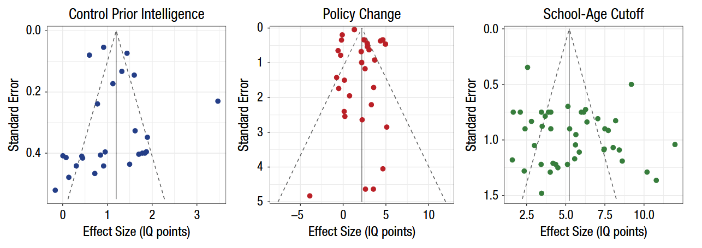
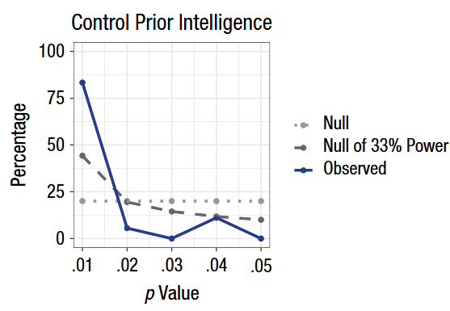
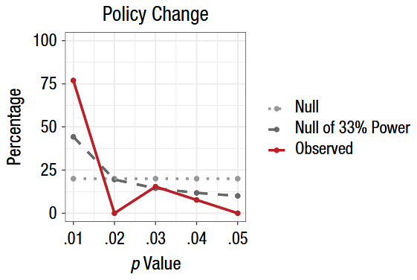
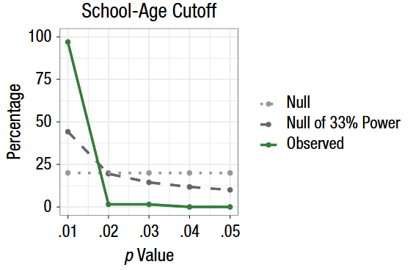
No evidence of publication bias or p-hacking in the studies with statistically significant results and minimal systematic bias in the results
Del Solar
Notes:
Result #6:
Lastly, they found no evidence of publication bias or p-hacking in the studies with statistically significant results, demonstrating minimal systematic bias

Slide 43
Discussion Questions
Madison: The meta-analysis includes a substantial number of effect sizes indexing the relationship between time in school and achievement test performance (versus standard intelligence tests). Given that achievement tests often directly measure academic exposure, how might the exclusion of these effect sizes change the study's overall findings about the relationship between education and intelligence? Is the claim they make in the paper an accurate representation of the findings?
Lang: The authors made a huge claim that their results "support the hypothesis that education has a causal effect on intelligence test scores," but they also go on to note that they looked at the effect of the quantity of education on youth intelligence rather than the quality of education. This makes me think about the role of gifted programs in schools that take kids with higher IQ scores and put them through more rigorous curriculum than their peers with lower IQ scores. The quantity of education for both groups is still the same, but the quality is quite different. Additionally, quantity was operationalized as the number of years youth engage in education, but there are other metrics of quantity that may be more informative, such as how many face-to-face hours youth had with an instructor. Therefore, could the quality of the education confound these findings?
Britney: Going off Lane’s previous question, aside from formal education, how might other learning experiences produce similar or different intelligence gains?
Del Solar

Slide 44
Thank you!
Del Solar

