Slide 1
Advanced
Developmental
Psychology
PSY 620
Notes:
Advanced
Developmental
Psychology

Slide 2
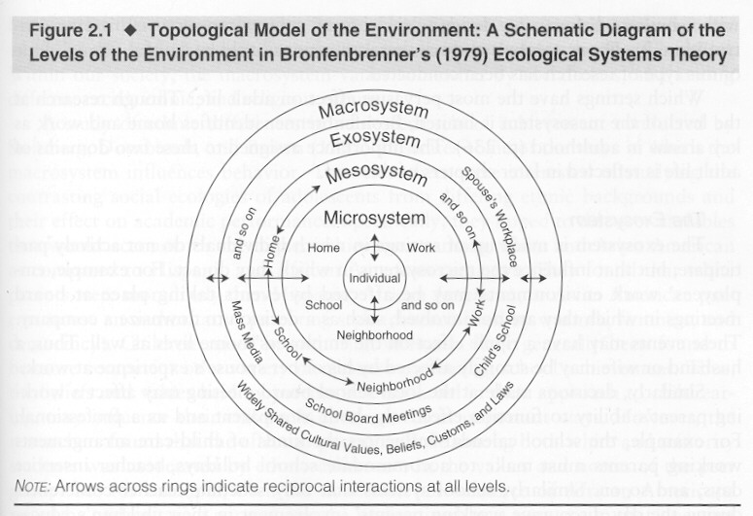
Socialization Processes
Parent-child relationships
  Face-to-face
  Still-face and prediction
  Attachment and its prediction
  Sensitivity and prediction
Peer relationships
School/community

Slide 3
Attachment overview
Attachment as a motivational system
Measuring attachment security
  Strange Situation
Parental sensitivity predicts attachment security
  Experimental & observational (meta-analytic and large sample) evidence
Genetic moderation of stability in attachment?
  Mother’s physiology and affect?
Temperament is weakly associated with attachment security (resistance)
Attachment stability, prediction, and the adult attachment interview (theory & practice)
But what’s sensitive?
  (More) evidence for the midrange model

Slide 4

Introduction to Attachment
Credit: Christine Sinicrope

Slide 5
Attachment Theory
(Bowlby, 1969)
Based on ethological theories of emotional communication between infants and parents
  Infants have innate capacities to signal needs to others
    Examples of attachment behaviors?
  Adults are biologically predisposed to respond to these signals

Slide 6
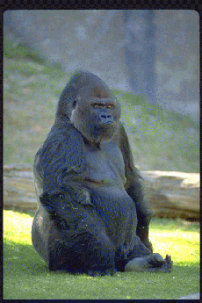
Environment of evolutionary adaptiveness
Protection from predators and . . . conspecifics (aka stranger danger)

Slide 7
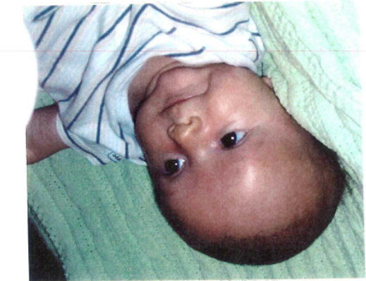

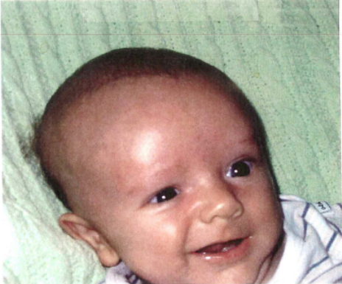
Recasting early interaction:
Signals that function to establish or maintain proximity of caregiver
  Indiscriminate Social
  Responsiveness (0 to 8 weeks)
Based on ethological theories of emotional communication between infants and parents

Slide 8
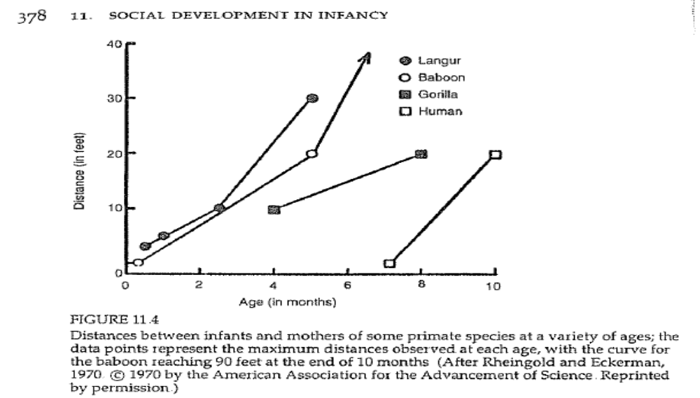
Attachment’s Function/Goal:
Keeping Caregivers Close

Slide 9
Attachment system
Inherent motivation
Organization of different behaviors
  Doesn’t matter how you get to caregiver
With single function
In a goal-corrected manner
Attachment as an organizational construct

Slide 10
Multiple attachments
Infants form attachments to many caregivers
A hierarchy is assumed
  In which infant turns first to primary caregiver
    But remember the Efe’s multiple caregivers
Role of fathers…

Slide 11
Intellectual History
Old dominant theory:
  Affection/attachment to mother originate because mother is the source of food
    Two versions
      Behaviorist: Contact becomes conditioned reinforcer because it is paired with food, an unconditioned reinforcer
      Learning theory: Primary drive toward food (oral) becomes secondary drive toward contact
Harlow says this is wrong
  Harlow movie: http://www.youtube.com/watch?v=KlfOecrr6kI

Slide 12
What forms the basis for attachment relationships?
How do we know that attachment represents an “emotional” bond?
Primary Drive Reduction Theory
  Preference based simply by having primary needs (i.e., hunger) met?

Slide 13
What is the basis of attachment relationships?
Harlow -- the rejection of “drive reduction” explanations
  Spitz (1946) noticed that infants in orphanages (who were adequately nourished but had no loving attention) did very poorly
  Harlow’s surrogate mother studies examined relative influence of feeding vs. contact/comfort on attachment

Slide 14

Harlow’s Surrogate Mother Studies
Bale-wire mesh
vs.
Terry cloth
Each could be
equipped with feeding
nipple
Test preference during
times of stress

Slide 15
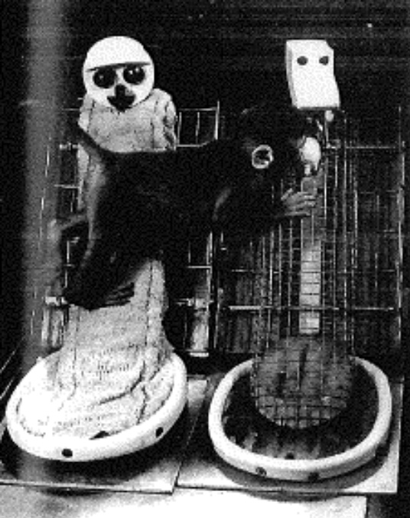
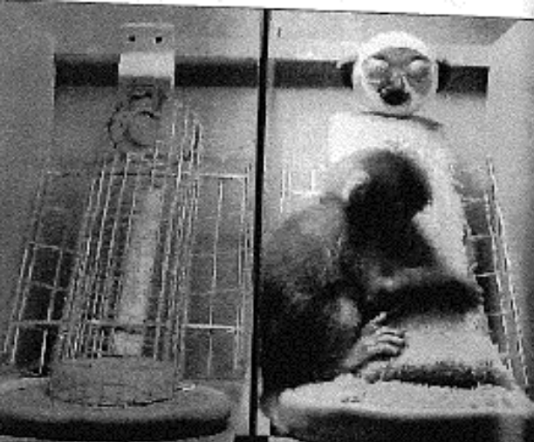
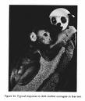
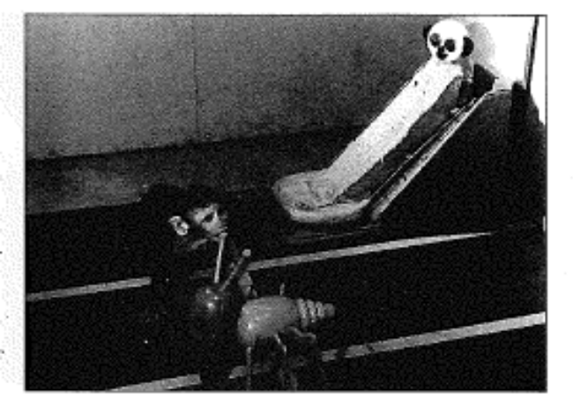
Harlow’s Surrogate Mother
https://www.youtube.com/watch?v=hsA5Sec6dAI
From Blum (2003)

Slide 16
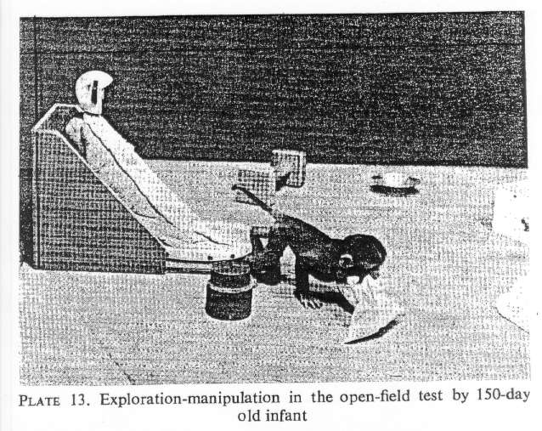
Key Attachment Concepts in Harlow
Contact with attachment figure
Retreat to attachment figure when afraid
Become less afraid
Use attachment figure as secure base from which to explore

Slide 17
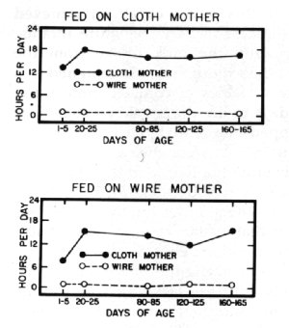
Time is spent on cloth mothers
Both wire and cloth fed spend most of their time on cloth surrogate mother
  Regardless of which “mother” fed you

Slide 18
Internal Working Models
Mental representations of the availability of the attachment figure and what to do when the attachment system is activated
        Mental rules for organizing, accessing, and limiting access to information relevant to attachment.
Impact individual differences in strange situation behavior and infant attachment classification.

Slide 19


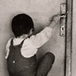


Attachment makes social contact a psychological reality
Carrying feelings of being with other inside you
Attachment disorders:
Romanian adoptees

Slide 20
Exposure to institutional rearing → disinhibited attachment disturbance
Romanian adoptees
Attachment disorders:
Disturbance (from interview) means
  Lack of differentiation among adults;
  Clear indication that child would readily go off with a stranger;
  Lack of checking back w parent in anxiety-provoking situations.
        Rutter, M. and T. G. O'Connor (2004). "Are There Biological Programming Effects for Psychological Development? Findings From a Study of Romanian Adoptees." Developmental Psychology 40(1): 81-94
          In memoriam, Sir Michael Rutter

Slide 21
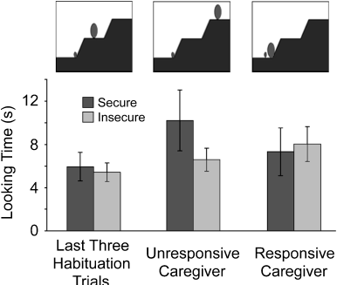
What infant expects
What do you expect?
Evidence for Infants’ Internal
Working Models of Attachment. 2007.
Susan C. Johnson, Carol S. Dweck, and Frances S. Chen

Slide 22
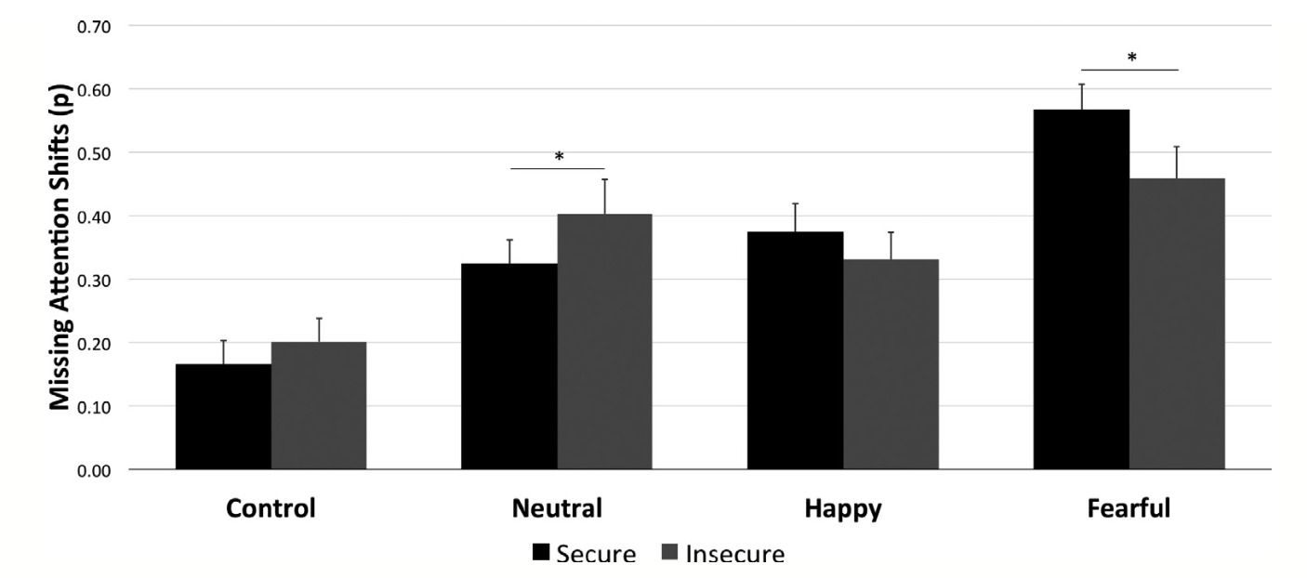
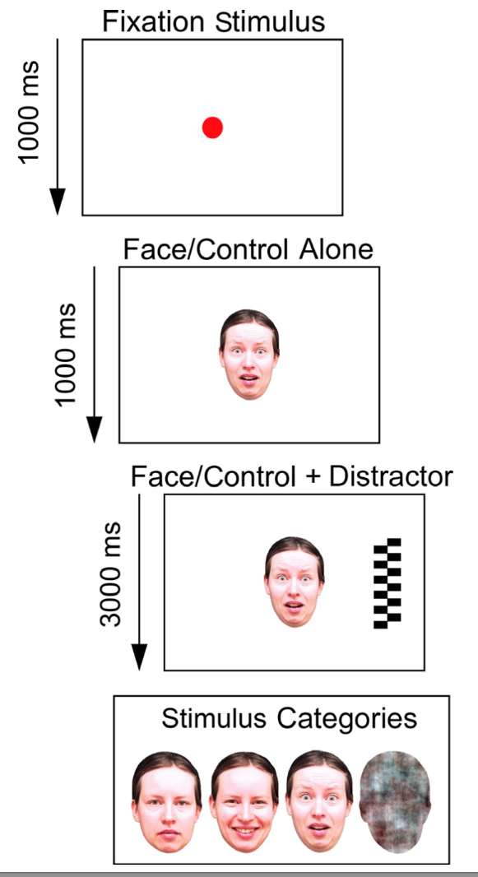
Attention to Fear Faces at 7 months Predicts 14 month Security
Peltola, Forssman, Puura, van IJzendoorn, & Leppänen (2015)

Slide 23
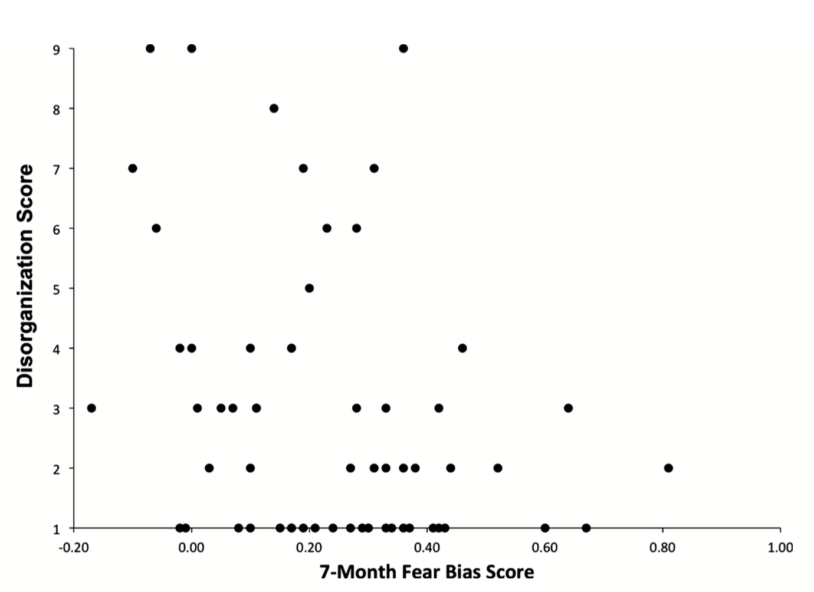
Attention to Faces Expressing Negative Emotion at 7 months Predicts Attachment Security at 14 months
Peltola, Forssman, Puura, van Ijzendoorn, & Leppänen (2015)

Slide 24
Measuring attachment security
A construct (secure attachment)
Is different than its measurement or operationalization
Attachment security can be measured with a Q-sort (an intricate rating system)
Prototypically measured with the Strange Situation (12 – 36 months at least)

Slide 25
Overall strategy
A – Avoidant
  Avoid caregiver
B – Secure
  Seek and be comforted by caregiver
C – Resistant
  Seek caregiving without surcease
D – Disorganized
  Lack a coherent strategy

Slide 26
Attachment types/categories
Low Avoidance
SECURE
RESISTANT
65%
15%
High Displayed Anxiety
Low Displayed Anxiety
AVOIDANT
DISORGANIZED
20%
No longer rare
High Avoidance
Notes:
Once children form an attachment to a caregiver, there are 4 specific types of attachment…
Secure Children: Use parents as a secure base. When separated, they may or may not cry but when the parent returns, they actively seek contact and their crying is reduced immediately. About 65% of North American infants in middle-SES families show this pattern
Avoidant children seem not to care whether parent is present or absent.
When the caregiver leaves, the infant is not distressed, and at reunion, do not move toward the parent or try to initiate contact, or slow to
-Parent does not provide adequate comfort when the child is emotionally upset, ill, or hurt (rejecting)
Resistant -Before separation, infants are reluctant to explore their environment, seem preoccupied with getting attention of caregiver.
-When their parent leaves, they are distressed, and when the caregiver returns, both seek and resist contact. They combine clinginess with angry, resistive behavior (hitting/pushing parents, continue to cry, can’t be comforted)
Parents tend to be inconsistent in response to their child’s signals of distress.
Disorganized/disoriented children lack an organized pattern to their behavior
-Disorganized children display unusual behaviors such as approaching the caregiver with their head averted (fear or confusion to the cg)
-Disorganization is considered an extreme form of insecurity
-At reunion, these infants show confused, contradictory behaviors (like looking away while the parent is holding them or approaching the parent with a flat, depressed emotion – some display odd, frozen postures)
Insecure Attachment averages 85% in maltreated children

Slide 27
Attachment Classifications
Secure Attachment (Type B; 65% in NA)
Ambivalent/Insecure-Resistant (Type C, 15% in NA)
Insecure/Avoidant (Type A, 20% in NA)
Disorganized (Type D, very rare)

Slide 28
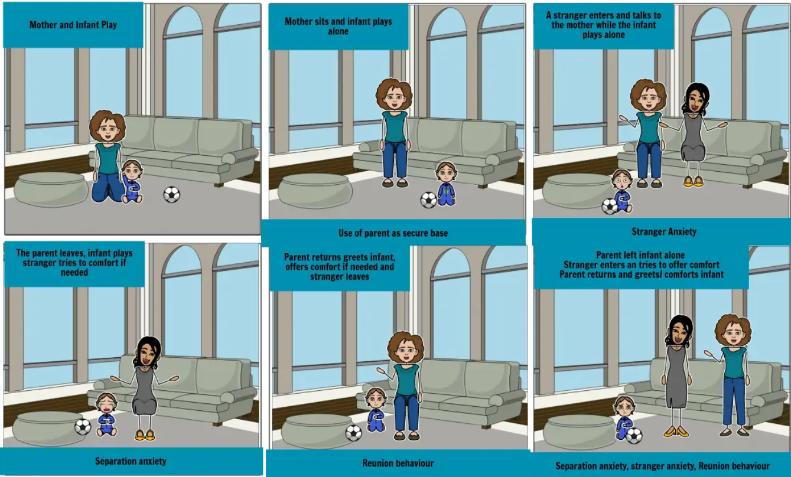
Ainsworth’s (1978) Strange Situation
  7 episodes increase stress (unfamiliar environment & adult, brief separations from parent)
  How are attachment behaviors are organized around parent
  Attachment classification based primarily on reunion behaviors
  See example at:
  http://www.youtube.com/watch?v=QTsewNrHUHU (van Ijzendoorn)
  Attachment examples ppt
  https://nyu.databrary.org/volume/108/slot/10325/-?asset=28995
  8 minutes, 13 minutes
  Practice cases: 1, 2, 4, 7
https://www.youtube.com/watch?v=DRejV6f-Y3c (Waters)
Leung

Slide 29
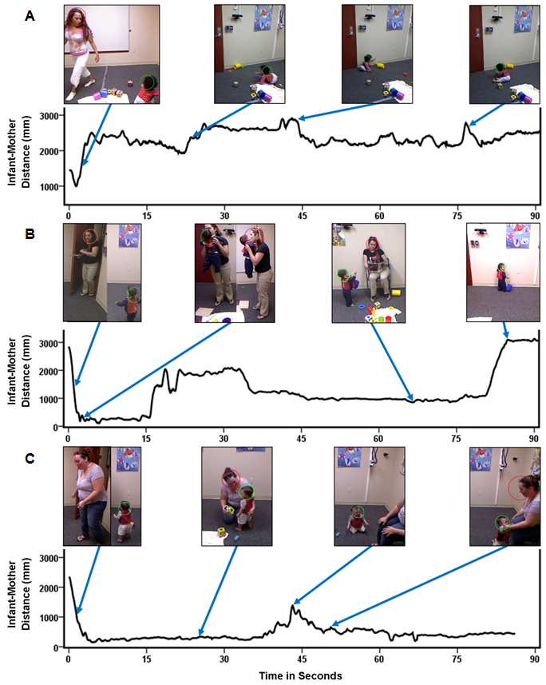
Strange Situation
Figure 2. Automated measurement of the distance between infant (green circle) and mother (red) in the first 90 seconds of the second Strange Situation reunion of infants reliably classified by an expert as A) avoidant, B) secure, and C) resistant. The avoidant infant shows the greatest overall distance from mother; the secure infant exhibits mid-range and variable distance; the resistant infant exhibits low distance levels, which show little variability.

Slide 30
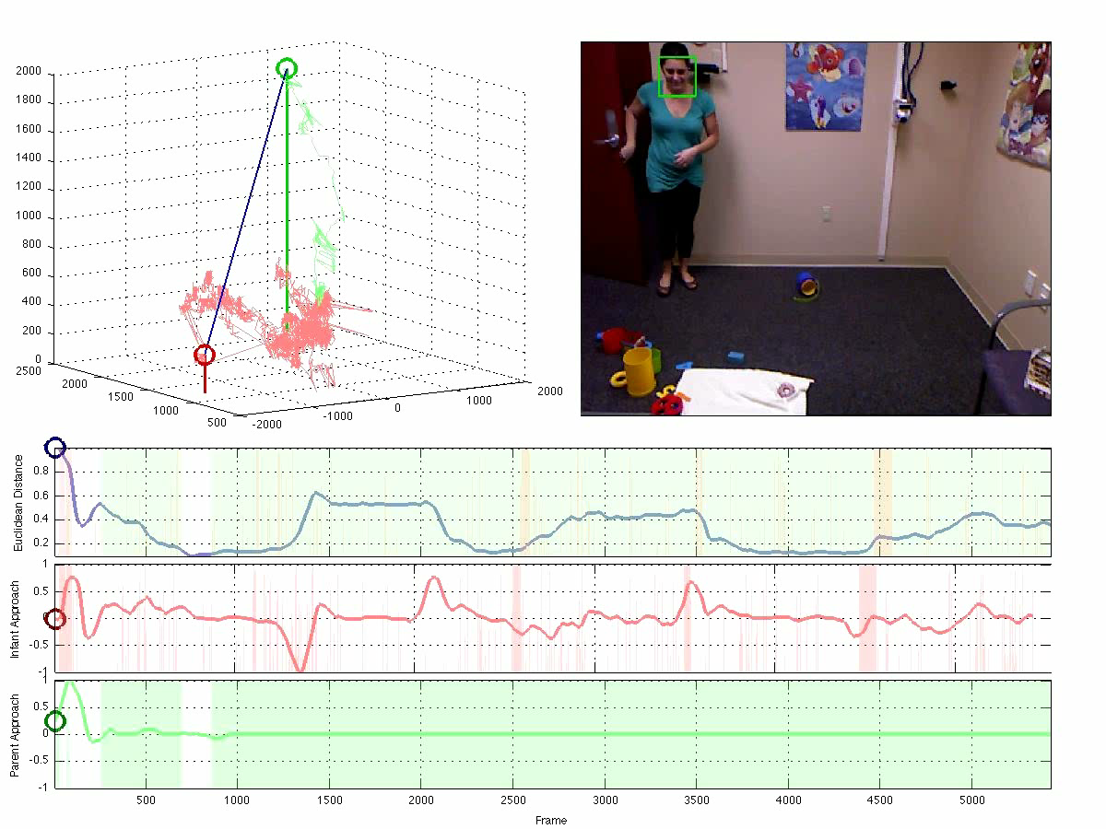
Attachment in Strange Situation
Fn1.r2. b6331

Slide 31
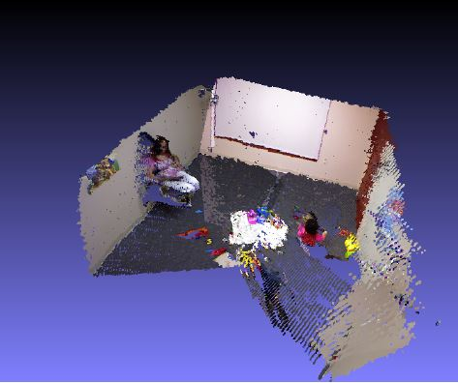
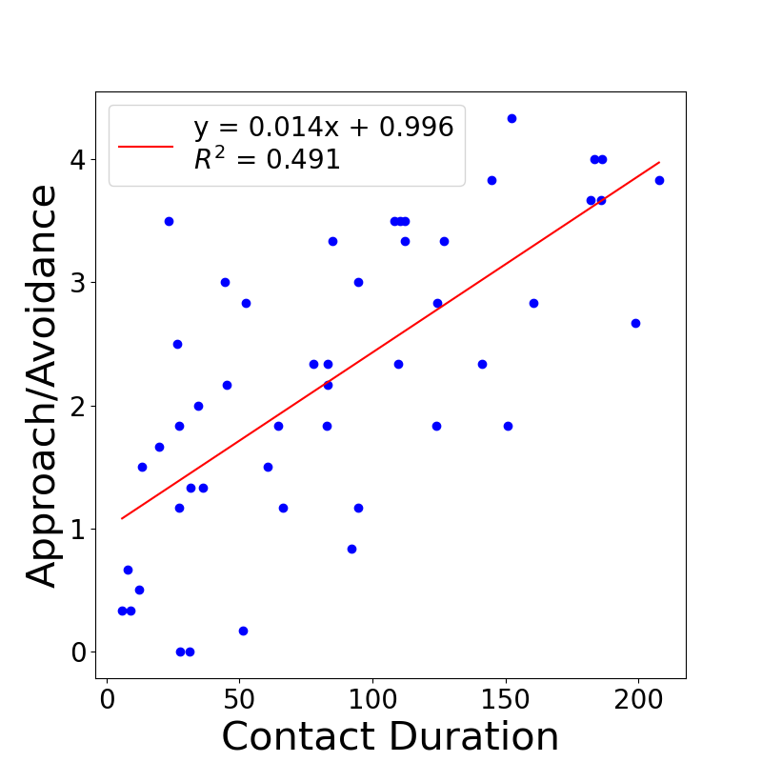
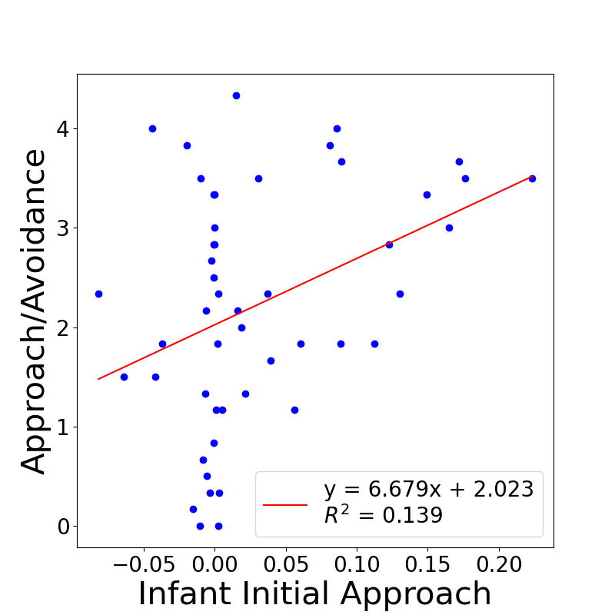
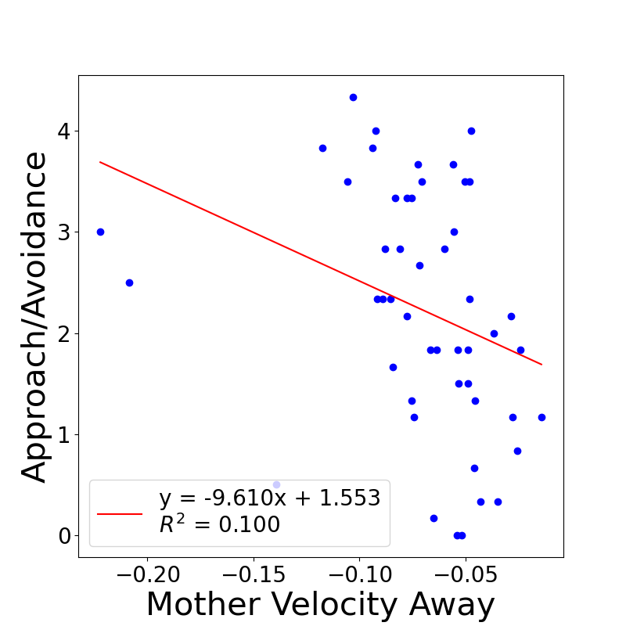
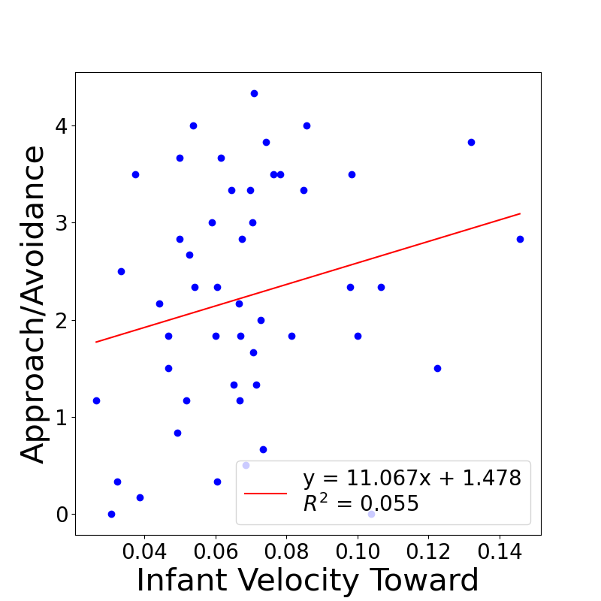
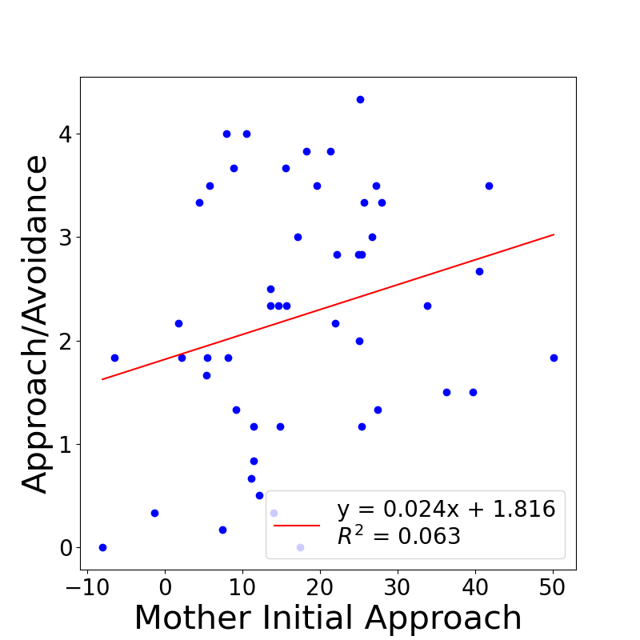
Attachment affected by
infant and parent
 | R² | F(df) | Objective Predictors | Predictor Statistics
 |  |  |  | B | t | p
Rated Approach/ Avoidance | .71 | 21.13 (5, 43) | Contact Duration | .65 | 7.81 | <.001
 |  |  | Infant Initial Approach | .26 | 3.05 | .004
 |  |  | Mother Velocity Away | -.19 | -2.23 | .031
 |  |  | Infant Velocity Toward | .21 | 2.55 | .014
 |  |  | Mother Initial Approach | .19 | 2.25 | .030
Prince, et al., 2022
Prince, et al., 2021

Slide 32
Attachment system
Stress activates the attachment system & reveals the child’s strategy
Security is an equilibrium
Avoidance is deactivation/shutting down
Resistance is over-activation/acting up
Notes:
So, the attachment behaviors are what we observe.
The attachment system is activated when the child is under stress.
We observe the behaviors that result and compare them to patterns and classify the child’s level of security.
Secure attachment is an balance btw proximity and exploration.
The child uses the mother as a secure base to explore their environment.
If frieghtened, he feels confident that he can go to mom for safety and comfort.
There are 2 types of insecure or anxious strageties: avoidance and resistance.
Avoidance is an insecure strategy where the child “shuts down” behaviorally.
These children do not see their mother as a secure base and they deal with that by shutting down their emotions.
Resistance is just the opposite. Here the child is overly emotional. Instead of shutting down they act up.
Resistant children get very distressed during the separations and are not able to be easily comforted.

Slide 33
Basis for Individual
Differences?
Sensitive/responsive caregiving
  Nurturant
  Attentive
  Nonrestrictive
  Synchronous
  Predictable

Slide 34
Ongoing debate
Individual differences in early attachment security are expected to have enduring implications for children's socioemotional development but are not expected to be shaped by child temperament
Individual differences in early attachment are the result of temperamental variation rather than characteristics of the specific parent-child relationship

Slide 35
The Current Study
What is the link between attachment and temperament?
  Conducted a meta-analytic review aimed at addressing the empirical overlap of infant attachment and temperament
  129 studies identified yielding 131 independent samples (13,018 children)

Slide 36
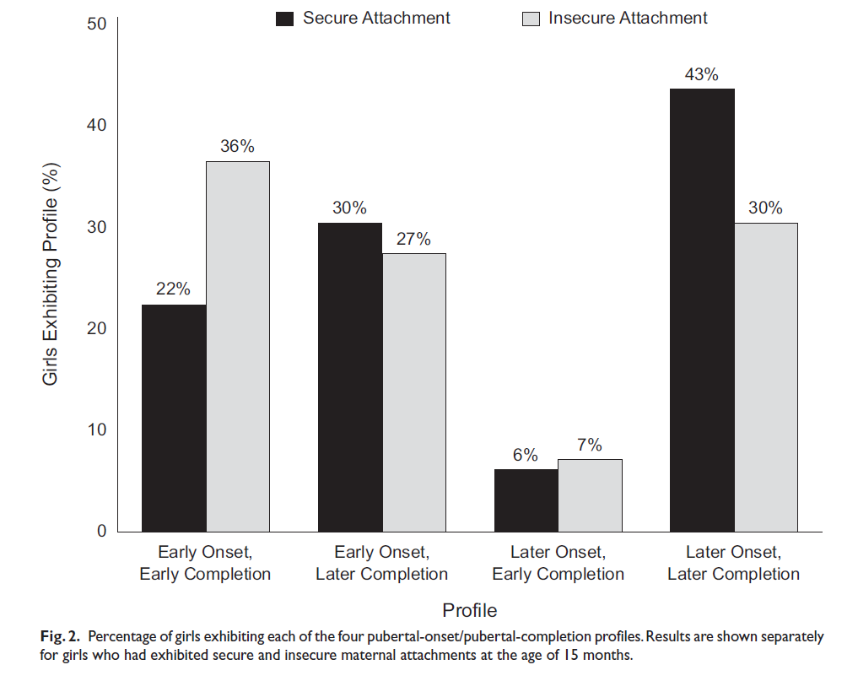
Attachment-Maturation Model
Early menarche: insecure over-represented?
Is insecurity a better fit to certain environments?
Belsky, Houts, & Fearon 2010

Slide 37
Predicting attachment security
Most infants are attached but only 2/3 of infants are typically securely attached.
There is strong but limited experimental evidence and extensive evidence from meta-analyses that caregiver sensitivity predicts secure attachment
Notes:
What does secure attachment predict?

Slide 38
Evidence for care-giving effects
Experimental
  Irritable infants
  Snugglies
Observational
  Meta-analysis of quasi-experiments

Slide 39
Experiment: Snuggly Effect!
49 low-socioeconomic status (SES) mothers of newborn infants
Given soft baby carriers (more physical contact) or infant seats (less contact).
More experimental (83%) than control infants (38%) were securely attached at 13 mo.
  3.5 mo, mothers in the experimental group were more contingently responsive than control mothers to their infants' vocalizations.
Low cost experimentally-validated intervention?
        Anisfeld, Casper, Nozyce, & Cunningham (1990). Does infant carrying promote attachment? An experimental study of the effects of increased physical contact on the development of attachment. Child Development, 61(5), 1617-1627.

Slide 40
Experiment: Sensitivity training
100 irritable, low-SES Dutch infants
50 mothers in experimental group
  receive 3 home visits to foster “contingent, consistent, and appropriate responses to + and - infant signals”
50 control mothers are observed only

Slide 41
Results
Experimental infants 36/50 (72%) secure
Control infants: 16/50 (32%) secure
Sensitivity training for mother decreases rates of insecurity among irritable infants
Meta-analysis of intervention studies showed a moderately large effect size, d = .48
  Van den Boom

Slide 42
Observational Meta-analysis:
Sensitivity Studies Only
Perceive signals accurately and respond promptly and appropriately
  22% (r = .22), 7,223 infants in 123 comparisons
Original Ainsworth subscale
  24% (r = .24), 837 infants in subset of 16 studies
  Socioeconomic class is a moderator
    Middle (r = .27); lower (r = .15)
De Wolff, M., & van Ijzendoorn, M. H. (1997). Sensitivity and attachment: A meta-analysis on parental antecedents of infant attachment. Child Development, 68(4), 571-591.

Slide 43
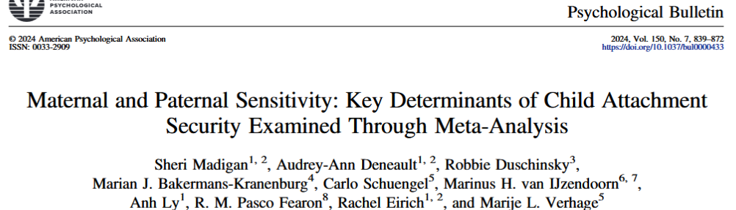
Sensitive caregiving behavior, which involves the ability to notice, interpret, and quickly respond to a
child’s signals of need and/or interest, is a central determinant of secure child–caregiver attachment. Yet,
significant heterogeneity in effect sizes exists across the literature, and sources of heterogeneity have yet
to be explained. For all child–caregiver dyads, there was a significant and positive pooled association
between caregiver sensitivity and parent–child attachment (r = .25, 95% CI [.22, .28], k = 174, 230 effect
sizes, N = 22,914). We also found a positive association between maternal sensitivity and child
attachment security (r = .26, 95% CI [.22, .29], k = 159, 202 effect sizes, N = 21,483), which was
equivalent in magnitude to paternal sensitivity and child attachment security (r = .21, 95% CI [.14, 27], k
= 22, 23 effect sizes, N = 1,626). Maternal sensitivity was also negatively associated with all three
classifications of insecure attachment (avoidant: k = 43, r = −.24 [−.34, −.13]; resistant: k = 43, r = −.12
[−.19, −.06]; disorganized: k = 24, r = −.19 [−.27, −.11]). For maternal sensitivity, associations were
larger in studies that used the Attachment Q-Sort (vs. the Strange Situation), used the Maternal Behavior
Q-Sort (vs. Ainsworth or Emotional Availability Scales), had strong (vs. poor) interrater measurement
reliability, had a longer observation of sensitivity, and had less time elapse between assessments. For
paternal sensitivity, associations were larger in older (vs. younger) fathers and children. These findings
confirm the importance of both maternal and paternal sensitivity for the development of child attachment
security and add understanding of the methodological and substantive factors that allow this effect to be
observe
Notes:
Sensitive caregiving behavior, which involves the ability to notice, interpret, and quickly respond to a
child’s signals of need and/or interest, is a central determinant of secure child–caregiver attachment. Yet,
significant heterogeneity in effect sizes exists across the literature, and sources of heterogeneity have yet
to be explained. For all child–caregiver dyads, there was a significant and positive pooled association
between caregiver sensitivity and parent–child attachment (r = .25, 95% CI [.22, .28], k = 174, 230 effect
sizes, N = 22,914). We also found a positive association between maternal sensitivity and child
attachment security (r = .26, 95% CI [.22, .29], k = 159, 202 effect sizes, N = 21,483), which was
equivalent in magnitude to paternal sensitivity and child attachment security (r = .21, 95% CI [.14, 27], k
= 22, 23 effect sizes, N = 1,626). Maternal sensitivity was also negatively associated with all three
classifications of insecure attachment (avoidant: k = 43, r = −.24 [−.34, −.13]; resistant: k = 43, r = −.12
[−.19, −.06]; disorganized: k = 24, r = −.19 [−.27, −.11]). For maternal sensitivity, associations were
larger in studies that used the Attachment Q-Sort (vs. the Strange Situation), used the Maternal Behavior
Q-Sort (vs. Ainsworth or Emotional Availability Scales), had strong (vs. poor) interrater measurement
reliability, had a longer observation of sensitivity, and had less time elapse between assessments. For
paternal sensitivity, associations were larger in older (vs. younger) fathers and children. These findings
confirm the importance of both maternal and paternal sensitivity for the development of child attachment
security and add understanding of the methodological and substantive factors that allow this effect to be
observe

Slide 44
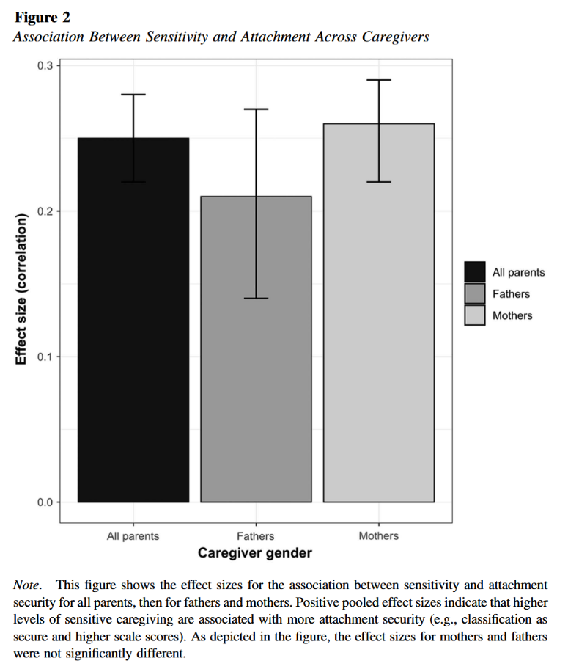
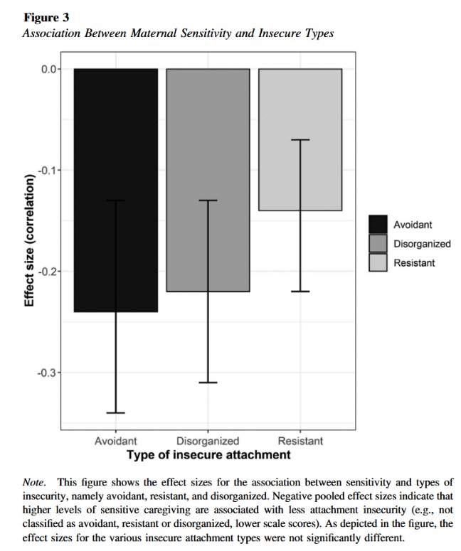

Slide 45
Conclusions
Sensitivity and quality of interaction are important and consistent (but not exclusive) predictors of attachment security.
Sensitivity important but not only factor
  Orthodox hypothesis supported weakly

Slide 46
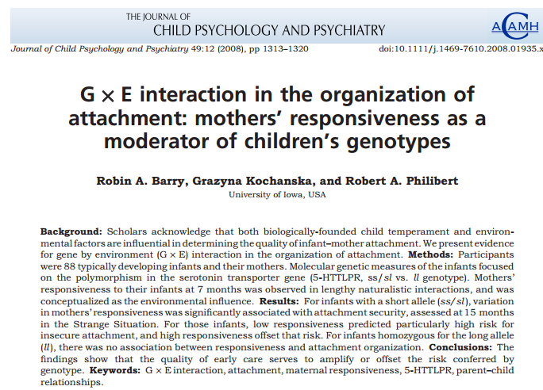

Slide 47
Two Temperamental Pathways
Indirect effect
  Temperament → Caregiver-Infant interaction → Attachment security
Direct effect (Not empirically supported)
  Temperament → Strange Situation Behavior → “Attachment Security”
  Less prone to distress → “Avoidant”
  More prone to distress → “Resistant”

Slide 48
Attachment in the Early Life Course
Meta-analytic Evidence for its Role in Socioemotional Development
Groh et al., 2017

Slide 49
Types of Attachment Styles
Secure
Avoidant
Resistant
Disorganized
Feel safe and confident in their caregivers presence. Seek caregivers for comfort.
May seem indifferent to their caregivers presence/ departure. Avoid seeking comfort from caregivers.
Children may be clingy and hesitant to explore. May become upset when separated from caregiver.
Inconsistent behavior, alternating between seeking comfort or avoiding caregivers

Slide 50
Study Goals
This study aims to assess attachment theory's claims about early attachment diversity and its impact on children's development, particularly focusing on the association between attachment patterns and socioemotional outcomes, while considering parental caregiving sensitivity.
A meta-analysis was conducted on early attachment relationship research studies to assess the relation between early attachment and:
    Externalizing problems
    Internalizing symptoms
    Temperament
    Children’s competence with peers

Slide 51
Study Questions
This study addressed questions about the developmental significance of early attachment security vs insecurity:
  Across developmental domains, does early security have narrow or broad significance?
  Does the dynamic nature of these meta-analytic associations over childhood determine whether the predictive significance of early attachment endures or diminishes over time?
  Do the effects of attachment vary by populations (e.g., clinical status, sex, SES)?

Slide 52
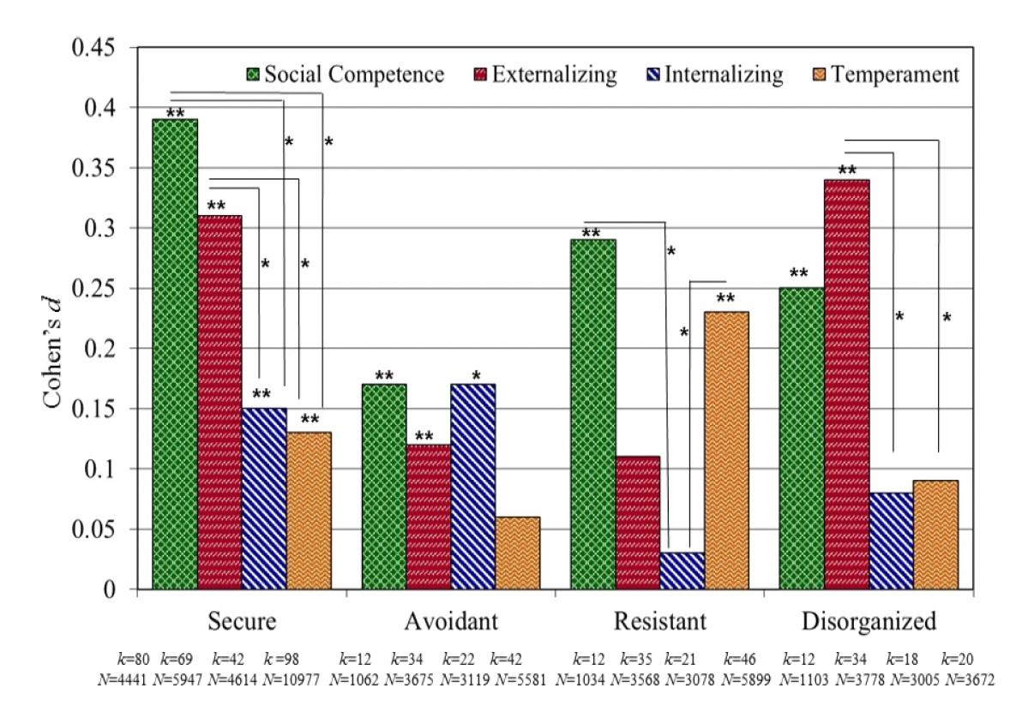
Attachment in the Early Life Course
Meta-analytic Evidence for its Role in Socioemotional Development. Groh et al., 2017

Slide 53
Attachment Security Across Childhood
Age
Significant
Attachment Security
Externalizing problems
Notes:
Relationship increased with age

Slide 54
Attachment Security Across Childhood
Age
Not significant
Peer Competence
Attachment Security
Internalizing symptoms

Slide 55
What about temporal lag?
Temporal lag
Not significant
Attachment Security
Any association

Slide 56
Attachment Security
Psychiatric History
Sex differences
The association between insecurity and externalizing sx was stronger when either the child or the parent had been diagnosed with a psychiatric disorder
Children’s sex moderated the association between insecurity and externalizing problems, with it being stronger for boys

Slide 57
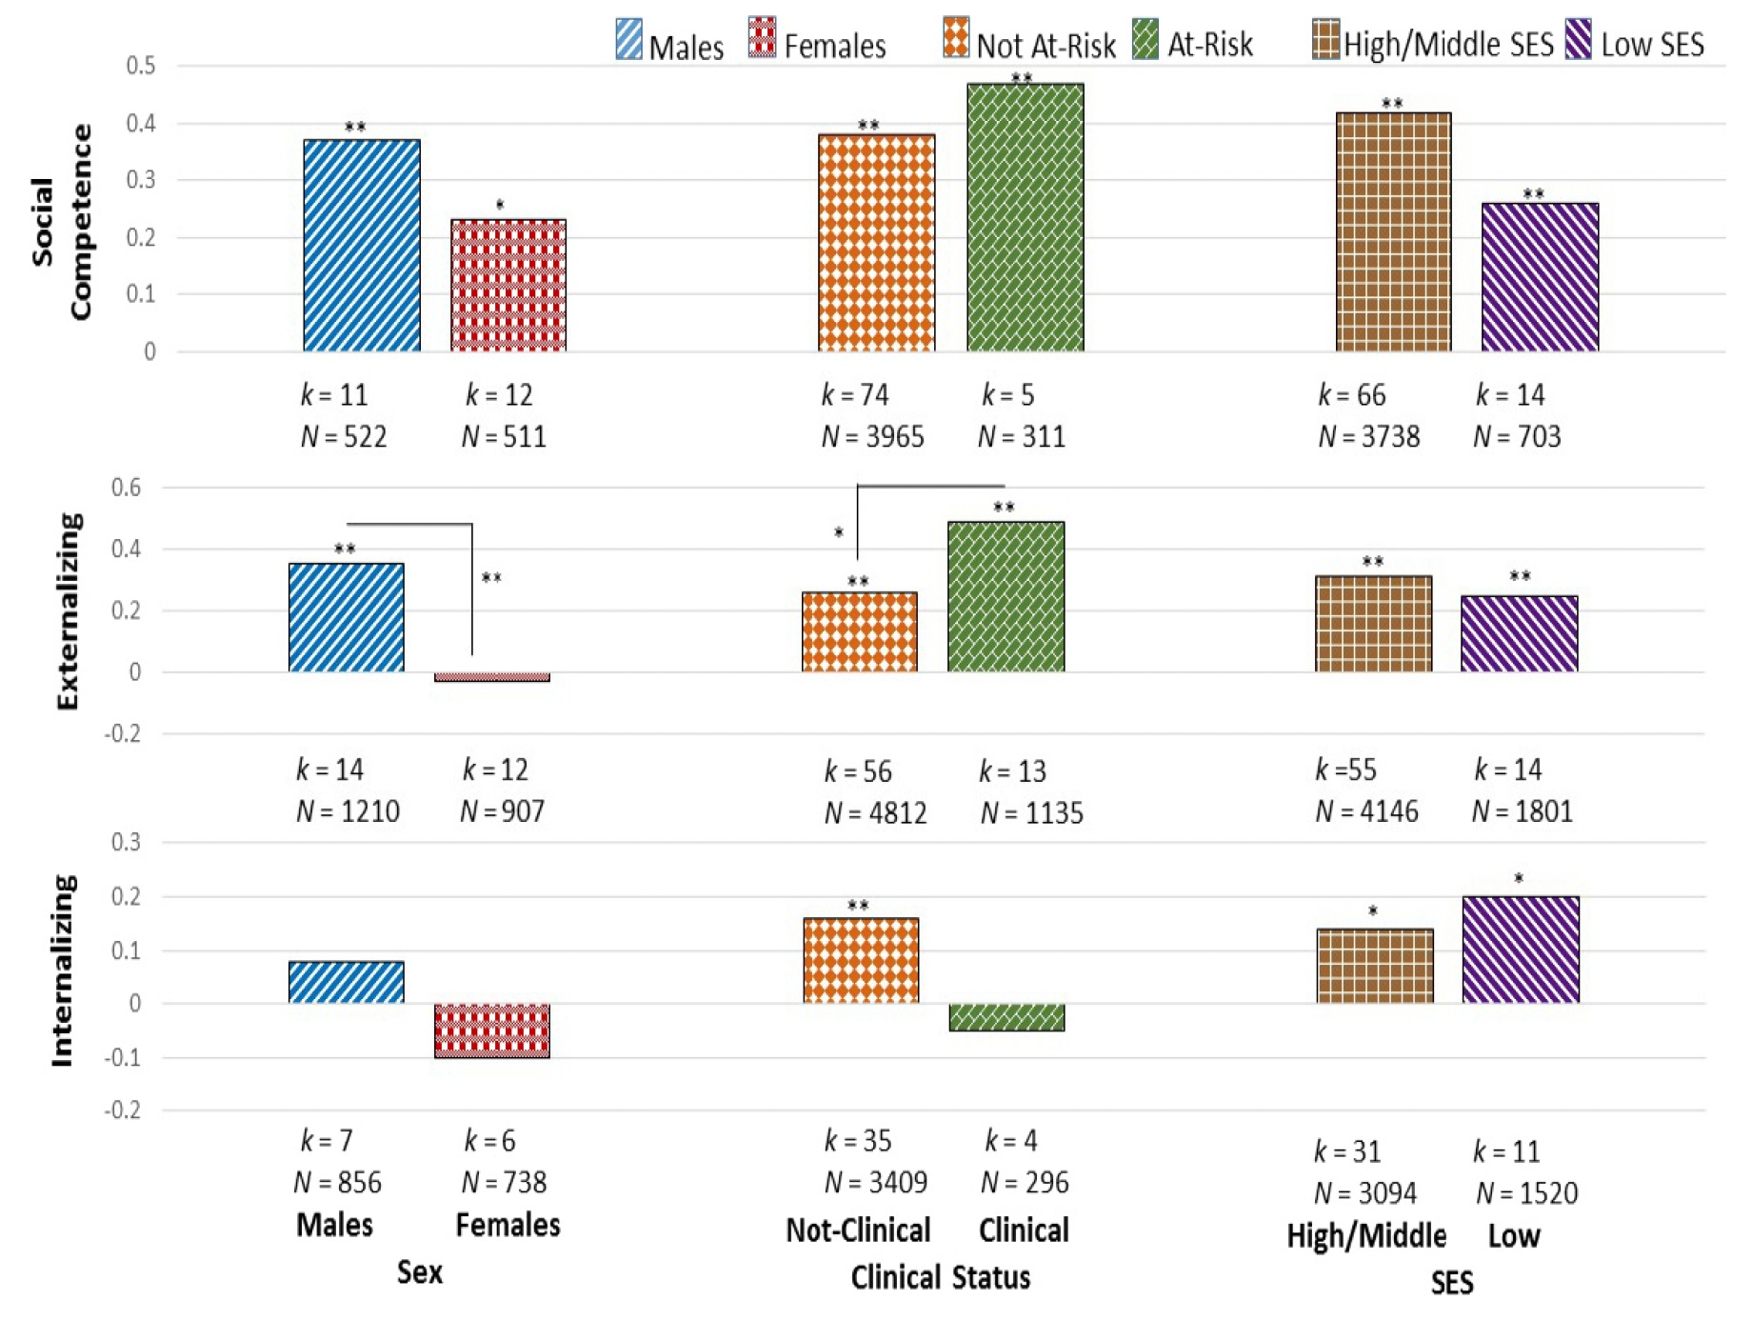

Slide 58
What about other attachment styles?
What is the association with temperament?

Slide 59
Results and Discussions
Findings suggest early attachment security:
  Is only WEAKLY associated with infant temperament
  Has enduring significance for children’s socioemotional (mal)adjustment
  Strongly involved in social competence
Findings suggest insecure attachments:
  Negatively associated with social competence
  Avoidance with both internalizing and externalizing problems
  Disorganization highest risk for externalizing problems

Slide 60
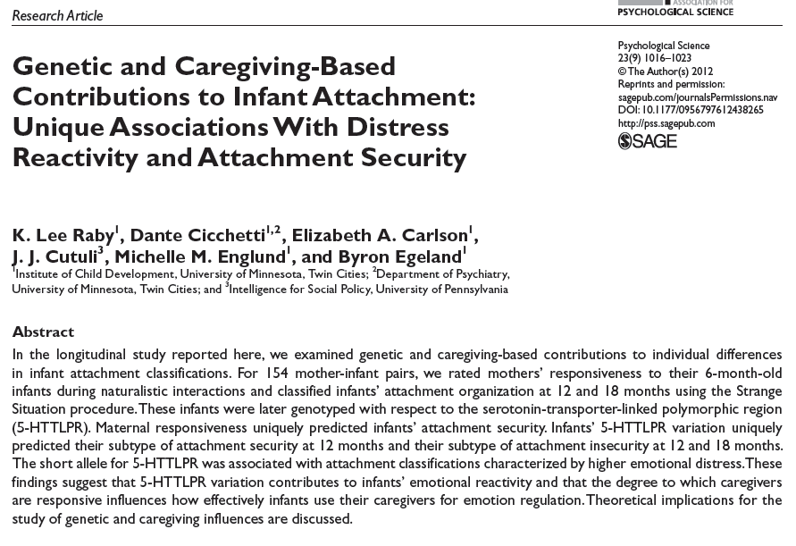

Slide 61
Empirical resolution?
What is infant attachment measuring?
  Caregiver responsiveness vs. child temperament
  Infant emotional reactivity vs. regulation
One possibility:
Insecure
Avoidant
Secure
B₁, B₂ vs B₃, B₄
Insecure
Resistant
Low
High
Distress Reactivity
Belsky; Sussman-Stillman; several replications

Slide 62
What about common genetic variant?
5HTTLPR
(Serotonin-transporter-linked polymorphic region)
  Short (S) allele – Negative affect, Emotional Disorders, Reduced Serotonin, Increased Amygdala Activity
    Long allele variant (L_{G})— same as S allele
  Long allele noncarriers (L_{A})

Slide 63
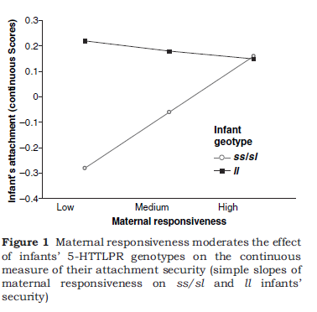
Gene*environment interaction?
Barry et al. 2008

Slide 64
Goals
Determine unique contributions of caregiver quality and genetic variation (5HTTPLR) on infant attachment at 12 and 18 months
Caregiver quality will predict secure vs insecure
  More responsive mothers lead to secure babies
5HTTPLR variation will predict reactivity across security
  S and L_{G} alleles will be more reactive than L_{A}
155 infants and their mothers
  Maternal Responsiveness at 6m
    Home-interactions
  Attachment Classification at 12m and 18m
    Strange Situation
  Genetics at 32 years

Slide 65
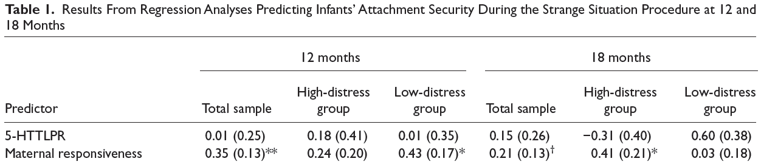
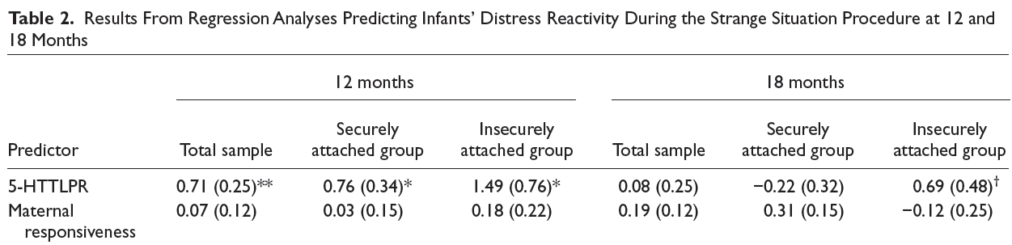
Predicting security & distress reactivity

Slide 66
Discussion
Should we keep investigating the effects of genes on attachment security?
  Multiple studies have found large environmental effects and “trivial genetic contributions” to infant’s attachment style
Maternal responsiveness expression did not predict distress reactivity
  Primate studies have shown that an unsupportive caregiving context may exacerbate the gene’s influence on negative affect
Are you convinced?
  Strengths/Limitations of this study
Future research?

Slide 67
Genetic and Caregiving-Based Contributions to Infant Attachment
Two contrasting explanations of differences in attachment:
  Quality of infant-caregiver relationship
  Reflection of infants’ temperament
Emotional reactivity vs. emotion regulation
Proposed reconciliation: distress reactivity during SSP shaped by predispositions for negative emotionality

Slide 68
Genetic and Caregiving-Based Contributions to Infant Attachment
155 infants and mothers
Measures of:
  Maternal responsiveness at 6 months
  Attachment at 12 and 18 months
  Emotional distress in SSP
  5-HTTLPR variation
  Raby et al., 2012

Slide 69
Genetic and Caregiving-Based Contributions to Infant Attachment
Maternal responsiveness predicted attachment
5-HTTLPR predicted distress during SSP, not attachment security
  Predicted subtypes
Genetic variation and caregiving context make unique contributions to differences in attachment behavior
  Caregiving → secure vs. insecure
  5-HTTLPR → how this is manifested

Slide 70
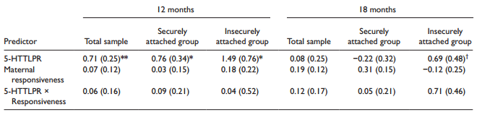
Maternal responsiveness uniquely predicted attachment security
Serotonin-transporter-linked polymorphic region (5-HTTLPR)--short allele associated with distress and B3/B4/C classifications at 12 months:

Slide 71
Disorganized attachment predicted by parent behavior
Strongly related to parental maltreatment, & moderately related to sensitivity
Unrelated to difficult infant temperament
2 studies have linked frightening parental behavior to disorganized attachment
    Though not significantly related to depression
      van IJzendoorn, M. H., Schuengel, C., & Bakermans Kranenburg, M. J. (1999). Disorganized attachment in early childhood: Meta-analysis of precursors, concomitants, and sequelae. Development and Psychopathology, 11(2), 225-249.

Slide 72
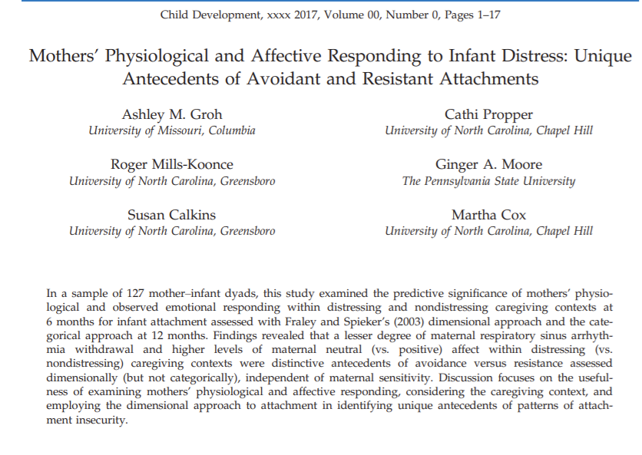

Slide 73
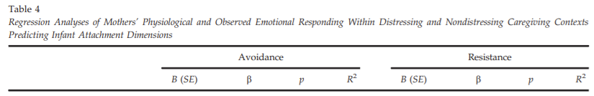
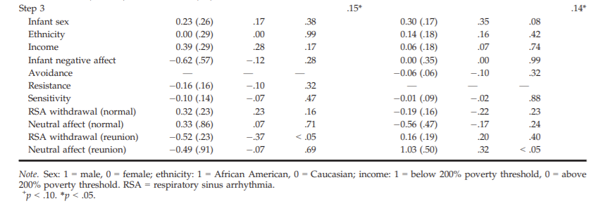
Positive values of RSA withdrawal indicated a larger decrease in RSA from baseline and, therefore, a greater degree of RSA withdrawal that putatively reflects attempts to regulate emotion and deploy attention.

Slide 74
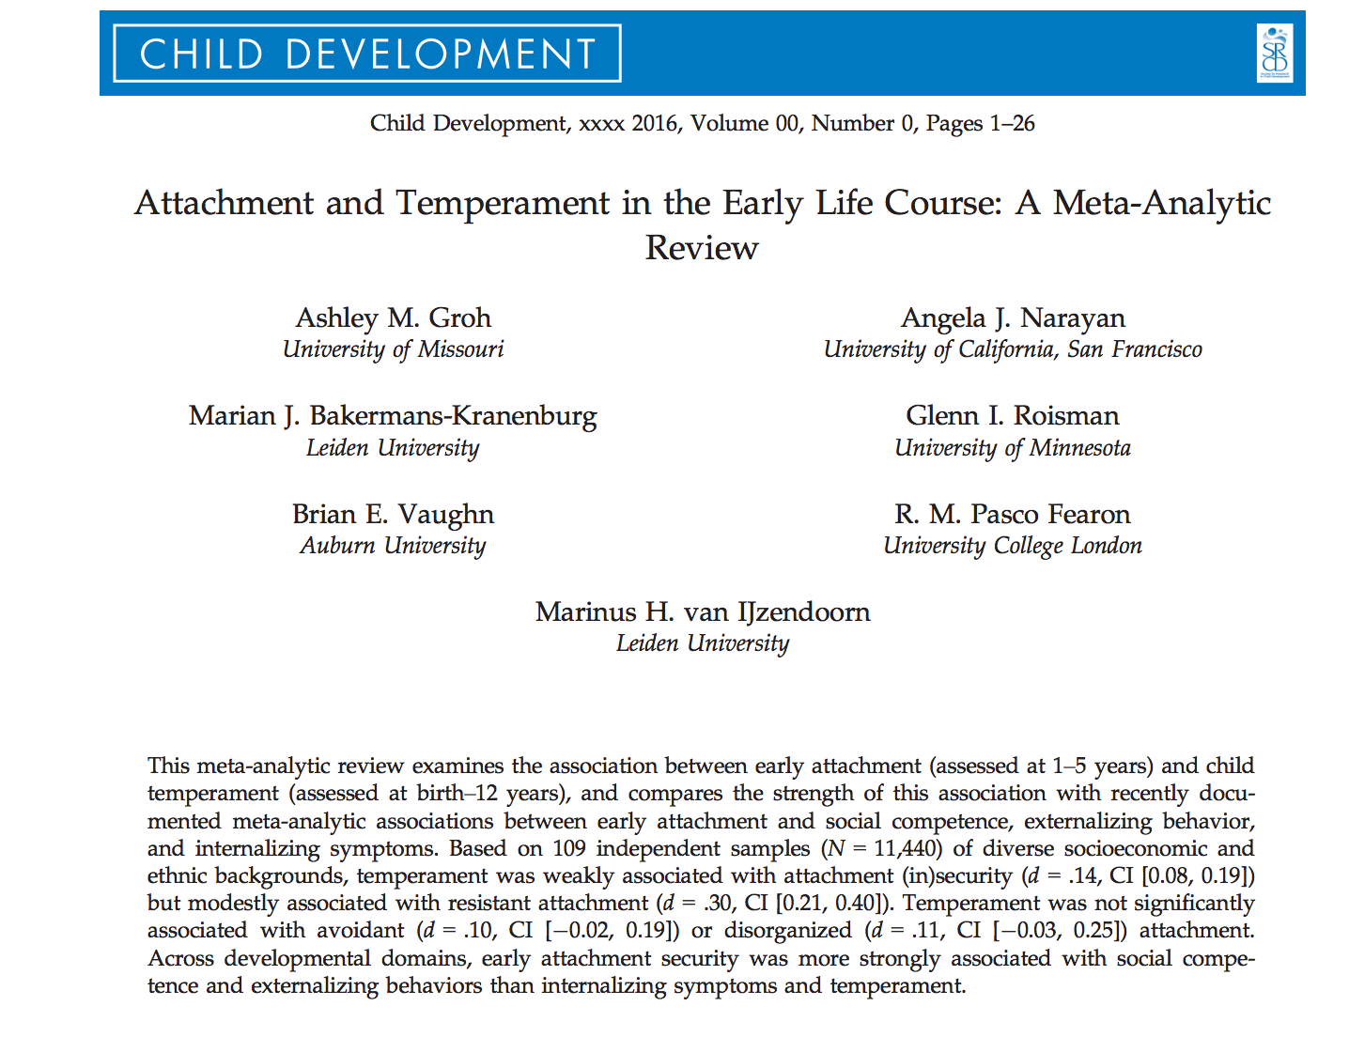
Attachment and Temperament
Are they overlapping constructs?

Slide 75
Quick Detour
What is temperament?
  “…individual differences in emotion, motor, and attentional reactivity and regulation that are constitutionally based but also shaped by experience”
What is attachment?
  “…relational construct with origins in history of parent-child relationship

Slide 76
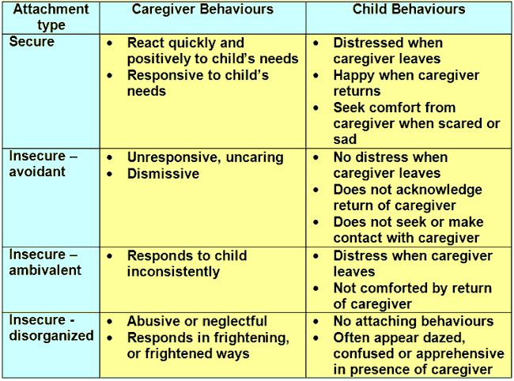
(Resistant)

Slide 77


Temperament
Negative Temperament
  More prone to emotional reactivity and dysregulation (e.g., fussy, inhibited, fearful).
Positive Temperament
  Less prone to emotional reactivity and dysregulation (e.g., sociable, adaptable, rhythmic).
Biologically-based and emerges early.

Slide 78
The Debate Simplified
Attachment Theorists
  Early attachment security is shaped by caregiving environment not temperament
Temperament Theorists
  Variation in temperament yields individual differences in infant attachment
VS
Formation of attachment related solely to caregivers or also informed by individual differences in babies?
Notes:
Some different outcomes in theory. If attachment theories are right, babies should be able to maintain distinct attachments with different caregivers depending on the quality of care, whereas in temperament theorists, their attachment would become more generalized.
Timing also becomes very important in measurement to see how these factors interact.

Slide 79
Ongoing Debate
Attachment Theorists
  Early attachment security is shaped by caregiving environment not temperament
Temperament Theorists
  Variation in temperament yields individual differences in infant attachment
VS
Is there a link between early attachment security and temperament? And if so, what is its strength?
Does variation in method matter? And how temperament is operationalized?

Slide 80
Current Study
Meta-analytic review of 131 samples (N=13,018)
Estimated the association between early negative temperament (i.e., negative and positive emotion reactivity) and (in)secure attachment
  Why is this important?

Slide 81
Hypotheses
Early attachment insecurity will be weakly associated with negative temperament
Negative temperament will be weakly negatively associated with avoidant attachment and positively associated with resistant attachment
Negative temperament will be trivially associated with infant disorganization
Temperament will be associated with attachment sub-classifications (high/low emotional reactivity)
    Negative temperament will be associated with B3-C2 (high separation distress)
Early insecurity will be more strongly associated with lower levels of social competence and greater externalizing and internalizing symptomology than with negative temperament
Insecure father-child attachment would be weakly associated with negative temperament

Slide 82
Methods
Literature Search: 249 + 30 articles
Inclusion/Exclusion Criteria:
  Studies reporting on relationship between attachment and (all dimensions of) temperament
  Excluded studies that included peer competence, externalizing behavior, & internalizing symptoms
  Temperament measured by questionnaires; attachment observed (e.g. SSP)
131 final, independent samples

Slide 83
Methods
Coding System and Moderators
  Type of measure/identity of attachment rater
  Type of instrument to assess temperament
  Measurement of temperament in relation to attachment
  Temporal relation of attachment and temperament assessments
  Demographics (child sex/ethnicity, country of study, SES, contextual risk of cohort)

Slide 84
Methods
Meta-Analytic Procedures
  4 separate meta-analyses
  Moderator analyses
  Effect sizes (d) calculated as the standardized difference between secure and insecure attachment
  Random effects models
  95% CI around point estimates; computed homogeneity Q statistics and p-values

Slide 85
Results:
Mother-Child Attachment and Overall Negative Temperament
Comparison of associations between attachment classifications and negative temperament
  No significant contrasts in combined effect sizes for the following comparisons on temperament
    Secure vs. avoidant attachment
    Secure vs. disorganized attachment
    Avoidant vs. disorganized attachment
    Resistant vs. disorganized attachment
    High vs. minimal separation distress during SSP
  Significant contrasts found between
    Resistant vs. secure attachment: combined effect size of d = .26
    Resistant vs. avoidant attachment: combined effect size of d = .26
    Demonstrating that resistant attachment showed stronger associations with temperament than secure or avoidant attachment

Slide 86
Results:
Attachment and Specific Dimensions and Assessments of Temperament
Moderating effect of theoretical operationalization of temperament on association between attachment and temperament
  85% CIs for associations between each negative temperament dimension from the four main theoretical traditions and attachment security overlapped
  85% CIs for associations between negative temperament dimensions and resistant, avoidant, and disorganized attachment overlapped
Moderating effect of temperamental dimension on association between attachment and temperament
  85% CIs for association between attachment security and temperamental fearful distress, irritable distress, and positive emotionality overlapped
  85% CIs for meta-analytic associations between each temperament dimension and avoidant and disorganized attachment overlapped
  Resistant attachment found to be more strongly associated with greater levels of fearful distress than with lower levels of positive emotionality
Method of temperament assessment did not moderate association between attachment and temperament

Slide 87
Results:
Father-Child Attachment and Overall Negative Temperament
Negative temperament was not related to secure, avoidant, or resistant father-child attachment styles
  Secure: non-significant effect size of d = .15
  Avoidant: non-significant effect size of d = .08
  Resistant: non-significant effect size of d = .27
However, magnitude of associations were comparable to those found for mother-child attachment

Slide 88
Results:
Temperament, Social Competence, Externalizing Behavior, and Internalizing Symptoms
Comparison of combined effect sizes for association between attachment and temperament with prior meta-analyses on associations between attachment and socioemotional outcomes
  Secure attachment
    85% CIs for social competence and externalizing problems did not overlap with CIs for internalizing symptoms or temperament
    Secure attachment was significantly more strongly related to social competence and externalizing problems than to temperament and internalizing problems
  Resistant attachment
    85% CIs for social competence and temperament did not overlap with CI for internalizing symptoms, but did overlap with CI for externalizing problems
    Resistant attachment was significantly more strongly related to internalizing symptoms than to social competence or temperament

Slide 89
Results:
Temperament, Social Competence, Externalizing Behavior, and Internalizing Symptoms
Comparison of combined effect sizes for association between attachment and temperament with prior meta-analyses on associations between attachment and socioemotional outcomes
  Disorganized attachment
    85% CIs for internalizing symptoms and temperament did not overlap with CI for externalizing problems, but did overlap with CI for social competence
    Disorganized attachment was significantly more strongly related to externalizing problems than to temperament or internalizing symptoms
  Avoidant attachment
    Not significantly more strongly related to social competence, externalizing problems, or internalizing problems than to temperament

Slide 90
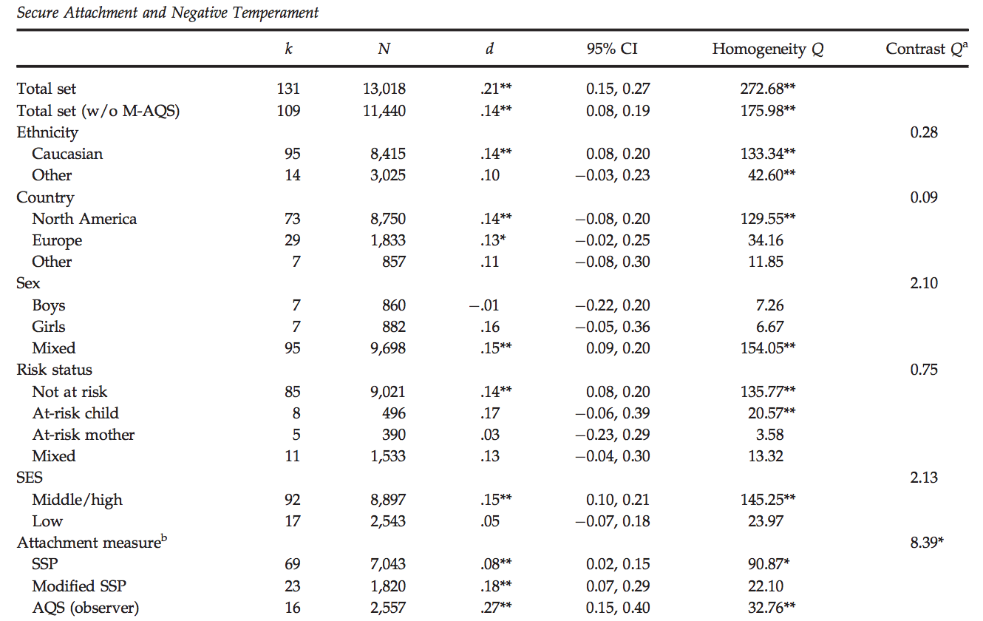
Results: Security and Negative Temperament
c

Slide 91
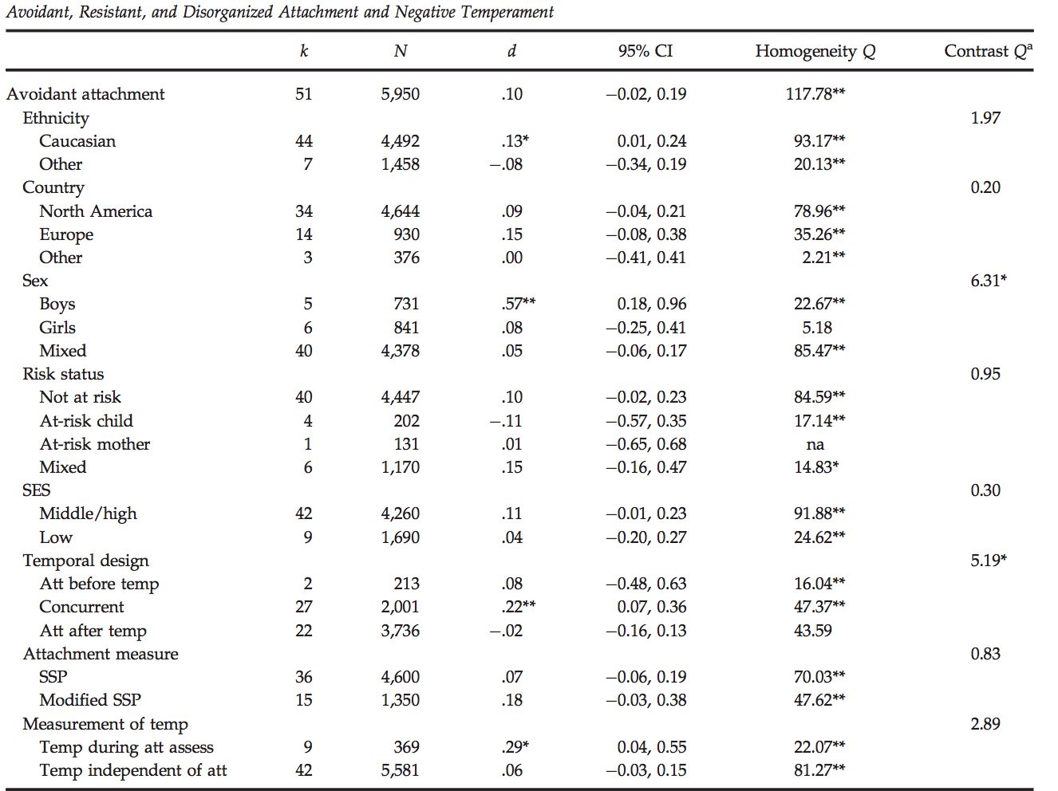
Results: Avoidant attachment and temperament

Slide 92
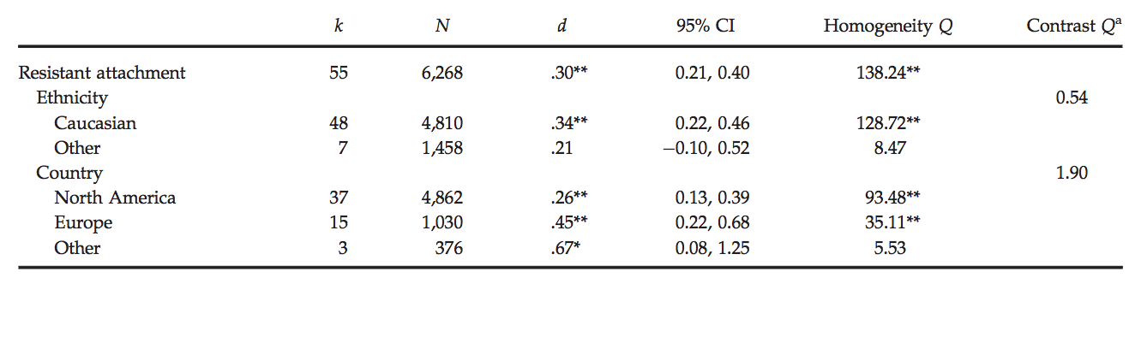
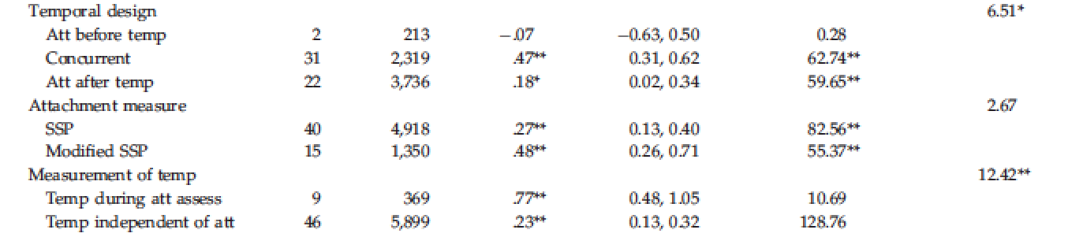
Results: Resistant attachment and temperament
Fisher

Slide 93
Results: Comparing Attachment Classifications
Contrasts between resistant vs. secure attachment, and resistant vs. avoidant attachment were significant
  Resistant attachment showed stronger associations with temperament than secure or avoidant temperament
Children classified as A1-B2 (low separation distress) versus B3-C2 (high separation distress) in SSP did not differ in negative temperament
Fisher

Slide 94
Results:
Dimensions and Assessment of Temperament & Father-Child Attachment
Association between negative temperament and attachment did not differ based on theoretical or dimensional classification
  Resistance more strongly associated with fearful distress vs. positive emotionality
Association also did not differ based on temperament assessment
Father-child attachment was not related to negative temperament
Fisher

Slide 95
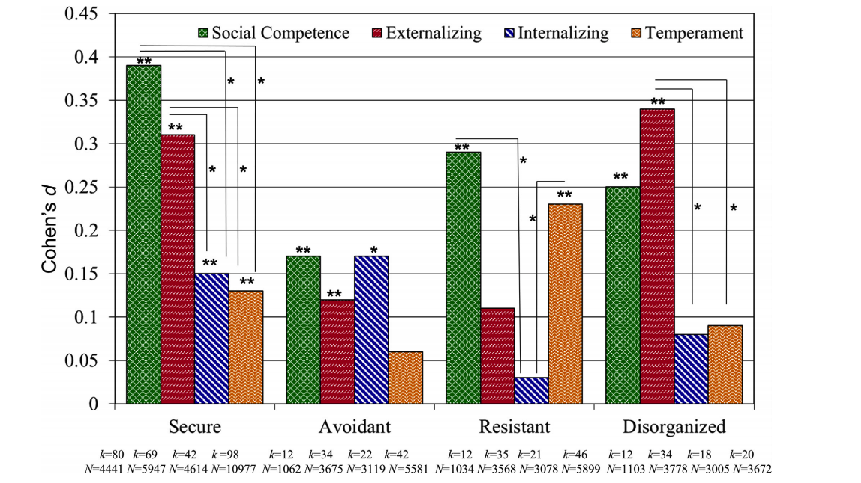
Overview
Temperament, Social Competence, Externalizing Behavior, and Internalizing Symptoms

Slide 96
Conclusions
Association between temperament and attachment security is weak
  Temperament is moderately associated with resistant attachment
Comparable to the weak association between attachment security and internalizing symptomatology
  Significantly weaker than association between attachment security and social competence and externalizing symptoms

Slide 97
The Big Question
How do early experiences of attachment relationships impact later relationships?
Through behavioral and then internal representations of what can be expected from relationships

Slide 98
Attachment Relationship Quality With Mothers and Fathers and Child Temperament:
An Individual Participant Data Meta-Analysis
Dagan et. al. (2024)

Slide 99
STUDY AIM
To assess the potential associations between temperament and attachment relationships—that is, assessment of children’s temperament and the network of child–mother and child–father attachment relationships.

Slide 100
HYPOTHESES
HYPOTHESIS #1
Negative emotionality would not be associated with the number of children’s secure attachment relationships.
HYPOTHESIS #2
Negative emotionality would not be associated with the number of children’s insecure-avoidant and disorganized attachment relationships.
HYPOTHESIS #3
Negative emotionality would be associated specifically with the number of children’s insecure-resistant attachment relationships.
Notes:
HYPOTHESIS 1
Given that negative temperament was meta-analytically shown to be only weakly associated with individual secure child– parent attachment relationships (d= 0.14; Groh et al., 2017), and that twin studies demonstrated the negligible role of genetic factors in individual differences in early attachment relationships with both mothers and fathers
HYPOTHESIS 2
The non significant associations with individual child–parent insecure-avoidant and disorganized attachment relationships
HYPOTHESIS 3
Given that negative temperament was meta-analytically shown to be modestly associated with insecure-resistant parent–child attachment relationships, and that insecure-resistant attachment relationships with both mother and father were shown to have an above-chance level chance of concordance.

Slide 101
METHODS:
Study Level
Studied identified through the:
Child Attachment Studies Catalog and Data Exchange (CASCADE)
Study team sought available studies that measured both:
Child attachment relationships with mothers and fathers via observational attachment behavior assessments (i.e. SSP)
Child negative emotionality assessment (i.e. Questionnaire)
Notes:
Study team sought available studies that measured both:
Child attachment relationships with mothers and fathers via observational attachment behavior assessments (i.e., excluding parent-report, parent-observation, self-report, self-observation, and projective measures)
A child negative emotionality assessment (observed and questionnaire-based).

Slide 102
METHODS:
Data Items
Observational attachment measures in this study:
Strange Situation Procedure (SSP) and two modified SSP coding systems for preschool children:
  MacArthur Preschool Attachment Coding System [PACS]
  Preschool assessment of attachment [PAA]
Notes:
Study team sought available studies that measured both:
Child attachment relationships with mothers and fathers via observational attachment behavior assessments (i.e., excluding parent-report, parent-observation, self-report, self-observation, and projective measures)
A child negative emotionality assessment (observed and questionnaire-based).

Slide 103
METHODS:
Participant Level
N=872 (7 studies)
Race
  82.8% White
49.2% Female
Temperament Assessment
  Mean Age = 15.86 Months
  1 month between mother and father assessment
Attachment Assessment
  Mean Age = 18.71 Months
  1 month between mother and father assessment
Mothers
  80% Post High School Education
  62% Employed
Fathers
  73% Post High School Education
  87% Employed

Slide 104
METHODS:
Participant Level
Study team assigned children to four
binary attachment classifications with each parent:
Secure/Insecure,
Avoidant/Non-Avoidant
Resistant/Non-Resistant
Organized/Disorganized
They then grouped children into an attachment configuration group depending on the analytic outcome
Notes:
(e.g., children who were classified as secure with both parents were assigned a score of 2 when regressing the number of secure attachment relationships on negative emotionality, and 0 when regressing the number of avoidant attachment relationships on negative emotionality).
Of note, the secure/insecure grouping was made regardless of whether children had a primary disorganized attachment classi cation or not, using the secondary subclassification of
disorganized-secure (categorized as secure)
disorganized-avoidant (categorized as insecure)
disorganized-resistant (also categorized as insecure)

Slide 105
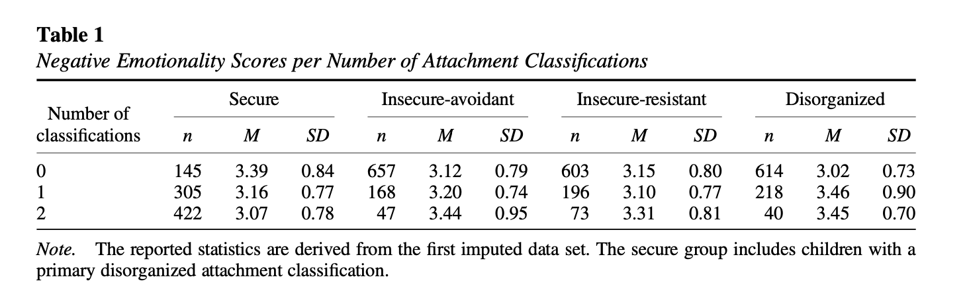
METHODS: Participant Level
Notes:
Orient that most kids in the secure configuration had 2 parents that had that attachment style

Slide 106
METHODS:
Analytic Approach
Linear Mixed Effects Analyses:
Used to test whether negative emotionality predicted the number of secure, insecure-avoidant, insecure-resistant, and disorganized attachment relationships.
Hierarchical Logistic Regression:
Used to assess the concordance between child-mother and child-father attachment relationships.
Tested whether negative emotionality influenced this concordance.
Notes:
Come back to this if we want to

Slide 107
RESULTS

Slide 108
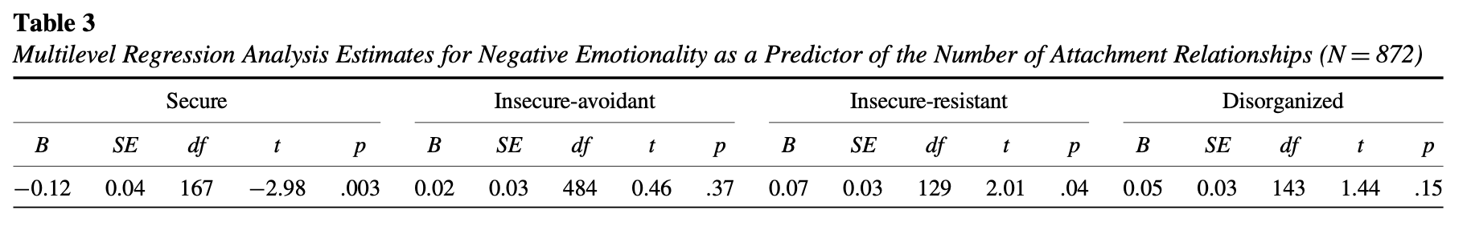
Negative Emotionality Predicted # of secure and insecure-resistant Attachment Relationships
Negative emotionality significantly predicted the number of secure and insecure-resistant, attachment relationships.
Negative emotionality was not a significant predictor of the number of insecure-avoidant, nor disorganized attachment relationships.
Notes:
Additionally:
No moderation effects for the timing of temperament assessments on the associations between temperament and attachment relationship quality.
No moderation effects for the child’s age during the first observational attachment assessment on the associations between temperament and attachment relationship quality
The equivalence test was non-significant in both cases of insecure-avoidant attachment relationships and disorganized attachment relationships, suggesting that tests of not only the presence but also the absence of non negligible associations between negative emotionality and the numbers of insecure-avoidant and disorganized attachment relationships, respectively, are inconclusive in this sample.

Slide 109
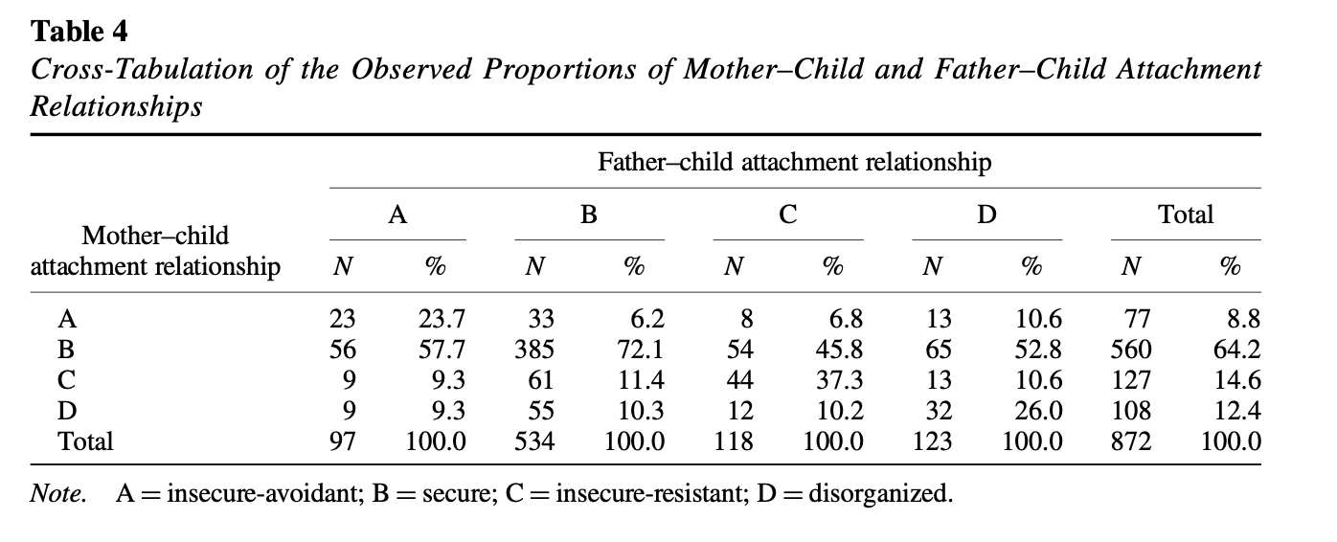
Concordance Between Mother/Child and Father/Child Attachment Relationship Quality
Notes:
A significant concordance between mother–child and father–child attachment relationships.
That is, the quality of mother–child and father–child attachment relationships (i.e., secure, insecure-avoidant, insecure-resistant, or disorganized) depended on one another.
Hierarchical multiple logistic regressions revealed that with the exception of child–mother and child–father insecure-resistant attachment relationships, where child–mother attachment relationship did not predict child–father attachment relationship, all other attachment classifications showed significant concordance between child–mother and child– father attachment relationships. The addition of negative emotionality as a model predictor did not seem to change the magnitude of the respective child–mother regression weights.
Children who were classified as insecure-resistant with both their mother and father had, on average, significantly higher negative emotionality ratings compared to children who were classified as insecure-resistant with only one or none of their parents.

Slide 110
TAKE HOME POINTS
Negative Emotionality as an Attachment Predictor
Concordance of Attachment Between Parent Relationships
Negative emotionality predicted Secure and Insecure-Resistant relationships, but not Insecure-Avoidant or Disorganized
Other than Insecure-Resistant type, attachment between mother/child and father/child showed a high level of concordance

Slide 111
DISCUSSION
Dagan et al (2024) found fascinating results regarding the relationship between children's negative emotionality predicting attachment styles to their mother and father. However, I wonder if there is a gender or race effect. Specifically, is negative emotionality more predictive of certain attachment styles for children from specific racial backgrounds? What about children of a specific gender? And could this differ by caregiver? I also wonder about the role of parental temperament as well.
I found it interesting that negative emotionality predicted secure attachment styles, and not avoidant or disorganized. It’s also interesting that while negative emotionality predicted resistant attachment, this was the only attachment type that did not have a strong concordance. Why might this be? Do we think these results are related?

Slide 112

Predicting behavior problems

Slide 113
Participants
Typically developing infants from traditional two-parent families

Slide 114
Measures
15 month visit
  Strange Situation
6.5 year visit
  Teacher report of Problem Behavior using the Child Symptom Inventory-4
8 year visit
  Parent report of Problem Behavior using the Child Symptom Inventory-4
  Child report of Problem Behaviors using the Dominic-R

Slide 115

Results
Mother and Father report of problem behavior significantly correlate with each other but do not correlate with teacher report or child report

Slide 116
Can 1 secure relationship act as a buffer?
Teachers rated children who were insecurely attached to both parents as having more externalizing behavior problems
Being securely attached to at least one parent has a significant beneficial effect
Teachers perceived children who had insecure attachments with their father at 15- months as having more externalizing behavior problems at 6.5 years old.

Slide 117


Double insecurity → behavior problems
(insecurity with dad is key)

Slide 118


Two insecure attachments…
..

Slide 119

Level of resistance
Disorganized attachment with dad at 15 months predicts children’s higher externalizing behavior problems
Child’s resistance with mother and father predicted higher teacher-rated externalizing behavior problems.
Even when children showed high resistance with their father, if the child demonstrated low resistance with mom it served as a protective factor
Low resistance with dad also predicted lower teacher reported behavior problems despite level of resistance with mom

Slide 120
Attachment and Children's Peer Relations
“Small-to-moderate” association between attachment security to mother and quality of children’s peer relations
  meta-analysis of 63 studies indicates
Effects “higher for studies that focused on children's close friendships rather than on relations with other peers.”
  Effects larger after early childhood
    “Gender & cultural differences … minimal”
      A Quantitative Review (Schneider et al 2001)

Slide 121
Overview
Temperament, Social Competence, Externalizing Behavior, and Internalizing Symptoms

Slide 122

Disorganized/Nonsecure → Internalizing/Externalizing
Disorganized→ externalizing
(Groh, Roisman, van Ijzendoorn, Bakermans-Kranenburg, & Fearon, 2012)
Based on 42 independent samples (N = 4,614),

Slide 123


What about attachment in adulthood?

Slide 124

Adult Attachment Interview

Slide 125
Scales/Categories
Scales associated with autonomous category
  coherence, metacognitive monitoring
Scales associated with dismissing category
  Idealization of attachment figures, insistence on lack of memory for childhood, dismissal of attachment-related experience/relationships
Scales associated with preoccupied category
  anger expressed toward attachment figure, passivity/vagueness in discourse
Unresolved (U) attachment is characterized by breakdowns in reasoning or discourse when individuals describe past experiences of loss (e.g., death of a loved one) or trauma (e.g., abuse or neglect). These lapses suggest that the speaker has not fully integrated or processed those experiences emotionally and cognitively.

Slide 126
How Speakers are Categorized
As Autonomous (secure), Dismissing (avoidant), or Preoccupied (resistant)
  And, independently, as Unresolved/Disorganized
Not based on experiences themselves
But on speaker’s current relationship to the experiences
  how they’ve processed their past
Based on the coherence of their discourse

Slide 127
Validity of AAI
Classifications are stable
  2 months, 3 months, 1.5 years
Not related to IQ measures
  6 of 7 studies
Discourse style relates to attachment
  not interviews about job
Machine learning shows some ability to distinguish adult attachment in AAI

Slide 128
Parent-Infant
Attachment Correspondence
Meta-analysis of 13 studies using three major categories
75% secure vs. insecure agreement (K=.49)
70% three-way agreement (K=.46)
  Prebirth AAI show 69% three-way agreement (K=.44)
        Bakermans-kranenburg, M. J. & Vanijzendoorn, M. H. (1993). A Psychometric Study of the Adult Attachment Interview - Reliability and Discriminant Validity. Developmental Psychology, 29, 870-879.

Slide 129

Parent-Infant Correspondence

Slide 130

95 samples (N = 4,819).
Confirmed intergenerational transmission of attachment

Slide 131


Larger effect sizes for secure-autonomous transmission (r =.31) than for unresolved transmission (r = .21)
58% agreement ( K= .28, p .001)
58% agreement ( K= .26, p .001)

Slide 132

Transmission Gap
Indirect effect: 0.24×0.26=0.06240.24
Transmission gap: 0.31−0.0624=0.2476≈0.25
Caregiver representation on sensitivity
sensitivity on child attachment
Path a: A → S (effect of caregiver representation on sensitivity)
Path b: S → C (effect of sensitivity on child attachment)
Path c: A → C (total effect of caregiver representation on child attachment)
Path c': A → C controlling for S (direct effect)

Slide 133
Kelsey Questions
How the effect size of the relationship between caregiver-attachment representations and caregiver-child attachment has declined over the years. One example of this was that the effect size of maternal forced autonomous transmission decreased over time. Verhage et al note that papers about the effect of maternal-child attachment compared to those about paternal-child attachment has also changed over time (i.e., there are more papers published on paternal-child attachment in recent years) and that these changes might reflect how the role of women in the family has changed over time. However, it also reflects a shift in research focus and therefore availability of papers.
Verhage et al. discussed the possibility of publication bias, but there may also have been shifts in methodology and/or how results are shared that may contribute to the decreased effect size. For example, in the original paper there were less papers from non-Western countries, while in this paper 9% of the papers were from non-Western countries. Intergenerational attachment transmission may be different in non-Western countries due to cultural differences in parenting, so the inclusion of these papers shifts the meta-analysis results from a focus on Western intergenerational transmission to a more global focus that may result in a decreased effect size.
Can you think of what other shifts that might have an effect?"

Slide 134
Breaking the Link
Parental attachment is not formed by past experiences but by current orientation to past.
Supportive experiences with a partner, friend or therapist can allow for earned autonomy in the face of experiences that would otherwise be associated with insecurity.

Slide 135
Interview
Interview a partner about one attachment figure focusing on questions 2 through 4
Each person analyzes their own responses
  no comments form partner
Only share what you want to share

Slide 136
Adult Attachment Interview

Slide 137
How to Think About What You’ve Said
Scales associated with autonomous category
  coherence, metacognitive monitoring
Scales associated with dismissing category
  Idealization of attachment figures, insistence on lack of memory for childhood, dismissal of attachment-related experience/relationships
Scales associated with preoccupied category
  anger expressed toward attachment figure, passivity/vagueness in discourse

Slide 138

Parenting Styles in Middle
Childhood
Baumrind’s Model of Parenting Styles

Slide 139
Parent-Child Relationships in
Adolescence and Early Adulthood
Developmental progression in time spent with different people (parents, same-sex peers, opposite-sex peers)
  Does not mean that adolescents are disengaged from parents
Adult Attachment Interview (AAI; George et al., 1994)
  Autonomous
  Dismissive
  Preoccupied
Inter-generational transmission of attachment

Slide 140
Father-Child Relationships
(Tamis-LeMonda et al., 2004)
Results Summary:
  Mom/Dad behaviors correlated at each age
  Dad predicts mom behaviors over time but mom less predictive of dad
  Dad demographics (income/education) predict some aspects of parenting
  Dad and mom supportive parenting independently predict children’s outcomes
Notes:
Mom/dad correlated at each age
Dad predicts mom behavs over time but mom less predictive of dad

Slide 141
Modest genetic influence on infant attachment security
Most evidence pointing to gene-environment interactions rather than direct genetic effects.
Twin studies yield mixed results. Three of four twin investigations report that genetic factors play a negligible role, whereas one study attributes 25 percent of the variability in attachment to genetics.
Molecular studies concentrate on the 5-HTTLPR polymorphism. Barry et al. (2008), Kochanska et al. (2009), and Raby et al. (2012) report that this gene moderates outcomes by interacting with maternal responsiveness or by associating with heightened emotional distress.
Other studies cite links between COMT Val158Met, GABRA6, and several novel genetic markers with attachment disorganization or stress responses. In sum, the evidence shows a modest genetic component to infant attachment security, primarily evident in gene–environment interactions.

Slide 142


Slide 143

Gene (HTR2A) by environment interaction (maternal sensitivity slopes) predicting romantic avoidance.
Shaded gray areas represent regions of significance (i.e., ranges of standardized sensitivity slopes at which the genotype groups were significantly different with respect to romantic avoidance). The regressions of avoidance on changes in sensitivity were significant for both genotype groups

Slide 144
Attachment Theory
Early experiences shape our beliefs about the responsiveness and trustworthiness of significant people in our life (i.e., working models)
  Child is cared for consistently and gets needs met → Child expects others will be supportive and available
Working models can impact behavior and shape social development and interpersonal relationships

Slide 145
Adult Attachment styles
Enduring patterns of thought, feelings, and behaviors in close relationships
  Implications for interpersonal functioning, emotion regulation, and well-being
Individual differences in adult attachment styles are due to differences in interpersonal experiences across the lifespan

Slide 146
Two dimensions of adult Attachment
Attachment-related avoidance (avoidant attachment)
  Uncomfortable depending on others
Attachment-related anxiety (anxious attachment)
  Concerned about availability and responsiveness of close others
Secure = low on both, insecure = high on either dimension
Global = related to relationships in general, domain specific = related to specific relationship (e.g., parent, friend, romantic partner)

Slide 147
Retrospective reports of sensitivity
Was your primary caregiver available and responsive to your needs?
  Learn that others will be available when needed
  Secure attachment: more likely to report warm, loving family environment
  Insecure attachment: more likely to report parents as cold or rejecting

Slide 148
Social competence
Early experiences contribute to development of a child’s social skills and competence
  Impacts later peer relationships
  Competence, cooperation, and self-control contribute to attachment style
  Secure attachment associated with high self-confidence and interpersonal warmth

Slide 149
Friendships
In adolescence and early adulthood, close friends become important attachment figures
  Friends are sources of trust and support outside of the family

Slide 150
Temperament & genetics
Early observable temperament may be an antecedent of anxious attachment
Variations in specific genes involved in affective processes related to variations in attachment styles
Gene*Environment interaction shapes developmental of adult attachment styles

Slide 151
Methods
Participants
COnstructs
Analyses
707 participants from NICHD Study of Early Child Care and Youth Development
Longitudinal study
Global attachment style
Romantic attachment style
Maternal sensitivity and depression, father absence
Social competence (mother & teacher reports)
Perceived friendship quality
Early temperament (mother report)
Genotyping
Latent growth curve models
Modeled latent intercepts and slopes
Covariates: child gender, child ethnicity, maternal education, and family income
Notes:
Attachment data comes from 18 y.o. follow-up
Latent intercept = estimated maternal sensitivity a child received in early childhood (i.e., the value of sensitivity at the first assessment wave, but estimated on the basis of the full array of observations rather than the first wave of observations alone)
Variation in these intercepts across people represents individual differences in the quality of people’s early caregiving environments
Latent slope represents the extent to which the quality of care a person received increased or decreased linearly across assessment waves
Person’s latent slope estimate does not represent his or her absolute change over time. Instead, it represents his or her change relative to others. A person with a positive slope, for example, increased over time in his or her rank-ordering relative to other people. A person with a negative slope, in contrast, decreased over time in his or her rank-ordering

Slide 152
Results: Attachment-related avoidance
Variation within a caregiving environment over time (latent slope) more important than differences between individuals (latent intercept)
Avoidant attachment associated with changes in maternal sensitivity, social competence, and quality of friendship relationships

Slide 153
Results: Attachment-related anxiety
Anxious attachment associated with changes in maternal depression and social competence
Individuals with increasing friendship quality were more likely to report higher levels of romantic anxiety

Slide 154
Temperament & Genetic Findings
Restless and irritable temperament (at 54 months) associated with global avoidance at 18
  Associations became ns after covariates added
Only one of the genes examined was associated with attachment (HTR2A serotonin receptor gene)
Gene*Maternal Sensitivity interaction significant in predicting attachment avoidance

Slide 155
Key takeaways
Avoidance
Anxiety
Temperament & Genes
Changes in maternal sensitivity, social competence, and friendship quality
Changes in social competence and maternal depression
Did not find robust support for impact of temperament, genes, or gene*environment interaction
Ongoing experiences in family and peer relationships impact adult attachment styles.
These results seem to suggest that environmental factors are more important than temperamental or genetic factors in predicting adult attachment.

Slide 156
Discussion Questions
I found it interesting that they chose to standardize the measures to assess between-persons differences to see the changes in rank-order among the group. With the range of ages for the longitudinal study, I would think there would be a lot of within-person changes throughout this period in regard to relationships and environments. I wonder how this approach may have minimized some of the individual differences that may have provided important insight into attachment styles?
We have talked a lot in class about the how having a best friend can serve as a protective factor for a variety of outcomes, so I find it interesting that the quality of friendship isn’t significantly associated with attachment-related anxiety in thinking of friendship as a sort of attachment. Is there an optimal level of quality of friendship that could protect against anxiety, similar to there being an optimal amount of maternal sensitivity for other outcomes?

