Slide 1
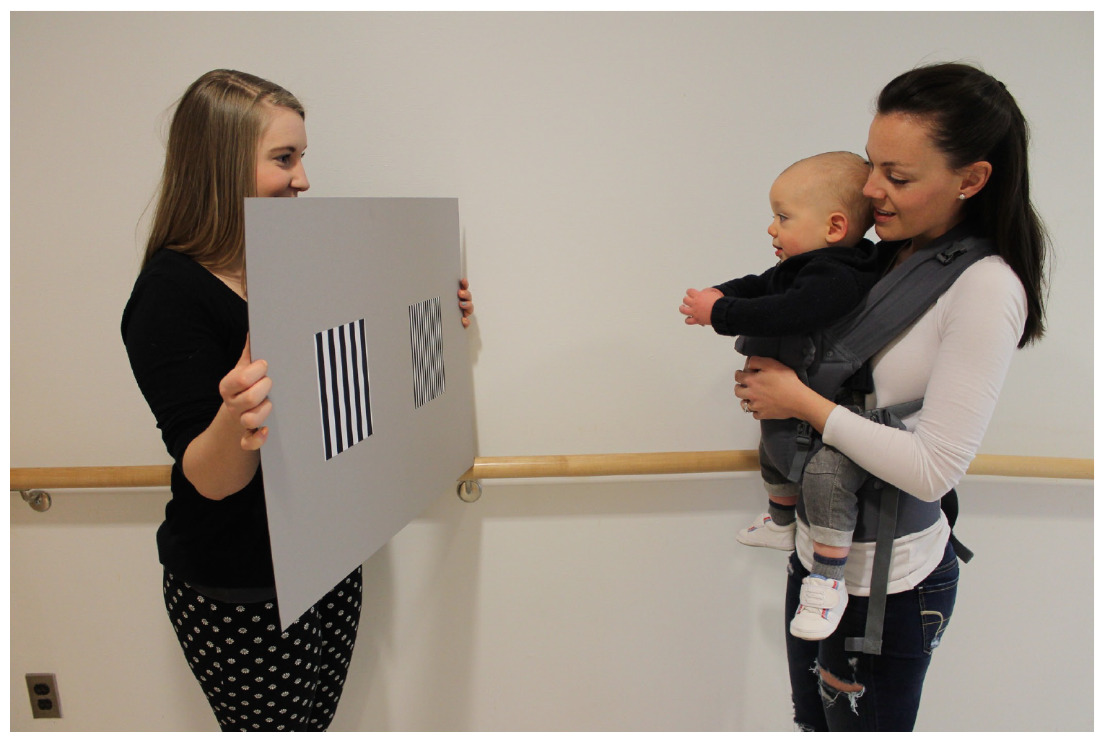
Developmental Research
Design, Measurement, & Analysis
Notes:
How many of you have taken developmental research methods course already?
How about another graduate-level research methods class?
Everyone has had undergrad level research methods, so a lot of the basic topics will be review for most of you.
Today we’ll only scratch the surface, but we’ll review some key issues for developmental research.
First of all…
Theoretically-based research questions should guide the choice of the specific design, measurement, and analytic approaches.
You never want your type of measure to guide or limit your questions.
Today we’ll review some commonly used methods…
BTW, anyone recognize this task pictured here? → This is the preferential looking task. An infant is presented with 2 side by side displays and if the infant shows a preference, this is taken as evidence that the baby can distinguish the two.

Slide 2
Overview
Review canalization
Crisis?
Experimental and other designs
Longitudinal and/or cross-sectional designs
Stability and continuity
Shape of developmental change
Missing data
Validity threats
Operationalization and measurement

Slide 3
What is the goal of developmental psychological research?
To describe and explain change over time.

Slide 4
Developmental methods overview
Crisis?
Experimental and other designs
Longitudinal and/or cross-sectional designs
Stability and continuity
Shape of developmental change
Missing data
Validity threats
Operationalization and measurement
Ethics
Notes:
We’ll first address the so-called “crisis” in science, not limited to developmental science, or even to psychology (although psyc has been a big focus).
We’ll discuss some specific types of experimental and other designs, including longitudinal and cross-sectional sampling approaches. (note: only quantitative, not qualitative research designs)
The issue of stability and continuity is discussed in our assigned article for today (Bornstein et al., 2017, Child Dev Perspectives), so we’ll discusss that next.
Then we discuss some additional issues related to the shape of development, challenges with missing data and threats to validity.
And finally, we’ll discuss how we measure constructs
We’ll end with a discussion of ethical considerations of research with developmental populations.
----
Notes (outline):
Design
Developmental Designs
Internal and External Validity of a Study
Measurement
Reliability and Validity of Measures
Instrument Construction Stages
Dealing with missing data
Ethics in Developmental Studies
Children as vulnerable population
Assent
Analysis
Visualizing your data
Hypothesis Testing
Approaches to Analyzing Change over Time

Slide 5
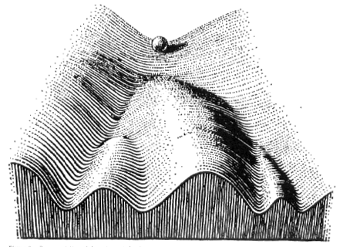
Canalization (Waddington)

Slide 6
Design, Measurement & Analysis in Developmental Research
Design
  Developmental Designs
  Internal and External Validity of a Study
Measurement
  Reliability and Validity of Measures
  Instrument Construction Stages
  Dealing with missing data
Ethics in Developmental Studies
  Children as vulnerable population
  Assent
Analysis
  Visualizing your data
  Hypothesis Testing
  Approaches to Analyzing Change over Time

Slide 7
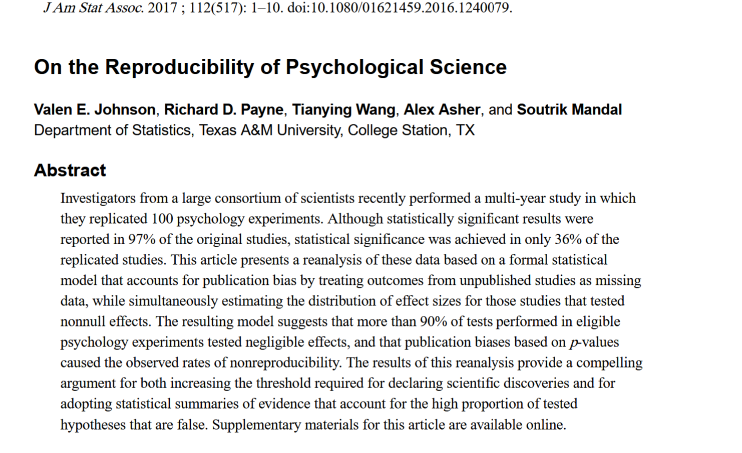
36% reproducibility

Slide 8
A crisis in behavioral / developmental science?
NIH rigor and reproducibility
  Bias
Replicability
  Replicable (addressing the crisis)
  Preregistration
  Data availability
  Objective measurement
  Big data?
  Access to samples
  Peterson, D. (2016). The Baby Factory: Difficult Research Objects, Disciplinary Standards, and the Production of Statistical Significance. Socius: Sociological Research for a Dynamic World, 2. doi: 10.1177/2378023115625071

Slide 9

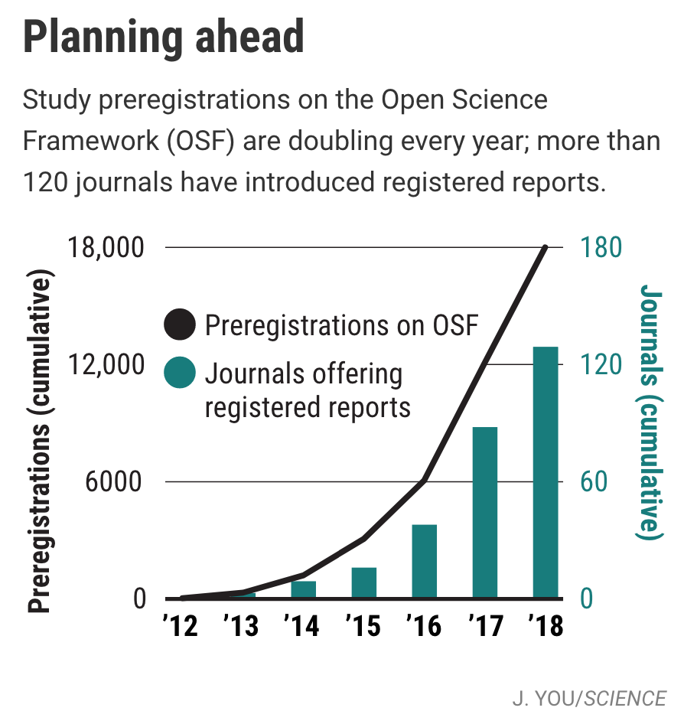
Study Preregistration
Do you preregister? Pros and cons?
https://cos.io/prereg
https://www.sciencemag.org/news/2018/09/more-and-more-scientists-are-preregistering-their-studies-should-you
Notes:
How many of you have pre-registered a study before?
There have been a growing # of pre-registered studies in recent years (see graph).
(discuss pros/cons)
https://www.sciencemag.org/news/2018/09/more-and-more-scientists-are-preregistering-their-studies-should-you

Slide 10


Data archiving tour
        Strange Situation examples
        Ubisense examples
        Scott Johnson on
        Databrary

Slide 11

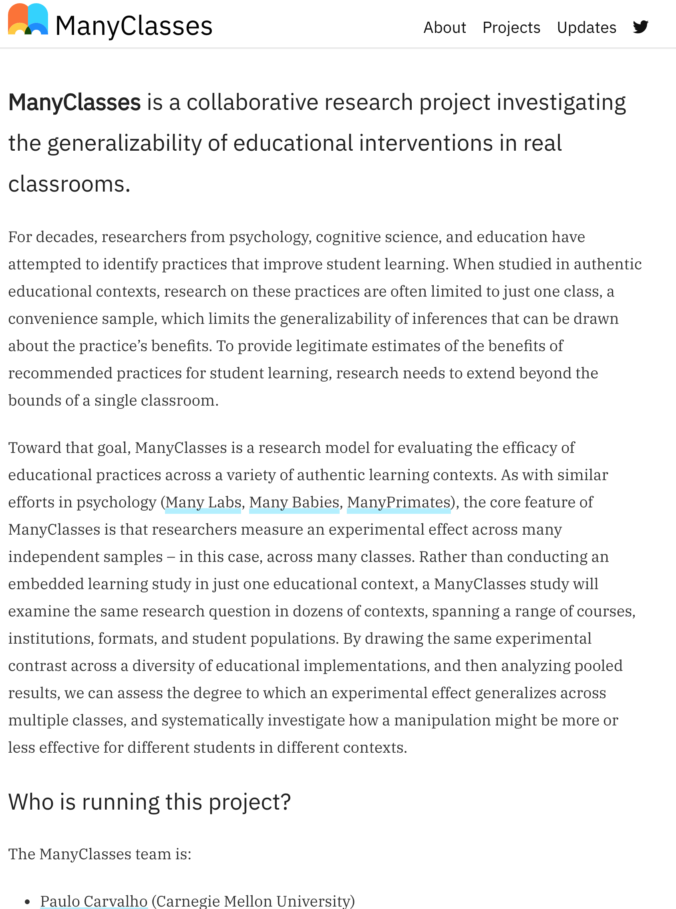

Multi-lab Research Collaborations
Notes:
Strengths:
* Can learn from one another (tips and tricks) – best practices
* Pre-register
* Larger & more diverse sample
* Can compare methodological differences to see if they matter
* Get a better idea of effect size & things that impact effects (e.g., language)
A few that I’ve been involved in so far…
Manybabies
Manyclasses
Manyprimates

Slide 12
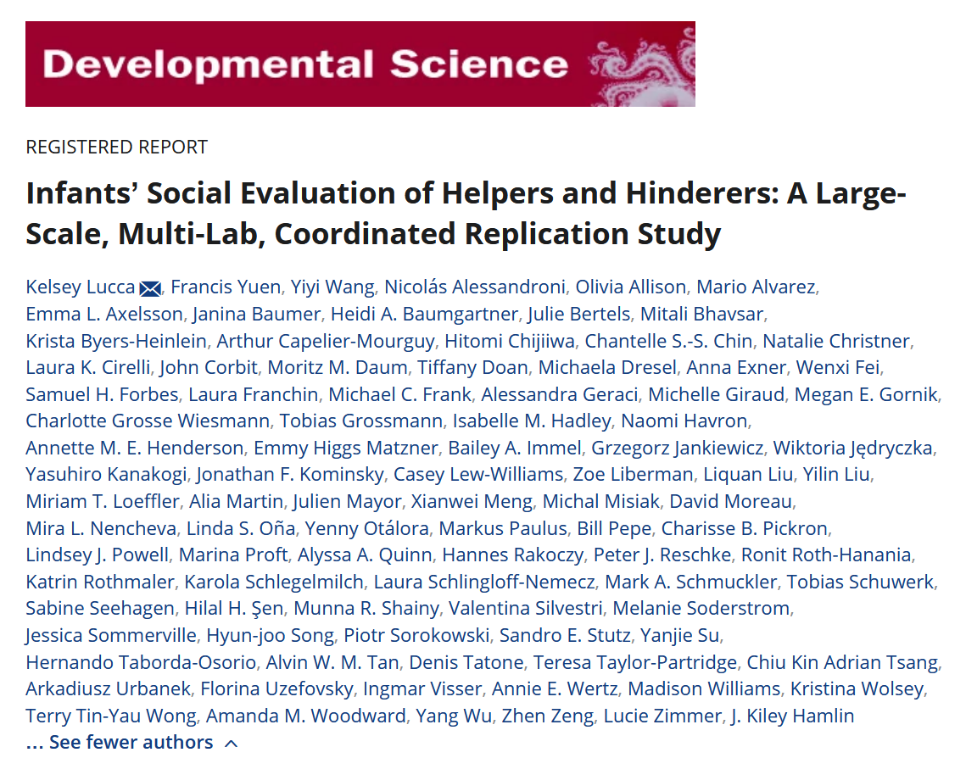
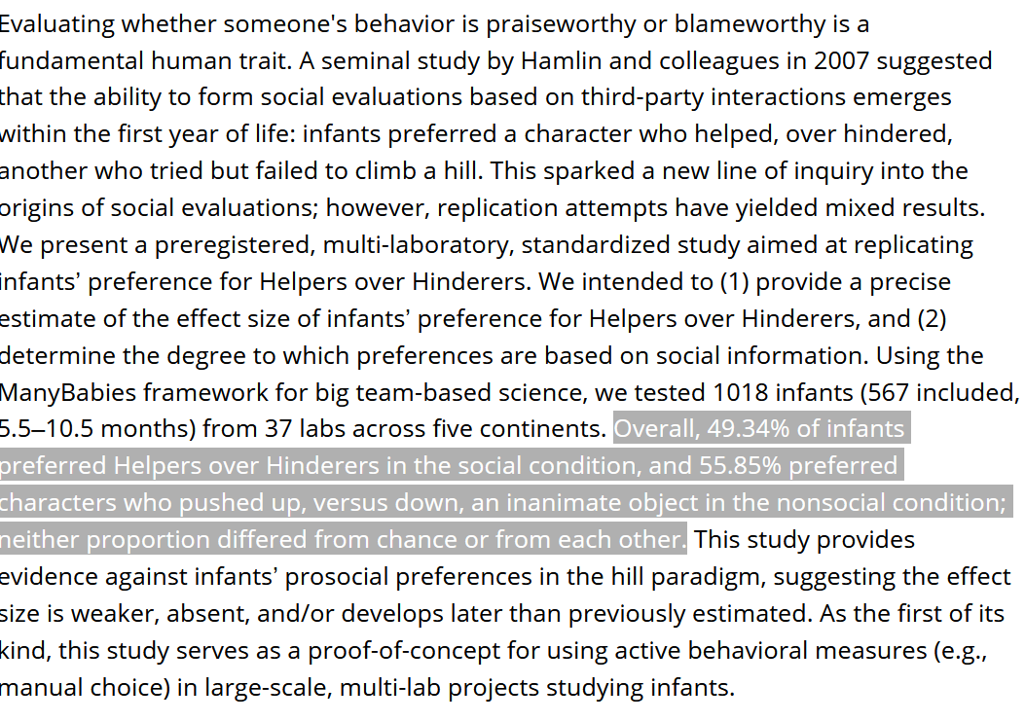

Slide 13

Online Child Labs
Notes:
Cool new ways to reach more diverse populations… bringing research into the home environment.
Pros/cons (need smart phone, internet connection)
Good news:
In sum, there are lots of great resources out there that will help us to overcome this “crisis” in behavioral sciences, and move science in the right direction!
Now, let’s discuss some specific types of designs used in developmental research…

Slide 14
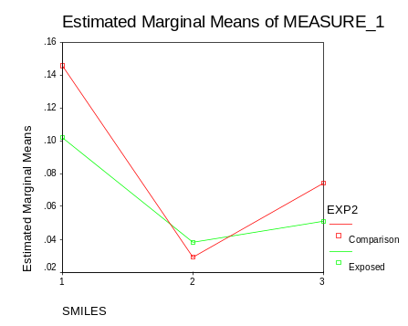
Experimental design
Between subject
  A treatment (independent variable) is assigned randomly
  creating treatment and control groups
Within-subject
  All infants get treatment and control
  Examples
    Rating study, Face-to-face still-face

Slide 15
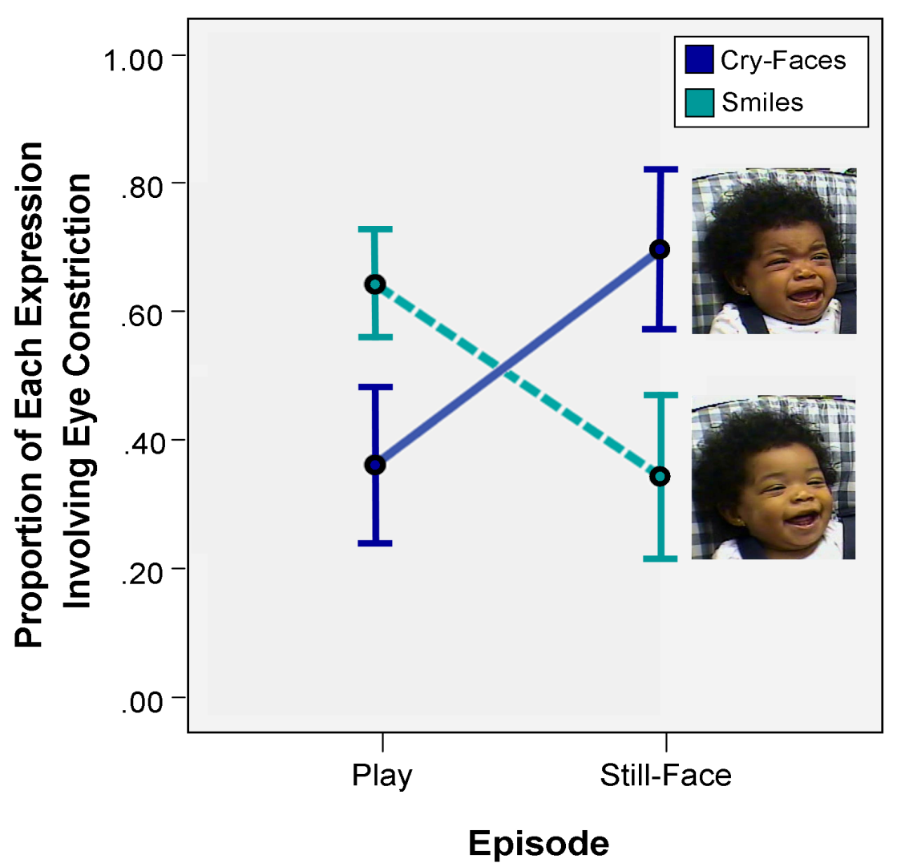



Can experiments uniquely demonstrate causality? How?
What about SEM?
BTW, what is causality?
Mattson, et al.,PLOS One, 2013

Slide 16
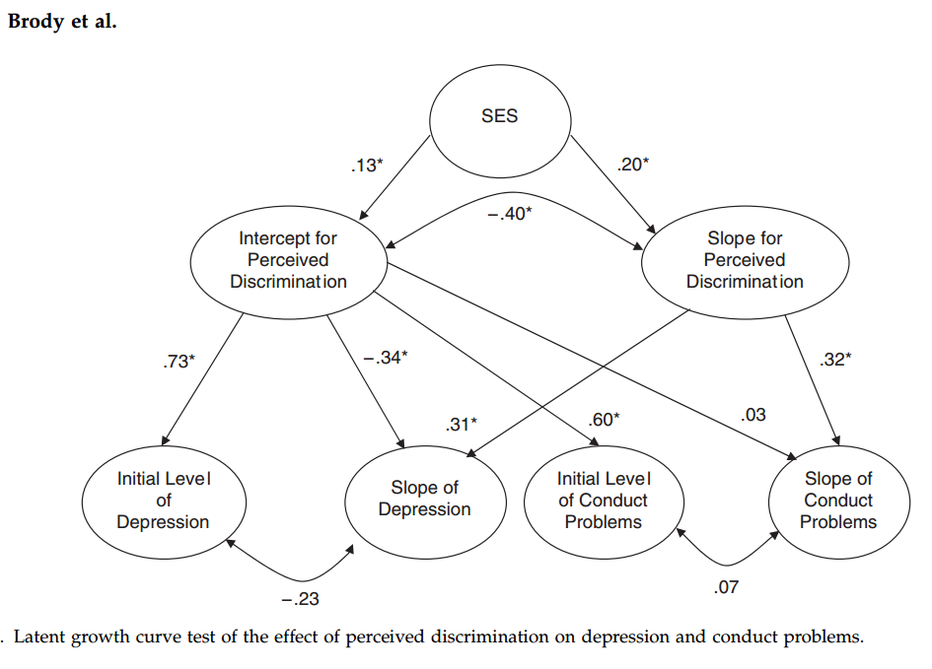
Latent Growth Model
SEM Example

Slide 17
Constrained behavior in experiments
Gazes at stimulus
  habituation and paired preference designs
Sucking & leg kicks
  Response contingencies

Slide 18
Example Moderators
Used multigroup comparisons to test for moderation effects
Discrimination → Conduct problems/Depression
  Weaker for youth with high
    Nurturant-involved parenting
    School efficacy
    Affiliation with prosocial peers

Slide 19
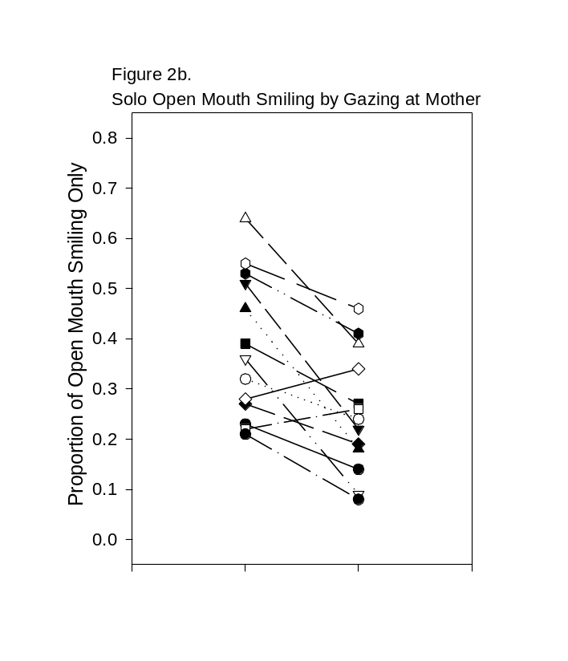
Observational
Quasi-experiment
  Between subject exploration of differences in naturally occurring groups
    Drug exposure, breast-feeding, and attachment groups
Observational
  Differences in naturally occurring conditions
    Gazing at mother versus gazing away
Is age (development) studied experimentally or observationally?

Slide 20
Types of observational research
Quasi-experimental
  Differences in naturally occurring groups
Observational -
  Differences in naturally occurring conditions
Complementary, not exclusive
Is age (development) studied experimentally or observationally?

Slide 21
Findings
Increases in discrimination positively associated with development of conduct problems and depressive symptoms
High SES youth more likely to have increases in discrimination over time
Growth trajectories for discrimination and conduct problems stronger for boys than girls (no difference for depression)

Slide 22
Qualitative methods
Intensive description in regular language
  Not measuring variables
    E.g., baby biography, one infant described over time
Pro: Insight into individual and developmental process
  Emerged with romantic emphasis on individual
Con: Not generalizable
Complementary (counting themes), not exclusive, NIH

Slide 23
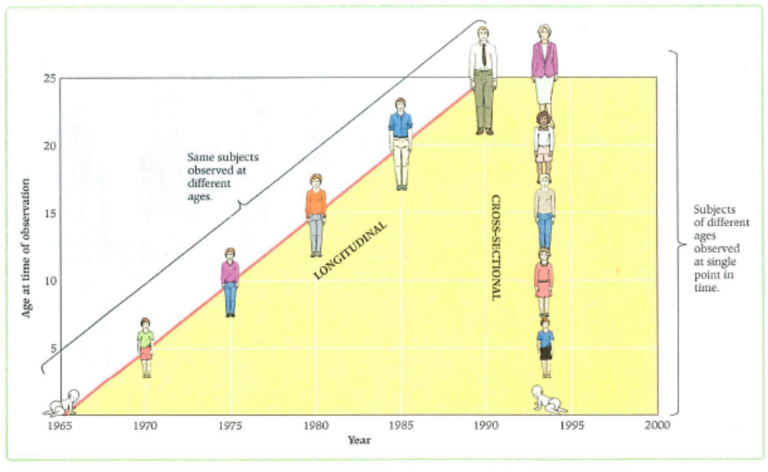
Developmental Designs
Longitudinal vs. cross-sectional designs

Slide 24
Developmental Designs (cont)
Longitudinal vs. cross-sectional designs
  Longitudinal
    Strengths:
    Weaknesses:
  Cross-sectional
    Strengths:
    Weaknesses:

Slide 25
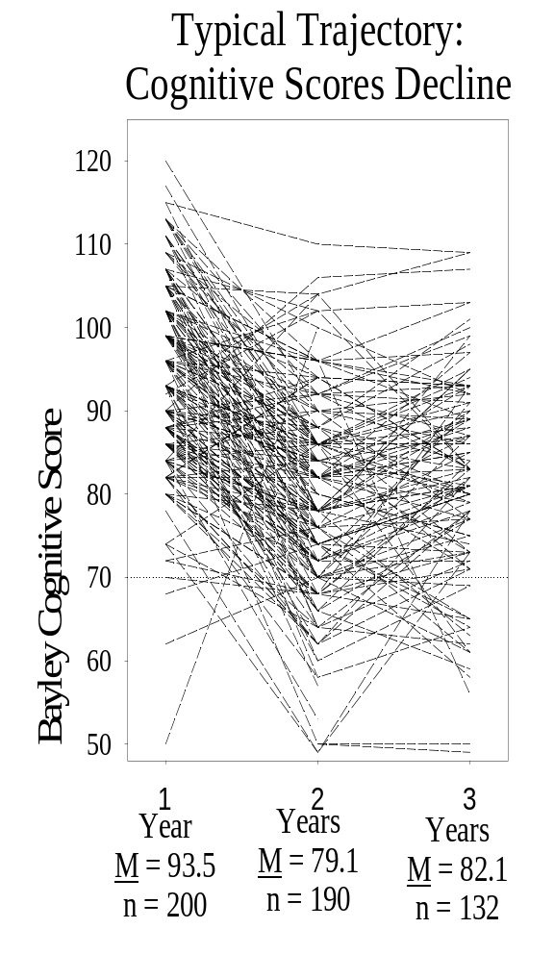
Longitudinal:
Same individuals over time
Pro: Answers ‘How do individuals change in time?’
Con: Takes a long time
  Attrition
Cohort dependent
  What about social change?
    COVID19…

Slide 26
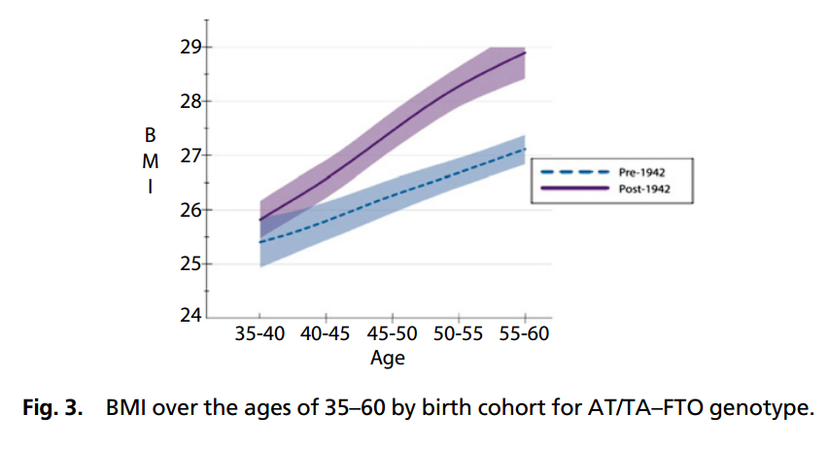
Other difficulties with longitudinal?
Rosenquist et al. PNAS | January 13, 2015 | vol. 112 | no. 2 | 357

Slide 27
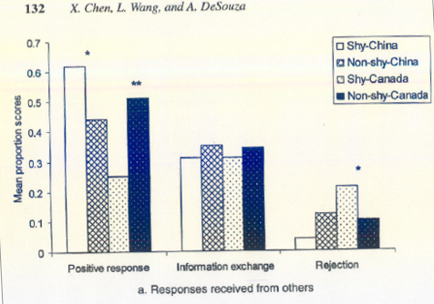
Culture and Peer Interactions
Chen, Wang, & DeSouza, 2006. Temperament, socioemotional functioning, and peer relationships in Chinese and North American children.
(Chen, 2012)
Notes:
Cultures have different socially accepted characteristics: obedience, independence, shyness, aggression. Values are basis for social evaluation and reaction in peer interactions.
Social initiative and self-control
Prosocial-cooperative behavior (optional v. required)
Aggression (acceptable exclusion or social support)
How does globalization/communcation affect this relationship

Slide 28
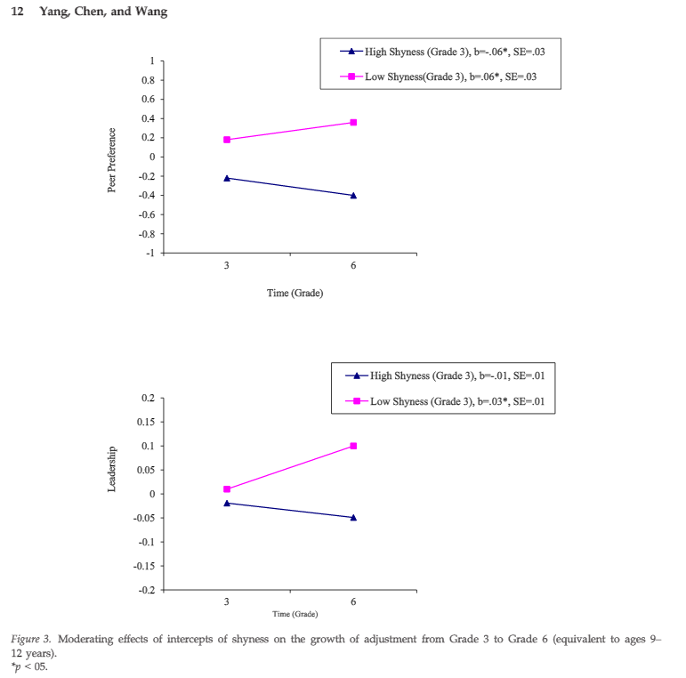
Cultural and developmental change
Is cultural change producing
developmental change?
Yang, F., Chen, X., & Wang, L. (2015). Shyness-Sensitivity and Social, School, and Psychological Adjustment in Urban Chinese Children: A Four-Wave Longitudinal Study. Child Development, n/a-n/a. doi: 10.1111/cdev.12414

Slide 29
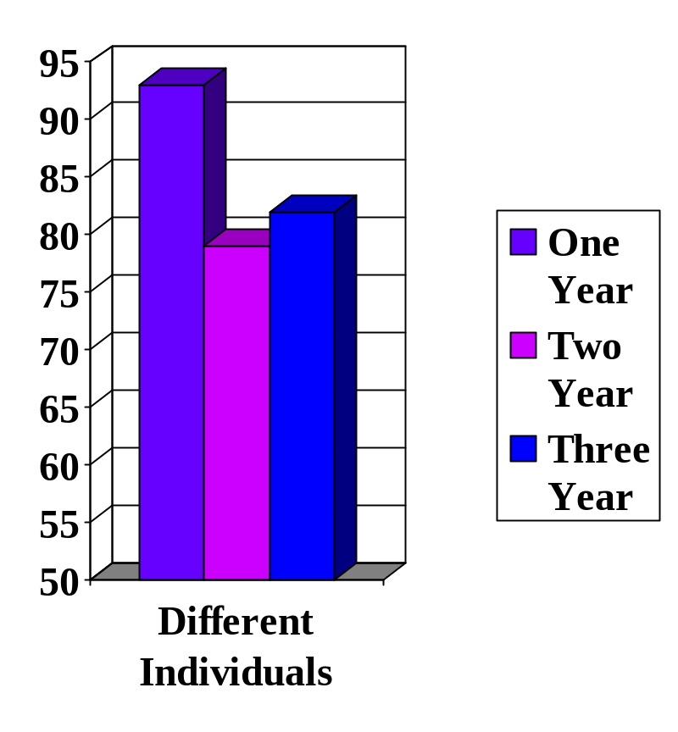
Cross-sectional
Different infants at different times
Pro: Efficient, large numbers of subjects
Con: Differences do not necessarily reflect individual’s development
  e.g. cohort

Slide 30
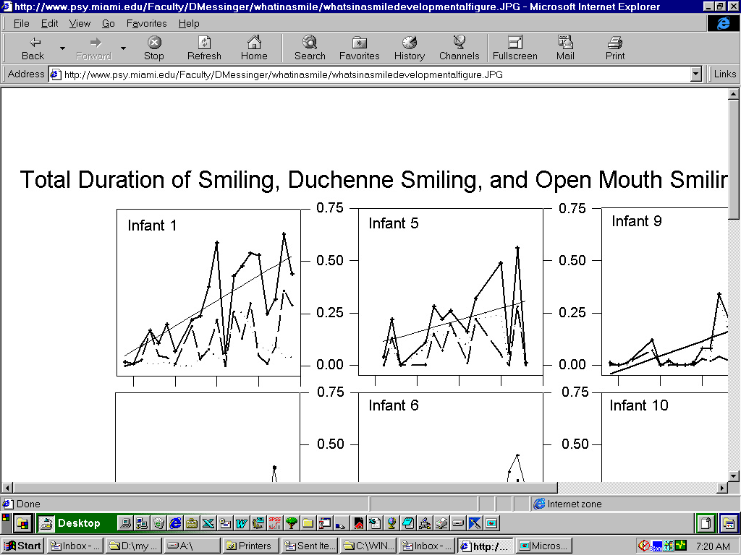
Longitudinal vs. cross-sectional
Development is relatively stable on large time scales
  Motor, physical, emotional, communicative
But choppy on smaller scales
Only longitudinal research can show individual development
Emergent order from chaotic, dynamic systems

Slide 31
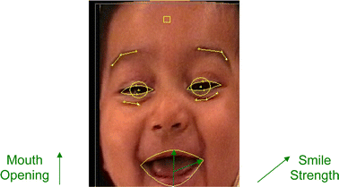
Longitudinal vs. cross-sectional
Development is relatively stable on large time scales
  Motor, physical, emotional, communicative
But choppy on smaller scales
Only longitudinal research can show individual development
(Messinger et al., 2008)
Emergent order from chaotic, dynamic systems
Notes:
Development is relatively stable on large time scales
In various domains: Motor, physical, emotional, communication
But development appears choppy on smaller scales, when we zoom in
Only longitudinal research can show individual development
For example, shown here you see examples of infant smiling over time, for a few specific individuals.
While you can see a trend upward, you notice it’s really messy when you zoom in.
Some hours in the day infants smile a lot, some days more than others, but when you average across weeks or months things level out.
There is variability within and between participants…
---
Reference:
I *think* the figure is from this project, but not sure…
Messinger, D. S., Cassel, T. D., Acosta, S. I., Ambadar, Z., & Cohn, J. F. (2008). Infant smiling dynamics and perceived positive emotion. Journal of Nonverbal Behavior, 32(3), 133.

Slide 32
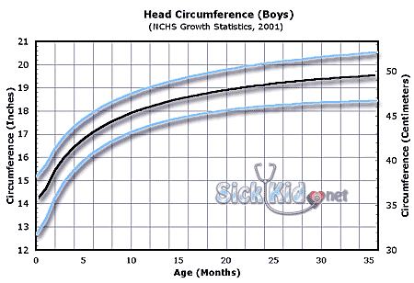
What type of research produced this commonly used chart?
6 mos.. 17”
24 mos. 19”
Birth 13.75”
12 mos. 18”

Slide 33
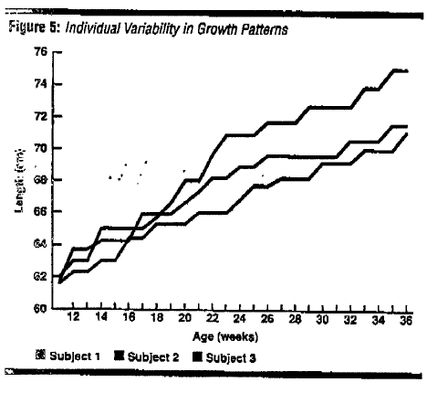
Individual differences

Slide 34
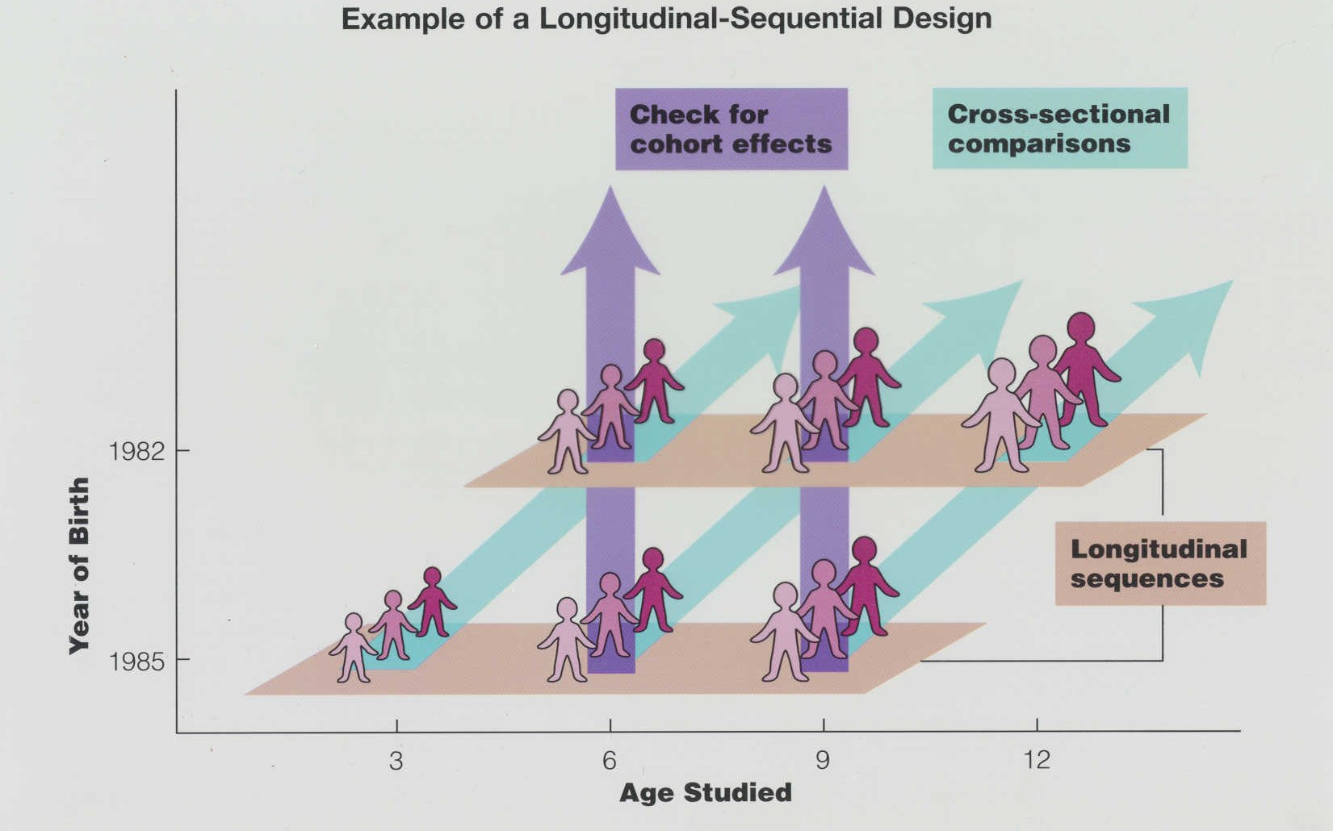
Longitudinal-sequential design
(= accelerated longitudinal design?)

Slide 35
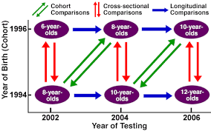
Longitudinal-sequential design
(accelerated longitudinal design)

Slide 36
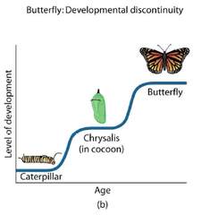
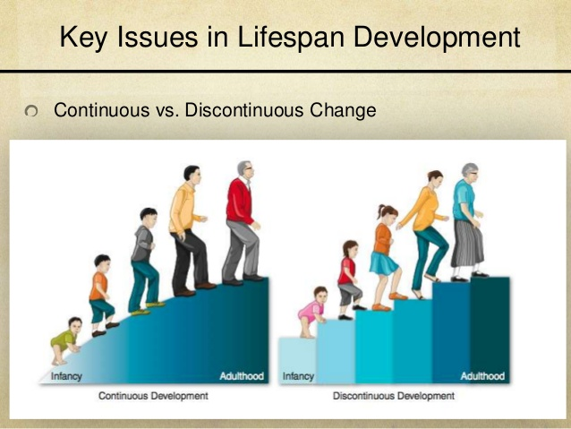
Conceptual Differences between Theories of Development
  Continuity – Discontinuity
How does a behavior change in form and/or function over the course of development? (=absolute change)
Notes:
Descriptive continuity-discontinuity
Explanatory continuity-discontinuity
Descriptions and Explanations can be either Quantitative or Qualitative

Slide 37
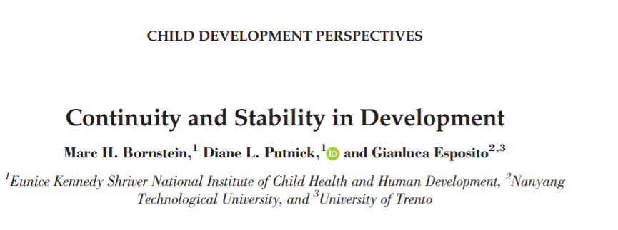
Consistency and change tracked using:
  Group mean-level consistency or change
  Individual-order consistency or change
AIM: to disentangle the two distinctive polarities:
  Continuity/discontinuity
  Stability/ instability
Milrad

Slide 38
Continuity and Stability
  Continuity(=absolute change)
  Behavior level is continuous (discontinuous) across ages
  How does a behavior change in form and/or function over the course of development?
Stability
  Rank of individual in group is stable
  How does a behavior change differently among individuals in the same group? (=relative change)
  Continuity(=absolute change)
  Behavior level is continuous (discontinuous) across ages
  How does a behavior change in form and/or function over the course of development?
Stability
  Rank of individual in group is stable
  How does a behavior change differently among individuals in the same group? (=relative change)

Slide 39
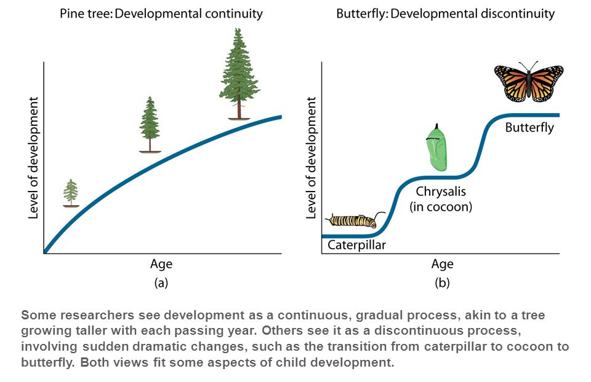
CONTINUOUS & DISCONTINUOUS
Celia

Slide 40
Conceptual example

Slide 41
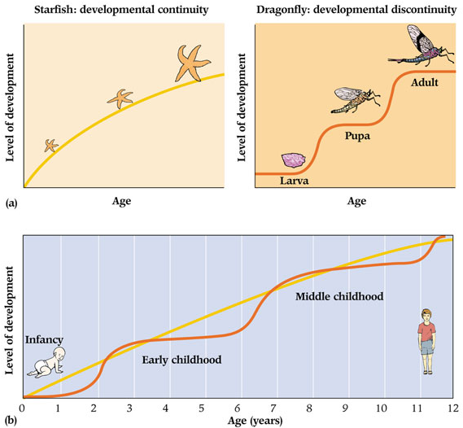
Celia

Slide 42
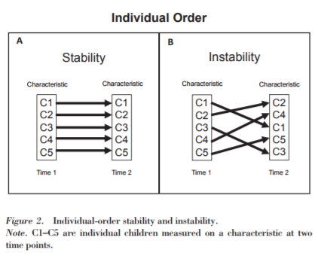
Individual stability vs. instability

Slide 43
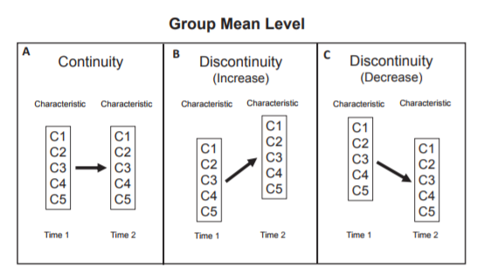
Group means: continuity vs. discontinuity

Slide 44
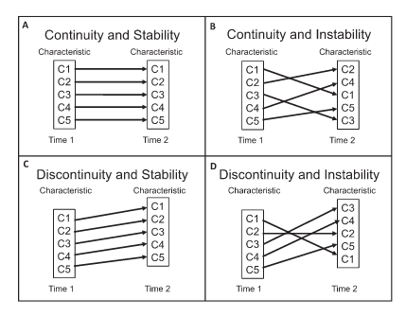
“Distinctions between mean-level continuity and individual-order stability”
Continuity( = absolute change)
Behavior level is continuous (discontinuous) across ages
Stability
Rank of individual in group is stable
Messinger
Notes:
Continuity and stability combine to paint a more complete, if nuanced, portrait of development.

Slide 45
“Distinctions between mean-level continuity and individual-order stability”
  Continuity(=absolute change)
  Behavior level is continuous (discontinuous) across ages
Stability
  Rank of individual in group is stable
Bornstein, M. H., Putnick, D. L., & Esposito, G. (2017). Continuity and Stability in Development. Child Development Perspectives, n/a-n/a. doi: 10.1111/cdep.12221

Slide 46
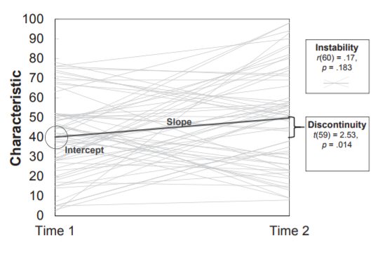
An example
Latent growth curve modeling
Intraclass correlation

Slide 47
What about Latent Growth Modeling (LGM)?
LGM measures within-person change during development by characterizing trajectories (intercept and slope differences) BUT group mean is intercept and slope is average rate of change= not measuring individual-order stability
PRO: can identify if initial avg. position predicts later change (r b/t intercept and slope)
CON: needs at least 3 time pts (vs. 2) and same metric
Milrad

Slide 48
Modeling Stability
Spoke of homotypic stability (same metric)
Heterotypic may be more appropriate
  Theoretically related but not same metric
  May serve as lower bound of estimate of stability (still a change, but that could be due to measurement discrepancy)
  Underlying factor→ latent variables
Good idea to combine both! “mediated stability” (X mediates relationship b/t A and A’)
Milrad

Slide 49
Discussion
What do we risk losing with assessing only continuity or stability?
Is one more appropriate/feasible for different research questions?
How does time factor in? What is the “best” time frame to capture what we need?
How does context affect interpretations?
How do we extrapolate and what does it all mean? What is meaningful change?
Daisy

Slide 50
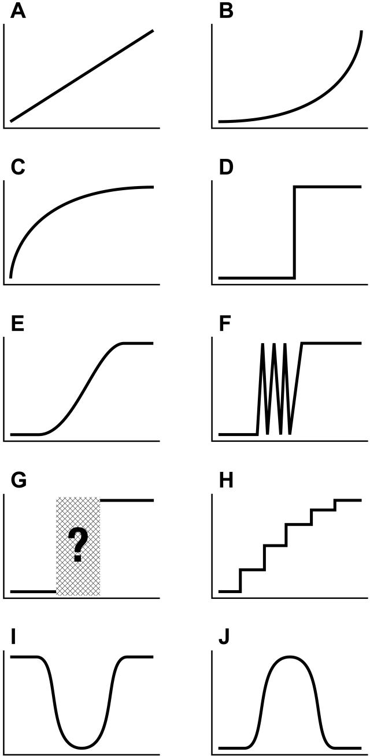
Longitudinal advantages:
Trajectories take many forms
Accurate depiction of trajectory depends on sampling rate of observations
  Overly large sampling intervals can distort shape of change
  Inaccurate picture of developmental trajectory
What is the Shape of Developmental Change? Adolf, Robinson, Young, & Gill-Alvare
Notes:
Microgenetic method – doesn’t quantify consequences of different sampling rates for depicting different patterns of development
Distort shape – skills with variable trajectories and reversals can appear as step functions, with a single abrupt transition
Onset ages – infrequent sampling may miss variability and give later onset age, or can occasionally catch a day skill is present but not stable and give earlier onset age

Slide 51
What is the Shape of Developmental Change?
Adolph et al, 2008
Call for study design based on formal theoretical models about the shape of the underlying function
  Dictates number of data points and optimal spacing
Difficult to apply in psychology
  “Chicken and egg” conundrum: Cannot mathematically calculate the shape of the function until we know the shape of the trajectory

Slide 52
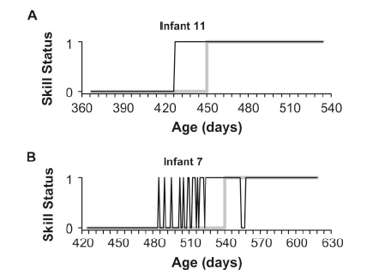
Sampling rate can misrepresent both form & age of development

Slide 53
Loss of sensitivity to detect trajectory
Study collected daily measurements of motor development
Next, systematically manipulated data to alter time between assessments
Observed how trajectories were affected

Slide 54
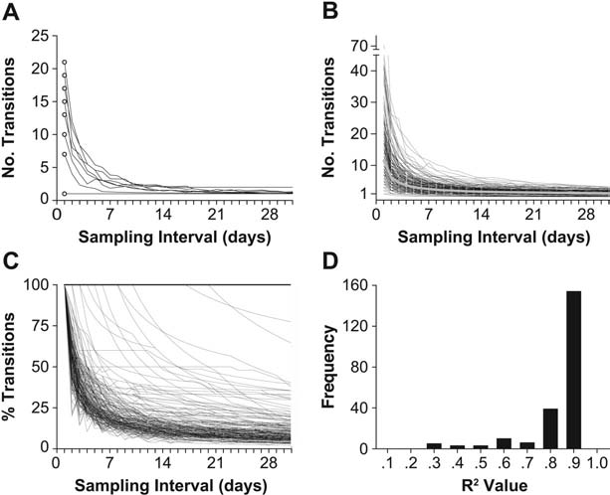
Loss of sensitivity to detect trajectory
  Many kids are variable in achieving motor skills
  Increased duration of time (as small as 2-3 days more) between assessment periods masks that variability

Slide 55
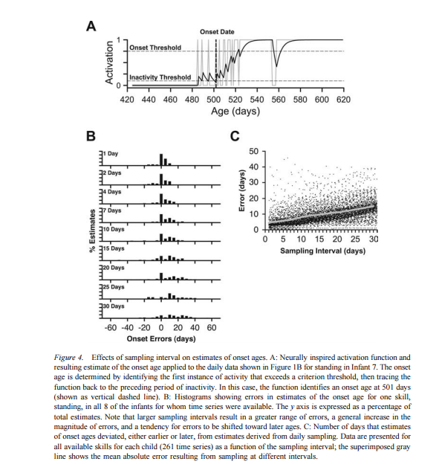
Effects of sampling interval on estimates of onset ages

Slide 56
How frequent?
How small is small enough? How large is too large?
Previously, measurement intervals chosen by:
  Intuition, convenience, and tradition
“Microgenetic method” – small time intervals to observe developmental process
Notes:
Microgenetic method – doesn’t quantify consequences of different sampling rates for depicting different patterns of development
Distort shape – skills with variable trajectories and reversals can appear as step functions, with a single abrupt transition
Onset ages – infrequent sampling may miss variability and give later onset age, or can occasionally catch a day skill is present but not stable and give earlier onset age

Slide 57
Discussion Questions
Determine the base rate.
Find the acquisition period.
Sample as small as you can.
Look before the onset.
Look for changes in variability.
What do you think of these criteria?
Are any more important than another?
How do sampling rate consideration apply to your research?
Roddy 2017

Slide 58
Complementary, not exclusive
A single study can combine longitudinal and cross-sectional methods
Some infant studies use neither method
  They look at behavior at one point in time
    E.g., Neonate study

Slide 59
Measurement Issues in
Developmental Studies
Missing Data
  Most common reason for low power in studies of change over time
Options
  Deletion
  Substitution
  Imputation
(Enders et al., 2013)
Notes:
We especially have problems with selective-drop-out…. E.g., babies who are already difficult in temperament are more likely to not contribute usable data (even if the family comes in for the study)… fuss-out.
Families under more stress may miss more visits.
High-risk populations may not have the means necessary to get to a visit (time/money/transportation).
Why does lower power matter? (fail to detect an effect that is actually there; type 2 error)
How to deal?
If we just drop them, we’re biasing our sample.
Approaches to handling missing data have improved dramatically:
‘The methodological literature favors maximum likelihood and multiple imputation
-- these approaches have a strong theoretical foundation, less restrictive assumptions, and the potential for bias reduction and greater power.
Benefits are especially important for developmental research where attrition is a pervasive problem.’
Multiple Imputation fills in estimates for the missing data. But to capture the uncertainty in those estimates, MI estimates the values multiple times. Because it uses an imputation method with error built in, the multiple estimates should be similar, but not identical. (does assume data is missing at random… which may or may not be true)
Maximum likelihood estimation - This method does not impute any data, but rather uses each cases available data to compute maximum likelihood estimates. The maximum likelihood estimate of a parameter is the value of the parameter that is most likely to have resulted in the observed data.
Still, always important to be honest and report rates of drop out (participants, trials, all of it!)
----
Ref:
Enders, Craig K.Child Development Perspectives, Vol 7(1), Mar 2013, 27-31.
https://www.theanalysisfactor.com/missing-data-two-recommended-solutions/

Slide 60
Approaches to handling missing data have improved dramatically
‘The methodological literature favors maximum likelihood and multiple imputation
  a strong theoretical foundation, less restrictive assumptions, and the potential for bias reduction and greater power.
Benefits are especially important for developmental research where attrition is a pervasive problem.’
Enders, Craig K.Child Development Perspectives, Vol 7(1), Mar 2013, 27-31.

Slide 61
What is the best approach to missing data in developmental studies?
AI Overview
The best approach to missing data in developmental studies is typically multiple imputation, which involves creating multiple plausible datasets by filling in missing values based on patterns in the observed data, and then analyzing each dataset separately before pooling the results to get a more robust estimate; this is considered superior to simply removing cases with missing data because it preserves more information and reduces potential bias.

Slide 62
Predicted or dependent variables
Experimental and all observational approaches measures variables
Variable - a measurable component of behavior or physiological functioning that can take on different values
Not all aspects of behavior or physiology
  specific features of interest

Slide 63
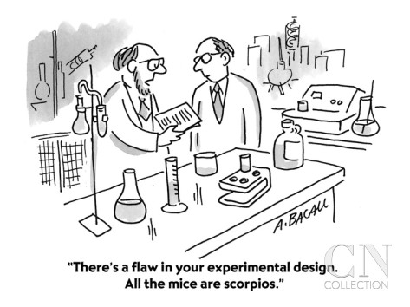
Validity of Developmental Studies
External validity
  Extent to which your results can be generalized to other people, places, or times
Internal validity
  Methodological soundness of study allowing changes in DV to be attributed to the IV
  Threats to internal validity = uncontrolled confounds
Notes:
External Validity is the extent to which your results can be generalized to other people, places, or times.
There are two kinds:
1. Does your study generalize to other people? [[Psyc participants are overwhelming WEIRD -- Western, educated, and from industrialized, rich, and democratic countries]]
2. Another kind of external validity asks: Does you study generalize to other situations? Ideally: realistic, real-world manipulation.
You can't have external validity until your study is internally valid….
Internal validity:
Did your IV actually influence your DV?
Did the thing you manipulated actually affect the thing you measured, or does it just seem like it did?
Is the effect you found actually due to your manipulation?
Another way to say it is the extent to which a valid causal statement can be made about the effects of the IV on the DV in your study
Methodological soundness of study allowing changes in DV to be attributed to the IV
Threats to internal validity = uncontrolled confounds
Need to control for various methodological confounds through adequate sampling, random assignment (when possible), inclusion of control group etc.

Slide 64
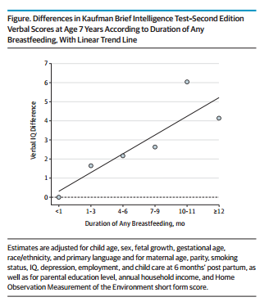
Validity threats?
Internal or external?
Belfort et al., 2013

Slide 65
Threats of particular concern in
Developmental Studies (cont)
History:
Maturation:
Testing:
Instrumentation:
Regression:
    Example of Regression * Selection effect

Slide 66
Threats of particular concern in Developmental Studies: Regression
High anxious freshmen selected for intervention in first week of school; by mid-year show significant decrease in anxiety
Pretest Intervention Posttest
90 70

Slide 67
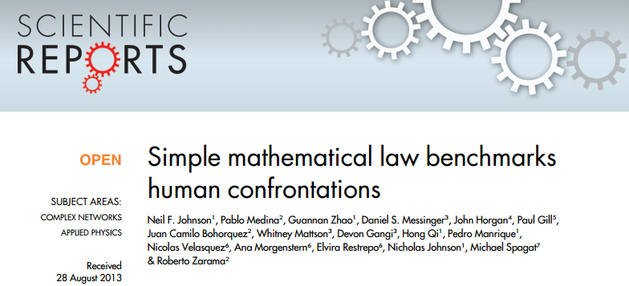
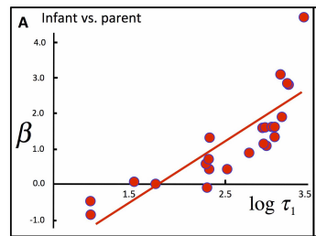
Example?

Slide 68
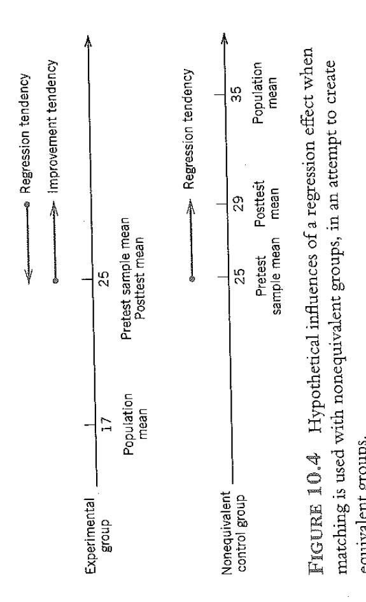
Regression in context of nonequivalent control group designs

Slide 69
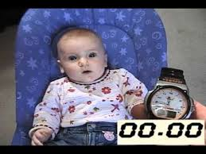
Measurement Issues in
Developmental Studies
Quantifying abstract concepts such as:
    Intelligence
    Sociability
    Emotion Regulation
Developmental assessments often rely on indirect measures
  i.e., habituation as processing index

Slide 70
Validity
Are we measuring what we think we’re measuring,
  Do the variables measured the constructs mentioned in the research questions?
  There is no final answer
    Reunion behavior = Attachment?
    Smiling = Joy?
    Looking = Preference?
    Heart rate = Arousal?

Slide 71
Measurement Issues in
Developmental Studies (cont)
Validity
  Does measure provide intended information for
  intended population?
    Can vary with age and subgroup (e.g., ethnicity or SES)
Reliability
  How consistent is children’s behavior?
    Tends to increases with age and diversity of sample

Slide 72
Measurement Issues in
Developmental Studies (cont)
Observational Measures
  How will behaviors be “parsed”
    Event-based
    Time-sampling

Slide 73
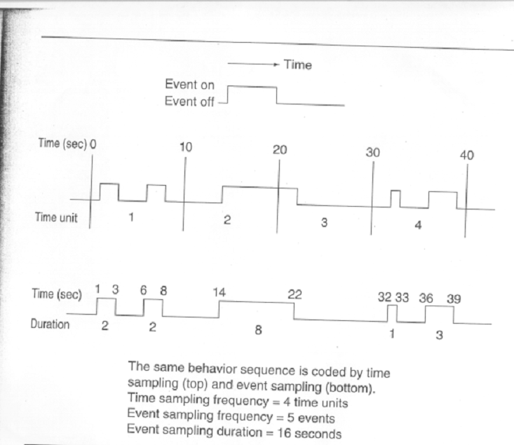
Time-sampling & event-sampling

Slide 74
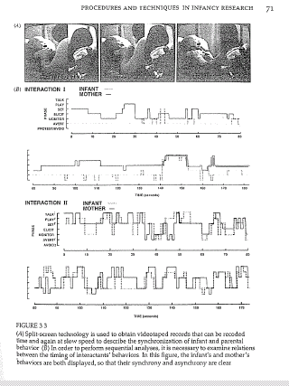

Slide 75

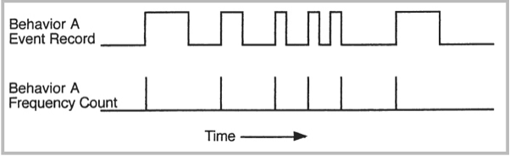
Observing behavior
Observed live, online, video-recorded
Measured with
  Trait rating - global judgment
  Time sampling
  Event sampling (frequency)
  Event sampling (duration)
Notes:
Behaviors can be measured by people or automated (eyetracking, facial expressions)
And measurements can be parsed up in different ways, placing children into broader groups/categories (“securely attached”)
Or based on the amount of time they spend doing something (time sampling)
The number of times they do something (event sampling or frequency sampling)
---
Measurement Issues in Developmental Studies (cont)
Observational Measures
How will behaviors be “parsed”
Event-based
Time-sampling

Slide 76
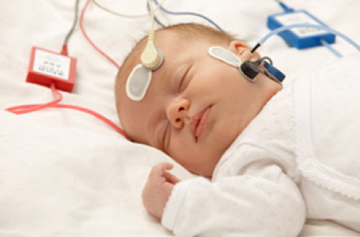
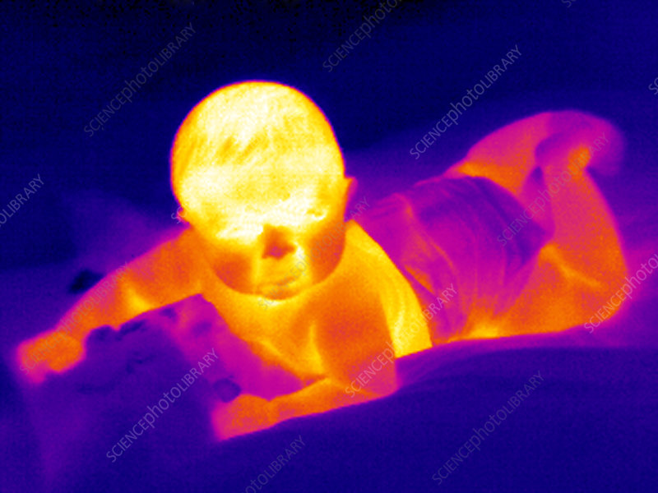
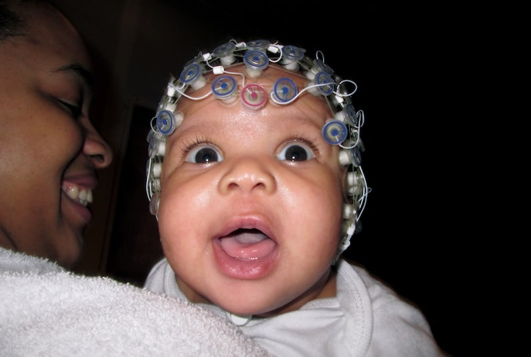
Physiological measures
Heart rate, respiration, skin conductance, pupil dilation, infrared thermography
Electroencephalogram
Actigraphy
Invaluable and increasingly important supplement to behavioral measures
Notes:
To more fully understand development it is useful to have not only behavioral measure, but also physiological measures. These can be particularly helpful for understanding things in nonverbal/preverbal populations, such as infants or young children.
Since you can’t just ask them how they feel, you can measure…
Measures of autonomic arousal -- Heart rate, respiration, skin conductance, pupil dilation
avoidant infants, infants on visual cliff
Measures of the brain, such as EEG (Electroencephalogram)
Relative lateral activation during crying
Actigraphy -- estimate sleep-wake patterns from activity levels
Index of ADD?
---
Increasingly important supplement to behavioral measures

Slide 77
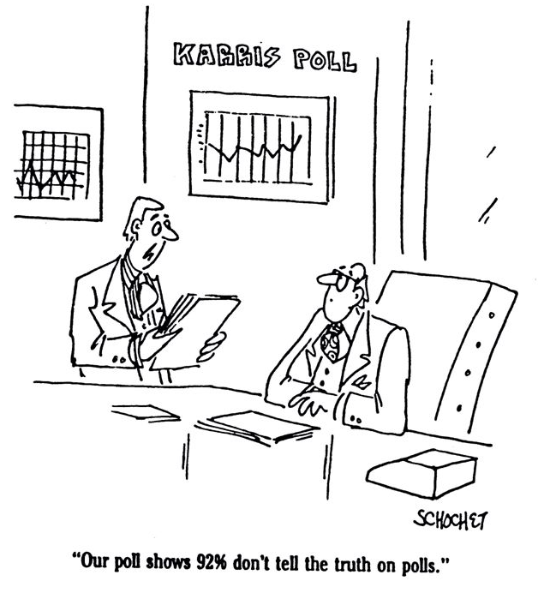
Adequacy of measures
Reliability
  Consistency of measurement
    Inter-rater reliability of observations
Bias
  Systematic impact of unmeasured variables
    Blinding in drug studies
    Keeping observations independent
Notes:
Reliability is the extent to which research results are repeatable.
If you were to take the same measurements with the same participants, under the same circumstances, would you get the same results?
Results should not depend on who the experimenter or observer is.
When looking for specific behaviors, it’s important to have more than one observer, and to compare their observations to ensure there’s an adequate level of inter-rater agreement (aka, reliability).
As with any study, it’s important to reduce bias, whenever possible. This may mean things like experimenter bias, which can be reduced through double-blind studies (neither experimenter nor participant knows which group they are in). This could be for a treatment vs. placebo, or high-risk vs. low-risk participant.

Slide 78
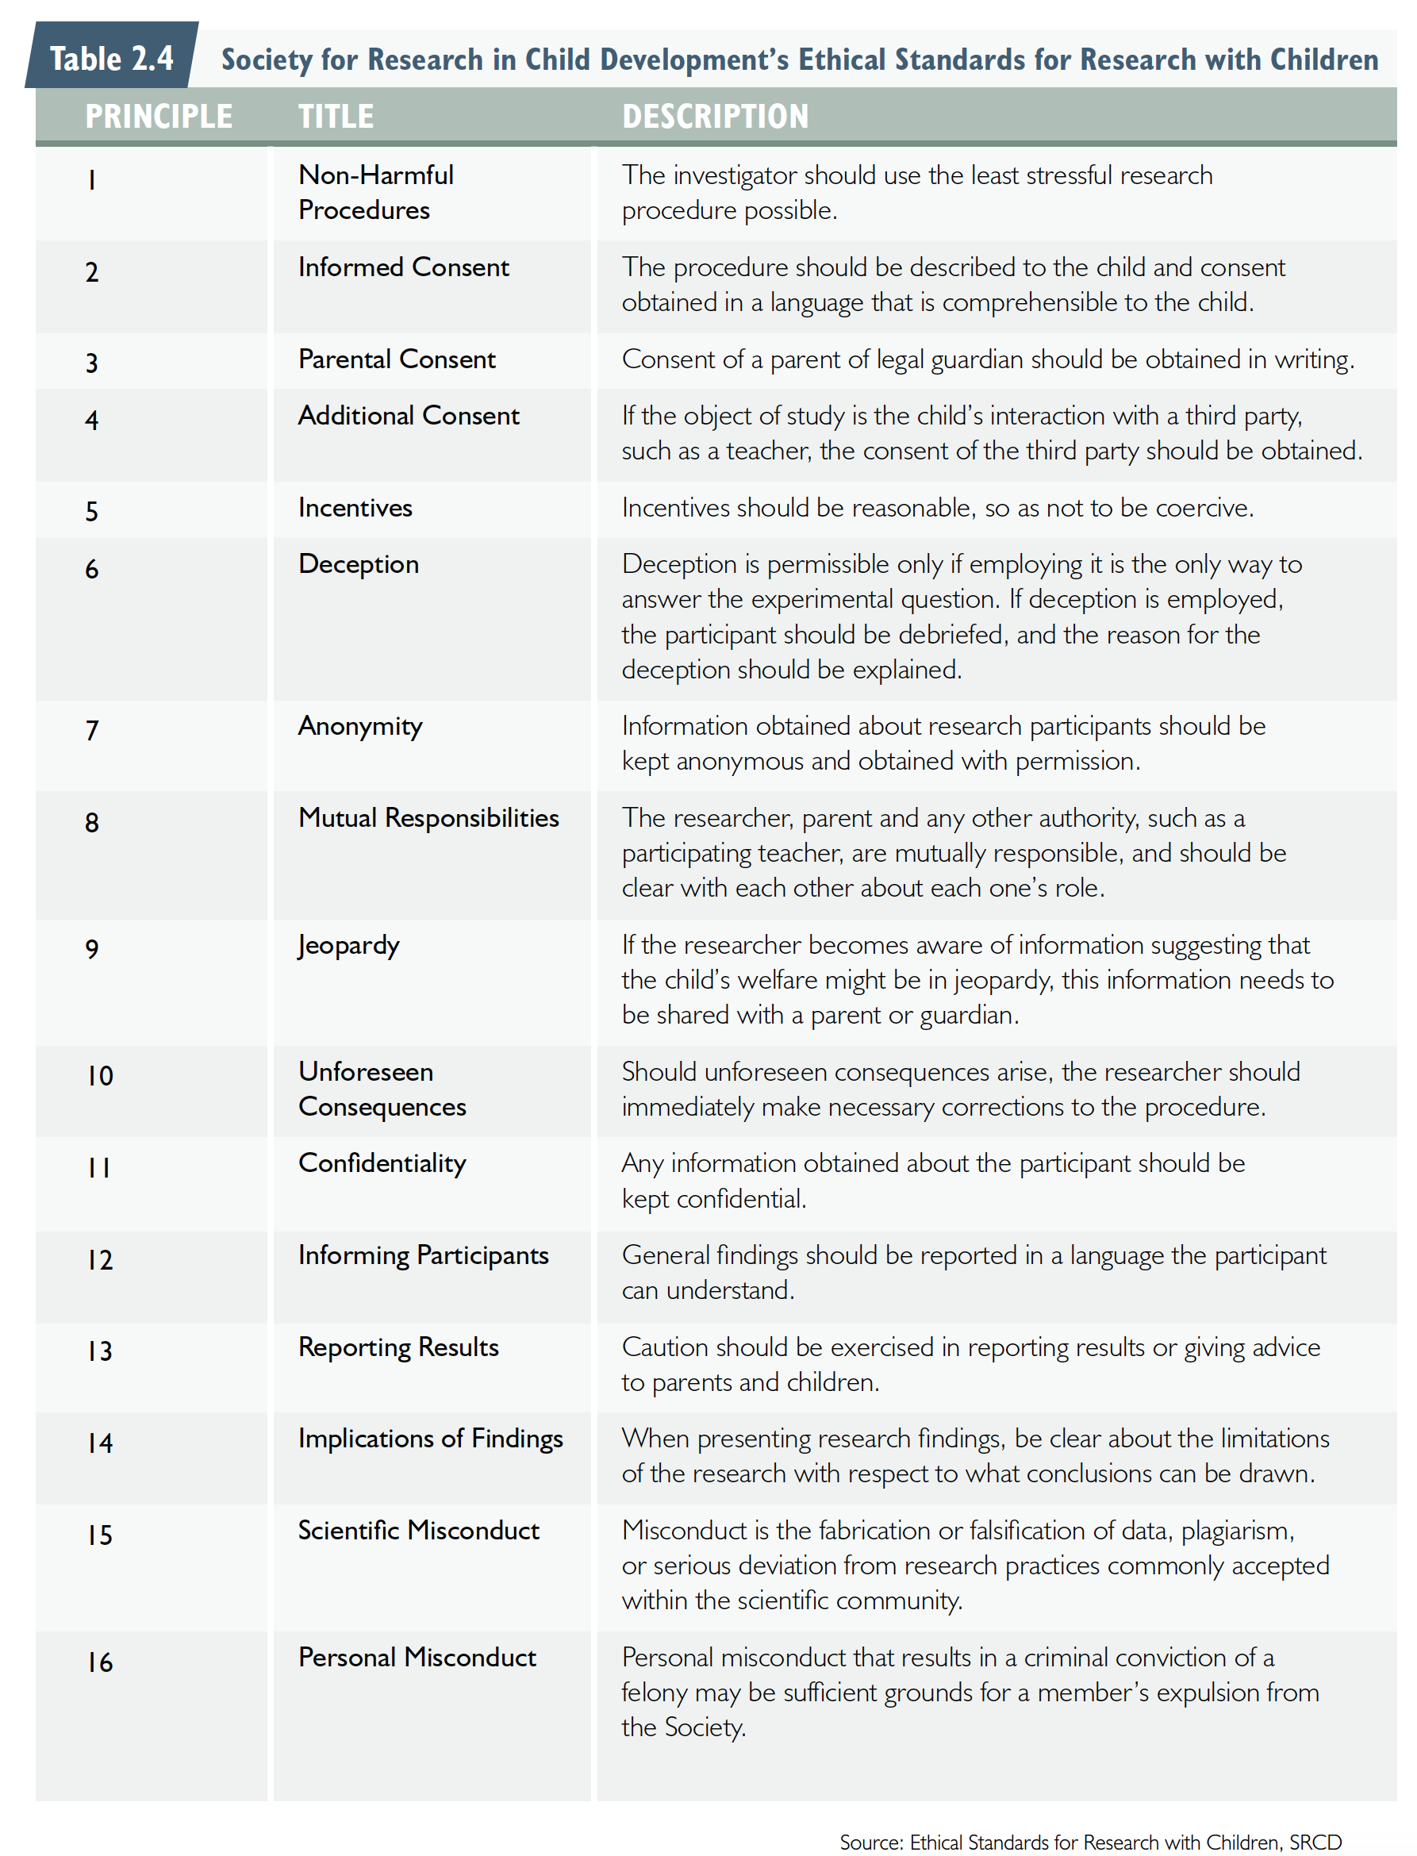
Ethics in Developmental Studies
Notes:
The expected benefits for any study must justify any risks.
Psychological research has benefits, both in terms of illuminating the workings of the mind and answering theoretical questions,
As well as practical, even therapeutic applications.
Children participating in research might be exposed to physical risks or psychological risks.
For example, being exposed to something scary, violent behavior, having to resist a treat, encountering a challenging problem they can’t solve, etc.
These might cause negative feelings, stress or discomfort.
IRBs make sure that research projects reach the ethical standards set out by the research community.
Here you see some principles by SRCD (page 1).

Slide 79
Ethics in Developmental Studies (cont)
Notes:
In my own research, our IRB has been pretty reasonable with most things.
If we’re measuring something like maternal depression, we have to offer resources to participants, in case they would like to seek treatment or counseling.
If we’re showing babies videos of other babies crying, which they might find upsetting, we have to tell the family that they can stop participating at any point if they feel uncomfortable (or we stop if babies cries for more than a few seconds).
We share all of our data, including videos of babies and parents, with the larger research community, which means even though names are not linked to the videos, someone could still identify you or your baby from the video (unlikely, but possible).
We also tell families that we will post photos/videos of them and their baby online. (Although if they request we don’t we obv won’t. but it’s in our consent that we have permission).
Recruitment - Incentives… can put $50 in large print, = too coercive

