Slide 1
Advanced
Developmental
Psychology
PSY 620P

Slide 2
Example midterm question
Conradt et al. report that high maternal depressive symptoms and insensitive behavior during face-to-face play are associated with higher levels of methylation of NR3C1 and 11b-HSD2 but lower cortisol. Design a follow-up study which addresses weaknesses in the parent study. Indicate how data will be analyzed, and the intellectual significance of possible findings.

Slide 3
Neural development
(and behavioral associations)
Ontogeny and phylogeny
Longer gestation and cognitive development
Intelligence & cortical maturation dynamics
  cortical thickness
    Shaw, Burgaleta
Autism Hazlett et al – early brain overgrowth (surface area)
Higher SES as longer period of neural enrichment
Environmental influences on the pace of brain development (Tooley/Tooler-Renfree)
A Randomized Controlled Trial of a Parenting Intervention During Infancy Alters Amygdala-Prefrontal Circuitry in Middle Childhood (Valadez)
Mom behavior → infant EEG power development (Bell)
Developmental changes in variability (Nomi, et al.)
------------------------------------
Cortisol and SES
How to study the infant brain
Infant brain development
Brain development / risk-taking (Casey)

Slide 4
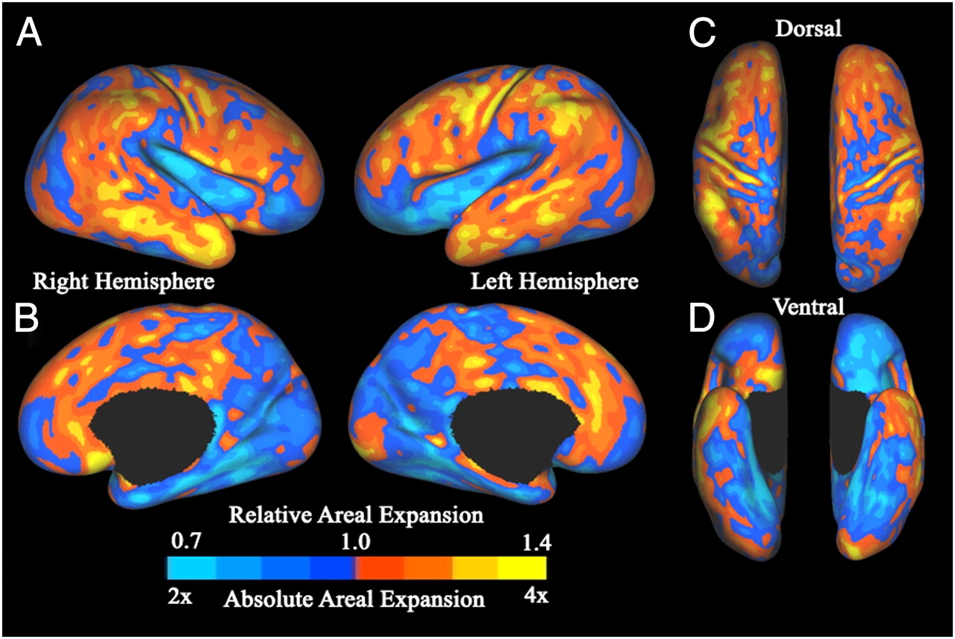

Postnatal cortical surface expansion.
Fig. 1. Postnatal cortical surface expansion. Maps of postnatal cortical surface expansion
on the standard mesh average inflated term infant surfaces for both hemispheres, shown in lateral (A), medial (B), dorsal (C), and ventral (D) views. The absolute expansion scale indicates how many times larger the surface area of a given region is in adulthood relative to that region’s area at term. The relative expansion scale indicates the difference in proportion of total surface area at term birth and adulthood.
Hill J et al. PNAS 2010;107:13135-13140
©2010 by National Academy of Sciences
Notes:
Postnatal cortical surface expansion. Maps of postnatal cortical surface expansion on the standard mesh average inflated term infant surfaces for both hemispheres, shown in lateral (A), medial (B), dorsal (C), and ventral (D) views. The absolute expansion scale indicates how many times larger the surface area of a given region is in adulthood relative to that region’s area at term. The relative expansion scale indicates the difference in proportion of total surface area at term birth and adulthood.

Slide 5
Cortical Expansion
Similar patterns of cortical expansion between infants and adults as between macaque monkeys and adults
“The pattern of human evolutionary expansion is remarkably similar to the pattern of human postnatal expansion”
  (Hill et al., 2010)

Slide 6
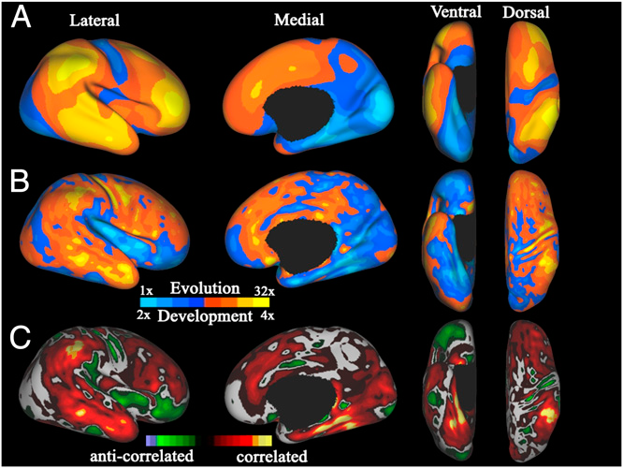
Comparing evolutionary and postnatal cortical surface expansion
(A) Map of regional evolutionary cortical expansion between an adult macaque
and the average human adult PALS-B12 atlas (right hemisphere only).
Evolution expansion scale indicates how many times larger the surface area is
in humans relative to the corresponding area in the macaque.
(B) Map of human postnatal cortical expansion (combined left and right hemispheres)
for comparison.
(C) Correlation map comparing postnatal to evolutionary cortical surface expansion.
How to evolve a smarter primate--neoteny

Slide 7
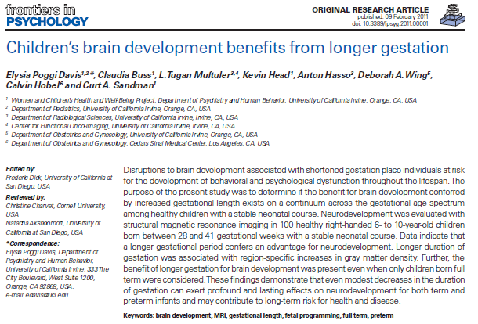
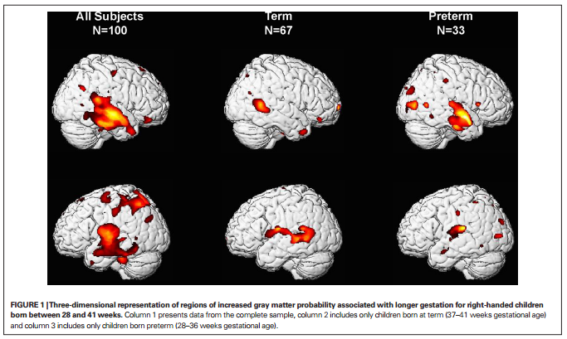
Application—premature birth

Slide 8
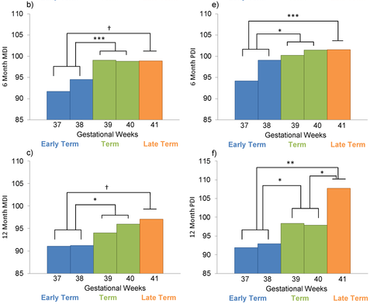

Longer Gestation among Full Terms → Higher Cognitive/Motor functioning
Not only brain, but behavior too
Espel EV, Glynn LM, Sandman CA, Davis EP (2014). PLoS ONE 9(11): e113758. doi:10.1371/journal.pone.0113758
http://127.0.0.1:8081/plosone/article?id=info:doi/10.1371/journal.pone.0113758

Slide 9
Intellectual Ability and Cortical Development (Shaw et al., 2006)
Cortical Thickness
  Index of
    neuronal density
    synaptic connections
    myelination
Regional differences in rates of
thickening and thinning over
development

Slide 10
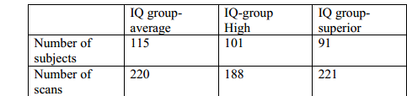
Longitudinal design..
178 participants (58%) had at least two scans; 92 (30%) had three or more scans;
Mean interscan interval was ~2 yr
  Superior (121–149), high (109–120), & average intelligence (IQ range 83–108).
    http://:
www.nature.com/nature/journal/v440/n7084/extref/nature04513-s1.pdf
  Age-appropriate versions of Weschler scales.
Notes:
For longitudinal analyses, subjects were divided into three groups on the basis of full-scale IQ with the primary constraint of attaining a roughly equal number of total scans in each group:

Slide 11
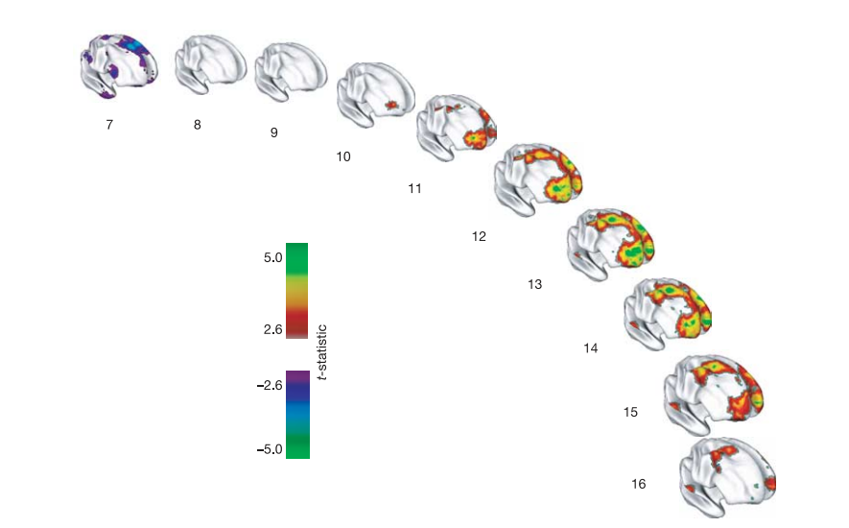
“[I]ntelligence is related to dynamic properties of cortical maturation”
“the superior intelligence group has a thinner superior prefrontal cortex at the earliest age (purple regions). There is then a rapid increase in cortical thickness (red, green and yellow regions) in the superior intelligence group, peaking at age 13 and waning in late adolescence.”
Notes:
Figure 4 | Developing differences in cortical thickness between the
superior and average intelligence groups. Group differences are
represented by t-statistics (t . 2.6), and show that the superior intelligence
group has a thinner superior prefrontal cortex at the earliest age (purple
regions). There is then a rapid increase in cortical thickness (red, green and
yellow regions) in the superior intelligence group, peaking at age 13 and
waning in late adolescence.

Slide 12
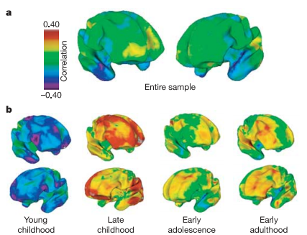
Associations of cortical thickness and IQ structure→function changes with age
(Shaw et al., 2006)
  Across entire sample?
  By age group?

Slide 13
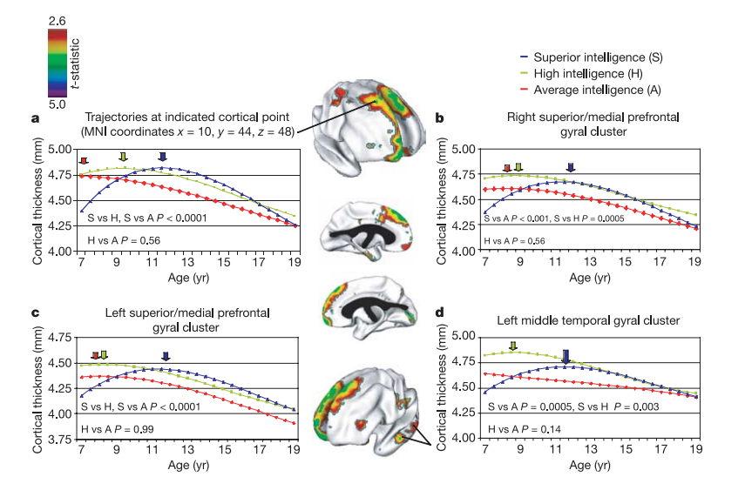
Interaction of IQ and age predict prefrontal cortical thickness growth trajectories
(Shaw et al., 2006)
Notes:
Figure 2 | Trajectories of cortical change. The brain maps (centre panel)
show prominent clusters where the superior and average intelligence groups
differ signiﬁcantly in the trajectories of cortical development (t-statistic
maps show areas of signiﬁcant interaction between these IQ groups and the
cubic age term). a, Graph showing the trajectories at the cortical point of
maximum trajectory difference in the right superior frontal gyrus (point
indicated in upper brain map). b–d, Graphs showing the trajectories of the
mean thickness of all cortical points in the other clusters. The graph in d
relates to the area indicated in the lower brain map. The age of peak cortical
thickness is arrowed and signiﬁcance values of differences in shapes of
trajectories are given on the graphs. MNI, Montreal Neurolog

Slide 14
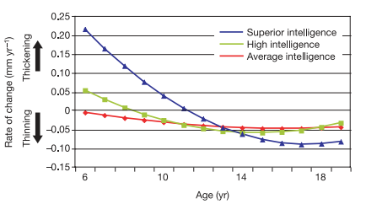
IQ group and rate of change in cortical thickness with age
(Shaw et al., 2006)

Slide 15
Adaptiveness/function of prolonged phase of prefrontal gain for IQ?
Benefit of longitudinal design?
  “Most previous studies infer developmental processes from purely cross-sectional data, an endeavor fraught with methodological complications” (p. 676)
(Shaw et al., 2006)

Slide 16
Cognitive ability changes and dynamics of cortical thickness (Burgaleta et al., 2014)
Background:
  IQ associated with changes in cortical thickness (Ramsden et al., 2011)
    Higher IQ associated with greater fluctuations in cortical thickness ;
    declines in cortical thickness during late adolescence (Shaw et al., 2006)
Goal:
  Better understand structural correlates of changes in IQ for healthy youth over time
    Are these changes in cognitive ability or measurement error?
Hypotheses:
  Structural change in the brain (e.g., cortical thickness/surface area) positively associated with Verbal IQ, Performance IQ, and Full Scale IQ for children/adolescents over time
    Associations in sensorimotor areas
Why do you think these are important questions to study?

Slide 17
Methods
(Burgaleta et al., 2014)
Sample
  Multi-site (6 sites), longitudinal study
  N= 188, Ages 6-20, Mean age at Time 1: 11.59 + 3.46; assessed at 2 year follow-up
Measures
  Cognitive Measures:
    WASI (VIQ, PIQ, and FSIQ)
  MRI and MRI processing system
    Used corticometric methods to represent gray matter change: cortical thickness (CTh) and cortical surface area (CSA)

Slide 18
Analysis
(Burgaleta et al., 2014)
  As part of pre-post design, computed difference scores for CTh, CSA, and IQ
      Change scores represent relative change compared to same-aged peers (not absolute change)
  Analyzed change by IQ change group (using 90% CI):
    Reliable IQ increases
    Reliable IQ decreases
    No reliable IQ changes

Slide 19
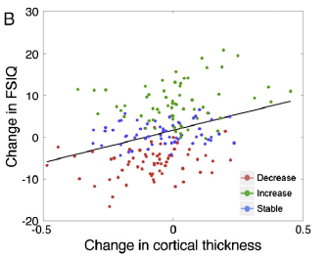
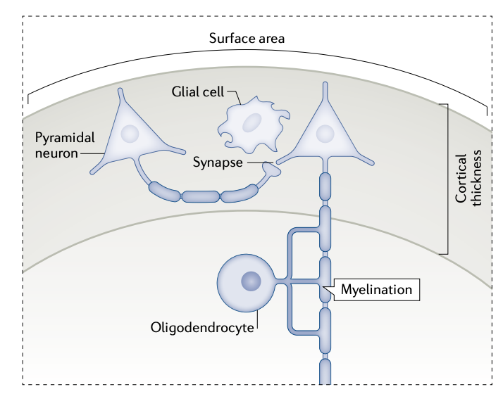
ΔFullScaleIQ [IQ] associated with Δ CTh (not Δ CSA)
  ΔPIQ associated with changes in CTh; trend for ΔVIQ
(Burgaleta et al., 2014)

Slide 20
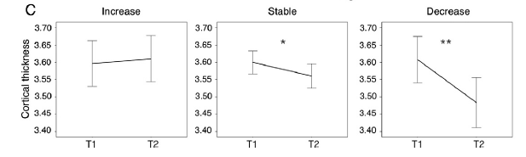
ΔCorticalThickness over time
  Increase IQ group: non-significant increase in CTh
  Stable IQ group: smaller decreases in CTh
  Decrease IQ group: steepest rates of reduction in CTh
Burgaleta et al., 2014

Slide 21
Conclusions
(Burgaleta et al., 2014)
Consistent with previous literature, individual differences in rate of change in cortical thickness appears to be related to changes in 3 parts of IQ
  Results of this study support that relationship over time
CSA does not seem to be associated with changes in IQ
How can we explain these changes in FSIQ/brain structure? Ideas for future directions?

Slide 22
Discussion
Frontoparietal regions previously related to general cognitive ability (Barbey et al., 2012)
Why CTh and not CSA?
  CTh = number of neurons, amount of glial and capillary support and level of dendritic arborization
    Sensitive to post natal development
    Not likely due to changes in number of cortical neurons
    Gliogenesis occurs as a consequence of learning and experience (Dong & Greenough, 2004)
  CSA = number and spacing of mini-columnar units of cells
    Dependent on neurogenesis and neuronal migration (complete by term gestation; Hill et al., 2010)
Synaptic pruning:
  Excessive loss of neuronal connections might be behind steeper cortical thinning
J. Rooks

Slide 23
Reconceptualizing functional brain connectivity in autism from a developmental perspective
Uddin, Supekar & Menon, 2013

Slide 24
Functional Connectivity =
“temporal correlations between remote neurophysiological events”
Analysis:
  1) seed region of interest
  2) correlating multiple regions
  3) mapping areas with shared profiles
Resting State fMRI – reflects history of task-dependent activation
Development and functional connectivity:
  Adults have more high level connections
  Networks are more diffuse in adult brain

Slide 25
Autism and Connectivity
ASD: social and communication deficits, repetitive and restricted behaviors
Hypo VS. Hyper connectivity theories
  Methodology? Conceptual questions? Development?!?!?!
Hypo-Connectivity
Language
Working Memory
Executive Functioning
Visuomotor coordination
Cognitive Control
Hyper-Connectivity
Language
Memory
Emotion Processing
Visual search
Visuomotor coordination

Slide 26
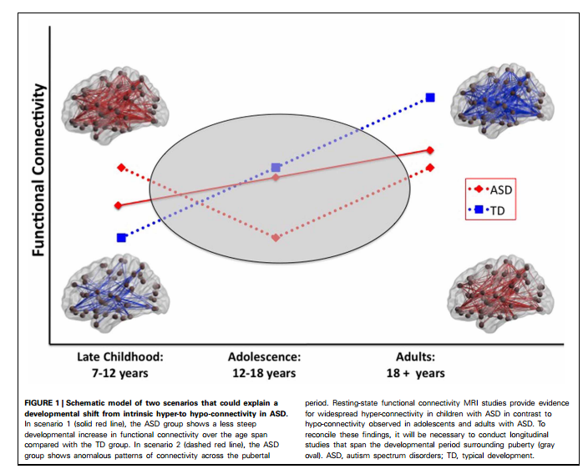
Functional Connectivity and ASD
Pattern of hypo-activity in adults
Hyper-activity in children
  Found in children aged 7-12
Possible hormonal role?
Reconceptualizing functional brain connectivity in autism from a developmental perspective.
Uddin, Supekar & Menon, 2013
Notes:
Direct your attention to Table 1

Slide 27
Core properties of structural brain connectivity stable during maturation
  Structural connectivity based on diffusion tensor imaging (DTI) in 121 participants between 4 and 40 years of age.
The number of fiber tracts, small-world topology, and modular organization remained largely stable despite a substantial overall decrease in the number of streamlines with age.
Decrease mainly affected fiber tracts that had a large number of streamlines, were short, within modules and within hemispheres;
  such connections affected more than expected given # of occurrences in network.
    Streamline loss occurred earlier in females than in males.
Decrease in short-range connectivity?
    Preferential Detachment During Human Brain Development: Age- and Sex-Specific Structural Connectivity in Diffusion Tensor Imaging (DTI) Data. 2013. Sol Lim1,2, Cheol E. Han1,3⇑, Peter J. Uhlhaas4,5,6 Marcus Kaiser1,2http://cercor.oxfordjournals.org/content/early/2013/12/13/cercor.bht333.full.pdf+html

Slide 28
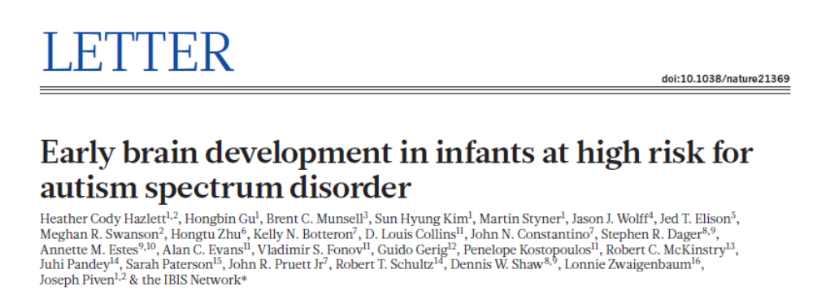
Milrad

Slide 29
Brain enlargement in infants, children, adolescents, and adults with ASD
Timing and significance in relation to ASD-relevant behavioral problems are unknown
Most apparent in early childhood (eg 12-24 mos)
Prospective neuroimaging study for familial high risk for ASD (HR N=106, LR N=42)
  Comparable in race/ethnicity (85%white), family income, maternal age, gestational age, birth weight
  HR had more males
  LR mothers had higher education level
  Subset of longitudinal study of 318 HR infants (70 were clinically HR, 248 not clinical HR, and 117 LR)
Milrad

Slide 30
METHODS: Sample
Subset from longitudinal study of 318 HR infants (70 were clinically HR, 248 not clinical HR, and 117 LR)
Comparable in race/ethnicity (85%white), family income, maternal age, gestational age, birth weight
HR had more males
LR mothers had higher education level
Milrad

Slide 31
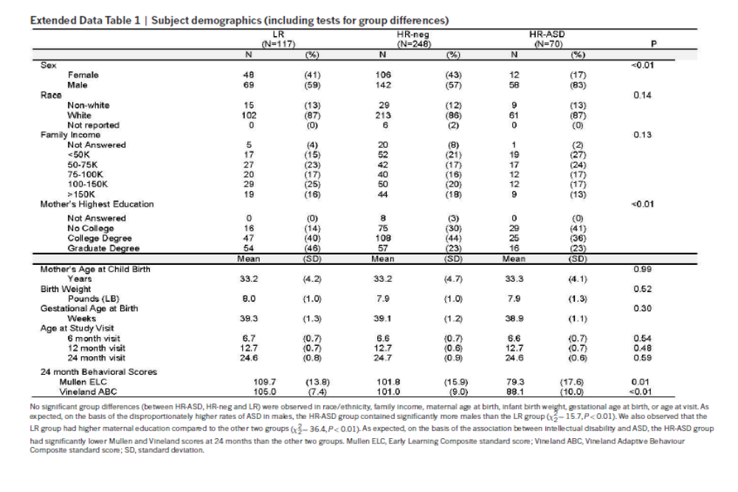
PARTICIPANTS
Milrad

Slide 32
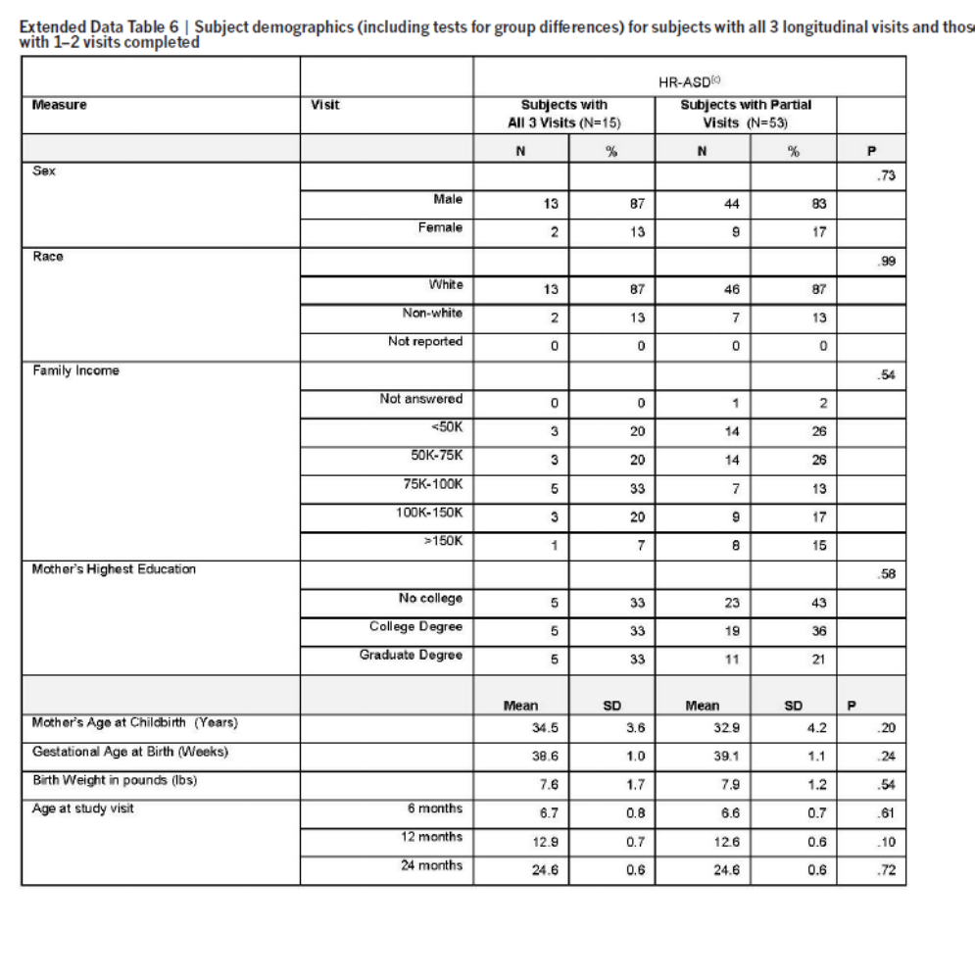
Milrad

Slide 33
Brain change biomarkers of ASD? (before behavioral differences)
Infants evaluated 6, 12, 24 months
  Behavioral assessments (ADOS, CSBS)
  High resolution MRI of brain
H1: brain overgrowth begins before 24 mo.
  Overgrowth associated with expansion of cortical surface area
  Early brain changes linked in time to emergence of ASD-defining behaviors
Milrad
Notes:
Subset: 106 HR (15 HR-ASD, 91 HR-neg.), 42 LR

Slide 34
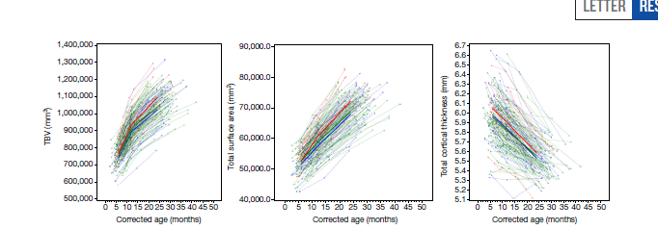
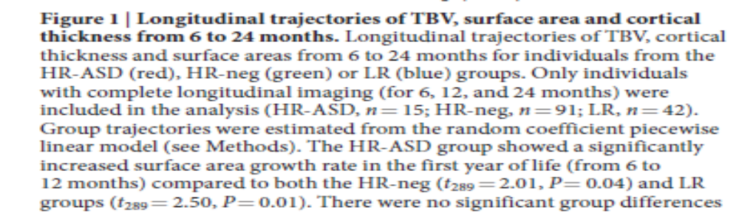
HR-ASD:
Increased surface area growth 6-12 mo
Milrad

Slide 35
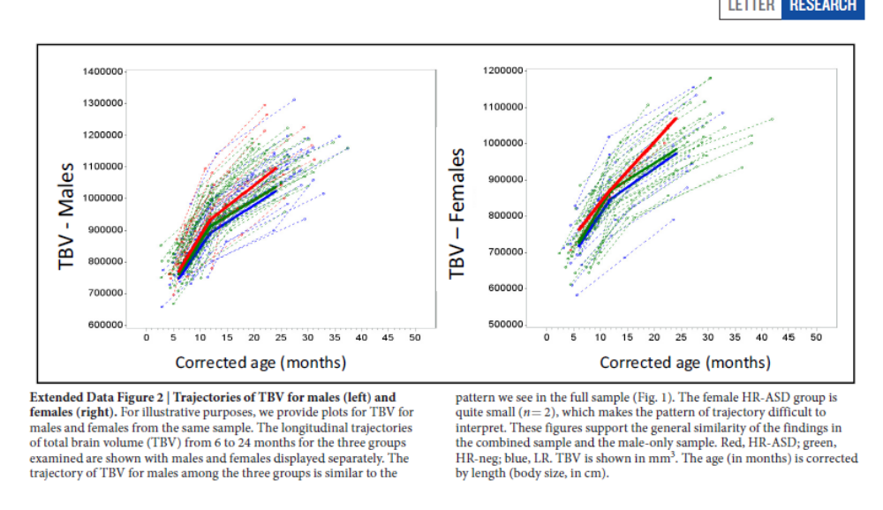
Pairwise Comparisons at 24 mo.
Milrad

Slide 36
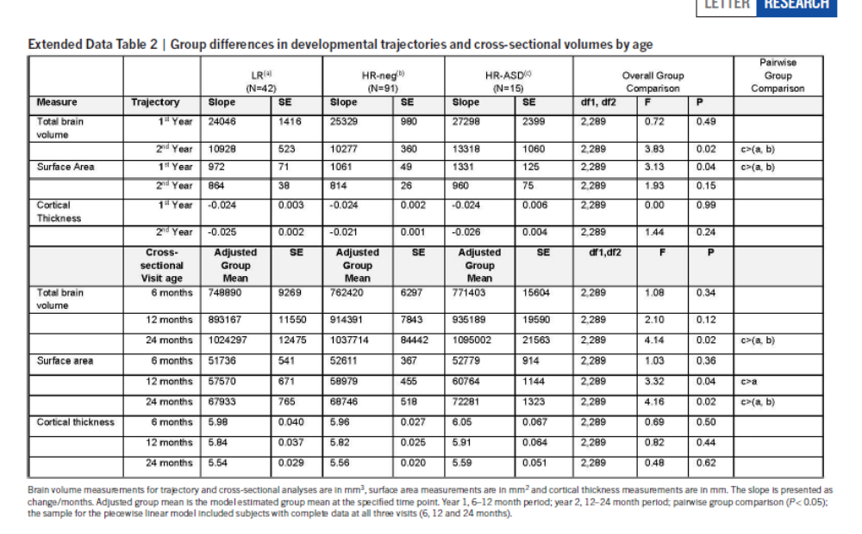
Significant Differences at 24 mo.
Milrad

Slide 37
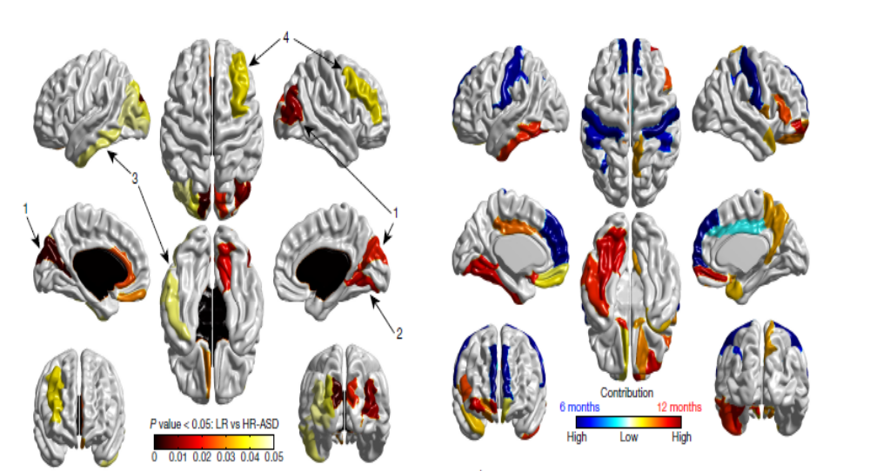
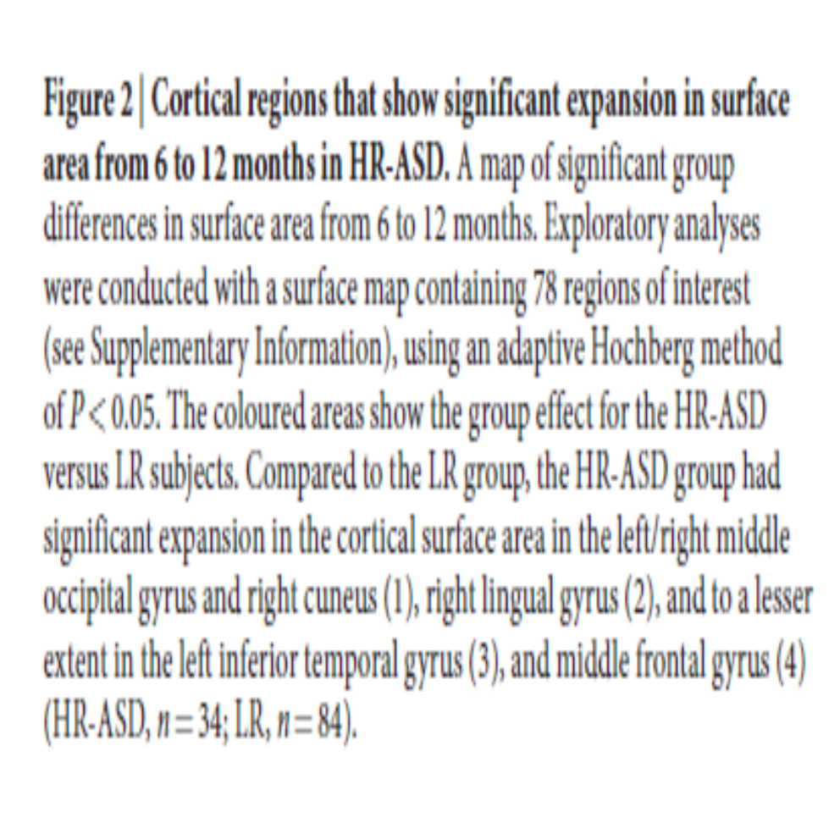
Surface Area Differences 6-12 mo.
Milrad

Slide 38
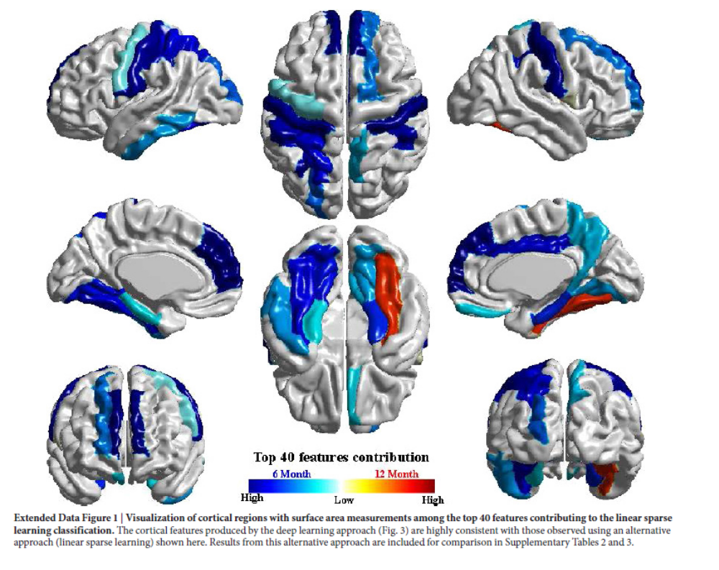
Milrad

Slide 39
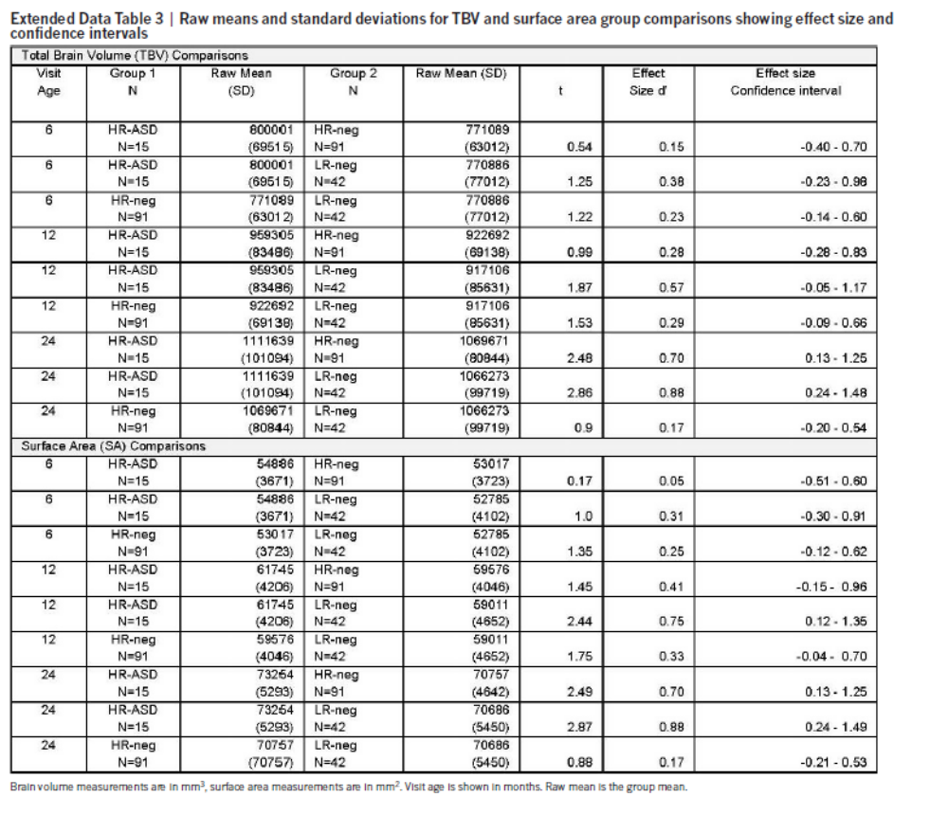
Milrad

Slide 40
RESULTS SUMMARY
HR-ASD group showed significantly increased TBV GR compared to both groups
HR-ASD group showed increased surface area GR from 6-12 mo. compared to both groups (in areas related to sensory processing)
No group differences in cortical thickness
Sig. correlation between S.A. GR (6-12) and TBV (12-24) in all subjects, and in combined HR group (?)
No correlation between 24 ADOS score and 6-12 mo. TBV change rate at either time pt.
Sig. correlation between 24 ADOS and 12-24 mo. change rate
  Correlation with ADOS social affect score but not ADOS restrictive/repetitive score
CSBS composite score related to rapid TBV change rate at 12-24 months in HR subjects (but not 6-12 mo)
Group (HR+ vs HR-)x time (12-24) interaction for CSBS
Deep learning network/ classification algorithm predicted ASD at 24 mo. using sex, regional SA and cortical thickness at 6-12 mo., and intracranial volume (6-12) with 94% accuracy, 88% sensitivity, 95% specificity, 81% positive predictive value, and 97% negative predictive value
  *mostly predictive: surface area (not cortical thickness, TBV, or sex)
Milrad

Slide 41
DISCUSSION
Biomarker potential?
Reflective or causative?
Brain overgrowth
S.A. expansion 6-12 mo.
ASD 24 mo.
Notes:
Practical/clinical significance?
Why does this make sense? (or not…)
Methodological issues?

Slide 42
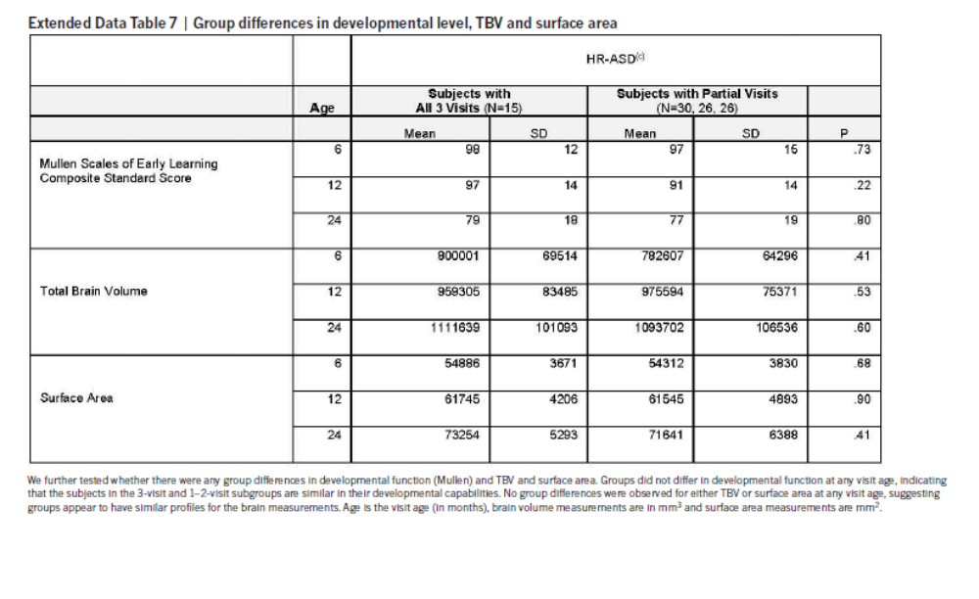
Milrad

Slide 43
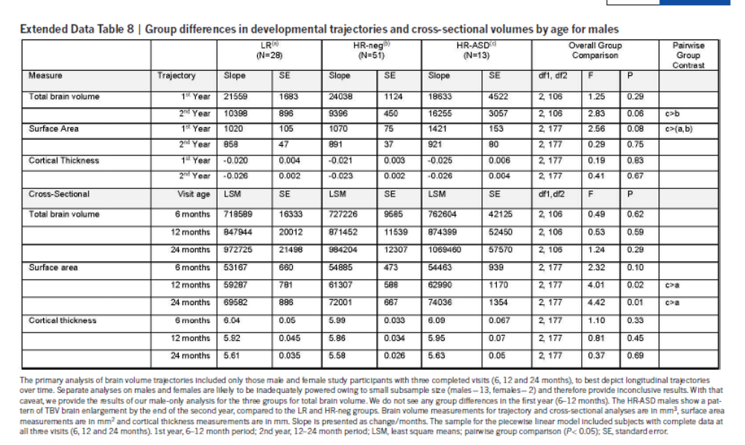
Milrad

Slide 44
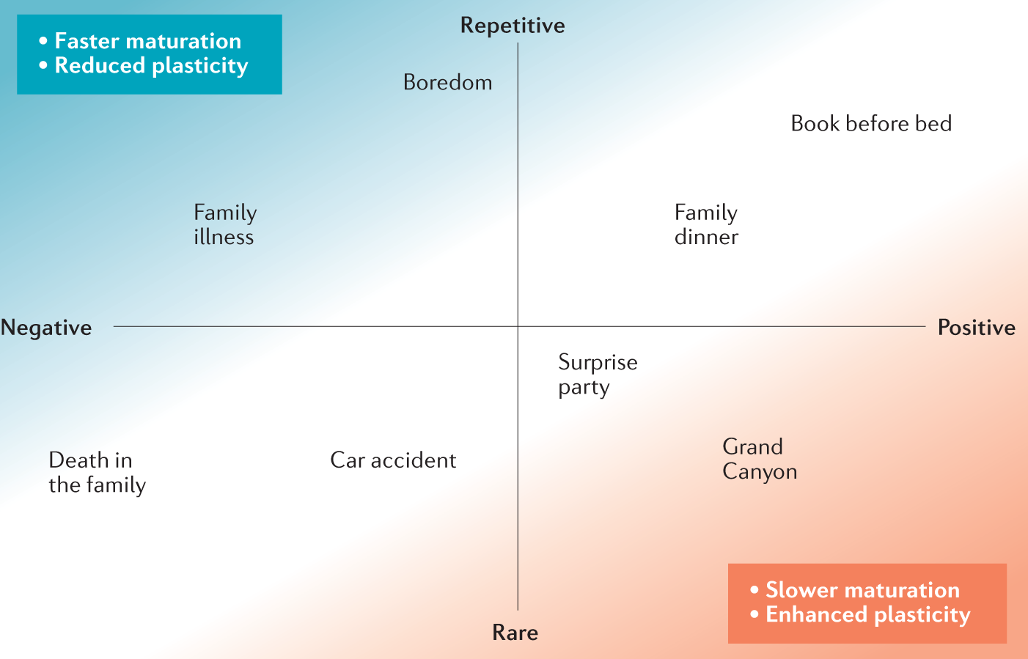
Childhood experiences affect the pace of brain development.
Tooley, et al. (2021). Environmental influences on the pace of brain development. Nature Reviews Neuroscience, 22(6), 372-384. doi:10.1038/s41583-021-00457-5

Slide 45
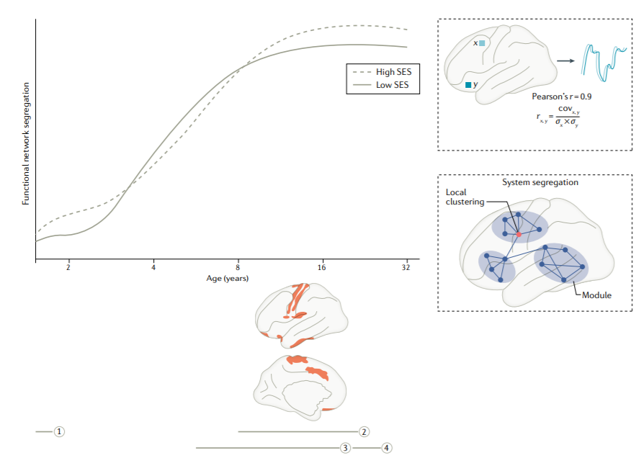
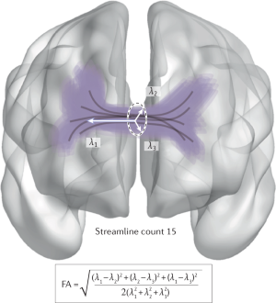
SES and functional networks
Tooley, U. A., Bassett, D. S., & Mackey, A. P. (2021). Environmental influences on the pace of brain development. Nature Reviews Neuroscience, 22(6), 372-384. doi:10.1038/s41583-021-00457-5

Slide 46

Environmental influences on the pace of brain development
Tooley et al., 2021
Argument: gher childhood SES is associated with protracted structural brain development and a prolonged trajectory of functional network segregation,

Slide 47
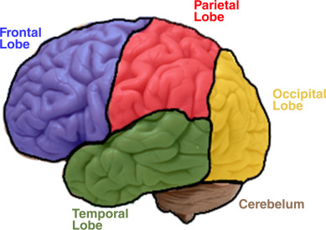
Hypothesis: greater exposure to chronic stress accelerates brain maturation; greater access to novel positive experiences decelerates maturation
SES: household (e.g., parental income, education, or occupation) or neighborhood (e.g., crime rate, poverty levels, or median income) level
        Little is known about SES and brain maturation trajectories
Frontal- complex thinking
Occipital- visual information
Parietal- sensory information
Temporal- auditory information
Cerebellum- motor movement, balance
Notes:
Image from Camara 2015

Slide 48
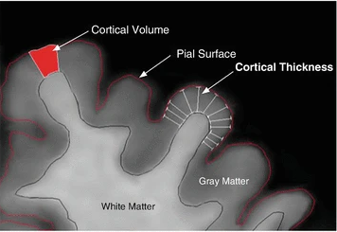
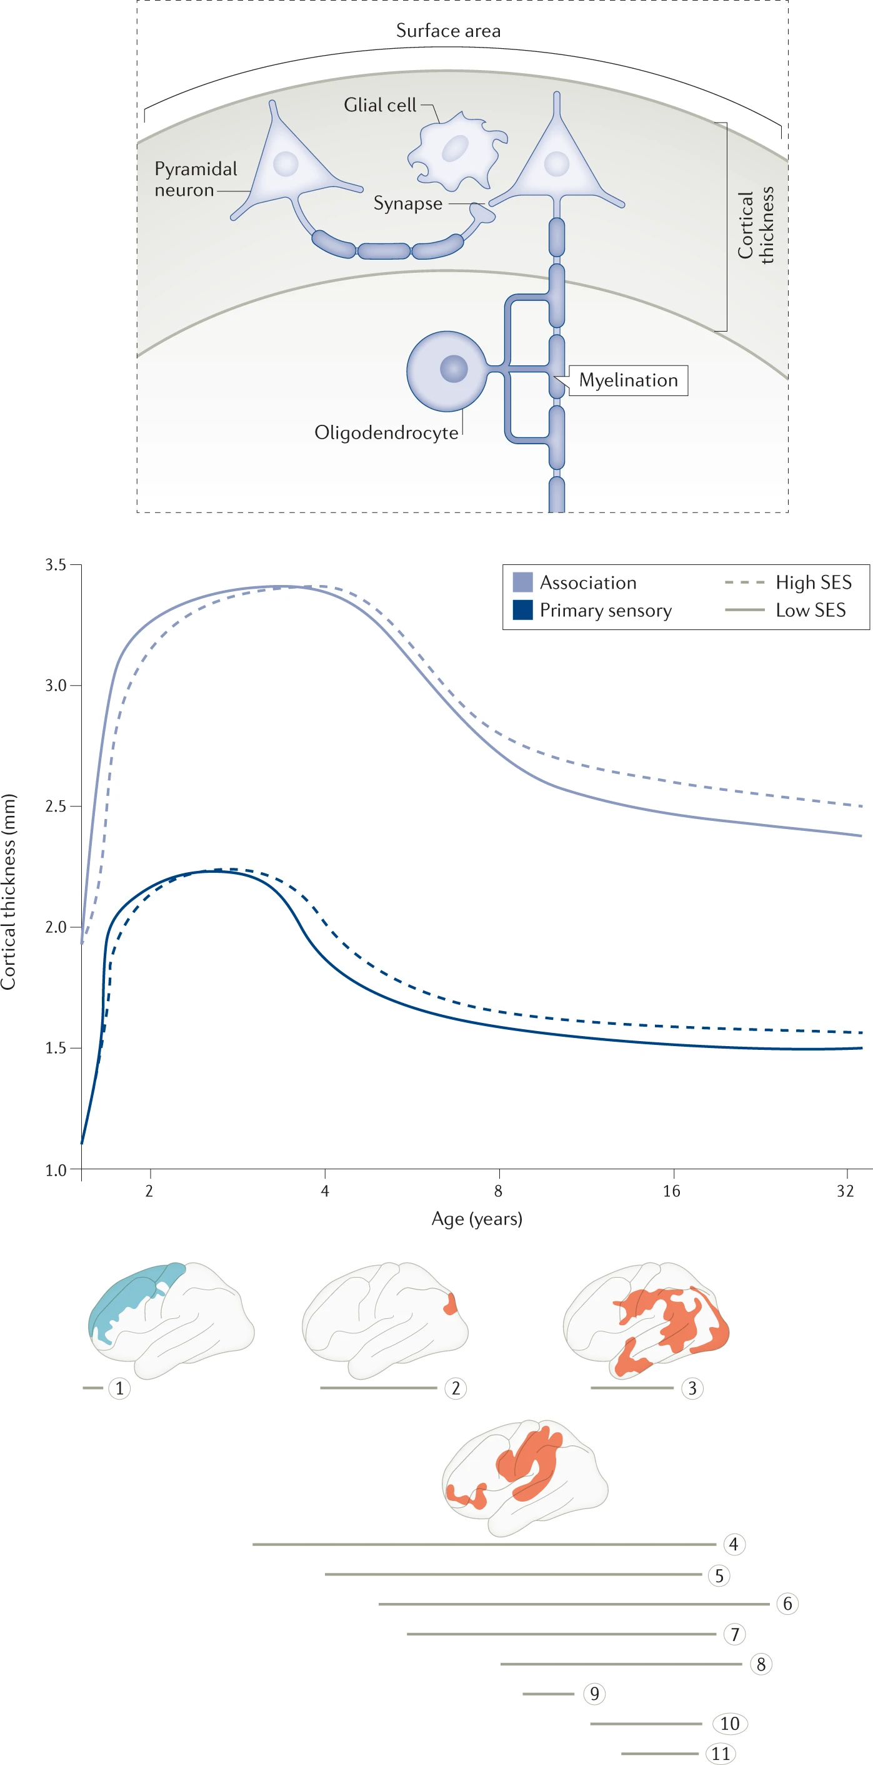
Cortical thickness (structural)
Thickness between innermost and outermost edges of cerebral cortical gray matter (Gale & Huff, 2017)
Responsible for cognitive functions- perception, attention, etc.
Associations with general intelligence
Association- complex cognitive, primary sensory- process sensory inputs
        Lower SES= steeper curvilinear decrease- accelerated cortical thinning through adolescence/adulthood
Red- positive relationships between SES and thickness
Blue- negative relationships

Slide 49
Cortical thickness (structural)
Thickness between innermost and outermost edges of cerebral cortical gray matter (Gale & Huff, 2017)
Responsible for cognitive functions- perception, attention, etc.
Associations with general intelligence
Association- complex cognitive, primary sensory- process sensory inputs
Red- positive relationships between SES and thickness
Blue- negative relationships

Slide 50
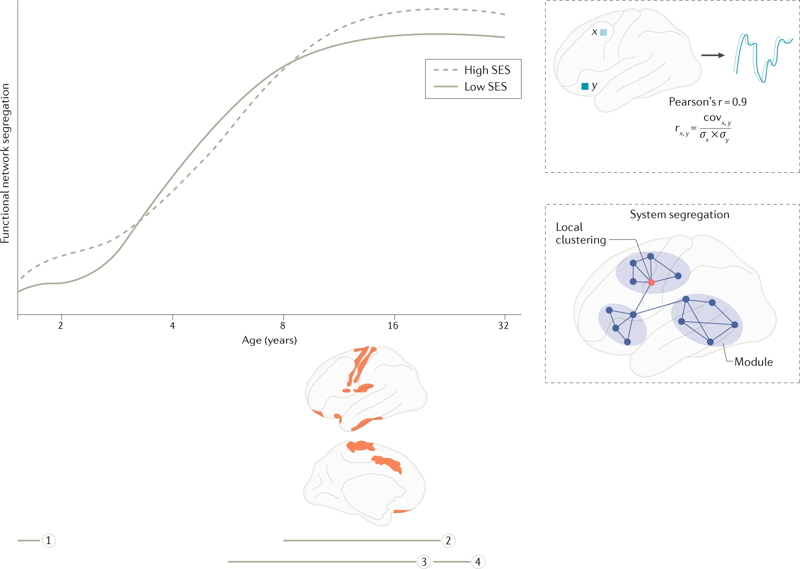
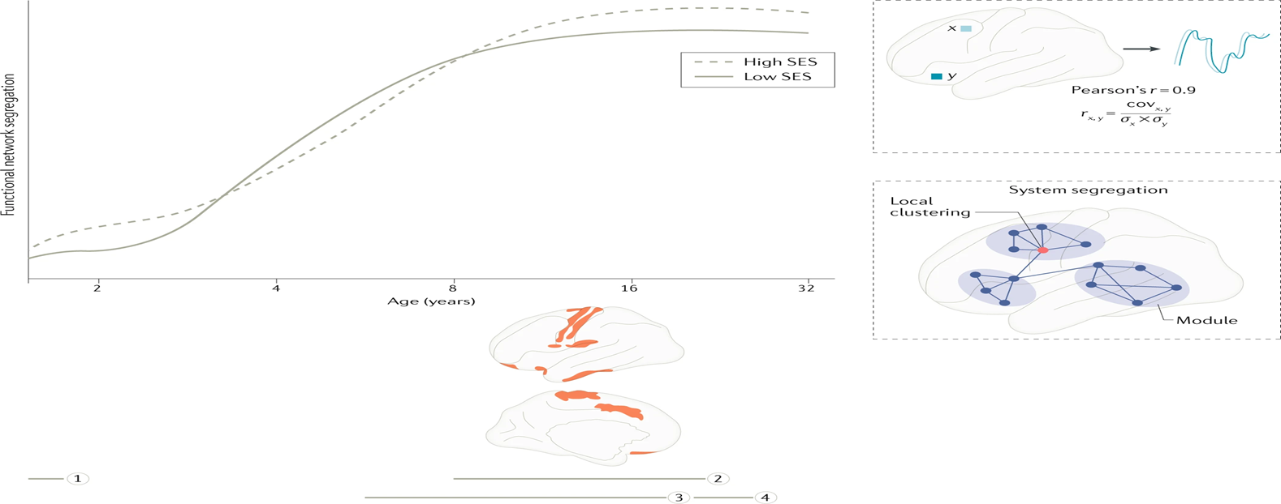
Functional network development
Benefit of resting state analyses but mixed results- lower SES, weaker connectivity
Network analysis- segregation (groups) and integration (combining information)
Association between functional network segregation at rest and cognitive abilities
Youth from high SES have more widespread connectivity and lower segregation (extended period of development), then rapidly develop a more segregated network
Higher SES –associated w/ more protracted functional network development:
Effects of SES on structural development seems to be reflected in functional development!

Slide 51
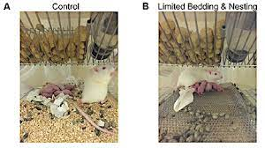
Stress as a potential mechanism
Three hypotheses
1. Repeated use of stress-detection and stress-regulation circuitry (Amygdala and medial prefrontal cortex) could lead to faster maturation
2. Stress could cause faster aging of entire body (e.g., earlier puberty)
3. Differences in threat processing= their environment requires maturity (developmental support hypothesis)
Limited bedding and nesting model in rodents- brains grow faster, cognitive impairments

Slide 52
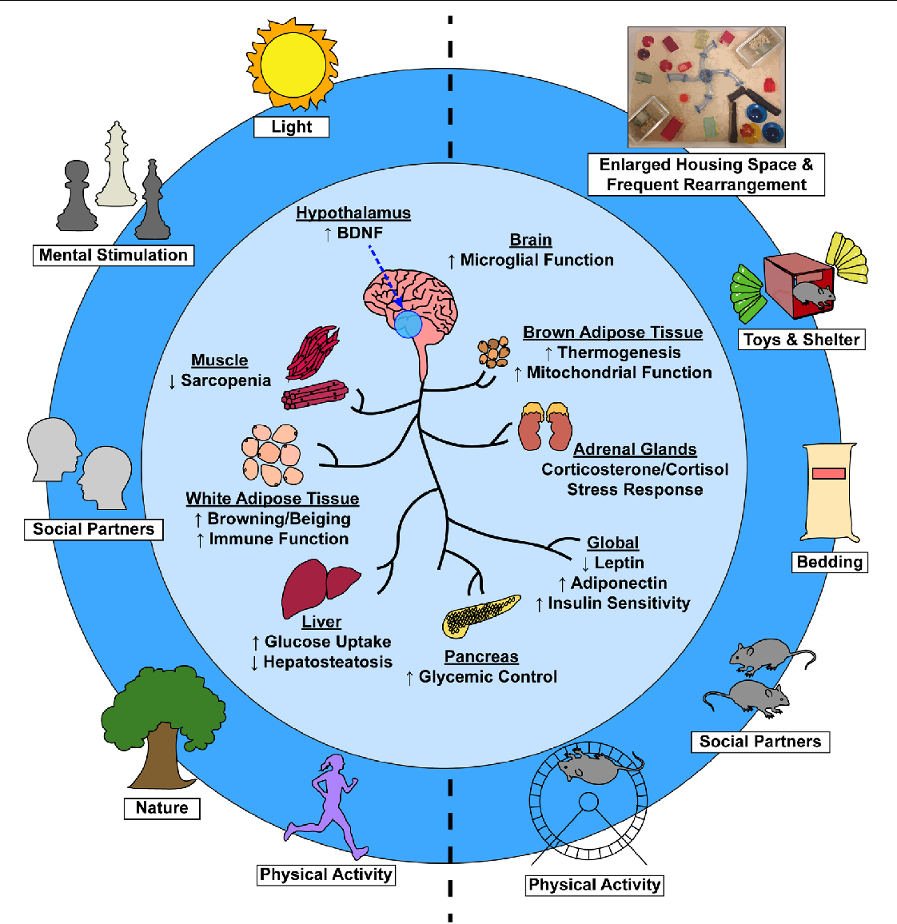
Cognitive enrichment as a potential mechanism
Cognitive enrichment- exposure to complex environment, diverse learning materials
Absence can lead to accelerate synaptic pruning
Environmental enrichment paradigms with animals
- increased cortical thickness, cortical surface area

Slide 53
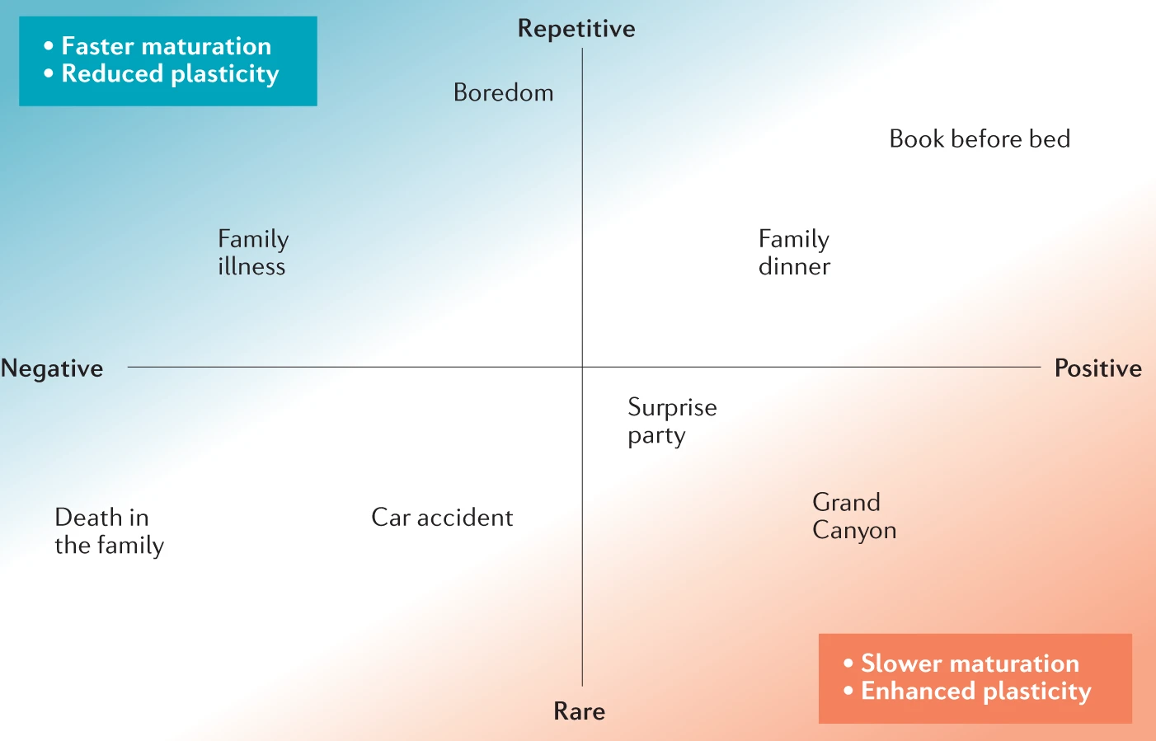
Consequences for plasticity
  Chronic, repetitive, & negative experiences encourage faster maturation, restricting plasticity
Process- changes in response to experiences throughout life
Potential- varies with age
Windows of high plasticity could close more quickly in low-SES children
Environmental enrichment prologs and enhances plasticity
  Rare, positive experience are associated with strong neurochemicals signals -> delay maturational processes and enhance plasticity

Slide 54
Future directions, conclusions, and discussion questions
Low stress exposure and high exposure to novel, positive experiences promotes longer structural brain development which leads to a longer trajectory of functional network segregation and more efficient cortical networks in adulthood
Limitations- WEIRD, cross-sectional
Future directions- network methods, integrating structural and functional data, ABCD
Could/should distinctions be made between family and neighborhood level SES?
How might this relate to equifinality and multifinality?
What role might resilience play? How could we quantify that?

Slide 55
Environmental Influences on the Pace of Brain Development
Tooley, Bassett, & Mackey; 2021
Presented by Molly Ream

Slide 56
Investigating SES and Brain Development
Childhood SES is highly related to lifelong well-being
This literature review investigates whether and how experiences associated with SES affect the pace of brain development (in addition to outcome of development)
Ream

Slide 57
Structural Development: Cortical Thickness
  Cortical Thickness
    Increases in the prenatal and immediate postnatal period
    Dendritic and axonal growth and synaptogenesis
    Different regions develop at different rates (e.g., sensory regions faster than association regions)
    Around age 2-5, cortical thinning begins (synaptic pruning, myelination), and continues through adolescence
Ream

Slide 58
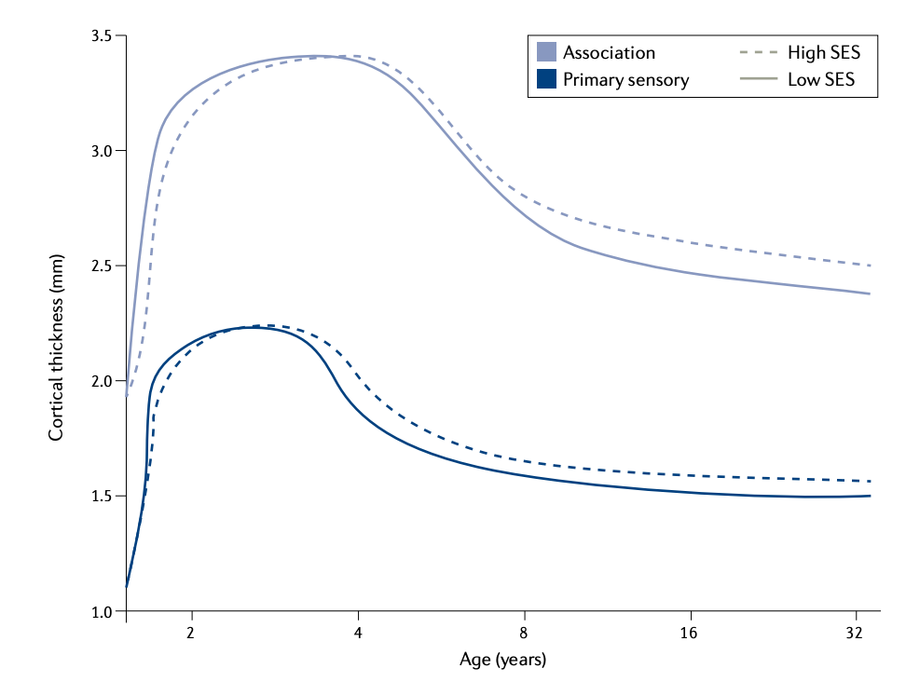
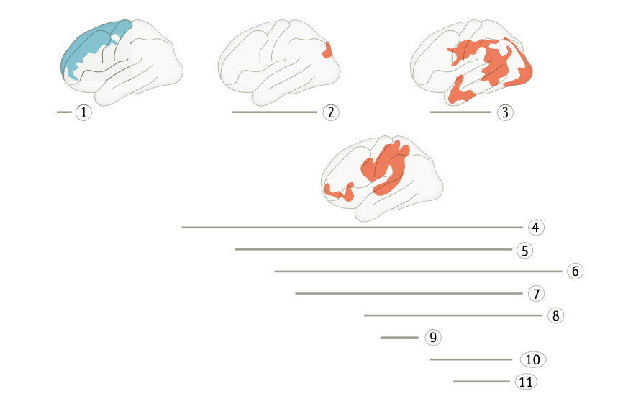
Cortical Thickness is Related to SES
    Childhood SES is associated with thicker childhood/adolescent cortex
    Evidence this effect varies with age:
      In first postnatal year, higher paternal education is associated with thinner cortex in frontal lobe
      Multiples studies show that in ages ~3-20, SES moderates negative relationship between age and thickness
        Lower SES= steeper curvilinear decrease- accelerated cortical thinning through adolescence/adulthood
Ream

Slide 59
Surface Area is Related to SES
  Cortical Surface Area and SES
    Not correlated in infancy
    Later childhood/adolescence, higher SES is associated with greater cortical surface area
    Earlier and faster brain maturation in lower SES samples
Takeaway: This cumulative evidence is consistent with the hypothesis that lower SES is associated with protracted structural development throughout childhood and adolescence
Ream

Slide 60
SES is Related to Functional Networks
  rsFMRI-> Functional Connectivity
      Network science: brain is nodes (regions) and edges (connection)
        Segregation: presence of subnetworks of densely interconnected nodes in a network
          rsFMRI segregation is related to cognitive abilities
          Higher SES –associated w/ more protracted functional network development: more widespread connectivity (thus lower segregation) early in development -> rapid development of more segregated network into adulthood
  Takeaway: Effects of SES on structural development seems to be reflected in functional development!
Ream

Slide 61
White Matter Maturation is Related to SES
  If lower SES was truly associated with brain maturation, we would expect to see differences in the pace of white matter maturation
    Higher SES is associated with higher integrity of white matter fibre tract (fractional anisotropy; FA) throughout childhood and into adolescence/early adulthood
  Can we decipher what role the environment plays?
    Measures of FA may conflate experience-expectant (age-related) myelination with experience-dependent myelination, impairing our ability to detect environmental influences on the rate of maturation.
  Other studies have investigated the role of environment with different methods…
Ream

Slide 62
Environmental Effects – Stress and Enrichment
  Lower SES is consistently associated with chronic stress
    Chronic stress exposure may accelerate brain development/cellular aging (epigenetic processes/methylation; increased glucocorticoid release, etc.)-> causal models based on animal studies
  Greater cognitive enrichment (vs. deprivation) is associated with higher SES
    Animal studies show that early enrichment enhances structural development
    Enrichment is associated with greater cognitive abilities independent of stress exposures
      SES effect on cognitive abilities has been shown to be mediated by enrichment at home
      Some models suggest that the absence of enrichment in specific domains leads to accelerated synaptic pruning in brain regions that process cognitive and social stimuli
  Takeaway: Stress seems to play a major role in the relationship between SES and brain development, but
  cognitive enrichment may be a buffer!
Ream

Slide 63
Childhood Experiences Affect the Pace 0f Brain Development: Integrative Theory
  Chronic, repetitive, & negative experiences encourage faster maturation, restricting plasticity
  Rare, positive experience are associated with strong neurochemicals signals -> delay maturational processes and enhance plasticity
Notes:
Experiences in other quadrants (rare/negative, repetitive/positive) likely have a smaller impact on the global pace of maturation

Slide 64
Events Related to SES are Associated with the Outcome and Pace of Development
Cumulative evidence cited in this literature review suggests that low exposure to repetitive stress and high exposure to novel positive experiences promote protracted structural brain development
  Gives rise to a delayed but longer trajectory of functional network segregation -> more efficient cortical networks in adulthood

Slide 65
Caveat: Current Methods are Limited!
Human studies have been primarily Western populations
Most studies cross-sectional; need longitudinal
Brain networking/segregation methods are new, greater understanding and applications of these methods needed
  Methods to integrate structural and functional data needed

Slide 66
Discussion Questions
In their integrative theory, the authors noted that acute trauma is less likely to impact brain development versus repetitive negative events. Do you think this theory would hold for children who develop PTSD following an acute trauma?
Could one investigate the causal relationship between cognitive enhancement and the pace of brain development in humans? If yes, how would you approach this?
Do you think these results may have implications beyond early adulthood (e.g., is there a relationship between later-life SES, chronic stress, and cognitive enrichment with structural/functional changes)? How might you go about studying this from a life-span perspective?
Is the variability of SES measurement approaches (e.g., household vs. neighborhood-level) used in these studies a problem in terms of generalizing findings? Why or why not?
Ream
Notes:
Alternative:
The authors acknowledge that one limitation of this body of work is that human studies have been from primarily Western populations. How might you expect these theories to change if we conducted similar studies in more diverse populations?

Slide 67
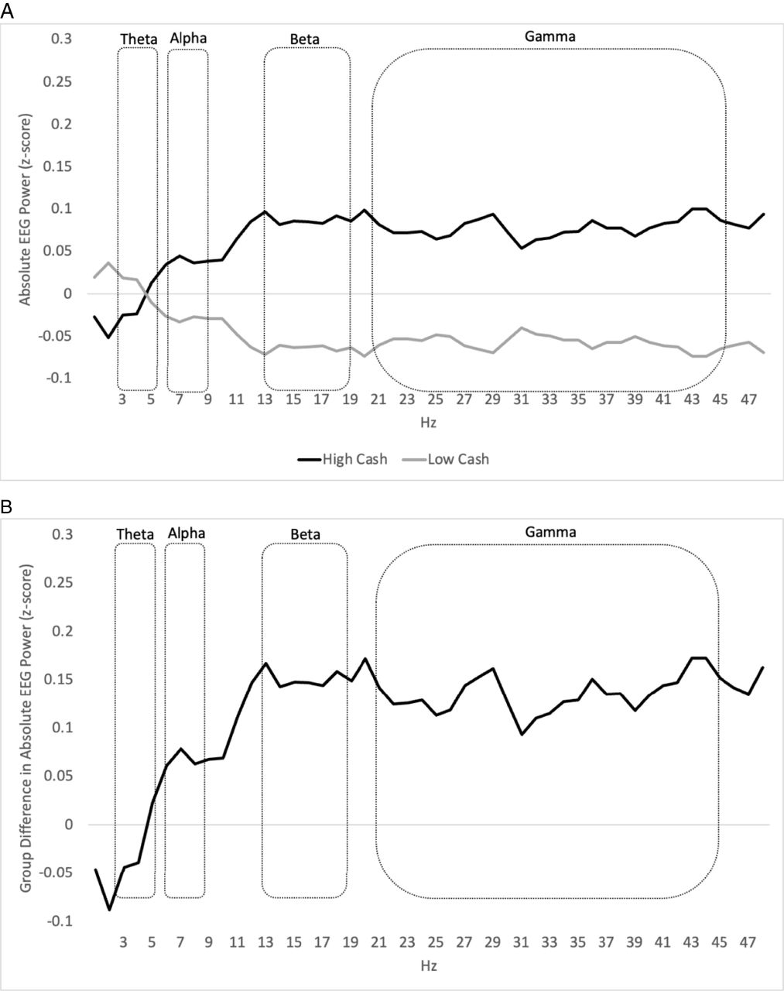
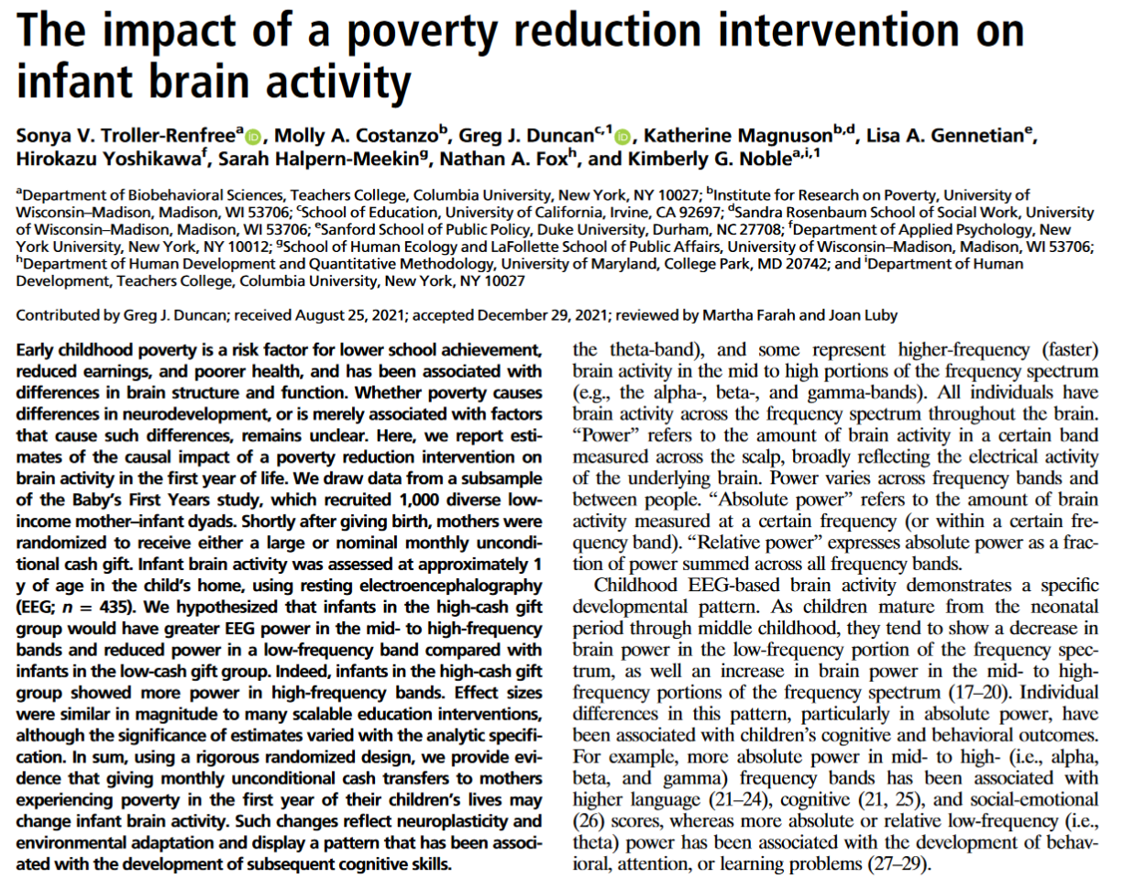

(A) Standardized mean absolute EEG power is presented separately for the high-cash and low-cash gift groups.
Sonya V. Troller-Renfree et al. PNAS 2022;119:5:e2115649119
©2022 by National Academy of Sciences
Notes:
(A) Standardized mean absolute EEG power is presented separately for the high-cash and low-cash gift groups. The high-cash gift group’s means are depicted with a solid black line and the low-cash gift group’s means are depicted with a solid gray line. The power spectrum is displayed continuously with single-hertz bins on the x axis, standardized absolute power on the y axis, and with the boundaries of the preregistered theta-, alpha-, beta-, and gamma-frequency bands delineated, demonstrating that the pattern of results is consistent across the spectra and that a small number of single-hertz bins did not unduly impact the results shown in Table 2. Because power values were standardized (z-scored) using the mean and SD of the entire n = 435 sample, the two lines are mirror images of one another. This graph is intended for illustrative purposes only and does not include adjustment for covariates; statistical testing was conducted on aggregations of single-hertz bin values within a given frequency band (e.g., theta). (B) The difference between standardized EEG absolute power (z-scores) in the high-cash vs. low-cash gift groups is depicted with a solid black line. The power spectrum is displayed continuously with single-hertz bins on the x axis, group differences in standardized on the y axis, and with the boundaries of the preregistered theta-, alpha-, beta-, and gamma-frequency bands delineated, demonstrating that the pattern of results is consistent across the spectra and that a small number of single-hertz bins did not unduly impact the results shown in Table 2. This graph is intended for illustrative purposes only and does not include adjustment for covariates; statistical testing was conducted on aggregations of single-hertz bin values within a given frequency band (e.g., theta) and is shown in Table 2.

Slide 68
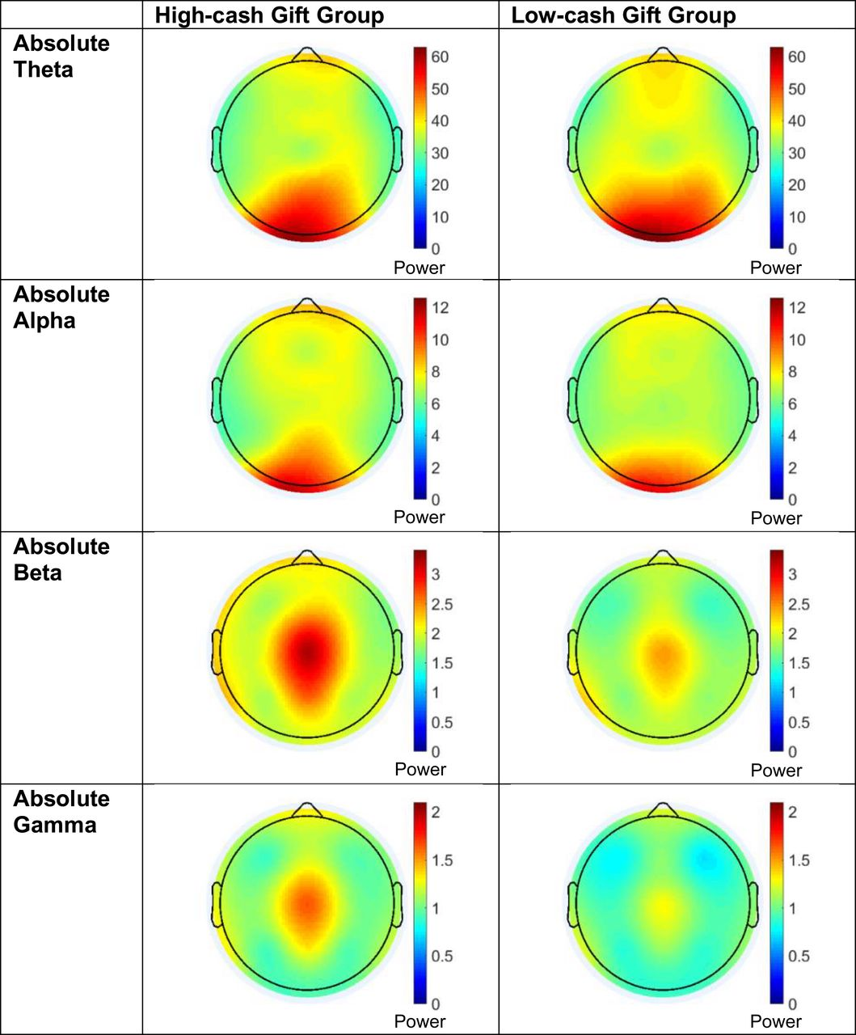
Topographic heat maps show the distribution of absolute theta-, alpha-, beta-, and gamma-power across the scalp for the high-cash gift group (Left) and low-cash gift group (Right).
Sonya V. Troller-Renfree et al. PNAS 2022;119:5:e2115649119
©2022 by National Academy of Sciences
Notes:
Topographic heat maps show the distribution of absolute theta-, alpha-, beta-, and gamma-power across the scalp for the high-cash gift group (Left) and low-cash gift group (Right). Warmer colors represent more power in each respective frequency band. Heat maps also illustrate the absence of any major artifact (e.g., remaining eye blinks). Regional differences are explored in SI Appendix, SI6. Additionally, because the EEG data are referenced to an average of the T7 and T8 electrodes, the temporal data are estimated from the surrounding electrodes for visualization purposes only.

Slide 69
[Preprint]. 2023 Feb 7:rs.3.rs-2507540. [Version 1] doi: 10.21203/rs.3.rs-2507540/v1
Unconditional Cash and Family Investments in Infants: Evidence from a Large-Scale Cash Transfer Experiment in the U.S.
Lisa A Gennetian ¹, Greg Duncan ², Nathan A Fox ³, Sarah Halpern-Meekin ⁴, Katherine Magnuson ⁵, Kimberly G Noble ⁶, Hirokazu Yoshikawa ⁷
The marginal propensity to consume child-focused items from the cash transfer exceeded that from other income, consistent with the behavioral cues in the design. We find no statistically detectable offsets in household earnings or impacts on pre-registered outcomes related to expenditures, labor supply, childcare or subjective well-being.

Slide 70

Lerner

Slide 71
Amygdala & prefrontal cortex (PFC) functioning and connectivity
Associated with emotion regulation
Early parenting can impact amygdala-PFC circuitry
  Causal evidence from animal work
    Amygdala-mediated pathway in nonhuman animals
  Correlational evidence from research with humans
Early interventions as an opportunity to causally link parenting to human brain development
Lerner

Slide 72
RCT: leveraging an early parenting intervention
Attachment and Biobehavioral Catch-up (ABC) intervention
  Targets parental nurturance and sensitivity
High-risk sample; children referred from CPS randomly assigned to receive ABC or control intervention
  Control: Developmental Education for Families (DEF) – targets motor skills, cognition, language (parental sensitivity aspects removed)
Current: fMRI sub-study
  54 children from high-risk sample
    ABC (experimental) intervention: n = 21; DEF (control) intervention: n = 20
  26 children from new sample (no intervention, no history w/ CPS)
    Low-risk (comparison group) : n = 19
Lerner

Slide 73
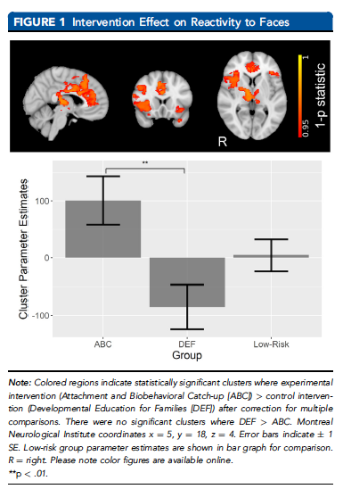
Blood oxygen level-dependent (BOLD) activation in response to face stimuli
Any face vs. Blank screen stimulus
  Block-design task
  Fearful & neutral faces combined (no group differences in fear minus neutral contrasts)
Greater BOLD activation in ABC group vs. DEF group
  Significant difference between intervention groups (p = .003)
  No significant difference for either intervention group compared to low-risk comparison group (ps > .05)
Lerner
Notes:
In clusters of brain regions included the anterior cingulate cortex, right orbitofrontal cortex, and right insula

Slide 74
Amygdala-seeded functional connectivity
Connectivity between the amygdala seed (region of activation origin) and a cluster of brain regions (including the right insula and right frontal orbital cortex).
Positive vs. Negative connectivity
Positive connectivity: direct relationship between activity in seed region and activity in connected region (e.g., as one increases the other increases)
Negative connectivity: inverse relationship between activity in seed region and activity in connected region (e.g., as one increases the other decreases)
“Amygdala-PFC connectivity”
Lerner

Slide 75
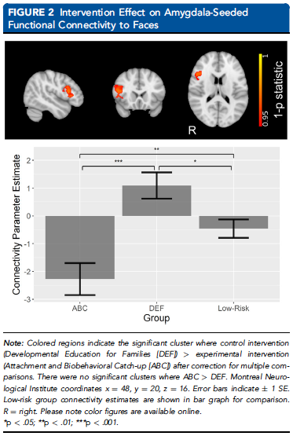
Amygdala-seeded functional connectivity in response to face stimuli
DEF group showed positive connectivity
  When PFC activity increased, amygdala activity increased (and vice versa)
ABC group showed negative connectivity
  When PFC activity increased, amygdala activity decreased (and vice versa)
  Pattern is common in adults – thoughts?
Significant intervention effect on amygdala-PFC connectivity
  ABC vs. DEF (p < .001)
  Both groups vs. zero (ps < .04)
  Both groups vs. low-risk comparison (ps < .02)
    In opposite directions
  Same pattern when using bilateral dorsal amygdala seed or left/right amygdala as separate seed regions
Lerner

Slide 76
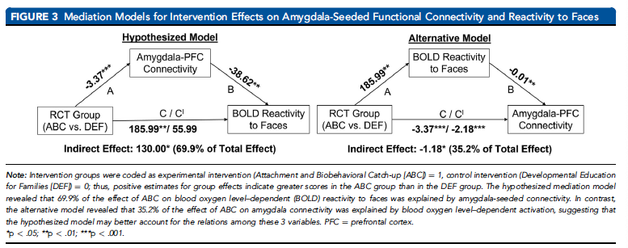
Mediating role of Amygdala-PFC connectivity
Both mediator and outcome variables measured during the same assessment
  Tested alternative model
Results support hypothesized mediation model
Lerner

Slide 77
Understanding the role of early parenting quality on amygdala-PFC function
Potentially unique impact of sensitive parenting on children’s emotional development / amygdala-PFC circuitry depending on adversity
  Why might this differ for children with vs. without a history of early life adversity?
Temporal precedence of amygdala connectivity over brain responses to emotional stimuli (study design limitation)
  Is the hypothesized vs. alternative mediation model comparison sufficient?
Greater PFC activation and Negative amygdala-PFC connectivity (inverse relation, common in adults) in children whose parents received an intervention targeting positive parent-child interactions
  What factors may be contributing?
Lerner

Slide 78
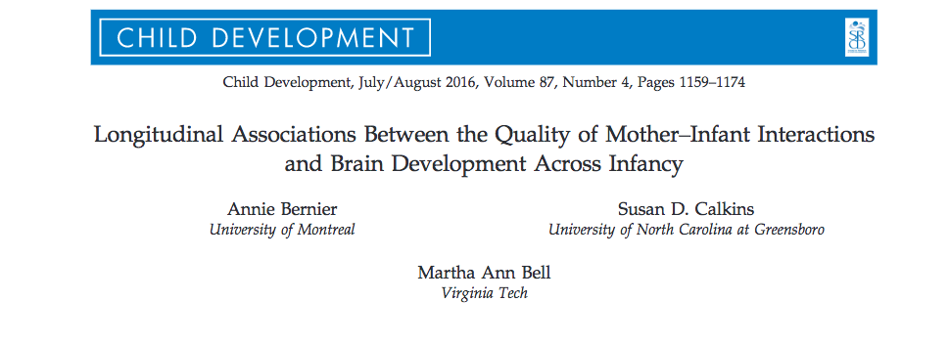
Lucette, 2017

Slide 79
Background
What is the impact on brain development?
Early caregiving relationships
Social, emotional, cognitive, biological outcomes
Lucette, 2017

Slide 80
Background
Adversity affects brain growth
  Providing a positive environment is associated with healthy brain development
No studies on the impact of normative parenting
Do normative variations in parenting affect brain development?
Lucette, 2017

Slide 81
Current study
Longitudinal study
Infant-mother dyads observed at 5 months, 10 months, 24 months
Is the quality of maternal parenting behavior related to infant brain development?
Outcomes: frontal EEG resting power and increase in frontal EEG resting power
Lucette, 2017

Slide 82
Hypotheses
Infants whose mothers showed higher quality behavior while interacting with them at 5 months will
  show higher frontal EEG power at 10 and 24 months
  show more pronounced increases in power
Lucette, 2017

Slide 83

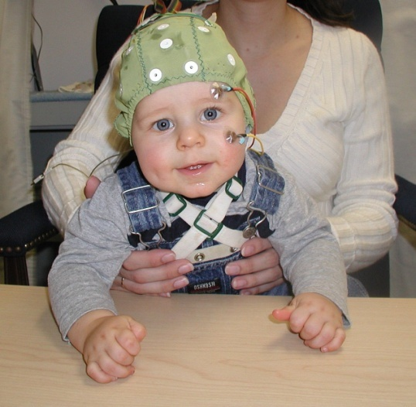

Methods
352 dyads
2 minutes mother-infant interaction
  interact with infants as they would at home at 5 months
Maternal intrusiveness and maternal positive affect
Resting EEG recorded for one minute
  Colored balls at 5/10 mos, Nemo at 24
More neural activity = more EEG power
Frontal EEG resting power is indicative of brain development
Lucette, 2017

Slide 84
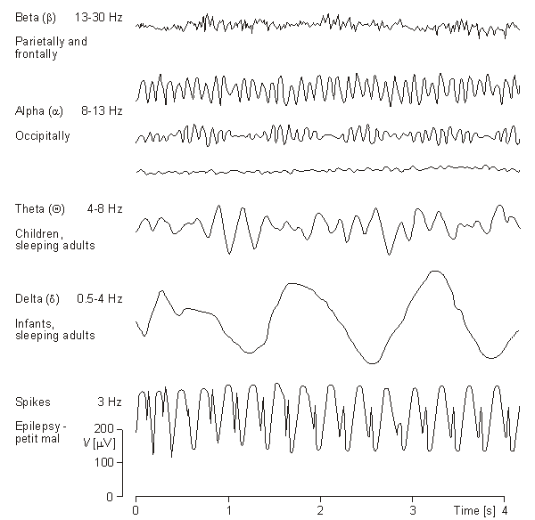
The EEG signal
Baseline/Resting EEG
  Ongoing EEG-- summation of all electrical activity occurring in the brain at a given moment
  Frequency distributions -- indicators of state (sleep/wake) and trait (arousal) marker

Slide 85
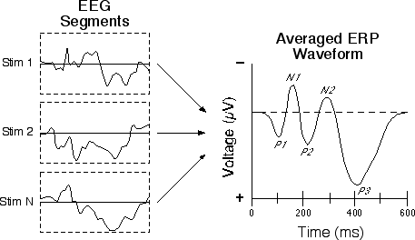
Event-Related Potentials (ERPs)
EEG data is time-locked to a specific stimulus or event and then averaged
  Averaging allows filtering of unrelated/background EEG

Slide 86

Development

Slide 87

Brain Development
Activity-dependent specialization –
  Face Processing example
    N170 to faces becomes specialized for upright faces by 12 months; prior to that elicited to inverted and upright (de Haan et al., 2002; Halit et al., 2003)
Notes:
Does not imply innateness b/c most humans have very similar pre- and postnatal environments

Slide 88
Methods
Mother-infant interaction recorded for 2 minutes
  Mothers were instructed to interact with their infants as they normally would at home
Maternal intrusiveness and maternal positive affect
Exploratory analyses
Lucette, 2017

Slide 89
Are maternal behaviors associated with EEG power?
Maternal intrusiveness not associated with EEG power
Maternal positive affect related to EEG frontal power at 10 and 24 months
Lucette, 2017

Slide 90
Maternal positive affect → age-related increases in frontal power
Maternal intrusiveness not associated with EEG power
Maternal positive affect related to EEG frontal power at 10 and 24 months
  Hierarchical regressions controlling for prior power
Lucette, 2017

Slide 91

Maternal positive affect and infant EEG activity
Bernier, Calkins & Bell, 2016

Slide 92


5 month mom positive affect → later infant EEG power

Slide 93


Maternal positive affect and infant EEG activity

Slide 94
Parenting→brain→behavioral functioning…
Normative variation in parenting quality may contribute to brain development….

Slide 95
Differential Regional Growth Rates – Adolescence (Casey et al. 2008)
Adolescence associated with increased incidence of:
  Unintentional injury
  Violence
  Alcohol and drug abuse
  Risky sexual behavior
Traditionally attributed to protracted development of PFC
  Is this explanation sufficient to explain changes in behavior?

Slide 96

Differential Regional Growth Rates – Adolescence (Casey et al. 2008)
“Treating adolescence as a transitional developmental period rather than a single snapshot in time” (p. 63)

Slide 97

Using neuroimaging to examine developmental changes in
  Reward circuitry
  Cognitive control
  Their developmental interactions

Slide 98

Individual differences and risk susceptibility
Differential Regional Growth Rates – Adolescence (Casey et al. 2008)

Slide 99


Slide 100



Variability -- mean square successive difference (MSSD)
Aims:
Test changes in MSSD across the lifespan
Test differences in MSSD between TR groups (repetition time between successive pulses)
Conduct analyses with resting-state versus task-based fmri
Jaso

Slide 101


Participants
Why do you think it is important to control for framewise displacement?
Jaso

Slide 102



Difference in MSSD between TR groups
Jaso

Slide 103


Different lifetime trajectories
Salience Network
Jaso
Notes:
Do you find any of these results surprising? What implications does this have for the way we conceptualize development or how we think about the manifestation of certain illnesses?

Slide 104


Results
What does a quadratic slope mean in terms of brain development across the lifespan?
How can we interpret these findings?
Jaso

Slide 105

Intersecting variability trajectories
Do you think this developmental trajectory of bold signal variability is congruent with the manifestation of certain neural, developmental, or psychopathological illnesses?
Can you think of any “interventions” that could change this trajectory?
Jaso
Notes:
Do you think this developmental trajectory of bold signal variability is congruent with the manifestation of certain neural, developmental, or psychopathological illnesses?

Slide 106

Kelly Shaffer

Slide 107

How low SES affects hormonal trajectories
Low SES predictive of disparate risk in multiple domains including
  Mental health
  Physical health
  Academic Achievement
Psychosocial factors alone do not account for the disparities
  Alternate pathways?
How does poverty get under our skin?

Slide 108
How does poverty get under our skin?
“Health disparities are a pressing reality of our society”
Low SES
Stress
HPA axis disturbance
Psychiatric & Physical ailments
Vigilance for Threat
Daily Home Chaos
Shaffer | Chen et al., 2009
Notes:
Lower SES more at risk for both mental and physical health problems
Depression, PTSD
Diabetes, obesity
Not random problems, but particularly those related to HPA axis disturbance
Psychological distress impacts body through “fight or flight” system
Chronic stress: chronically activated
First study to longitudinally assess how SES impacts change in physiology (HPA axis function), allowing for better understanding of how SES may produce HPA axis disturbance (and thus increase risk for later disease)
Also allows for study of mediators: HOW SES alters physiology
(1) Vigilance for threat: low SES negative events happen randomly, shown to appraise ambiguous events as more threatening
WHY WOULD THAT HAVE BEARING?
(2) Daily chaos in home environment: low SES more likely to have more crowding, noise, less predictable routines
WHY WOULD THAT HAVE BEARING? Authors didn’t discuss much (adds to stress burden)

Slide 109
Methods
54 healthy children → 50 included in analyses
IV: SES
  Family savings
  Home ownership
Mediators:
  Children’s perception of threat – Cognitive Appraisal and Understanding of Social Events videos
  Household chaos – Parent report on Confusion, Hubbub, and Order Scale
DV: Salivary cortisol – total cortisol output
Shaffer | Chen et al., 2009
Notes:
Separate models for 2 types of SES questions
Multiple measures per day – allows to measure both PATTERN (how the system is working) and MAGNITUTE (how MUCH system is working)
Analyses they report is on total system volume

Slide 110

SES and Cortisol
Shaffer | Chen et al., 2009
Notes:
Does anyone want to take whack at interpreting this?
Lower SES households showed steeper increases over time
Predicted significantly by both family savings and home ownership
Intercepts: only home ownership differentiated intercepts
So, both family savings and home ownership are indicators of how much you’ll increase with time, but only home ownership is related to lower starting cortisol
Meaningful in any way?

Slide 111
SES and Cortisol Moderated by Threat Interpretation and Chaos
Low SES
Higher Home Chaos
Greater HPA output
Threat Interpretation
Shaffer | Chen et al., 2009
Notes:
When include both moderators, only home chaos remained as significant mediator

Slide 112


SES and Cortisol Moderated by Threat Interpretation
Both home ownership and family savings became nonsignificant predictors of total cortisol output when threat interpretation included in model
Reduced effect of SES by about 40%
Both home ownership and family savings became nonsignificant predictors of total cortisol output when threat interpretation included in model
Reduced effect of SES by about 40%
Both home ownership and family savings became nonsignificant predictors of total cortisol output when threat interpretation included in model
Reduced effect of SES by about 40%
Shaffer | Chen et al., 2009
Low SES
Higher Threat Interpretation
Greater HPA output
Notes:
Both home ownership and family savings became nonsignificant predictors of total cortisol output when threat interpretation included in model
Reduced effect of SES by about 40%

Slide 113
SES and Cortisol Moderated by Chaos
Low SES
Higher Home Chaos
Greater HPA output
Shaffer | Chen et al., 2009
Notes:
Same findings when Chaos only
Reduced effect of SES by about quarter to a third

Slide 114

Perceptions of threat as a mediator
‘Less family savings was associated with greater child threat interpretations, r(49) = –.47, p < .01.
Similarly, children living in rented homes made greater threat interpretations, t(47) = 2.88, p < .01 (see Fig. 2).
In turn, greater threat interpretations predicted larger increases in cortisol AUC over time (b = 0.3698, SE = 0.1853, p = .05).’

Slide 115
SES and Cortisol Interactions
Low SES
HPA axis disturbance
Girls > Boys
Post-Puberty > Pre-Puberty
Shaffer | Chen et al., 2009
Notes:
Stronger effect of SES on cortisol among certain subgroups of children
Girls – suggest hormonal system among women may be more impacted by social environment
Post-puberty – suggest SES may take more time to accumulate (those post-puberty had more impact)

