Slide 1
Advanced
Developmental
Psychology
PSY 620P

Slide 2
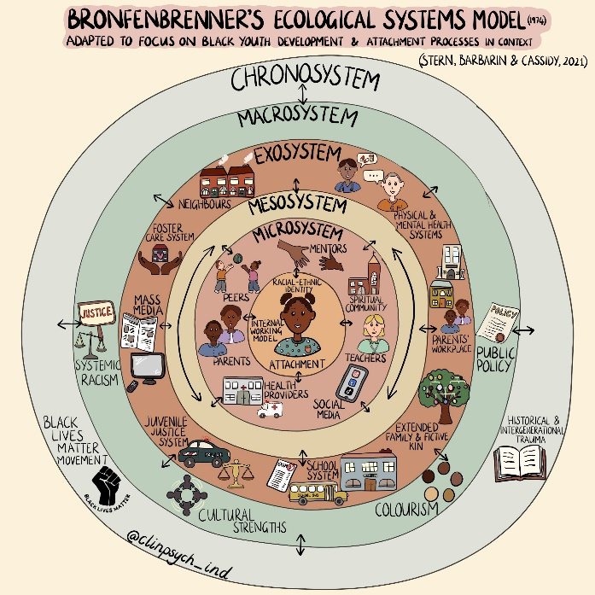
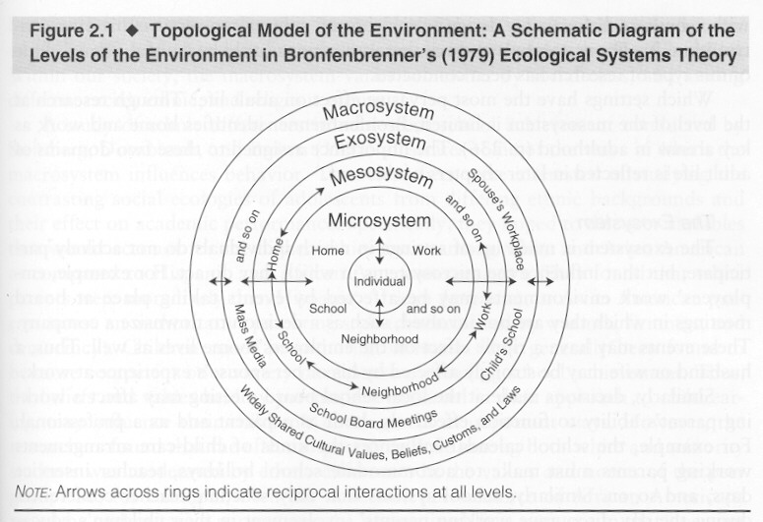
Socialization Processes
Parent-child relationships
Peer relationships
School and community influences

Slide 3

Peer Relationships - Overview
Peer sociality overview
Behavioral inhibition & social reticence
Friendships, Peer Groups
Sociometry, popularity, and context
Acceptance vs. Rejection
  Causes and Consequences
Peer victimization
  Deviant peer affiliation thru externalizing
      Rudolph
  Deviant peer evaluation and adolescent outcomes
      Schwartz
Friends
  Protective effects
  Influence
Friends
  Friendship dissolution
  Homophily (mechanisms and extent)
  Children in ethnically diverse classrooms and those with cross-ethnic friendships excel at understanding others' minds. Alex.
Becoming a sexual being
Development of social participation (Parten)

Slide 4
Theories
Sullivan emphasized pre-adolescent chumships as foundation of intimacy and precursor to romantic coupling
Piaget emphasized moral development occurring during give-and-take with peers
  rather than obedience to, or rebellion against, adults

Slide 5
Early development
Infants have rudimentary abilities (to 1 yr)
  I.e., increased gazing at peers
Toddlers
  Imitate and are aware of being imitated
    Sister dance https://www.youtube.com/watch?v=mfzD_kwUXwM
    Toddler imitates Rocky video, https://www.youtube.com/watch?v=yCt89VSRe4w
    Baby copies brother (prompted) https://www.youtube.com/watch?v=4AQMygJwutQ
    Baby copies brother poetry recital https://www.youtube.com/watch?v=TxEbMDLTwlk
  Have reciprocal relationships with specific kids
    Babies imitating fathers https://www.youtube.com/watch?v=-y4XHz4d6UU unavailable

Slide 6
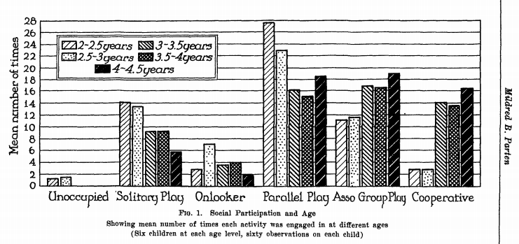
Middle childhood
& school
Peer interaction rises and changes
  10% (3 y olds) to 30% (middle childhood)
  Peer group increases and is less supervised
Friendship develops
  Friends more likely to resolve conflicts with eye toward protecting relationship
Groups emerge
  As does understanding of role and status in group

Slide 7
Adolescence
29% of waking time with peers
  Out of classroom
Friendship
  Autonomy granting and increased intimacy
Groups
  Single sex cliques mesh into looser mixed-sex groups
Crowds
  Druggies, loners, brains, jocks
  Increasingly prominent aspect of social life

Slide 8
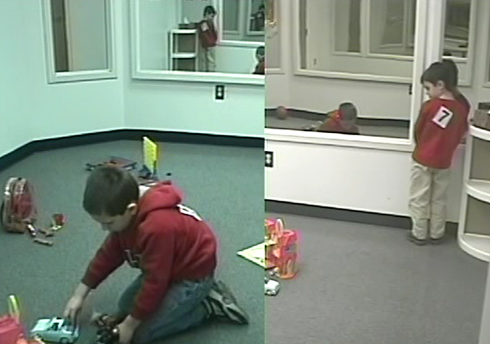
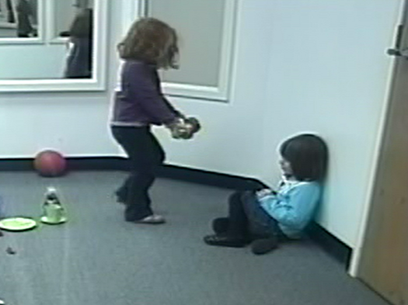
Peer Relations
Is a child who spends a lot of time playing alone necessarily at risk?
    Examples of different forms of nonsocial play

Slide 9
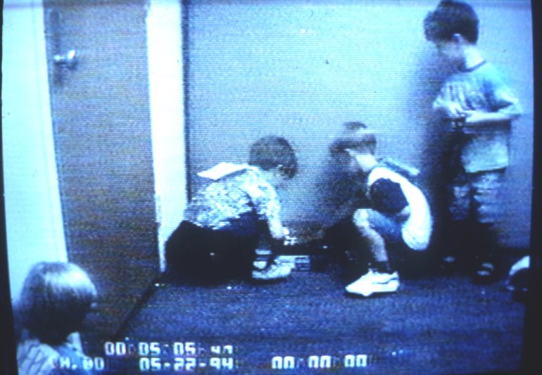
Notes:
VIDEO_TS 9:16

Slide 10
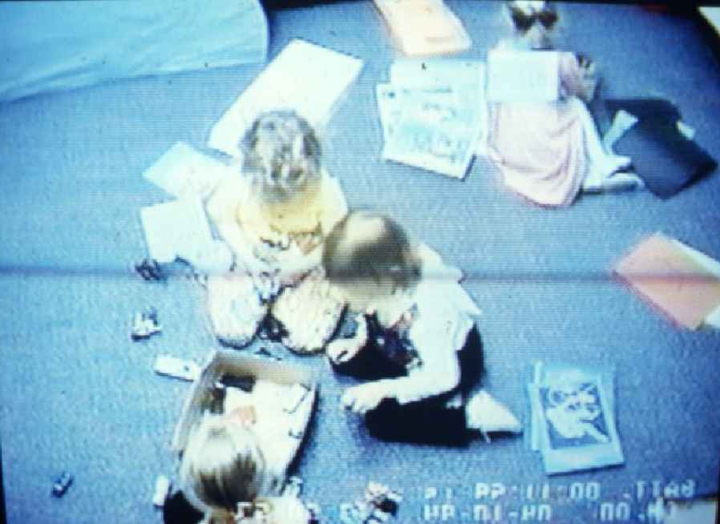

Slide 11
Coplan et al. (2004) Methods
2 samples of preschool-age children (~50 mos.)
Parents reported:
  Conflicted Shyness, Social Disinterest (both), questions about child’s temperament (S1), parenting style (S2), and maternal social goals (S2).
Teachers rated preschool adjustment with peers.
Sample 1: Coded observations of free play time
Sample 2: Perceived social competence & play preference (alone, with peer, with teacher)

Slide 12
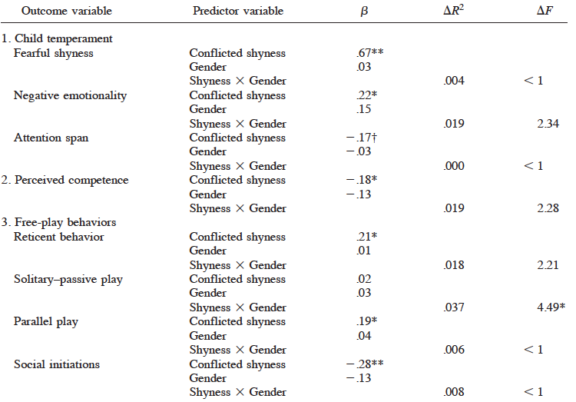
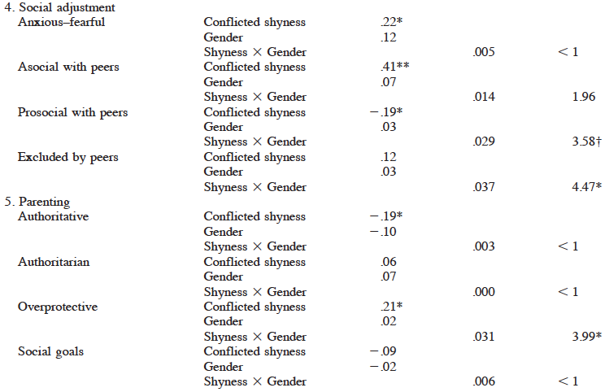
Shyness

Slide 13
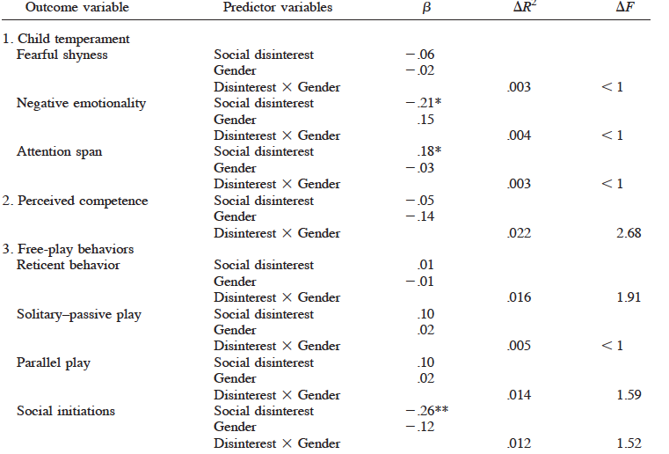
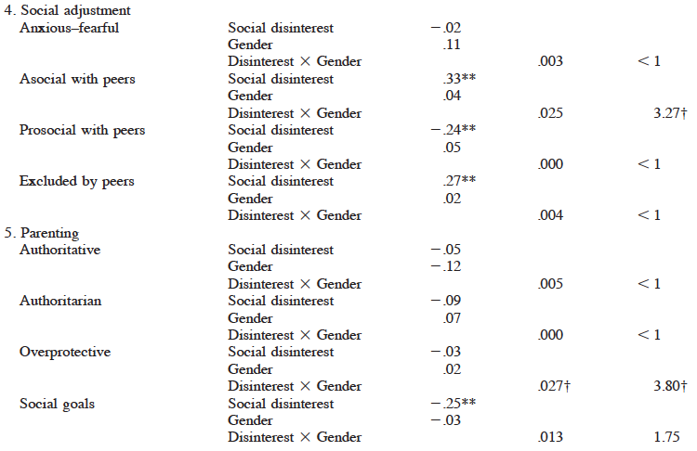
Social
Disinterest

Slide 14
Differing forms of solitude
(Coplan et al., 2004)
Relations of different forms of solitude to:
  Parenting – social goal orientation
  Child temperament
  Child play behaviors
  Self-perceived competence
  Teacher ratings
Primary IV
  Parent reported:
    Conflicted shyness
    Social disinterest

Slide 15
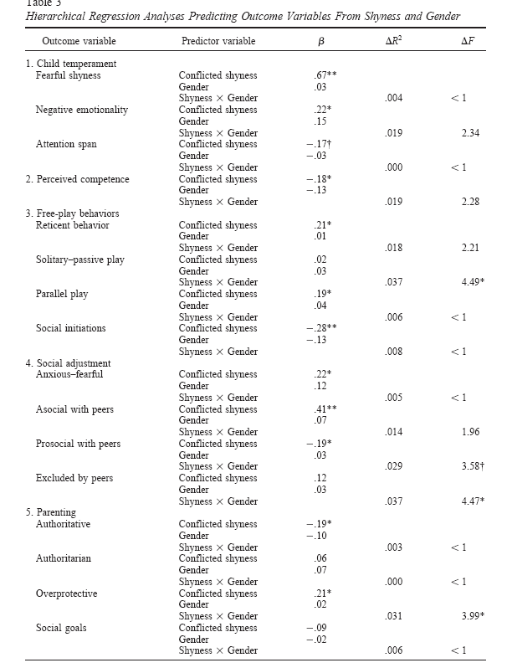
Conflicted
Shyness

Slide 16
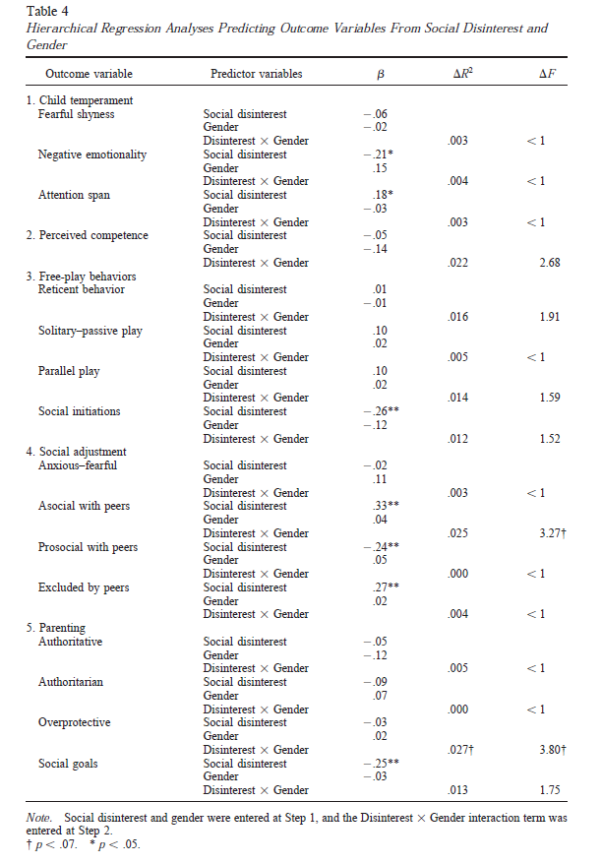
Social disinterest

Slide 17
Distinguishing conflicted shyness from social disinterest @ 3-5 years
Conflicted Shyness
  High approach + high avoidance
  Want to play, but are too fearful or anxious
    Overprotective parenting may be a contributing factor.
    Related to later maladjustment
    Puts boys at greater risk than girls
Social Disinterest
  Prefer to play alone but willing to engage
  Low approach + low avoidance
    Often not distinguished from shyness
    Participation in solitary activities →later internalizing
E.g., Three forms of social withdrawal in early childhood. Coplan & Armer
Coplan et al. (2004) Intro

Slide 18

Three forms of social withdrawal in Early Childhood
Coplan & Armer
Shyness
  Wariness/anxiety due to social novelty and perceived evaluation
    Behavioral inhibition, linked to maladjustment across lifespan
      Extreme shyness (Boys)
    Protective: language ability, high-quality friendship
    Risk: parental overprotection, negative emotional climate classrooms
Social Avoidance
  Low-social approach and high-social avoidance
  Extreme fearful shyness? Pre-cursor to child depression?
Social Disinterest
  “Non-fearful” preference for solitary play, unsociability
  Independent of shyness; relatively benign?
    Association: solitary play & peer rejection/internalizing problems
    Solitary play not a sufficient indicator of social disinterest?

Slide 19
Individual differences in friendships
  Shy/Withdrawn Children
    Equal number and stability of friendships
    But those who lack best friend or have best friend who is equally shy may be at increased risk for later problems
    Harder for shy boys?
  Aggressive
    Equal number of friendships but less stable

Slide 20
National social context effects
Pronounced role of peer group in Cuban society regulating social behaviors.
  Withdrawal associated with loneliness Cuba > Canada
  Aggression a correlate of loneliness in Cuba
Social withdrawal and maladjustment in a very group-oriented society. Valdivia, Ibis Alvarez; Schneider, Barry H.; Chavez, Kenia Lorenzo; Chen, Xinyin International Journal of Behavioral Development. Vol 29(3), May 2005, 219-228.
Notes:
Sociometric, 4 & 6 grade, 2 cohorts.

Slide 21
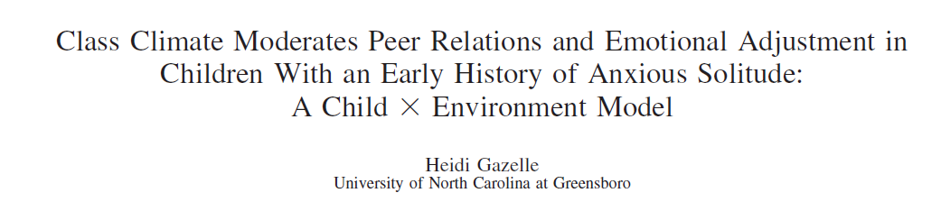
Classroom Context
“Children with an early childhood history of anxious solitude were more rejected, poorly accepted (boys), and victimized (girls) by peers and demonstrated more depressive symptoms (girls) in 1st-grade classrooms with a negative observed emotional climate.”

Slide 22
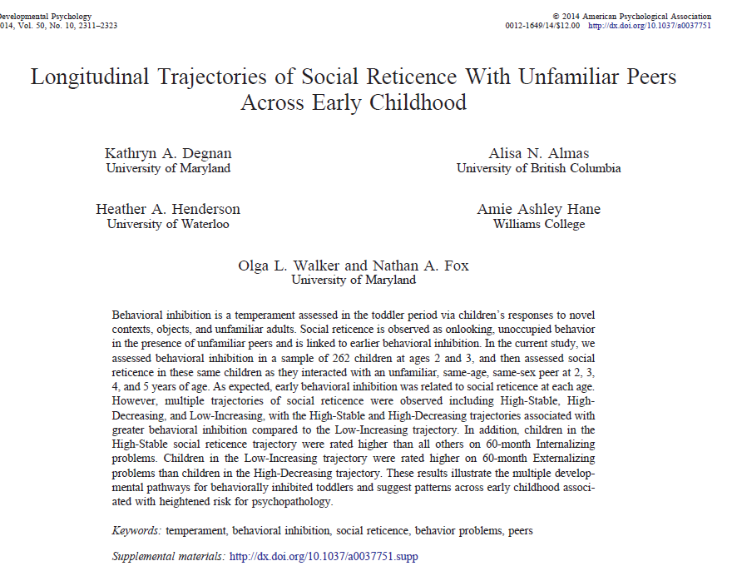

Slide 23
Background
Behavioral Inhibition (BI)
  Temperament assessed in toddler period
  Wariness of novelty/uncertainty (i.e., novel contexts, objects, unfamiliar adults)
Social Reticence (SR)
  Onlooking, unoccupied behavior in presence of unfamiliar peers
  Do not engage in social or solitary play
BI has been linked to child and adolescent SR and social anxiety but ..
  not all end up experiencing such outcomes
  Less than 1/3 of sample displayed both behavior patterns at 2 years
    Many patterns that do exist do not hold from ages 2-4 years
    BI and social reticence also linked to anxiety disorders in later childhood
AIM
  Examine differential trajectories from BI (temperament) to behavioral consequences (SR and psychopathology)

Slide 24
Longitudinal Method
    Participants:
        315 total in sample (199 complete data)
        selected for temperamental reactivity to novelty at 4 months, both high and low reactive, and both positively and negatively reactive
      Behavioral Inhibition (24 & 36 months)-
        assessed behavior and affect using BI paradigm (stranger, robot, and tunnel tasks)
        composite BI measure created for toddlerhood (average score)
      Social Reticence (24, 36, 48, & 60 months)-
        interacted in laboratory with unfamiliar peer
          (free play, cleanup, and social problem solving tasks)
        composite SR measure created based on social wariness from free play, proportion of time unoccupied on looking from cleanup, and proportion of passive problem-solving techniques used (average score)
      Behavioral Outcomes (Psychopathology at 60-months or 5 years)-
        mothers report behavior problems (symptom measures)- CBCL, HBQ
        externalizing & internalizing composite scores created from subscales of measures

Slide 25
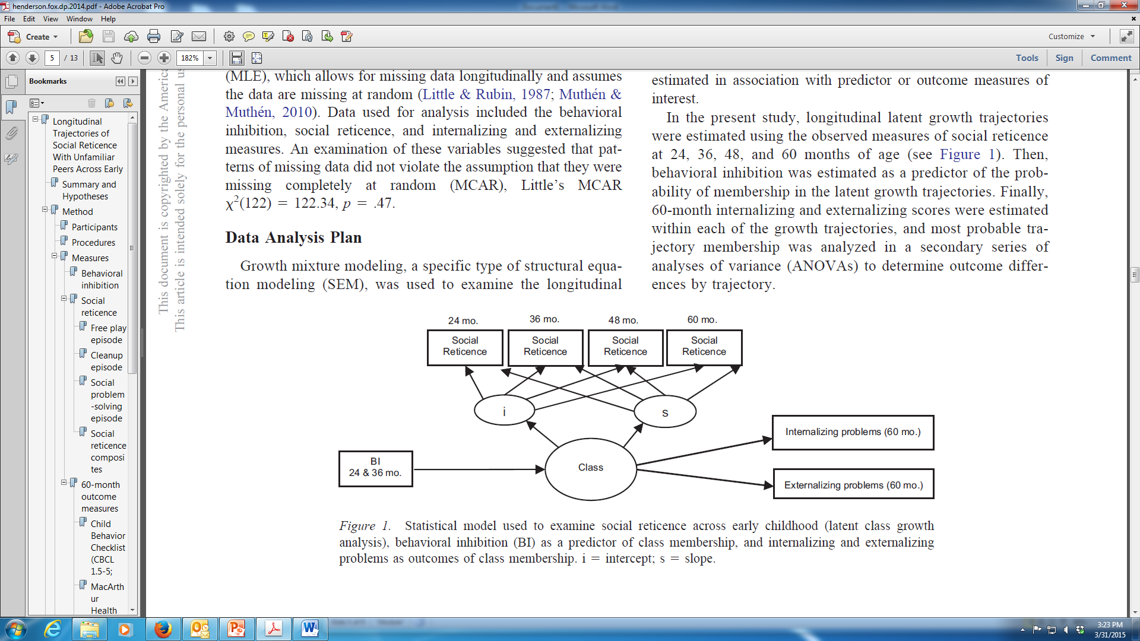
Growth mixture modeling (SEM) of trajectories of social reticence
  Latent growth trajectories estimated using SR measures at 4 time points
  BI then estimated as predictor of probability of membership to latent growth trajectory
  Symptom-based psychopathology measures estimated within each growth trajectory and most probable trajectory membership analyzed secondarily using ANOVA

Slide 26
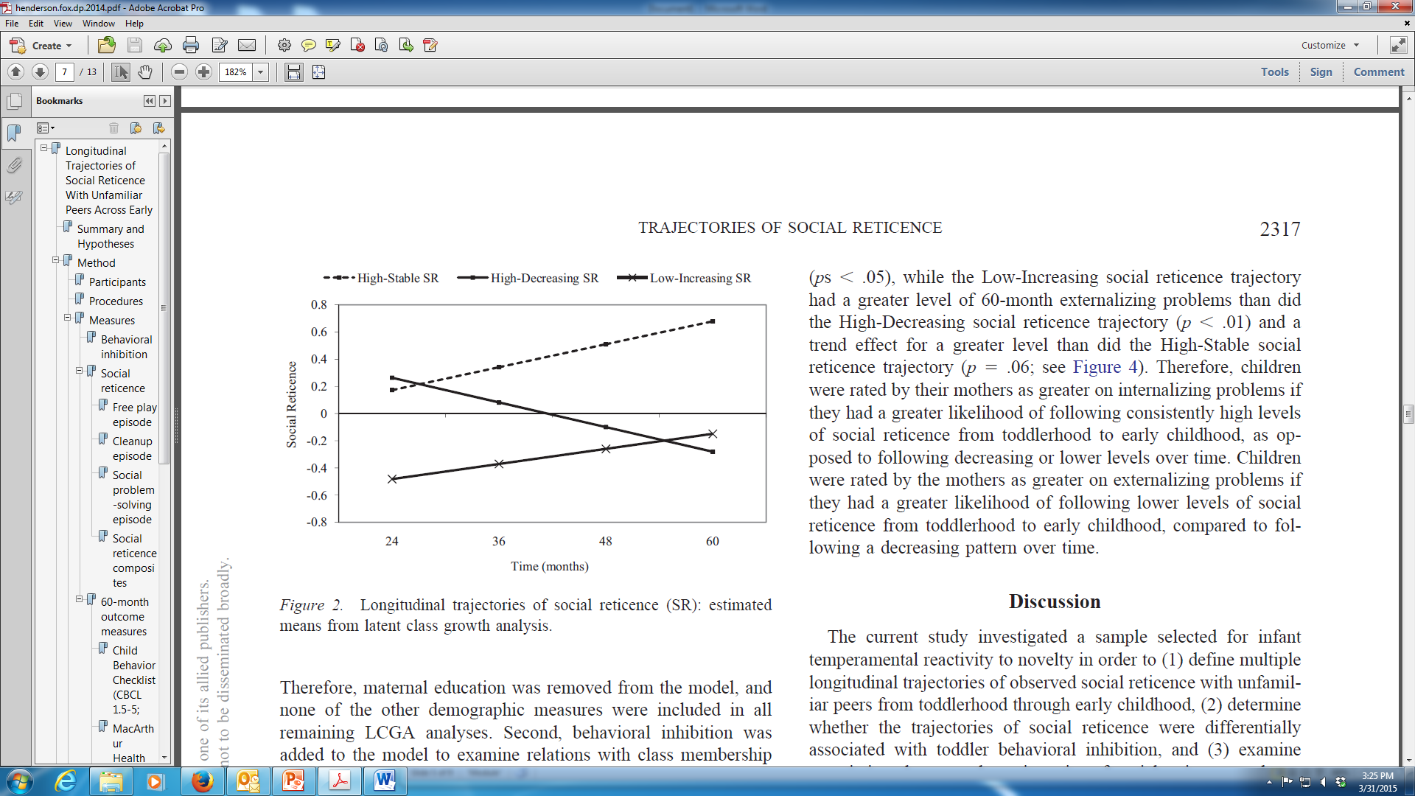
Social Reticence (SR) Trajectories
Onlooking, unoccupied behavior with unfamiliar peers; No/low social or solitary play
3 Class Model of Social Reticence Trajectories
High-Stable (n=43, 16% of sample): High level of social reticence at 2 years, with consistently higher levels and small increase over time
High-Decreasing (n=112, 43% of sample): High level of SR at 2 years, with significant decrease over time
Low-Increasing (n=107, 41% of sample): Lower level of SR at 2 years, with significant increase but still consistently low SR over time

Slide 27
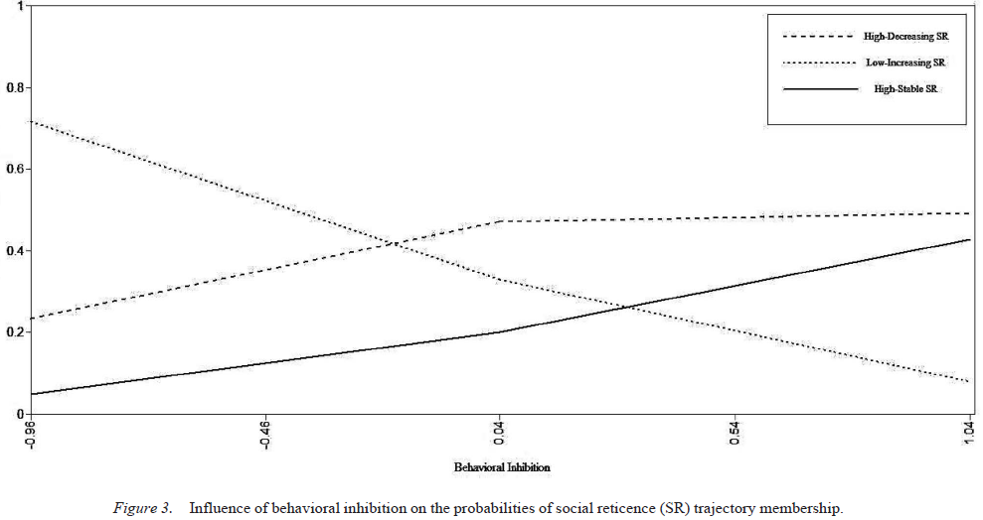
BehavioraI Inhibition → Probability of Social Reticence Trajectory?
High-Stable/High-Decreasing SR > BI than Low-increasing SR trajectory
  BI did not
As BehavioraI Inhibition increases, probability of High-Stable & High-Decreasing SR trajectories rises – probability of Low-Increasing SR trajectory decreases not differentiate between High-Stable and High-Decreasing
Temperament assessed in toddler period
Wariness of novelty/uncertainty (i.e., novel contexts, objects, unfamiliar adults

Slide 28
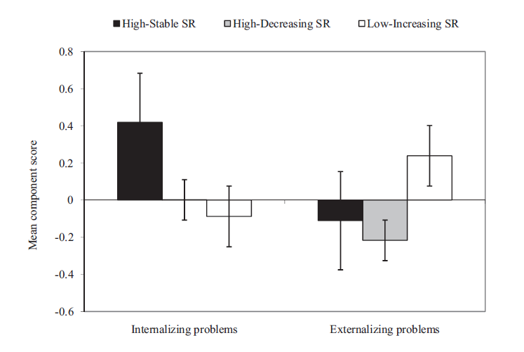
SR Trajectory Predicts Psychopathology Symptoms
High-Stable SR trajectory predicted greatest internalizing problems
Low-Increasing SR trajectory predicted greatest externalizing problems
High-Decreasing SR trajectory predicted least problems
continua
** But all very much subclinical

Slide 29
Peer group as socialization context
  Cooperative activity in support of collective goals
  Skills associated with leading and following
  Regulation aggression/hostility
  Group loyalty

Slide 30
Middle childhood
& school
Peer interaction rises and changes
  10% (3 y olds) to 30% (middle childhood)
  Peer group increases and is less supervised
Friendship develops
  Friends more likely to resolve conflicts with eye toward protecting relationship
Groups emerge
  As does understanding of role and status in group

Slide 31
Peer Groups: Cliques vs. Crowds
5 or 6 same-sex peers
Middle childhood → cliques
  Provide psychological support for autonomy
  Intimate, friendship-based groups
Adolescence →larger crowds
  Provide context for identity formation
  Reputation-based groups
  Defined by shared attitudes and activities
  Less intimate
Notes:
Stereotypical and biased reasoning about characteristics of crowd members; biased use of reputational or stereotypical information about particular groups; crowd specific evaluations help perpetuate group stereotypes
Crowds and importance of crowds declines later in adolescence; dating relationships leads to mixed sex cliques; also decline in importance once adolescents create their own personal values and morals; no longer need to have identity defined by particular social group membership

Slide 32
Adolescence
29% of waking time with peers
  Out of classroom
Friendship
  Autonomy granting and increased intimacy
Groups
  Single sex cliques mesh into looser mixed-sex groups
Crowds
  Druggies, loners, brains, jocks
  Increasingly prominent aspect of social life

Slide 33
Social status:
Sociometric nominations
Each child in class asked to name 3 - 5 peers:
  Like the most
  Like the least
High Disliking
(Rejection)
Like?
Few
Many
Rejected
Kids
Controversial
Kids
Neglected |  | Popular
Rejected |  | Contro- versial
Few
Low Liking
High Liking
(Acceptance)
Average
Dislike?
Neglected
Kids
Popular
Kids
Many
Low Disliking

Slide 34
Neglected, popular
Neglected kids
  Less interaction of all types
  Social competence reports = average kids
Popular kids
  High prosocial behaviors, low aggression
Rejected kids
  40=50% are aggressive

Slide 35
Behavioral Correlates of Peer Acceptance
Popular kids
  High prosocial behaviors, low aggression
Neglected kids
  Less interaction of all types
  Social competence reports = average kids
  Not necessarily associated with anxiety or extreme withdrawal
Sociometrically Controversial
  Mix of + & - social behaviors
Rejected kids
    May be associated with aggression
      As cause or consequence
High Disliking
(Rejection)
Rejected
Kids
Controversial
Kids
Low Liking
High Liking
(Acceptance)
Neglected
Kids
Popular
Kids
Low Disliking
Notes:
Perceived popular = dominant, aggressive, stuck-up

Slide 36
Social Exclusion: Hypothetical Stories vs. Observed in Lab
“What would you do?”
  Responses coded as:
    Assertive
    Indirect
    Withdrawal
    Redirect
Real life exclusion – Ball Toss Game
What does child do?
  Responses coded as:
    Assertive
    Indirect
    Withdrawal
    Redirect
Video examples
Notes:
DYAD 73 Child 6 – Interview.
Individual Visit Interview – BIKE STORY 1:45-2:31; TAG STORY 4:30-5:10
Dyad Visit Ball Toss – 54:00-56:15= Ball Toss-- 14:09

Slide 37
Relative
Relation between behavior and popularity depends on whether behavior is normative
  Chinese popularity highlights (highlighted?) reticence
  Friendship possibilities depend on similarity to group
Cross-cultural work needs to be done
  Cross-age groups understudied?
Sex differences less pronounced than might be expected

Slide 38
Peer Acceptance – Methodologies
Peer-perceived popularity
  Select kids in your class you think are:
    Popular
    Unpopular
Little agreement between sociometric ratings and perceived popularity ratings
  Why?
Notes:
Practicality—need consent from all participants on list; and all within school system

Slide 39
Conceptualization & measurement
  Peer-nomination procedure (quantitative)
    like most - like least
    most popular - least popular
  No a priori definition
  Social power of perceived popularity (qualitative)
Social behaviors
  Aggression
    Overt
    Relational
  “model” vs “tough”
  Differences due to age & gender

Slide 40
Child Behavior Assessments
Peer assessment
  Nominate peers who show specific behaviors/characteristics
    Good leader?
    Gets into fights?
    Plays alone?
Teacher assessment
  Relatively good agreement with peer reports on aggression and sociability

Slide 41
Popularity within Peers
Sociometrically nominated: Tim
  Well liked by others
  High prosocial & cooperative behaviors
  Low aggressive behaviors
Perceived popular: Jason
  Well known, socially central & emulated
  High prosocial behaviors
  High aggressive & antisocial behaviors

Slide 42
Behavioral Correlates of Peer Acceptance
Sociometrically Popular
  Skilled at initiating and maintaining positive relationships
  Able to share frame of reference with new group; cooperative
  Engage others vs. draw attention to self
  Negotiate and compromise in conflict
vs. Perceived Popular
  = dominant, aggressive, stuck-up?
Notes:
Perceived popular

Slide 43
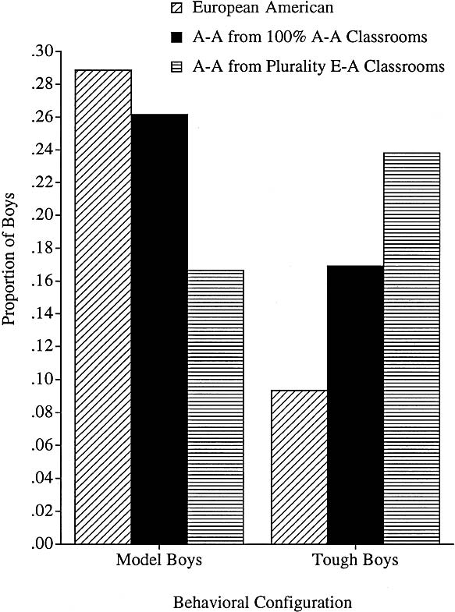
Antisocial & prosocial popular boys prominent classroom groups
Popular pro-social boys
  High Academic, Affiliative, Popular, Winning
Popular anti-social boys
  High Aggressive, Popular, Winning
Differentiated by teacher ratings
  And self & peer nominations
      Rodkin & Farmer. (2000). Heterogeneity of Popular Boys: Antisocial and Prosocial Configurations. Developmental Psychology, 36(1), 14-24

Slide 44
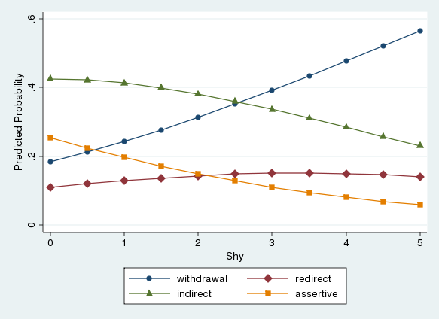
Shyness only related to observed responses….not self-reports
Walker et al., revision under review
Notes:
Dyad 73 Ball Toss;
Individual Visit Interview – BIKE STORY 1:45-2:31; TAG STORY 4:30-5:10
Dyad Visit Ball Toss – 54:00-56:15

Slide 45
Peer Acceptance and
Social Outcomes
Aggressive rejection predicts externalizing problems
Anxious/withdrawn rejection predicts internalizing problems
Potential mechanisms?

Slide 46

Contributing factors to individual differences in peer relationships
Temperament
  Difficult temperament
  Emotion regulation
  Shyness/Inhibition
Parenting
  Attachment and internal working models of interpersonal relationships
  Specific parenting behaviors
    Facilitating opportunities for peer interaction
    Socialization processes

Slide 47
Parenting and peers
Security of attachment has a pervasive moderate impact on quality of peer relations
Parenting beliefs influence behaviors influencing social competence & peer relations
  Child-directed parenting → pos. peer relations
  Inept parenting → antisocial behavior → peer rejection
    But reverse cycle is also plausible

Slide 48
Peer Relationships in Cultural Contexts
Different meanings assigned to social behaviors in different cultural contexts
  Aggression
  Shyness

Slide 49
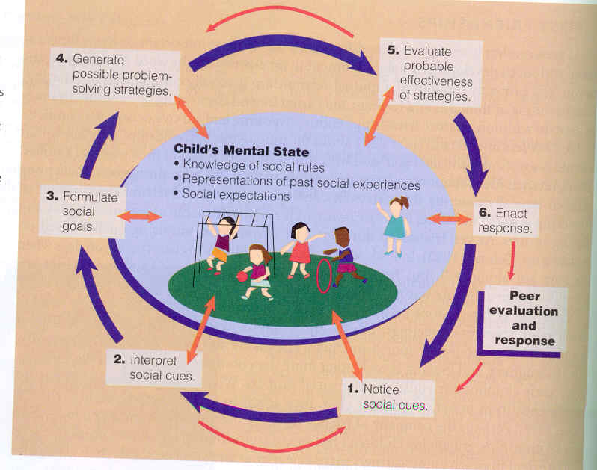
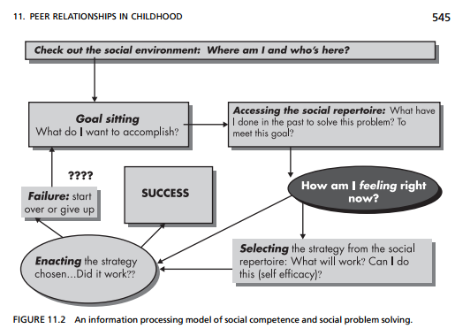
Peer Acceptance and
Social Cognition
Differences based on sociometric classifications?
Social information processing
See Rubin & Krasnor, 1986; Crick & Dodge, 1994

Slide 50
Peer Victimization and
Social Alienation: Predicting Deviant Peer Affiliation in Middle School
Rudolph et al. (2014)

Slide 51
Social Consequences of PV
Social network theory (Lazarsfeld & Merton, 1954)
  Children enter different peer groups based on either (a) homophily selection or (b) default selection
PV experiences may disrupt this natural process and cause youth to associate with “deviant peers”
However, little is known about social consequences of PV
  Youth may be alienated from groups, have a damaged reputation
Authors most interested in social alienation (SA), which refers to:
  Subjective loneliness
  Social dissatisfaction (e.g., feeling excluded)
  Social helplessness (e.g., being frustrated, staying away from peers)
Notes:
Homophily selection: “actively seek affiliation due to perceived similarity with peers”
Default selection: children passively enter affiliations with peers due to their lack of viable alternatives”
There is a lot of research on mental health and adjustment outcomes for kids who experience PV, but much less on social consequences

Slide 52
Background
Peer Victimization (PV) can have adverse effects on development
Little is known about long-term social consequences of PV
Aim was to examine Deviant Peer Affiliation (DPA) as a consequence of PV.
Notes:
PV often takes one of the following forms: Overt/physical (e.g., punching), relational (e.g., being excluded from a group), verbal (e.g., name calling)

Slide 53
Hypotheses
Hypothesis 1
Peer Victimization (PV) in early elementary school
Social Alienation
Study 1: Self-reported loneliness and social dissatisfaction
Study 2: Teacher-reported socially helpless behavior
Deviant Peer Affiliation (DPA)
Hypothesis 2
Internalizing Symptoms and Externalizing Behavior
Peer Victimization
Social Alienation
Deviant Peer Affiliation
Notes:
Hypothesis 1 was that exposure to PB would lead to social alienation which would lead to DPA
They also tested whether PV led to DPA directly even after adjusting for social alienation
In the each study they looked at social alienation differently (from the teacher and child's perspective)
Hypothesis 2 was to see what sets off this trajectory of peer victimization; they looked at Early risk factors (internalizing and externalizing to see if these predicted PV and Social Alienation (and then DPA)
They also tested whether early risk factors led to SA and DPA after adjusting for PV

Slide 54
Hypothesis 1 Background
Peer Victimization (PV)
Social Alienation
Deviant Peer Affiliation (DPA)
Exposure to PV may undermine children’s engagement with mainstream groups, more likely to affiliate with deviant peers
PV has been shown to predict rejection from peer groups and difficulty making friends
  Forced out of conventional peer groups
Sense of loneliness and alienation resulting from PV
As a result, may actively seek out deviant peers or other “outcasts”, or may simply gravitate to them given limited options

Slide 55
Hypothesis 2: Background
Internalizing/
Externalizing
Peer Victimization
Social Alienation
DPA
Children with behavior or emotional problems may trigger problematic social interactions
  This might produce PV and social alienation
Internalizing and externalizing behavior have been shown to predict PV
Children at early risk more likely to experience PV over time, self-perpetuating the cycle

Slide 56
Participants
Study 1
Study 2
Participants:
  585 families
  81% white
  Diverse SES (Hollingshead Mean=39.03)
Participants:
  638 children and teachers
  66.7% white
  Diverse SES (?)—34.7% had subsidized lunch

Slide 57
Procedures
Study 1
Study 2
Procedure:
  Recruited in Kinder (Cohort 1 in 1987; Cohort 2 in 1988); 3 sites (Knoxville and Nashville, TN Bloomington, IN)
  Annual assessments with parents and children
Procedure:
  Families of 2nd graders recruited at schools in Midwestern towns; some participants added in 3rd grade
  Annual assessments with teachers and children

Slide 58
Study 1 Methods
Participate when child entered kindergarten
3rd /4th grade interviews assess peer victimization
6th grade interview-- social loneliness/ dissatisfaction
7th grade interview--best friend antisocial behavior
Parent-report of internalizing/externalizing behavior
Notes:
PV was rated by nomination of peers
Measures of aggression were overt, not relational aggression

Slide 59
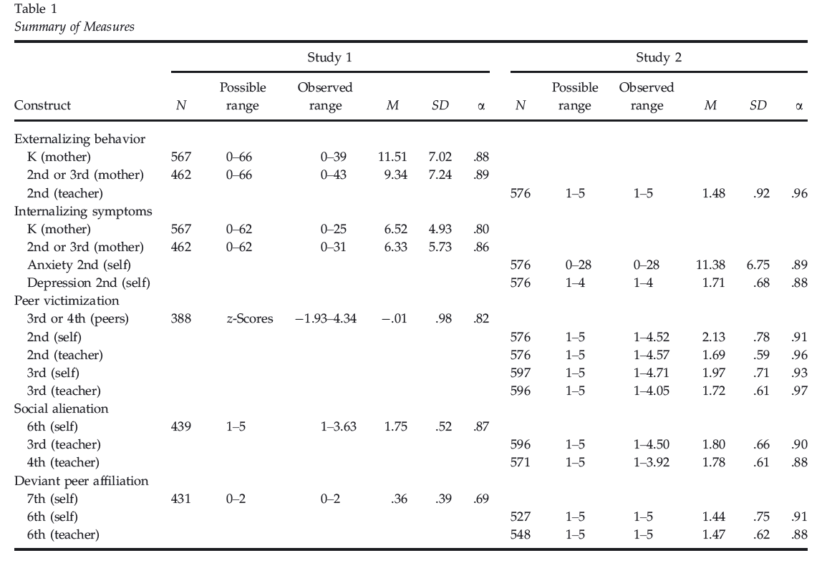
Measures

Slide 60
PV leads to social alienation and DPA in middle school
Victimized children may be rejected from mainstream social groups
  Results in subjective loneliness and behavioral helplessness
Social alienation predicted later affiliation with antisocial peers in middle school
Peer Victimization [PV] and
Social Alienation: Predicting Deviant Peer Affiliation [DPA] in Middle School
Rudolph et al. (2014)

Slide 61
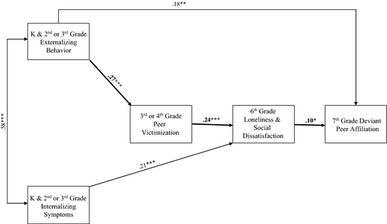
Study 1:
Peer Victimization (PV)
Social Alienation
Deviant Peer Affiliation (DPA)
Internalizing/
Externalizing
Peer Victimization
Social Alienation
DPA
Rudolph et al., 2014
Notes:
Path model results with standardized coefficients for . Bolded paths reflect components of the hypothesized pathway. Not displayed are nonsignificant paths and paths between both gender and ethnicity and each of the variables in the model. Of those paths, the following were significant: gender to deviant peer affiliation (β = −.13**); ethnicity to victimization (β = −.11*).
*p < .05. **p < .01. ***p < .001.
Model comparisons included the following:
Path between PV and DPA
Path between externalizing behavior and loneliness
Path between internalizing symptoms and DPA
None improved model fit
Internalizing symptoms and loneliness improved model fit
Externalizing symptoms and DPA improved model fit
All of these included paths with gender and ethnicity

Slide 62
Study 2 Methods
Teachers and 2nd grade children
Yearly assessment from 2nd through 6th grade
Teacher-reported aggression; child reported internalizing symptoms
Child- and teacher-reported PV
Teacher-reported social helplessness
Teacher-reported DPA

Slide 63
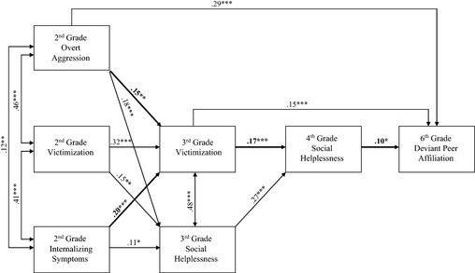
Study 2 Results
Internalizing/
Externalizing
Peer Victimization
Social Alienation
DPA
Rudolph et al., 2014
Notes:
Path model results with standardized coefficients for Study 2. Bolded paths reflect components of the hypothesized pathway. Not displayed are nonsignificant paths and paths between both gender and ethnicity and each of the variables in the model. Of those paths, the following were significant: gender to second‐grade overt aggression (β = −.20***) and fourth‐grade social helplessness (β = −.08*); ethnicity to second‐grade overt aggression (β = .29***), second‐grade victimization (β = .16*), fourth‐grade social helplessness (β = .10*), and sixth‐grade deviant peer affiliation (β = .21***).
*p < .05. **p < .01. ***p < .001.
Model comparisons included the following:
Overt aggression and social helplessness
Internalizing and social helplessness
Internalizing and DPA
None of these improved model fit
Direct effect from PV and DPA improved model fit
Direct path from aggression and DPA improved model fit
Victimization had a unique effect on DPA in study 2 but not in study 1
Internalizing symptoms had a unique effect on social alienation in study 1 but not study 2
Internalizing symptoms predicted social helplessness from 2nd to 3rd grade

Slide 64
PV in elementary school →
DPA in middle school
Early externalizing behavior likely sets this process in motion and eventually leads to DPA
PV has negative long-term social consequences
Early behavior problems are a risk factor for experiencing PV and eventually associating with deviant peer groups
  Role of internalizing symptoms is less clear

Slide 65
PV leads to social alienation and DPA in middle school
Victimized children may be rejected from mainstream social groups
  Results in subjective loneliness and behavioral helplessness
Social alienation predicted later affiliation with antisocial peers in middle school

Slide 66
Conclusions
Externalizing behavior shapes later adverse peer environments, even after adjusting for PV
Both initial externalizing behavior and PV lead to social disengagement and DPA.
  DPA may have resulted from default selection or actively seeking out these affiliations
Internalizing Sxs have a less clear cascade
  Study 2 Internalizing Sxs predicted greater PV; an indirect effect on social helplessness via PV
  May be due to variability in measurement in studies (CBCL vs. Internalizing index, anxiety heavy vs. depressive Sxs)
    May be that depressive Sxs more likely to elicit PV and later DPA

Slide 67

Peer Victimization During Middle Childhood as Lead Indicator of Internalizing Problems and Diagnostic Outcomes in Late Adolescence
Schwartz et al. (2014)

Slide 68

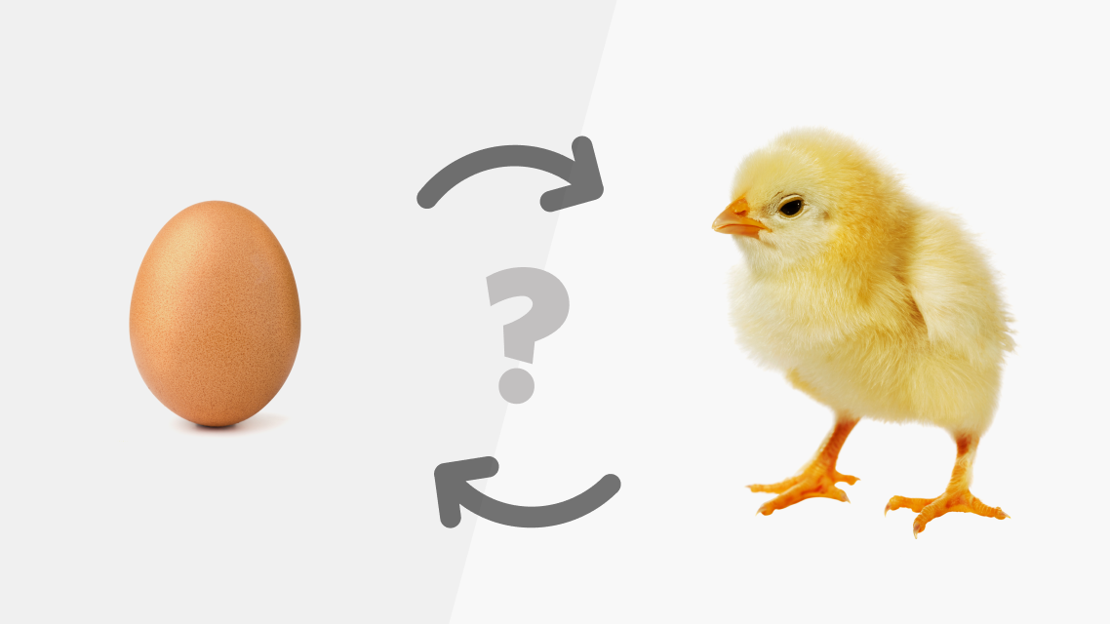
Lead Indicator
Current study considered evidence that peer victimization (PV) during middle childhood serves as a ‘‘lead indicator’’ of depression, anxiety, and related problems later in adolescence/early adulthood
Derived from economic theory
“Denotes a construct that is not necessarily casual but can effectively identify trends toward an outcome of interest.” (Schwartz et al., 2014)
Notes:
Our overall goal was to enhance efforts to detect children who are likely to experience later internalizing disorders. To this end, we sought to build on existing research by considering adjustment trajectories and incorporating a focus on diagnostic outcomes. We also conducted supplemental analyses examining the moderating role of gender.

Slide 69
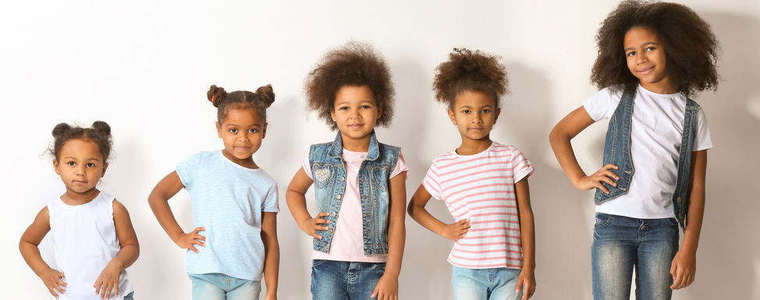
Child Development Project (CDP)
Study conducted as part of larger multisite longitudinal project
Two cohorts (no sig differences)
  Recruited before kindergarten
  Initial sample included 585 children (304 boys, 281 girls), 308 in Cohort 1 (C1) and 277 in Cohort 2 (C2)
  In middle childhood, obtained peer nomination data for a representative subsample (388 children; 198 boys, 190 girls) of the initial participants
Notes:
part of the Child Development Project (CDP; see Schwartz, Gorman, Dodge, Pettit, & Bates, 2008), a multisite prospective study that served as the basis for past reports on the predictors and outcomes associated with peer victimization (Schwartz, Dodge, Pettit, & Bates, 1997; Schwartz, Dodge, Pettit, Bates, & The Conduct Disorders Prevention Research Group, 2000; Schwartz, McFadyen-Ketchum, Dodge, Pettit, & Bates, 1998, 1999). The CDP is an ongoing study that began in 1987 and has included annual assessments through childhood and adolescence.
Two separate cohorts, recruited in consecutive years, are participating in the CDP. We recruited both cohorts from the same school districts, and they did not differ markedly in composition. There were no differences across cohorts in the concurrent correlates, predictors, or outcomes associated with peer group victimization (Schwartz et al., 1997).
We recruited the initial sample just prior to kindergarten enrollment in three geographic regions (Bloomington, IN; Knoxville, TN; Nashville, TN). Research staff approached parents and invited them to participate in a longitudinal study of child development. About 75% of the parents consented. A total of 585 children (304 boys, 281 girls) participated in the study, 308 in Cohort 1 (C1) and 277 in Cohort 2 (C2). By the time they reached middle childhood, the original participants had been dispersed into a number of differ- ent elementary schools over a wide geographic area. Resource limitations precluded data collection in all of these schools, but we xc of the initial participants. This subsample has been the subject of a number of previous reports based on the CDP (Schwartz et al., 1997; Schwartz et al., 2000; Schwartz, Gorman, Dodge, et al., 2008; Schwartz et al., 1998, 1999), and our past analyses have demonstrated similar patterns of attributes to the full sample.

Slide 70
Assessment Timepoints
388 children (198 boys, 190 girls)
  ~24% of the original subsample were from minority racial or ethnic backgrounds (almost all African American)
  ~26% of the children came from families classified in the two lowest socioeconomic status groups (based on criteria from Hollingshead, 1979).
  Children attended schools in a range of urban, suburban, and semirural contexts.
PV: ~8.5 years old
Internalizing behavior problems: assessed in 9 consecutive years (~8 - ~18 years old)
Structured clinical interview: ~18.5 years old
Notes:
The sample size with peer victimization and maternal reports of internalizing behavior problem data was as follows:
329 at third=fourth grade, 276 at fourth=fifth grade, 315 at fifth=sixth grade, 315 at sixth=seventh grade, 317 at seventh=eighth grade, 300 at eighth=ninth grade, 284 at ninth=tenth grade, 296 at tenth=eleventh grade, and 300 at eleventh=twelfth grade. In addition, 286 of the participants completed the structured clinical interview.
Approximately 24% of the original subsample were from minority racial or ethnic backgrounds (almost all African American), and 26% of the children came from families classified in the two lowest socioeconomic status groups (based on criteria from Hollingshead, 1979). These children attended schools in a range of urban, suburban, and semirural contexts.

Slide 71

Assessment of Peer Victimization
Peer Nomination Inventory
Administered to all children in the 5th year of the project.
  C1 was in the fourth grade (average of approximately 9 years) and C2 (average age of 8 years) was in the third grade.
Children were given a roster sheet and asked to identify up to three peers who fit a series of descriptors of physical and emotional peer victimization
Notes:
Peer victimization was assessed with a peer nomination inventory that was administered when the average age of the participants was approximately 8.5 years.
Internalizing problems were assessed using
a behavior problem checklist completed by mothers in 9 consecutive years,
and a structured clinical interview was administered to the participants in the summer following high school graduation (10–11 years after the victimization assessment).
. The interview included three items that assessed peer victimization (i.e., ‘‘kids who get picked on,’’ ‘‘kids who get teased,’’ ‘‘kids who get hit or pushed’’; a 1⁄4 .82). We calculated the total number of nominations received across these items standardized within class (as per Coie, Dodge, & Coppotelli, 1982).
Current trends emphasize the assessment of both relational and overt subtypes of peer victimization (Crick & Grotpeter, 1995), whereas the items in the CDP either tap overt victimization or are not specific to either subtype. Nonetheless, in a recent paper (Schwartz, Gorman, Dodge, et al., 2008), we used the CDP data to replicate findings from an independent 2-year longitudinal study that was conducted with separate items for relational and overt victimization (i.e., Los Angeles Social Development Project; Schwartz & Gorman, 2003; Schwartz, Gorman, Duong, & Nakamoto, 2008; Schwartz et al., 2005). Analyses conducted with the CDP scale produced findings that were nearly identical to the results obtained with the combined relational and overt items in the independent project, albeit for a 2-year period during middle childhood.

Slide 72
Assessment of Internalizing Behavior Problems
Child Behavior Checklist (CBCL)
Completed by participants’ moms
Assessed in 9 consecutive years for each cohort (3rd grade through 11th grade for C1, 4th grade through 12th grade for C2
Youth Self-Report (YSR)
Self report
Beginning with the 6th year after the peer nomination assessment (Grades 10, 11, and 12 for C1; Grades 9, 10, and 11 for C2)
Notes:
Peer victimization was assessed with a peer nomination inventory that was administered when the average age of the participants was approximately 8.5 years.
Internalizing problems were assessed using
a behavior problem checklist completed by mothers in 9 consecutive years,
and a structured clinical interview was administered to the participants in the summer following high school graduation (10–11 years after the victimization assessment).

Slide 73
Assessment of Diagnostic Outcomes
Computerized Diagnostic Interview (C-DIS-IV)
Structured interview administered at age 18 (10 years after the peer nomination assessment for C1, 11 years after the peer nomination assessment for C2).
Conducted by trained assessors
Generated dichotomous unipolar depression and anxiety scores.
  Unipolar depression if they met criteria for major depression and/or dysthymia
  Anxiety if they met criteria for generalized anxiety disorder, specific phobia, social phobia, obsessive compulsive disorder, panic disorder, or posttraumatic stress disorder
  Overall, 14.69% of the participants were positive for depression (10.00% of boys, 19.18% of girls) and 12.24% of the participants were positive for anxiety (6.43% of boys, 17.81% of girls). High comorbidity (9.8% of the participants meeting criteria for both disorders)
Notes:
Peer victimization was assessed with a peer nomination inventory that was administered when the average age of the participants was approximately 8.5 years.
Internalizing problems were assessed using
a behavior problem checklist completed by mothers in 9 consecutive years,
and a structured clinical interview was administered to the participants in the summer following high school graduation (10–11 years after the victimization assessment).

Slide 74
Sample Attrition and Demographics
The sample size with peer victimization and maternal reports of internalizing behavior problem data was as follows:
  329 at third=fourth grade, 276 at fourth=fifth grade, 315 at fifth=sixth grade, 315 at sixth=seventh grade, 317 at seventh=eighth grade, 300 at eighth=ninth grade, 284 at ninth=tenth grade, 296 at tenth=eleventh grade, and 300 at eleventh=twelfth grade. In addition, 286 of the participants completed the structured clinical interview.
Approximately 24% of the original subsample were from minority racial or ethnic backgrounds (almost all African American), and 26% of the children came from families classified in the two lowest socioeconomic status groups (based on criteria from Hollingshead, 1979). These children attended schools in a range of urban, suburban, and semirural contexts.

Slide 75
Hypotheses
PV during middle years of childhood as lead indicator of internalizing problems through late adolescence/early adulthood
Enhance efforts to detect children who are more likely to experience later internalizing disorders

Slide 76
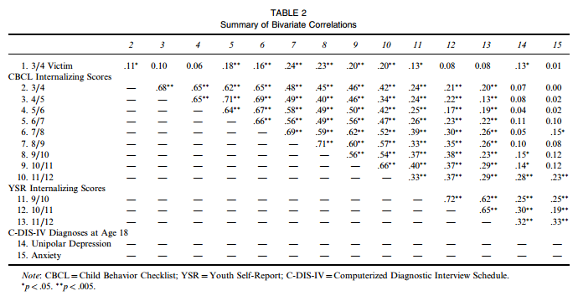
Bivariate Correlations

Slide 77
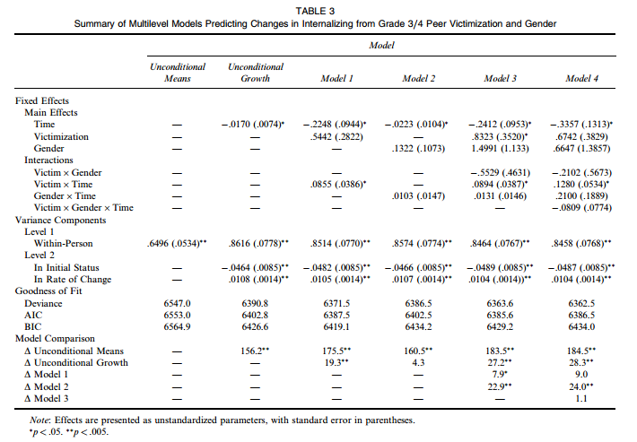
Multilevel Models

Slide 78
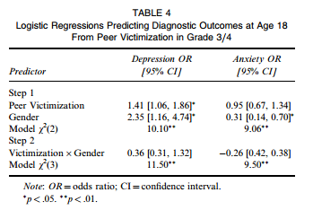
Relationship between PV and/or Depression or Anxiety Diagnoses
Notes:
In our final series of analyses, we conducted a series of hierarchical logistic regressions to examine relations between Grade 3=4 peer victimization and the dicho- tomous unipolar depression and anxiety diagnoses derived from the C-DIS-IV at age 18. On the first step of these models, each of the diagnostic outcomes was predicted from gender and Grade 3=4 peer victimization. On the second step, we entered the Peer Victimization x Gender interaction.
As shown in Table 4, there were significant gender effects for both anxiety and unipolar depression, with girls more likely than boys to experience each outcome. There was also a significant relation between Grade 3=4 peer victimization and unipolar depression, indicating that peer victimization had a small association with later unipolar depression. Peer victimization was not, however, predictive of anxiety outcomes. Moreover, we did not find any significant Peer Victimization x Gender interaction effects in either of the models. Thus, our analyses did not produce any evidence that the relation between peer victimization and diagnostic outcomes differs as a function of gender.

Slide 79
Results
Peer victimization in middle childhood was correlated with internalizing problems on a bivariate basis through the late years of adolescence.
Multilevel analyses also revealed associations between peer victimization and increases in internalizing problems over time. In addition, peer victimization had a modest link to unipolar depressive disorders in late adolescence.
Victimization in the peer group during middle childhood appears to be a marker of long-term risk for internalizing behavior problems and unipolar depression.
Notes:
The initial comparisons are made with an uncon- ditional means model and an unconditional growth model. The unconditional means model does not include any predictor variables, essentially implying that the outcome construct does not change over time. In the unconditional growth model, time is the only predictor variable so that change in the outcome construct that is not accounted for by substantive predictors is implied.
Table 3 summarizes unconditional means and unconditional growth models predicting the within-child slope of internalizing. As shown, the unconditional growth model offered a significant improvement in fit beyond the unconditional means model. This pattern indicates that mother-rated internalizing problems change over time.

Slide 80
Conclusions
PV in middle childhood correlated with internalizing problems through the late years of adolescence.
PV associated with an increase in internalizing problems over time
PV in middle childhood indexes long-term risk for internalizing behavior problems and unipolar depression.

Slide 81
Study Strengths
Consideration of gender
Trained evaluators of psychopathology
Assessment of intraindividual change
Notes:
Gender
exploratory goal, we also examined the role of gender. The existing findings do not provide consistent evidence that gender moderates associations between peer victimization and psychosocial functioning. Moreover, studies that have followed youths for 6 or more years have sometimes excluded girls (Olweus, 1992; Sourander et al., 2007). Nonetheless, by the middle years of adolescence, gender differences in the prevalence of internalizing disorders begin to emerge (Nolen-Hoeksema & Girgus, 1994). Marking the start of a trend that is maintained throughout much of the lifespan, girls begin to experience major depression, dysthymia, generalized anxiety disorder, and other classes of internalizing disorders at a much higher rate than boys (Lewinsohn, Gotlib, Lewinsohn, Seeley, & Allen, 1998; Sterba, Prinstein, & Cox, 2007). Some theoretical perspectives also suggest that these well-documented patterns may partially reflect the great- er susceptibility of girls to stress associated with inter- personal difficulties (Crick & Zahn-Waxler, 2003; Leadbeater, Blatt, & Quinlan, 1995; Nolen-Hokesema & Girgus, 1994).
Trained evaluators of psychopathology
A related methodological issue is that the extant research has been characterized by a nearly exclusive reliance on analogue assessments of symptoms or inter- nalizing tendencies. Generally, anxiety, depression, and associated difficulties are assessed via self-report ques- tionnaires or behavior problem checklists. The resulting indices are assumed to have a continuous distribution with most children having at least some level of symptoms. An alternative model, which often underlies intervention efforts, would view depression and anxiety primarily as extreme outcomes. From this framework, assessments would be optimized to capture traits, signs, and symptoms that are indicative of clinically significant levels of internalized distress. In the current study, we complemented our focus on trajectories of internalizing behavior problems by considering diagnostic outcomes determined by trained clinical evaluators.
Interindividual and Intraindividual Change
Typically, there is an initial assessment of functioning during childhood or adolescence with a follow-up at a later point in develop- ment (Isaacs et al., 2008; Olweus, 1993). Designs of this nature can illuminate the pattern of interindividual associations and provide a snapshot of relations between children’s propensity to be mistreated by peers and individual differences in distress. However, as Wohlwill (1973) noted, analysis of intraindividual change is central to an understanding of development. This distinction between inter- and intraindividual differences essentially reflects relative rank (i.e., whether a child experiences a high level of internalizing problems com- pared to his or her peers) versus the change experienced by children over time (i.e., whether a child’s absolute level of internalizing increases or decreases across develop- ment). The latter issue requires that outcomes be assessed over multiple waves so that within-child slopes can be calculated (Singer & Willet, 2003).
A focus on within-child change would also be consist- ent with recent trends in research on peer victimization (Barker et al., 2008; Boivin, Peticlerc, Feng, Barker, & Delgadillo, 2010; Rudolph, Troop-Gordon, Hessel, & Schmidt, 2011). Increasingly, investigators have empha- sized multiwave designs that support analysis of adjust- ment trajectories. Although these approaches have most often been applied in designs that target relatively constrained periods of 3 years or less, this empirical direction supports a potentially informative analytic shift. The literature on peer victimization has begun to examine multiple forms of developmental process.

Slide 82

Study Weaknesses
Single timepoint of victimization
Diagnoses grouping and treatment as dichotomous variables
Limited consideration of cultural/diversity factors

Slide 83
Discussion Topics
Indicators of what might make an adolescent more likely to be bullied growing up (i.e., can we identify these individuals)
Indicators identifying those who are likely to be bullies
Risk and protective factors for negative outcomes (e.g. increased internalizing symptoms) when faced with bullying
  Chronicity of bullying?
  Family factors?
  Peer support?
  Personality traits?
  Psychopathology?
What do you think of the authors’ groupings of anxiety and depressive disorders? Would you predict different relationships/trajectories associated with different DSM-5 disorders within these categories?
Notes:
Class Questions:
I'm really interested to learn more about the methodology used for this study. As I was reading, I was thinking about the likelihood of one becoming chronically susceptible to bullying or targeted behavior. In school districts where the child/adolescent might be in class each year with the same people (and their previous history following them), is victimhood in middle school not correlated to victimhood later as well? Or quantity of friends later in high school? The authors highlight the limitation of only having this single time point of victimization, but I'm very curious!
Kaitlyn, I agree with what has been said. Extending this line of reasoning, This article left me wondering 1) about possible indicators of what might make an adolescent more likely to be bullied growing up (i.e., can we identify these individuals), and 2) identifying those who are likely to be bullies? If we know these things, I think it would aid in the creation of a great preventative intervention.
Schwartz et al. (2014) examined the possibility of peer victimization in middle school as an indicator of internalizing behavior problems during adolescence. Their findings suggest that peer victimization in middle childhood was related to internalizing behavior probelms through late adolescence, in addition to having a moderate relationship to unipolar depressive disorders in late adolescence. I would be interested to know if family characteristics could act as protective factors for adolescents in this case.

Slide 84
Peer Victimization During Middle Childhood as Lead Indicator of Internalizing Problems and Diagnostic Outcomes in Late Adolescence
Schwartz et al. (2014)

Slide 85
Peer Victimization (PV) can have adverse effects
Moderate links between PV and symptoms of depression, anxiety, loneliness, and social withdrawal
Compelling evidence of short-term associations

Slide 86
Hypotheses
PV during middle years of childhood as lead indicator of internalizing problems through late adolescence/early adulthood
Enhance efforts to detect children who are more likely to experience later internalizing disorders

Slide 87
Methods
388 children (198 boys, 190 girls)
PV: ~8.5 years old
Internalizing behavior problems: assessed in 9 consecutive years (~8 - ~18 years old)
Structured clinical interview: ~18.5 years old

Slide 88
Bivariate Correlations

Slide 89
Multilevel Models

Slide 90
Peer victimization (PV) → Depression
Girls more likely than boys to experience each outcome

Slide 91
PV→internalizing and depression
PV in middle childhood associated with internalizing problems through late adolescence.
PV associated with an increase in internalizing problems over time
PV in middle childhood indexes long-term risk for internalizing behavior problems and unipolar depression.

Slide 92
Discussion
Do think we might find similar associations between PV and externalizing behavior problems?
Methods?
  Distinction between behavior problem checklists and structured interviews/clinical judgment

Slide 93
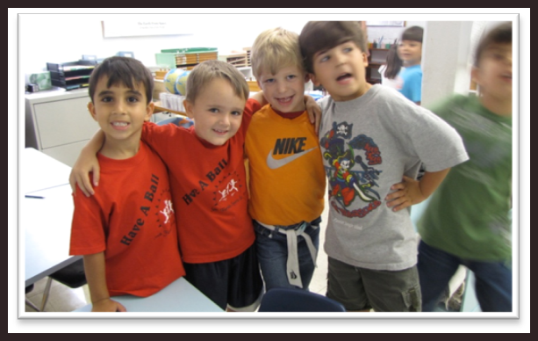
Friendships
Friendships provide:
  Support
  Emotional security
  Intimacy
  Instrumental and informative assistance
  Growth of interpersonal sensitivity
  Prototypes for later romantic & marital relationships
  Practice with conflict resolution
Notes:
Friendship = presense of close, mutual, and voluntary dyadic bilateral relationship (RECIPROCITY and FEELING OF PERCEIVED EQUALITY

Slide 94
Friendship development
  Behaviors with friends & non-friends differ early in development
  Children’s understandings of friendships change with development (Bigelow & LaGaipa, 1980)
    Content analysis of ‘describe what a best friend should be’ essays
    Reward-cost stage (7-8 yrs)
      E.g., proximity
    Normative stage (10-11 yrs)
      E.g., nice
    Empathic stage (11-13 yrs)
      E.g., loyal
Notes:
Changes reflect increases in perspective-taking skills and understandings of reciprocity (parallels cognitive changes of perceptions of world as concete vs. abstract)

Slide 95
Friendships & similarity
In early childhood friends are similar in terms of observable characteristics
  Age, sex, racial/ethnic background, behavioral tendencies
By adolescence friends are similar in terms of attitudes
  School, academic aspirations, use of drugs/alcohol

Slide 96
Presence of a mutual best friend as a protective factor
Most children have at least one friend, BUT 15% estimated to be chronically friendless
  Associated with increased loneliness, poor self-esteem
Victimization predicts behavior problems only for children without a best friend
  Hodges et al. (1999)
Although stable friendships can also have negative consequences depending on characteristics of the friend

Slide 97
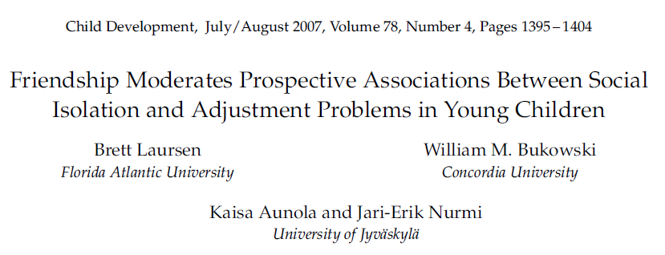
For unfriended children, initial social isolation→ increases in internalizing and externalizing;
  Initial internalizing and externalizing →
  subsequent increases in social isolation.
Among friended children, no prospective associations between social isolation and internalizing or externalizing problems.

Slide 98
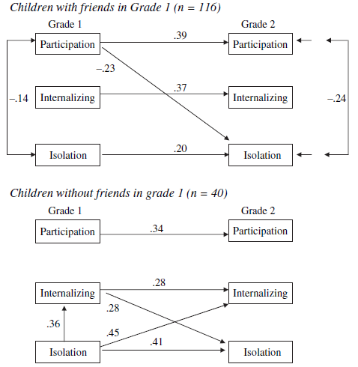
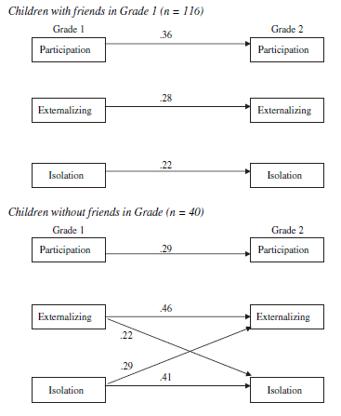
Friends don’t let friends… internalize or isolate
internalize
Friends
externalize
No Friends

Slide 99
Modeling homophily over time with an actor-partner interdependence model
Popp, D., Laursen, B., Kerr, M., Stattin, H., & Burk, W. (2008). Developmental Psychology, 44(4), 1028-1039.
Why do friends engage in similar deviant behavior?
  Socialization: friends influence behavior
  Homophilic selection: deviant kids choose deviant friends
Evidence for selection effect
  Higher similarity in deviant behavior pre-friendship
Evidence for socialization effect
  Increased deviant behavior controlling for pre-friendship levels
Difficulty in disentangling unique contributions
  Friends behave interdependently, i.e. behaviors are not statistically independent
  Actor-partner interdependence model (APIM) takes this into account

Slide 100
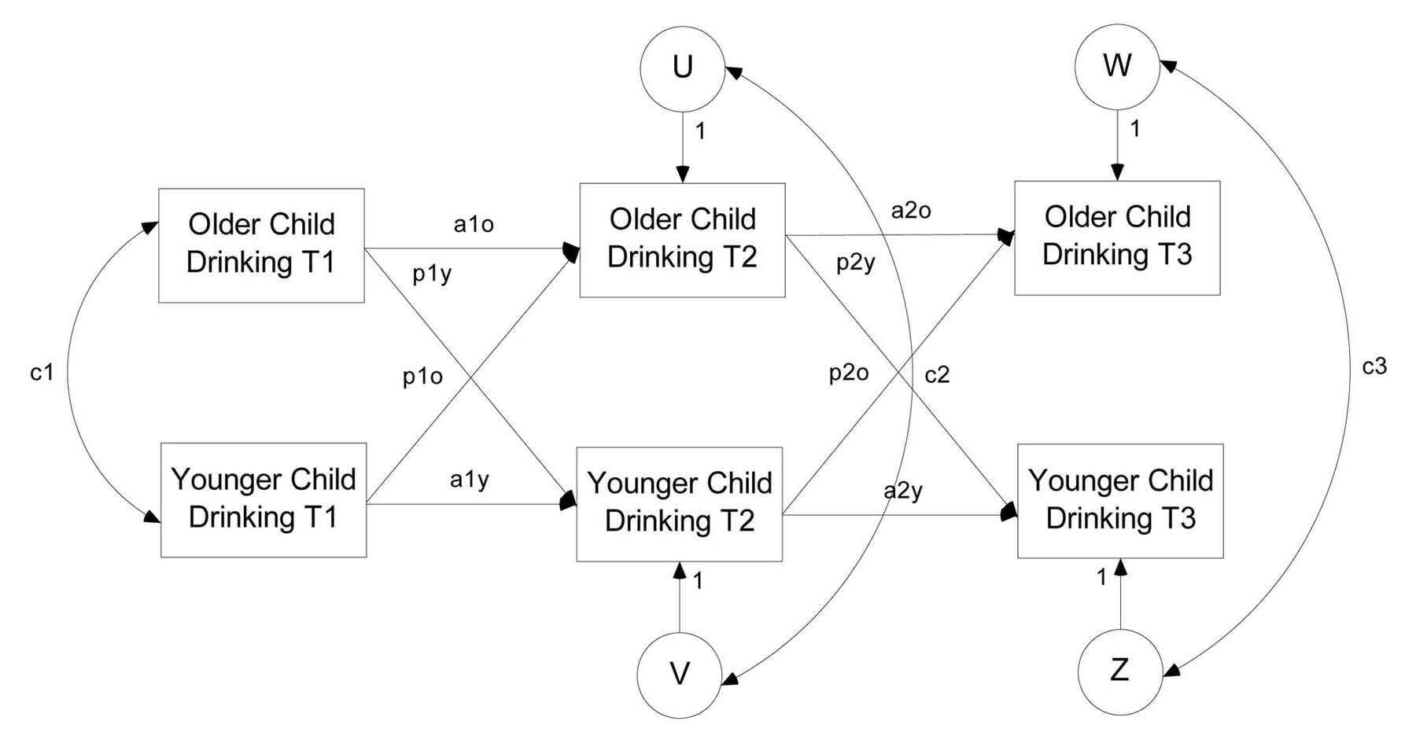
Actor-partner interdependence model
Control for “partner” influence
Control for initial similarity (selection)
Control for additional unobserved sources of similarity (socialization)
Control for “actor” stability
7th & 10th graders in small Swedish city
  Nominated 3 important peers on 3 consecutive years
  Reported frequency of intoxication each year
Reciprocated friendship groups (451 dyads)
Randomly paired comparison groups to gauge age-related increases (545 dyads)
  Friendless
  Friended
  Total sample
 | T1 | T2 | T3
Enduring | ✓ | ✓ | ✓
Waning | ✓ | ✓
Nascent |  | ✓ | ✓
Time 1 | ✓
Time 2 |  | ✓
Time 3 |  |  | ✓
Intermittent | ✓ |  | ✓

Slide 101
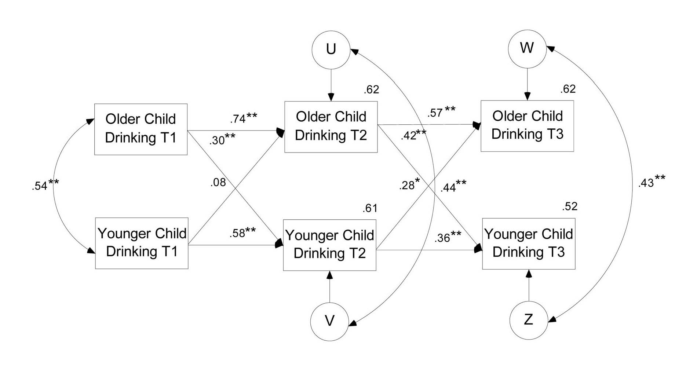
Nascent friend dyads
Not friends
Friends
Friends
Selection effects
  Based on correlation between Time 2, Time 3 & Nascent friends before friendship
  Relatively small correlations in comparison groups
Socialization effects
  Based on residual correlation of Time 2, Time 3 & Nascent friends during friendship
  Relatively small correlations in comparison groups
Selection and socialization effects similar in magnitude across models
Partner influence effects
  Based on nascent group as friendship developed
  Older child influence at first (.30), then mutual influence (.42 & .28)
  No significant effects in comparison groups

Slide 102
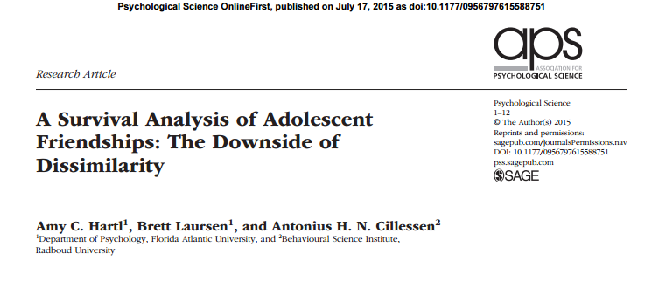
Differences between friends predicted friendship dissolution beyond individual characteristics
Friendship stability is a function of similarity

Slide 103
Who are the adolescents?
410 adolescents (ages 12 – 15)
Attending 2 public schools from lower-middle to middle-class neighborhoods in small Northeast city
  All were followed annually through 12th grade
  201 boys
  209 girls
72.4% Caucasian
16.1% African American
10% Latin American
1.5% Asian American
Rothman/Leite

Slide 104
Methods
All students were given a list of every student in the grade
  Friendship nominations – “who are your best friends?”
  Peer nominations – “who are the people that….
    you like the most?”
    you like the least?”
    start fights with, pick on, or tease others?”
  Teacher-reported school competence – Multidimensional Self-Concept Scale
  Friendship defined as any dyad in which both partners nominated one another for the first time in 7th grade
    Total of 573 friendships reported and entered into survival analyses
Friendship dissolution defined when one member of the friendship failed to nominate the other as a friend at a later point in the study
    ignore others when mad at them?”
    get picked on when teased?”
    are leaders?”
Rothman/Leite

Slide 105
Sources of Friendship Dissolution
Dissimilarity in friendships disrupts perception that both people are benefitting equally
Undesirable individual characteristics (i.e., poor social skills, impulsivity, emotional/behavioral problems) may make it difficult to initiate and maintain friendships
Goal of present study:
  Examine dyadic differences in school-related behaviors together with individual levels of each behavior in order to predict the dissolution of friendships that formed in middle school
Mitsven, 2018 & Kooi, 2017

Slide 106
Method
Participants:
  410 adolescents (12-15 years old) with at least 1 new, reciprocated friendship in 7th grade (201 boys, 209 girls)
  Participants were followed from 7th grade until 12th grade
  Those who participated in the study through their senior year had higher school competence
Measures:
  Peer nominations
    Friendship “dissolution” happened when one friend no longer nominated that particular friend
  Friendship nominations
  Teacher reported school competence (Multidimensional Self Concept Scale)
Mitsven, 2018; Bailey & Kooi, 2017

Slide 107
Statistical Approach
A discrete- time survival analysis allowed for multiple, correlated predictors to predict friendship dissolution
Hazard curve: probability a reciprocated friendship from 7th grade will dissolve at each grade
Survival curve: probability that a reciprocated friendship will continue at each grade
Mitsven, 2018; Bailey & Kooi, 2017

Slide 108
Model Construction
Step 1: Evaluate the constant hazard assumption to determine if dissolution probability varied by grade
Step 2: Evaluate the proportionality assumption to determine whether a predictor’s effect vary by grade
  Categorized predictors as either individual characteristics or dyadic difference scores
Step 3: Estimated the models that included either all the Grade 7 individual characteristics or all of the Grade 7 dyadic difference scores as predictors
Step 4: Estimated the final model that included the statistically significant predictors
Kooi, 2017

Slide 109
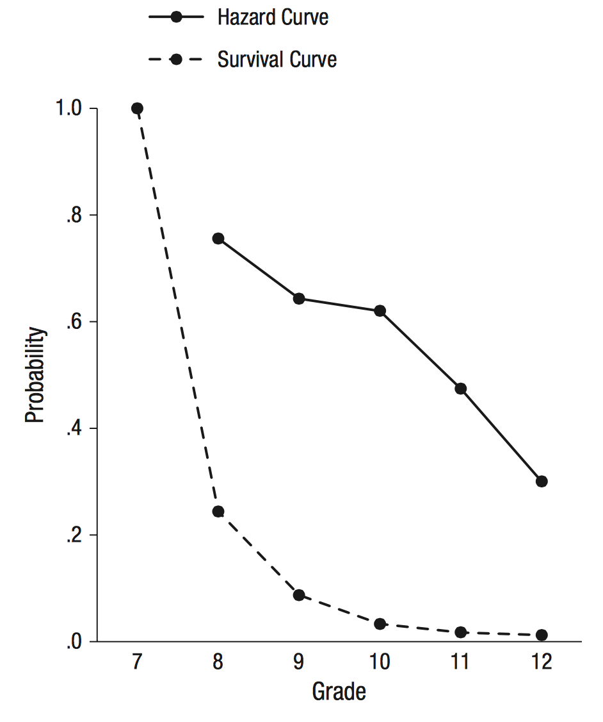
Hazard and Survival Curves Describing Friendship Dissolution
The probability that a reciprocated friendship that began in the 7th grade would dissolve at each subsequent grade declined significantly over time.
The probability that a reciprocated friendship would continue at each subsequent grade also declined over time.
Mitsven, 2018

Slide 110
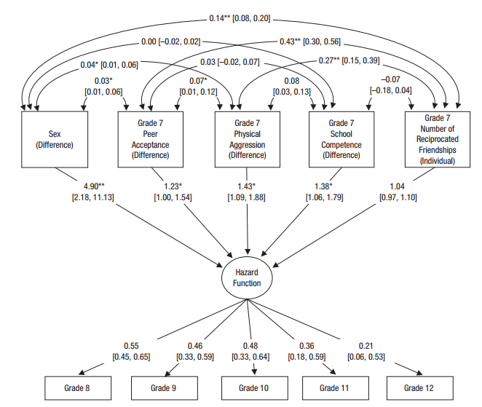
Dyadic Differences Are Significant Predictors of Friendship Dissolution
Mitsven, 2018

Slide 111
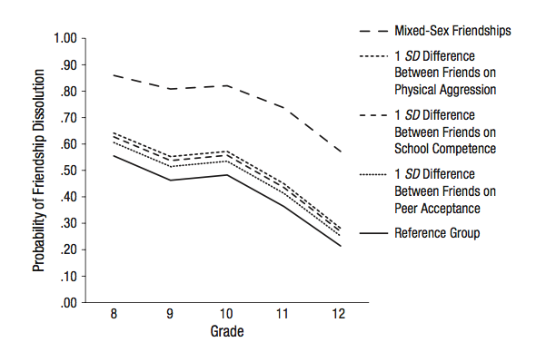
Dyadic differences predict dissolution
    The following dyadic difference variables predicted both the occurrence and timing of friendship dissolution
        Being in an opposite-sex friendship (odds 3.9x higher)
        Differing in peer acceptance (odds 23% higher for every SD difference)
        Differing in physical aggression (odds 43% higher for every SD difference)
        Differing in school competence (odds 35% higher for every SD difference)
Rothman/Leite

Slide 112
Final model predictors were dyadic
Significant predictors were: sex, peer acceptance, physical aggression, and school competence
  Dissolution was 3.9 times higher for different-sex friends
  23% higher for each SD in differing peer acceptance
  43% higher for each SD in differing physical aggression
  35% higher for each SD in differing school competence
When individual characteristics were considered along with dyadic differences, they were not predictive of friendship dissolution
Kooi, 2017

Slide 113
Take Aways
Differences in social and academic behavior anticipate the dissolution of friendships across middle school and high school
Friend compatibility and friendship stability are a function of similarity and not the presence or absence of individual attributes
Adolescents are more likely to enjoy successful long-term relationships with similar others
Mitsven, 2018

Slide 114
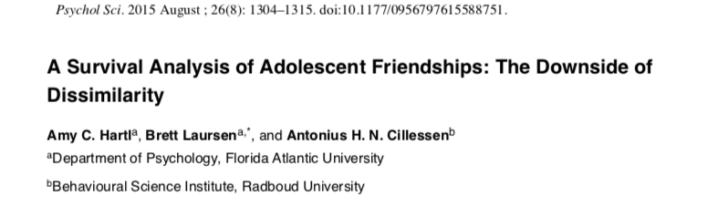

Slide 115

Why do friendships end?
Adolescence = a time where friendships are the key to attaining independence from parents and fostering social growth
Loss of friendships can be felt as debilitating for adolescent youths
However, adolescent friendships tend to be short-lived
  Often dissatisfaction due to imbalance of relationship rewards and costs
Rothman/Leite

Slide 116
Role of dissimilarity in dissolution
Research supports the general notion that friends tend to resemble each other, known as homophily
One possibility for why adolescent friendships are short-lived in adolescence is the idea of dyadic differences
  Social dissimilarity (social skills, risk taking, aggression)
  Demographic dissimilarity (different sex or ethnicity vs. same)
  Academic performance dissimilarity
Gender differences in adolescent friendship stability
  girls’ friendships less stable than boys’
Rothman/Leite

Slide 117
Study Aim
Aim: To compare dyadic differences in school-related behaviors with individual levels of each behavior to predict the occurrence and timing of the dissolution of friendships originating in middle school
Leite

Slide 118
Survival analyses
Discrete-time survival analyses
  Measure the occurrence and timing of events [dissolution] using multiple logistic regression
  For survival analyses to work, all events must share the same start-point
    All friendships examined were those that originated in the 7th grade
  Hazard curve
    Probability that a friendship will dissolve every subsequent year, assuming it did not dissolve already
  Survival curve
    Probability that a friendship will continue at each grade
Rothman

Slide 119
Variables of interest
Predictors:
  Age
  Ethnicity
  Number of reported reciprocated friendships
  Peer acceptance (being liked)
  Peer rejection (being disliked)
  Leadership
  Physical aggression (bodily harm)
  Relationship aggression (emotional or interpersonal harm)
  Peer victimization
  School competence
Moderator: Sex
Rothman/Leite

Slide 120
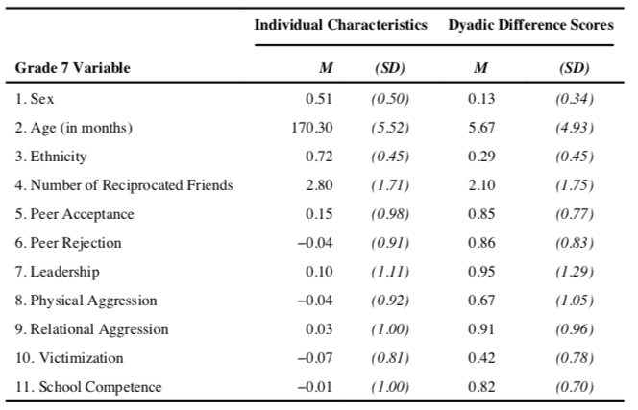
Individual & Difference Scores at Grade 7
  Dyadic difference scores were computed for each student on all predictors
  *higher scores indicate greater dissimilarity
Rothman

Slide 121
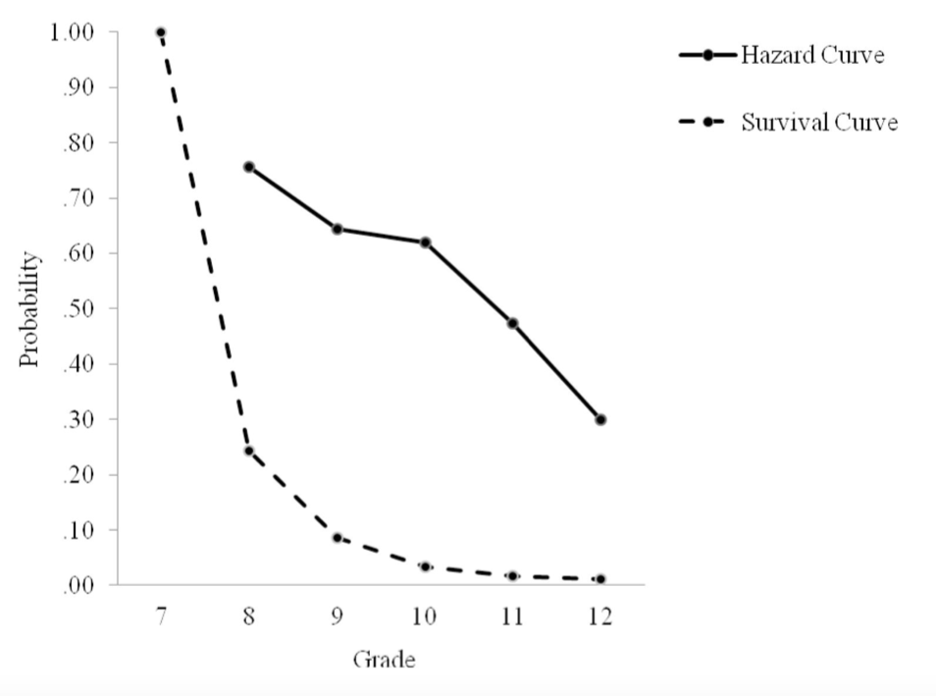
Hazard and survival curves
  Hazard curves
    Highest risk (76%) of friendship dissolution during 8th grade and decreased steadily each year thereafter
  Survival curves
    24% likelihood that friendships would survive the next school year (8th grade)
    9% likelihood that friendships would survive the transition to high school
    Only 1% of friendships continued through 12th grade
Rothman/Leite

Slide 122
Individual and dyadic difference predictors
  only individual predictors I the model:
    Number of reciprocated friendships in 7th grade significantly predicted both the occurrence and timing of friendship dissolution
        Across grades, each additional friendship reciprocally reported raised odds of friendship dissolution
  When individual and dyadic difference predictors were added to the model:
      The number of reciprocated friendships was not significant
Rothman

Slide 123
Conclusion: Similarity vs Dissimilarity in Friendships?
Dyadic differences in social and academic behavior predict dissolution between 7th and 12th grade
  Peer acceptance
  Physical aggression
  School competence
  Male-female friendships
Individual factors do not predict friendship dissolution in adolescence
Bottom line: the more similar you and your friend are, the more likely the friendship will outlast the transition from middle school to high school
Birds of a feather flock together?
Rothman/Leite

Slide 124
Discussion Questions
What role may racial/ethnic and cultural backgrounds play in the maintenance or dissolution of friendships?
  How about different attachment styles?
How may differences in SES predict friendship dissolution?
  If SES and school competence are confounded, which may be the one driving the dissolution of friendships?
  How might the results differ when looking at friendships in a small private school vs larger public school setting?
How might these results have differed if the authors had studied friendships in earlier or later adolescence? Or between high school and college?
  What dissimilarities may predict dissolution as adolescents age and develop stronger identities (e.g., professional or political identities)?
How could the maintenance versus loss of friendships overtime have implications for predicting for interpersonally-related disorders (e.g., antisocial personality disorder, SAD, BPD)?
Given the association between the individual predictors assessed (i.e., physical aggression, leadership, acceptance) and personality traits, to what extent might dissimilarity on big five personality dimensions yield similar results?
Leite

Slide 125
Making and keeping friends: the importance of being similar
laursen, 2017

Slide 126

Making and keeping friends: the importance of being similar
Laursen, 2017
Similarity-Attraction Model
Distinctiveness Model

Slide 127
homophily
Selection
Repulsion
Influence
Deselection
Attraction to similar others
Avoidance on the basis of dissimilarity
Similarity arising from experiences with friends
Dissolution of friendships because of dissimilarity

Slide 128
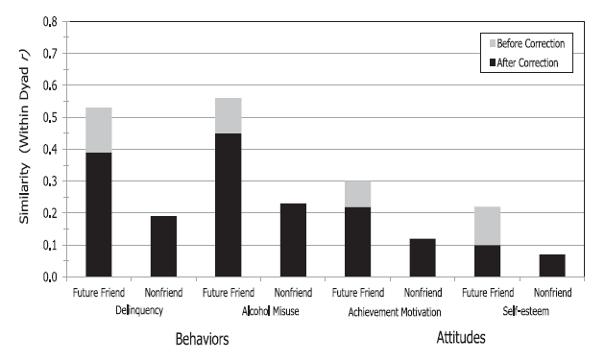
selection
Original studies
Corrections
Similarity on behaviors, not attitudes
Perceived similarity

Slide 129
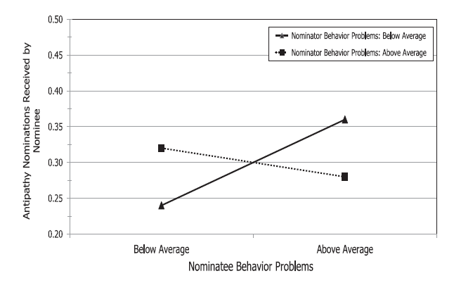
repulsion
Dislike those who are different
Both similarity and dissimilarity play a role in friendship
More dissimilarities between rivals
Similarity attracts; dissimilarity repels

Slide 130
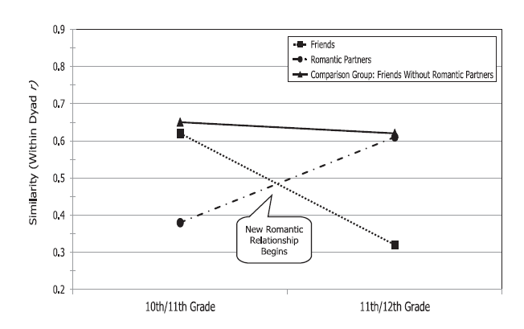
influence
Promote and maintain compatibility
Conformity
Unilateral and unidirectional
Romantic relationships

Slide 131
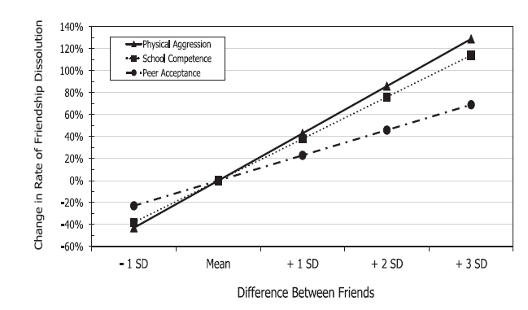
Deselection
Incompatibility results in disagreement
Negotiation?
Inequality between friends
Individual characteristics

Slide 132

conclusions
Similarity is the basis for friendship
Especially importance in adolescence
More research on what features matter most
Advice for adolescent friendship

Slide 133
Discussion Questions
What level of dissimilarity is tolerable, or even ideal for a friendship?
Do certain characteristics matter more at different stages in life?
How do these apply to romantic relationship?

Slide 134

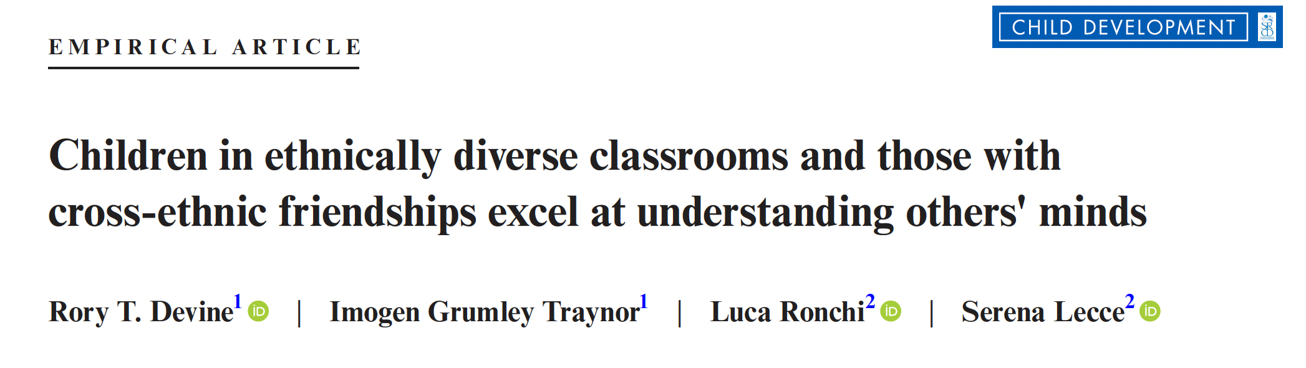
Alexandra Ramirez
PSY 620

Slide 135

THEORY OF MIND
  Ability to tune in to what other people think or feel
CLASSROOM DIVERSITY
Social psychological accounts of intergroup prejudice propose that contact with members of different social groups reduces negative attitudes toward members of that social group
Intergroup contact reduces prejudice
Primary school-aged children in the USA using measures of social competence teacher ratings have shown no association with classroom ethnic diversity
1

Slide 136
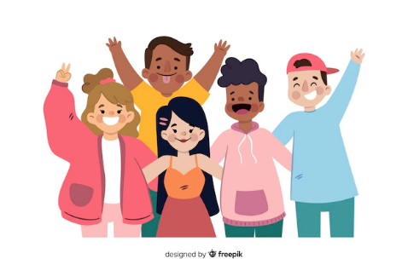
CROSS-ETHNIC FRIENDSHIPS
Social relationships linked with theory of mind
Friendships = reciprocal liking
Theory of mind positively associated with friendships (Fink et al., 2015; Peterson & Siegal, 2002)
Basic group intergroup contact from diverse classrooms does not guarantee emergence of cross-ethnic friendships
Cognitive liberation
CONTACT THEORY
Interplay between structural level diversity and interpersonal diversity
Vary by participant characteristics
2

Slide 137
AIMS
Examine the relations between classroom ethnic diversity and children’s theory of mind
Investigate the relations between cross-ethnic friendships and children’s theory of mind
Investigate the interplay between classroom ethnic diversity, cross-ethnic friendships, and theory of mind and test the consistency of any associations across age, ethnicity, and gender
3

Slide 138

METHODOLOGY
THEORY OF MIND
PARTICIPANTS
EXECUTIVE FUNCTION
  Silent Film Task
  Strange Stories Task
  Triangles Task
1100 children
8-13 years old
Participated in 2 class sessions led by researcher
English speaking
23% eligible for Free School Meals
1/5 special needs
  Digit span backwards task
  Heart and Flowers task
  Fish Flanker Task
ETHNIC DIVERSITY
VERBAL ABILITY
  Diversity Index
CROSS ETHNIC FRIENDSHIP
  Mill Hill Vocabulary Scale
  Peer nomination
  Social preference
4

Slide 139

ANALYSES
Confirmatory factor analysis for theory of mind and executive function
Imputed 50 data sets using Markov Chain Monte Carlo approach
Mean and variance weighted least squares estimator in Mplus
Multilevel Modeling
5

Slide 140

Model 1: Classroom ethnic diversity predicting theory of mind
Model 2: Cross ethnic friendship added
Model 3: Regresses theory of mind onto age, gender, ethnicity, free school meal status, verbal ability and executive function and same ethnic friendships
Associations between classroom diversity and cross ethnic friendships and theory of mind
7

Slide 141

8

Slide 142

Greater classroom ethnic diversity was positively associated with higher levels of cross-ethnic friendship
9
Notes:
Model depicting within and between-classroom effects

Slide 143
Children with cross-ethnic friendships outperformed their peers in theory of mind
9
Notes:
Model depicting within and between-classroom effects

Slide 144
No indirect effect of classroom diversity on between classroom differences in theory of mind
9
Notes:
Model depicting within and between-classroom effects

Slide 145
RESULTS AND IMPLICATIONS
Greater classroom diversity was associated with better performance on theory of mind tasks
Children with cross-ethnic friendships outperformed peers on theory of mind
Did not explain between-classroom difference in levels of theory of mind
Advanced intergroup contact theory by showing positive association between classroom ethnic diversity and direct theory of mind assessments
Extends social accounts of theory of mind beyond early childhood
Contributes to work on tertiary transfer effects
10
Notes:
cross-ethnic friendships show unique associations with theory of mind, cognitive flexibility and verbal ability

Slide 146
DISCUSSION
  Given that autistic individuals have historically shown difficulties with theory of mind, how might children with ASD fit into Devine et al.‘s research findings? I wonder about the directionality of the associations they found, like whether children with stronger theory of mind skills might naturally seek out diverse friendships. Would intentional efforts to support diverse peer interactions help scaffold theory of mind even in autistic populations?
  Considering that the study found a positive association between cross-ethnic friendships and theory of mind development in children aged 8 to 13, how might the developmental trajectory of theory of mind be influenced by the presence or absence of such friendships at different stages of childhood and adolescence, and what are the potential long-term social and cognitive implications of these influences?
11

Slide 147
THANK
YOU

Slide 148

Becoming a sexual being: the ‘elephant in the room’ of adolescent brain development
Woodard

Slide 149





Woodard
Notes:
despite the emergence of many excellent models highlighting the importance of puberty for neural development and new, adaptive learning, these models give limited consideration to the importance of adolescence as a sensitive period for romantic and sexual developmen

Slide 150




Woodard
Notes:
In the few cases when romance and sexuality are considered in these developmental models, they tend to emphasize sexual development as negative risk behavior (i.e., a risk-framework of sexual behavior). Studies using a sexual risk framework have helped to identify some of the underlying neural correlates associated with healthharming sexual decision-making, but, unfortunately, these studies have done little to expand our understanding of normative sexual development trajectories.

Slide 151
The importance of puberty
What is the evolutionary purpose of puberty?
To achieve reproductive maturity
How?
An important window of opportunity for learning an experience to shape neural networks
  Neuroplasticity
  More time with peers
  Orientation to social and emotional information processing
  Novel social behaviors and contexts
  Sensitization to reward learning
  Significant sex-specific structuring of the brain
A wide range of early romantic and sexual experiences likley shapes developing neural networks in enduring easy to support lifelong romantic and sexual trajectories
Woodard

Slide 152

Hormones
Gonadal hormones contribute to secondary sex characteristic development and neural circatry reshaping
Oxytocin, vasopressin, dopamine, serotonin, and cortisol also are activated or enhanced during puberty and influence how people experience romantic love
Collectively, these changes in hormones and neurotransmitters create an ideal physiological climate for fostering young people’s interest in learning about romantic love and sexual attraction
Woodard

Slide 153
Hormones
Testosterone- what does it do? | Estrogen- what does it do?
Social hormone: motivating status seeking, status maintenance, risk taking, aggression | Physical development of females, earlier than males. Limited research on brain development.
Relationship to sexual behavior may depend on developmental stage and relationship context | Limited research…
Woodard

Slide 154

Parents and Peers
Positive parent relationships are associated with decreased intentions to have sex and later age of first sexual acitvity
Positive parent relationships + open communication is associated with less sexual experinece, increased condom usage, later sexual debut, fewer unintended pregnancies, and fewer sexual partners
In adolescents specifically, presence or suggested presence of peers increases activation of reward circuitry
Having sexually active peers is associated with earlier first sexual activity, more frequent sexual acitvity, and more partners
How can society harness the power these relationships hold for adolescents?
Woodard

Slide 155

Media
Little is known about the effects of exposure to sexual media content on brain development
  However, violent media content does have effects on brain development and violent behavior
“Super sexual peer” influencing youth
  Over 70% of television contains sexual content or dialouge
  Between 23-29% of 10-19 year olds report viewing online pornography; 84% report it was unwanted or unintentional
  Association between increase pornography exposure and less restrictive sexual attitudes
Is there a positive effect of sexual media? How do we enhance it?
How do we minimize harm?
Woodard

Slide 156


Extended adolescence?
Definition: “time of preparation for adult reproductive life,” spanning the period between achieving physical readiness to engage in sexual activity and having social permission to reproduce
  What is the beginning of adolescence? What is the end?
Earlier trends of the beginning of puberty, especially for girls
  Do you think this coincides with changes in brain development?
Later trends in serious partnerships and having children
Thus, many individuals now spend a decade or more of their lives feeling biologically, physiologically, and motivationally primed to engage in romantic and sexual relationships outside of the context of reproduction. What consequences might this have?
Woodard

Slide 157

Contraceptive Innovation?
Many people begin having sex before they want to have children, and thus use birth control
  Global age of sexual debut for males is 16.5-24.5, for females 15.5-21.5
Combined oral contraceptives (containing estrogen and progestin) are the most common form of birth control and suppress up to 50% of testosterone in women
  Side effect?
  Chronic suppression effects?
  Effects if taken during sexual development?
Woodard

Slide 158

Childbearing and parenting?
Clear negative social and neurodevelopmental effects
of early parenthood (< 15)
  What about late parenthood?
Neural flexibility peaks in 30s
Men have different levels of testosterone based on relationship/parenthood status regardless of age
  What if you decouple typical neurobiological development trends from parenthood?
Overwhelming majority of people in the US and Europe have sexual and romantic relationships before committing to a single partner; similar trends beginning in Africa
  Differences between those who have multiple, high-intensity relationships and those who do not?
  Differences between those who have children at different ages?
Woodard

