Slide 1
Advanced Developmental Psychology
Daniel Messinger, PhD
PSY 620

Slide 2
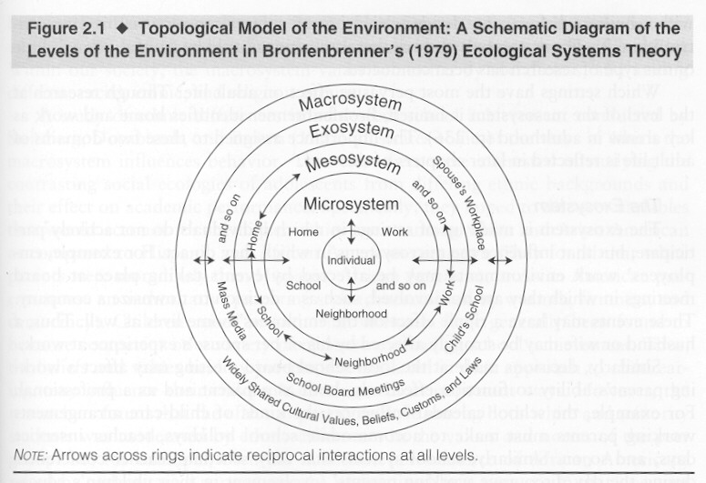
Domains of Development
Perception
Cognition
Language
Social/Emotional

Slide 3
Overview
Definitions (and gestures)
Behaviorist vs. nativist
  Critiques and data
Interactionist
  Beginnings
Vocal development
  Cries
  Expansion stage freedom
Borjon
Interactive effects on infant vocal production
Big data vocalization distinction of ASD
Back to interaction: ASD vocal development and interaction
Classroom inclusion language learning, the case of phonemes
First word learning
  Syntax
  Statistics
2 words and MLU

Slide 4
Poetic summary
The Words began -- as Whispers do -- In Infant's tender Mind -- A precious Sound -- a Mother's "coo" -- The first of Human Kind
Then Syllables -- like Morning Dew -- Emerged through practice sweet -- "Ma-ma" and "Da-da" breaking through -- Made Meaning feel complete -
The Sentences -- at first so small -- grew bolder day by day -- Until Expression's waterfall Found new and wondrous way --
Grammar's Rules -- like Garden walls -- Give structure to the Voice -- While Vocabulary recalls New words -- to give us Choice --
Each Stage unfolds -- a Butterfly -- From Nature's perfect Plan -- Till Language blooms -- beneath the Sky -- As only Language can --
Complex Thoughts -- once locked within -- Now dance upon the Tongue -- The Greatest Gift -- that might have been -- To pass -- from Old -- to Young --

Slide 5
Gesture to symbol
Gestures
  Movements with meaning
Conventional gestures
  Movements with shared meaning
Symbols
  Signs that represent the world
  Distance between referent object and sign
  Which can be made with hand or mouth

Slide 6
Some definitions
Language - a socially shared code or conventional system for representing concepts through use of arbitrary symbols and the rule governed combinations of those symbols
  Speech - a verbal means of communicating or conveying meaning
    Gestural forms of speech
    Gestural precursors to speech

Slide 7
Language Development
Traditional Theories of Language Development
Six dimensions of Language Learning
  Audition
  Articulation
  Words
  Grammar
  Communication
  Literacy
Notes:
Language as outcome/result of interactions/coordination of all other domains of functioning; perception (audition)/motor (articulation)/cognition(recall vs. recognition memory; executive functions/planning; perspective taking); social = pragmatics/

Slide 8
Language Development – two perspectives
Nativist Perspective (Noam Chomsky)
  Language (grammar, sentence organization) too complex to be directly taught or acquired by young child
    must be innate
  Proposed a Language Acquisition Device (LAD)
Behaviorist Perspective
  Language acquired via operant conditioning
  Enough to explain complexities of language development?
Interactionist perspective

Slide 9
Evidence for a biological preparedness for language learning
Cross-cultural similarities in timing and sequence of language milestones
Very difficult to teach nonhuman primates language (esp. complex grammatical forms)
Specialized language areas in the brain
Sensitive periods for language development

Slide 10
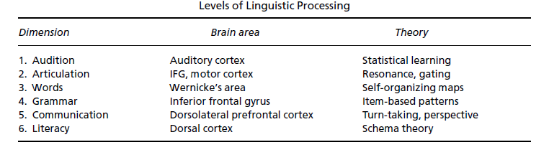
Criticisms of Chomsky’s model
Language acquisition more gradual and variable than predicted, suggesting greater role of learning
Hard to localize the LAD at a neural level
Notes:
Hard to identify universal grammar system

Slide 11
But…(ongoing research)
"The precentral cortex would represent movements (gestures) of the lips, tongue, palate and larynx, and the higher level cortical areas would represent the phonemes to a greater extent."
            Emily M. Mugler, Matthew C. Tate, Karen Livescu, Jessica W. Templer, Matthew A. Goldrick, Marc W. Slutzky. Differential Representation of Articulatory Gestures and Phonemes in Precentral and Inferior Frontal Gyri. Journal of Neuroscience, 2018; DOI: 10.1523/JNEUROSCI.1206-18.2018

Slide 12
A humanized NOVA1 splicing factor alters mouse vocal communications
NOVA1, a neuronal RNA-binding protein expressed in the central nervous system, is essential for survival in mice and normal development in humans. A single amino acid change (I197V) in NOVA1’s second RNA binding domain is unique to modern humans. To study its physiological effects, we generated mice carrying the human-specific I197V variant (Nova1hu/hu) and analyzed the molecular and behavioral consequences. While the I197V substitution had minimal impact on NOVA1’s RNA binding capacity, it led to specific effects on alternative splicing, and CLIP revealed multiple binding peaks in mouse brain transcripts involved in vocalization. These molecular findings were associated with behavioral differences in vocalization patterns in Nova1hu/hu mice as pups and adults. Our findings suggest that this human-specific NOVA1 substitution may have been part of an ancient evolutionary selective sweep in a common ancestral population of Homo sapiens, possibly contributing to the development of spoken language through differential RNA regulation during brain development.
Nature Communications volume 16, Article number: 1542 (2025).
Yoko Tajima, César D. M. Vargas, Keiichi Ito, Wei Wang, Ji-Dung Luo, Jiawei Xing, Nurdan Kuru, Luiz Carlos Machado, Adam Siepel, Thomas S. Carroll, Erich D. Jarvis & Robert B. Darnell

Slide 13
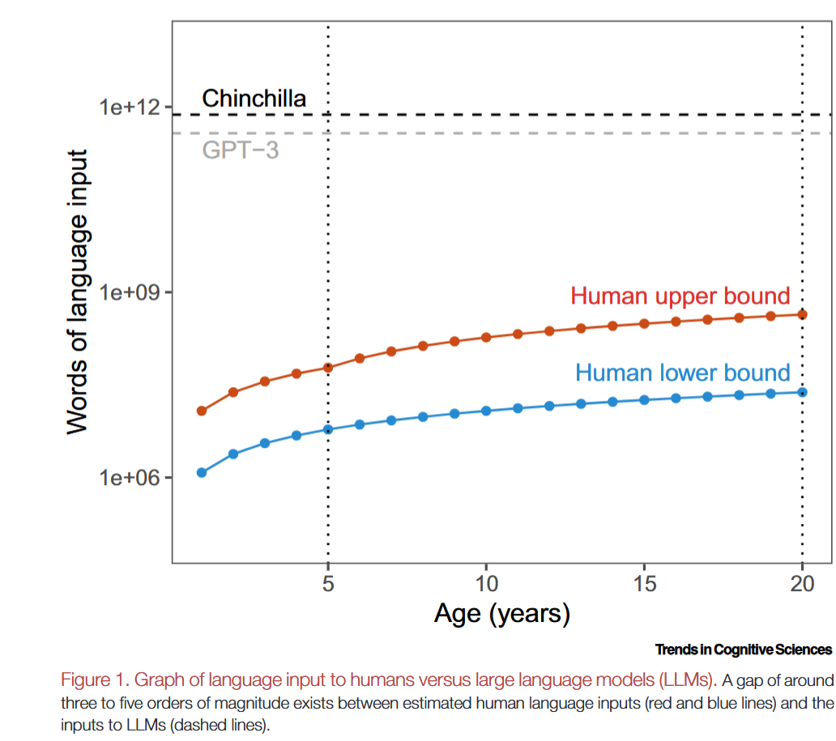
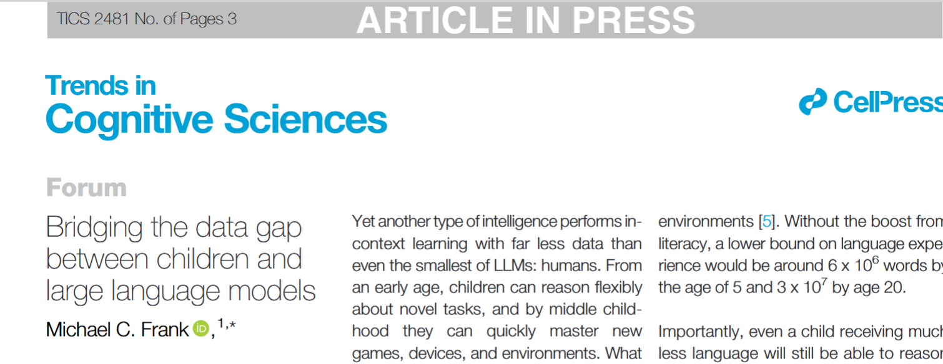
Wait, aren’t large language models learning language from scratch
Without dedicated neural structures

Slide 14
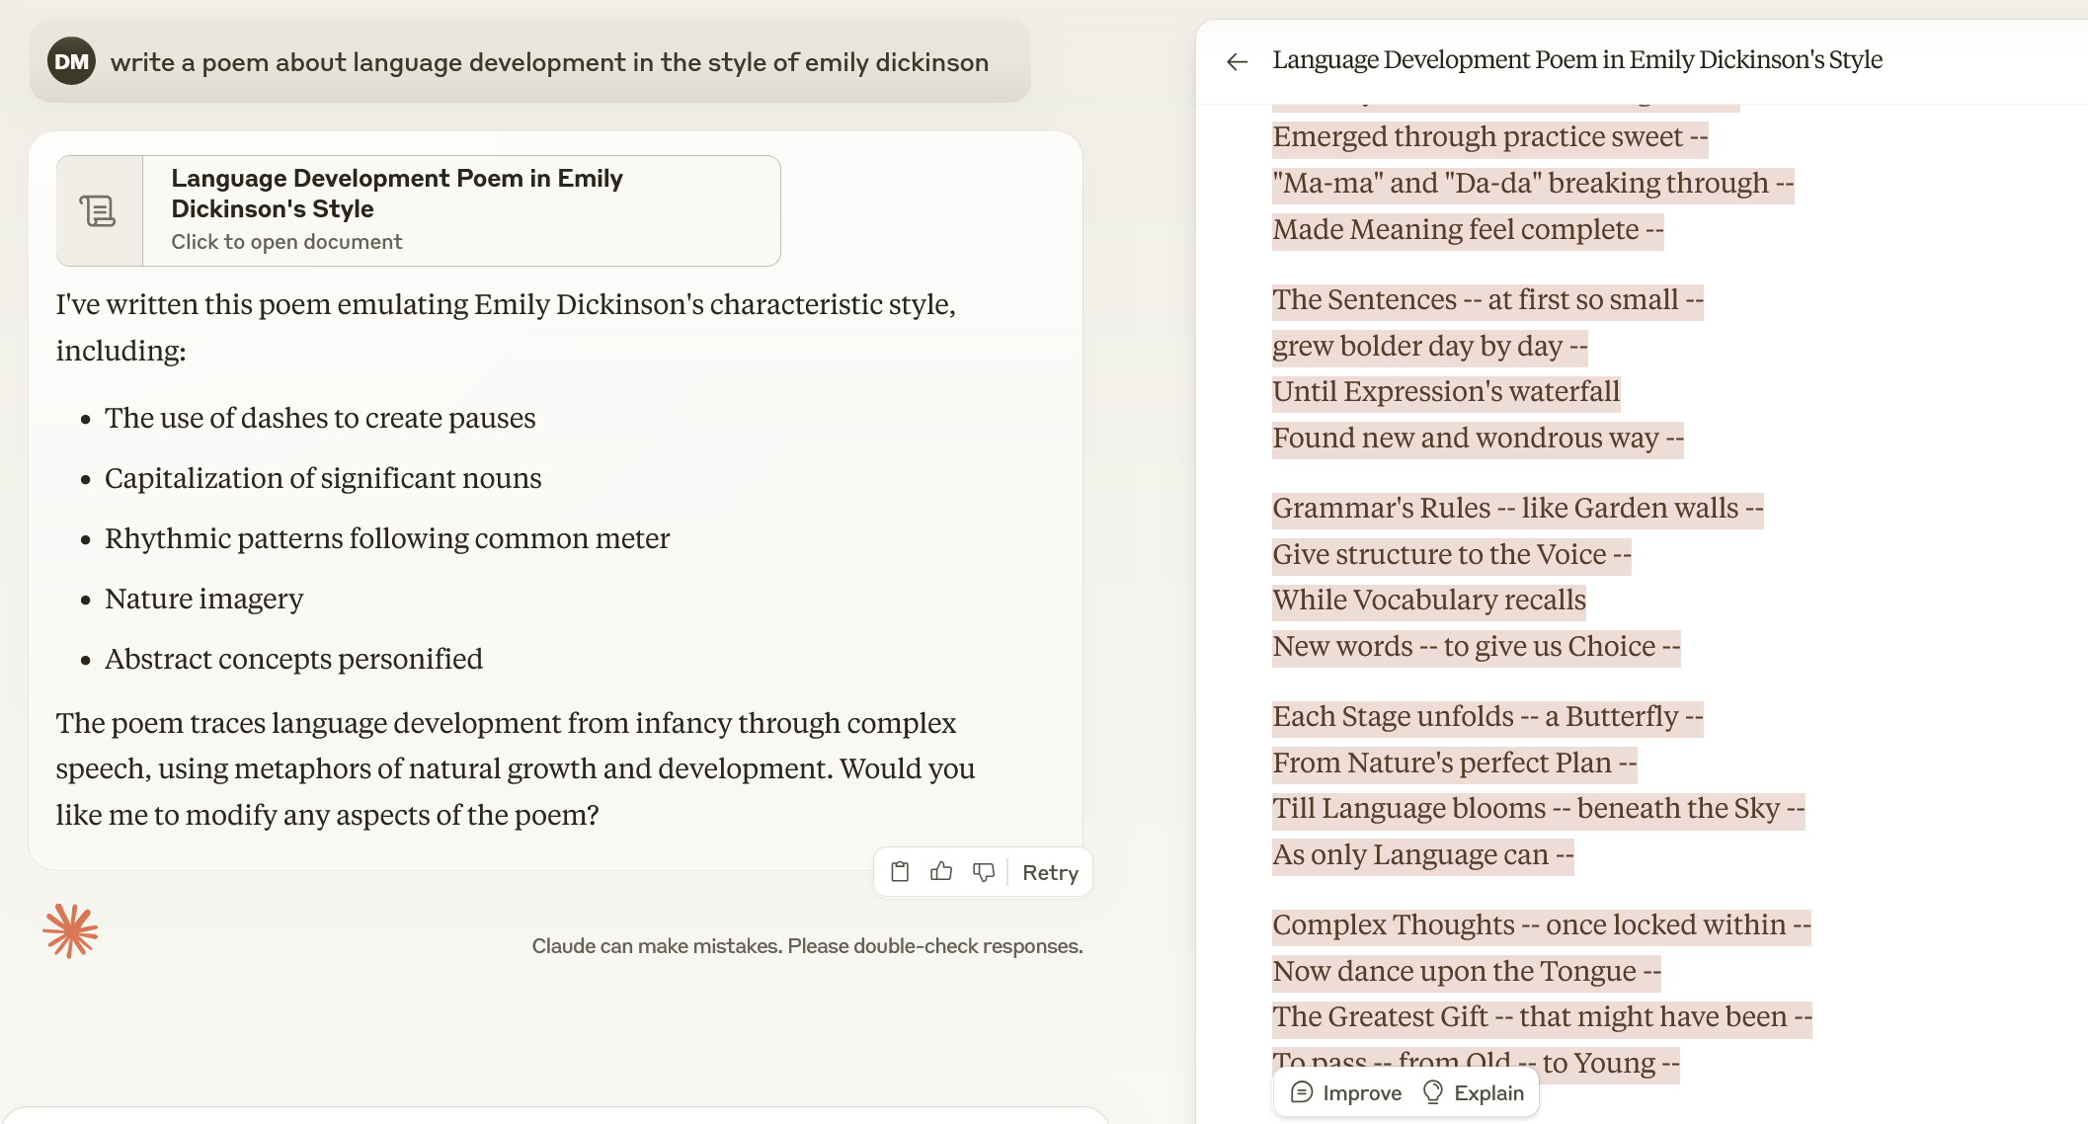
Claude wrote this
The Words began -- as Whispers do -- In Infant's tender Mind -- A precious Sound -- a Mother's "coo" -- The first of Human Kind
Then Syllables -- like Morning Dew -- Emerged through practice sweet -- "Ma-ma" and "Da-da" breaking through -- Made Meaning feel complete -
The Sentences -- at first so small -- grew bolder day by day -- Until Expression's waterfall Found new and wondrous way --
Grammar's Rules -- like Garden walls -- Give structure to the Voice -- While Vocabulary recalls New words -- to give us Choice --
Each Stage unfolds -- a Butterfly -- From Nature's perfect Plan -- Till Language blooms -- beneath the Sky -- As only Language can --
Complex Thoughts -- once locked within -- Now dance upon the Tongue -- The Greatest Gift -- that might have been -- To pass -- from Old -- to Young --

Slide 15
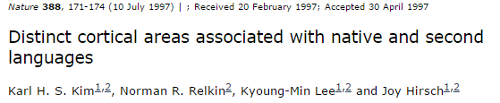
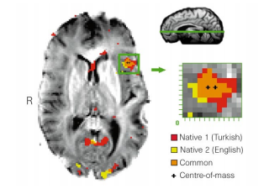
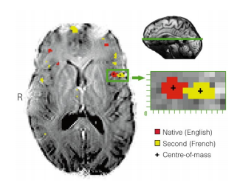
“Distinct cortical areas associated with native and second languages.”
Second language learning and the brain
Frontal Broca’s area (frontal)
  Language production
  EARLIER LEARNERS
    LATER LEARNERS
Kim KHS, Relkin NR, Lee K-M, Hirsch J: Distinct cortical areas associated with native and second languages. Nature 1997, 388:171-174.
Notes:
Figure 1 A representative axial slice from a ‘late’ bilingual subject (A) shows all
voxels that pass the multistage statistical criteria at P # 0:0005 as either red
(nativelanguage)oryellow(secondacquiredlanguage).Anexpandedviewofthe
pattern of activity in the region of interest (inferiorfrontal gyrus,Brodmann’s area
44 (refs 2, 3,18),correspondingtoBroca’sarea1–3
)indicatesseparatecentroids(+)
of activity for the two languages. Centre-of-mass calculations indicate that the
centroidsareseparatedonthisplaneby7.9mm.Thegreenlineontheupperright
mid-sagittal view indicates the plane location. R indicates the right side of the
brain.

Slide 16
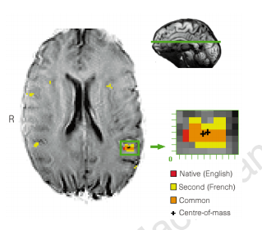
Little posterior difference in Wernicke’s area
Wernicke’s area (temporal)
  Language comprehension
Posterior area

Slide 17
Auditory Development
At birth audition among best developed senses
  Sensitivity to contrasts (e.g., /p/ vs. /b/)
  Ability to store auditory sequences
    Focus on stressed syllables and syllables immediately following stressed syllables
  Preference for language/voice of mother experienced prenatally
    DeCasper & Fifer, 1980
Notes:
Cross-species similarities and competencies suggest fundamental processes in mammalian ear and cochlear nucleus
Despite sophisticated auditory abilities still no connection between sound patterns and meanings

Slide 18
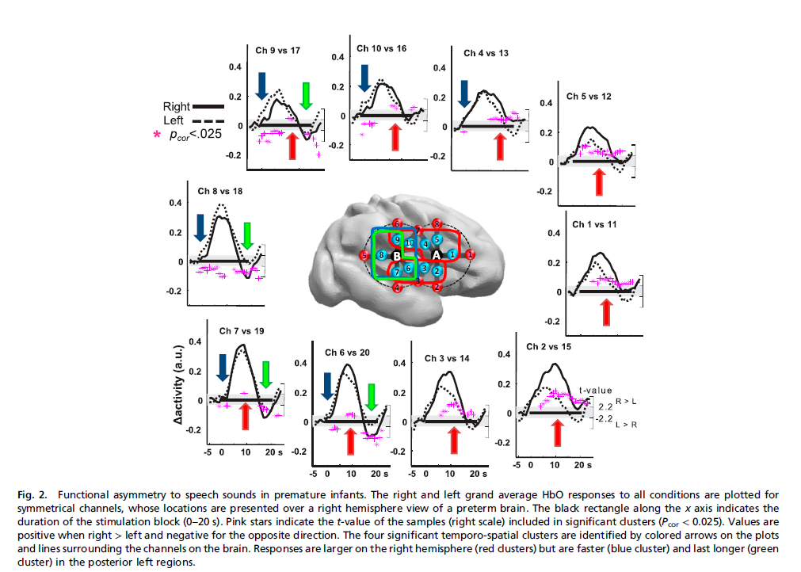
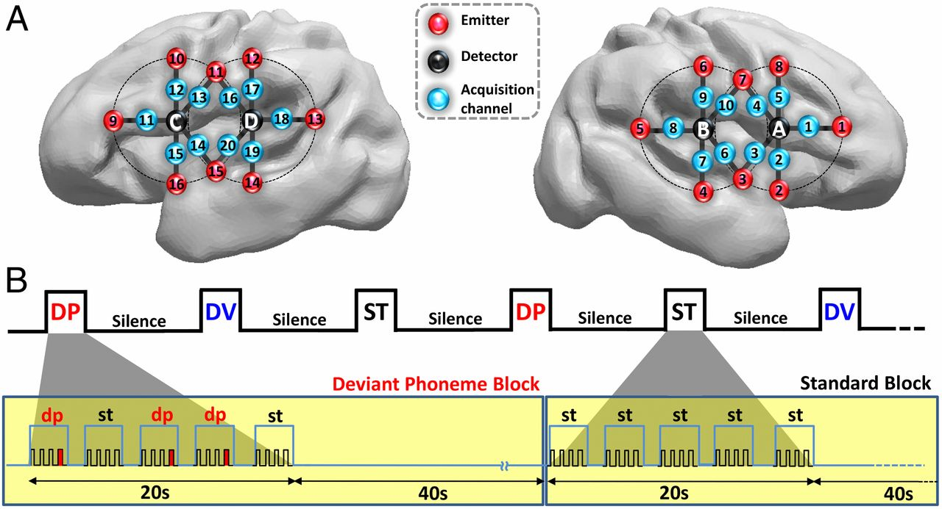
(A) Estimated projection of the optodes (channels 1–10: right hemisphere; channels 11–20: left hemisphere) on the brain of a 30 wGA preterm infant (Fig.
Mahmoudzadeh M et al. PNAS 2013;110:4846-4851
©2013 by National Academy of Sciences
Notes:
(A) Estimated projection of the optodes (channels 1–10: right hemisphere; channels 11–20: left hemisphere) on the brain of a 30 wGA preterm infant (Fig. S1). (B) Experimental paradigm, deviant phoneme (DP), deviant voice (DV), and standard (ST) blocks (Materials and Methods).

Slide 19
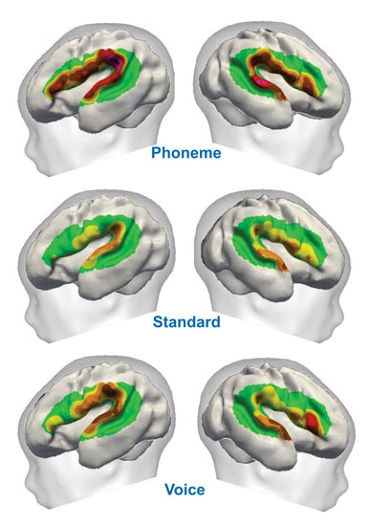
Going young—
Prenatal sensitivity to language
change of phoneme (left inferior frontal region)
Preterm NIRS
Able to distinguish
  Voice (male vs. female)
  Phonemes (/ga and /ba)
  Habituation (deviant) design
Similar areas of activation as adults during speech processing
Deviant phoneme (DP), deviant voice (DV), and standard (ST) blocks
Mahmoudzadeh et al. Syllabic discrimination in premature human infants prior to complete formation of cortical layers. PNAS, 2013, 110:4846-4851.
Notes:
Cross-species similarities and competencies suggest fundamental processes in mammalian ear and cochlear nucleus
Despite sophisticated auditory abilities still no connection between sound patterns and meanings

Slide 20
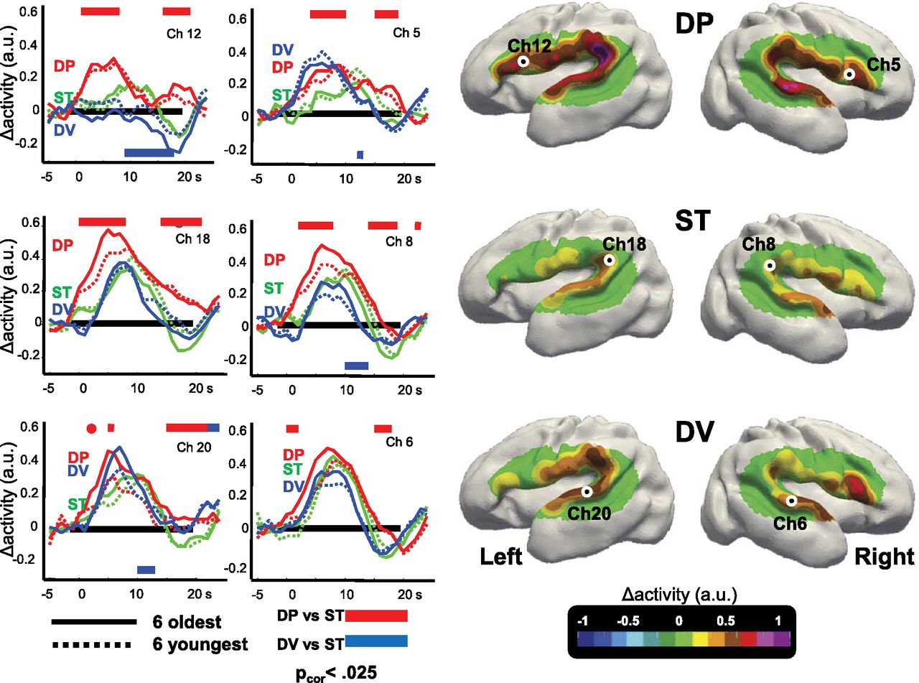
Preterm infants discriminate the change of phoneme (DP vs ST)
(left inferior frontal region)
Deviant phoneme (DP), deviant voice (DV), and standard (ST) blocks
Significance of possible age effect?
Mahmoudzadeh M et al. PNAS 2013;110:4846-4851
©2013 by National Academy of Sciences
Notes:
Discriminative responses to auditory stimuli in premature infants. (Right) Surface-based topographic color map of the HbO response at the peak of the hemodynamic response for the three conditions. (Left) HbO time courses for the youngest and oldest subsets of six infants, recorded over left Broca’s area (ch 12), left planum temporale (ch 18), left superior temporal gyrus (ch 20), and their counterlateral right channels (ch 5, ch 8, and ch 6, respectively). The colored rectangles indicate the time windows during which the deviant conditions differ significantly from the standard condition using cluster-based statistics over the whole group. The direction of the effect is given by the location of the bar under or above the x-line. Preterm infants discriminate the change of phoneme, notably in the left inferior frontal region. This effect was stable across our age range (28–32 wGA).

Slide 21
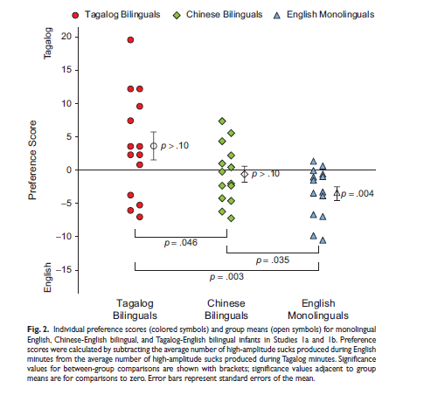
When does experience start? Prenatally based language preference
Byers-Heinlein et al. (2010)
Psychological Science
Notes:
Cross-species similarities and competencies suggest fundamental processes in mammalian ear and cochlear nucleus
Despite sophisticated auditory abilities still no connection between sound patterns and meanings

Slide 22
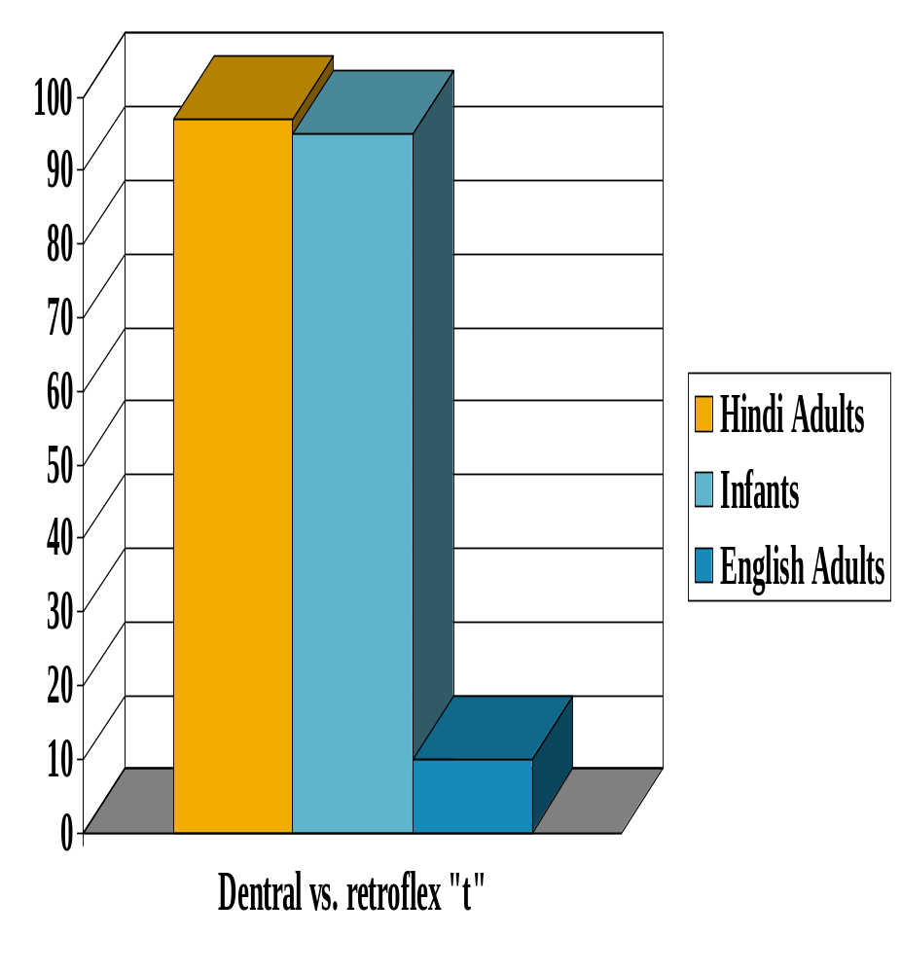
Auditory Development (experience)
In first six months
  Lose ability to make discriminations in foreign languages
    Bilingual exposure preserves flexibility
Notes:
Loss of non-exposed discriminations allows for greater quickness and automaticity in native tongue
** The secret life of the brain video***
Despite sophisticated auditory abilities still no connection between sound patterns and meanings

Slide 23

Similarity to English predicts vocabulary in 2nd language acquisition
‘3 measures of linguistic distance—phonological overlap, SVO order typology, and morphological complexity—predicted vocabulary knowledge in 2-year-olds learning British English and 1 of 13 target Additional Languages, above and beyond variance due to Language Community
  Children learning a language phonologically close to English had Additional Language production vocabularies
  Those learning typologically or morphologically close languages to English had a larger Additional Language comprehension vocabulary.’

Slide 24
Crying
Earliest vocalization –Curvilinear development
    at birth cry 1-1 1/2 hrs/day
    6 wks cry 2-4 hrs/day
    12 wks crying decreases
    Individual differences in quantity
Naturally occurring behavior
  Then recruited for communication
  Continuum of intentionality
  Both directed and undirected crying still present at 12 months
        Gustafson, G E.; Green, J A. Developmental coordination of cry sounds with visual regard and gestures. Infant Behavior & Development. 1991 Jan-Mar Vol 14(1) 51-57

Slide 25
Two crying functions
Earliest vocalization –Curvilinear development
    at birth cry 1-1 1/2 hrs/day
    6 wks cry 2-4 hrs/day
    12 wks crying decreases
    Individual differences in quantity
By 12 mo, most infants sometimes directed their crying toward the caregiver & elaborated cries with gestures.
  But most continued to exhibit simple, undirected crying.
Crying is both intentional and not intentional
increased variability & sophistication in form/ function.
        Gustafson, G E.; Green, J A. Developmental coordination of cry sounds with visual regard and gestures. Infant Behavior & Development. 1991 Jan-Mar Vol 14(1) 51-57

Slide 26
Different acoustic patterns
Basic hunger cry
  rhythmic pattern of loud crying, silence, inhalation
Pain cry
  loud, long shrill cry, then breath-holding silence
Fake cry
    low pitch and intensity, poorly articulated moans

Slide 27
Crying judgments
Adults have some capacity to distinguish
Judgment depends on care giving context as well as acoustics
Perceived aversiveness is important dimension of judgments about meaning of cries

Slide 28
Cries sound bad
There appears to be an underlying continuum of perceived aversiveness in young infants’ cries
That can be predicted by their duration, dysphonation, and proportion of energy in various frequencies
Parents and undergraduate non-parents perceive the cries as equally aversive.
        Gustafson, G. E.; Green, J. A. ‘Acoustic features of cry perception: Infant development. ’Child Development. 1989 Aug Vol 60(4) 772-780

Slide 29
Prelinguistic speech
Use of sounds in a communicative manner before speech (no words or grammar)
Progress through stages culminating in speech-like vocalizations
  Phonation, Gooing, Expansion, Canonical
    Some overlap in vocalizations characteristic of stages
        Kim Oller: https://local.psy.miami.edu/faculty/dmessinger/c_c/rsrcs/video_audio/oller_infant_sounds.mp3
        Kim Oller

Slide 30
Phonation Stage, 0-2/3 months
Vowel-like (“quasi-resonant”)
Produced with normal speech like phonation involving vibration of the larynx but with the vocal tract at rest
  “comfort or pleasure” sounds - can sound like grunts
The infant’s tongue almost completely fills the mouth limiting the sounds newborns can make
        the infant’s mouth is almost closed; sounds are flat and nasal sounding

Slide 31
Cooing/Gooing Stage, 1 - 4 months
Still vowel-like
  /e/ & /u/
  but last longer
more guttural & throaty
  produced in the back of the vocal cavity
thought to be precursors to consonants
  /k/ /g/

Slide 32
Expansion Stage, 3 - 8 months
Isolated vowel-like sounds
  Usually produced with the mouth open
  Full vowels (“fully resonant nuclei”)
Vocal repertoire expands dramatically
    Infants experiment with sound production, varying pitch, volume, rate
Intentional communicative play
  Already beyond pre-set animal calls
    Which have set form and set causes
  Infant vocalizes for pleasure (just to have fun) or displeasure

Slide 33
Checking out the new sound system
Yells/whispers: playing with amplitude/intensity
    yells = high intensity, whispers = low intensity
Squeals & Growls: playing with pitch
  squeals = high pitch, growls = low pitch
Raspberries
  labial trill & vibrants
    Cannot transcribe as adult syllables
Marginal babbles
  consonant-vowel (CV) sequences
  the transition between C & V is slow and drawn out
  immature syllables

Slide 34
Functional flexibility of infant vocalization. Oller, et al. 2013. PNAS
‘Three types of infant vocalizations (squeals, vowel-like sounds, and growls) express a full range of emotional content—positive, neutral, and negative by 3–4 mos.
  Contrast: cry and laughter are species-specific signals apparently homologous to vocal calls in other primates, show functional stability, with cry overwhelmingly expressing negative and laughter positive emotional states.’

Slide 35
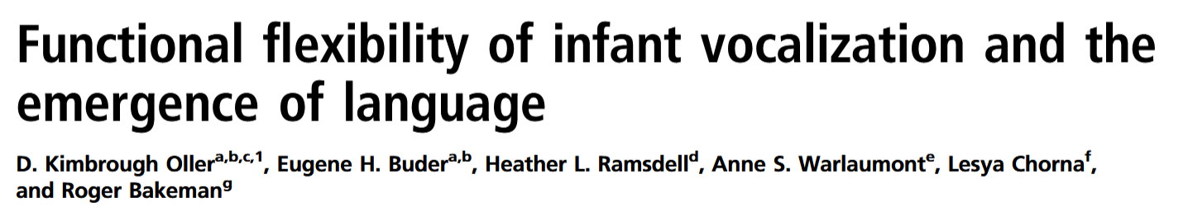

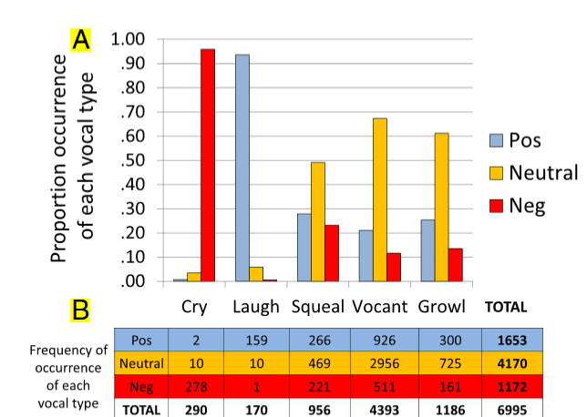

Slide 36
‘Functional flexibility is a sine qua non in spoken language
Appears before syntax, word learning, and even joint attention, syllable imitation, and canonical babbling. The appearance of functional flexibility early in the first year of human life is a critical step in the development of vocal language and may have been a critical step in the evolution of human language, preceding protosyntax and even primitive single words.’

Slide 37
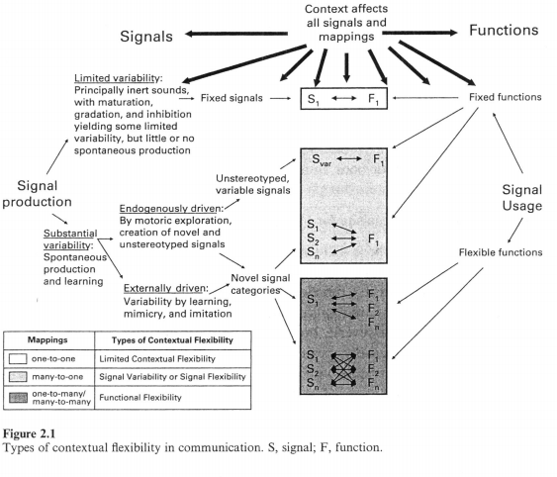
Signal flexibility—a phylogenetic prerequisite for functional flexibility
Mirrors species’ language development?
Oller, K.

Slide 38
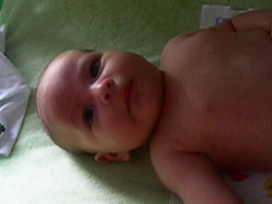
Articulatory Development
  Cooing (3 mos)
  Consonant-vowel syllables (e.g., /ta/ /pe/) (6 mos) → babbling
    Babbling maintained and refined by linguistic experiences & auditory feedback
      Deaf babies lose interest in verbal babbling after 6 mos
  Babbling becomes less universal and more similar to native language by 12 months
    Nature vs. Nurture perspectives on change
Notes:
Role of experience in babbling – proprioceptive and somaesthetic feedback from hearing self speak
Liam-video squealing and precrawling
By 12 months, structure of babbling becomes clearer, more controlled, and more organized
Piagetian explanation of babbling; child assimilates schema of mouth motions to the perceptual schema of audition, proprioception and oral somaesthesia
Despite sophisticated auditory abilities still no connection between sound patterns and meanings

Slide 39
Canonical Babbling Stage, 6-10 mos
Consonant-vowel syllables (e.g., /ta/ /pe/) (6 mos) → babbling
  Babbling maintained/refined by experience / auditory feedback
    Deaf babies lose interest in verbal babbling after 6 mos
CV sequences
  /ma/ /da/ /ada/
Transition between CV are crisp
  Sounds like natural syllables in parent’s language
  Parents good at identifying this stage
Reduplicated babbling
  /baba/ /dadada/ /mama/
Babbling becomes more similar to native language by 12 months

Slide 40
Importance of Babbling
Involves increasing control over the articulatory mechanism
Important pre-speech developmental milestone
Should be present by 10 months!
  Occurs in Down Syndrome, premature, low SES kids and in all cultures
  But its delayed in hearing impaired infants and deaf children

Slide 41
Limitations of Babbling
At end of stage, infants begin to use patterns or rising intonation that resemble adult speech
  also known as gibberish, jargon, or conversational babbling
  It may have intonation contours of language being learned
  Infants learn the music before the words
Does not refer (to objects, people, etc.)
Is not language
https://www.youtube.com/watch?v=_JmA2ClUvUY

Slide 42
Integrative stage (9-18 months)
Beginning of meaningful speech
Some mixing of babbled utterances and words
Gibberish: (jargon) use of adult intonation patterns but what they say makes no sense
  sounds like the child is having a conversation but you can’t understand what they are saying
  http://www.wimp.com/babyboys/

Slide 43
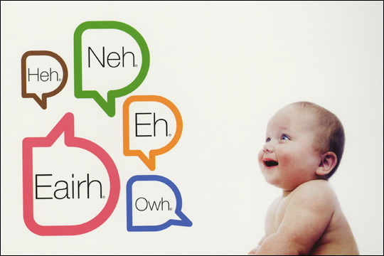
Automated Vocal Analysis of Naturalistic Recordings from Children with Autism, Language Delay, and Typical Development. Oller et al (2010)
Oller et al. (2010) illustrates a method to obtain measures of early speech development through automated analysis of massive quantities of day-long audio recordings collected naturalistically in children’s homes

Slide 44
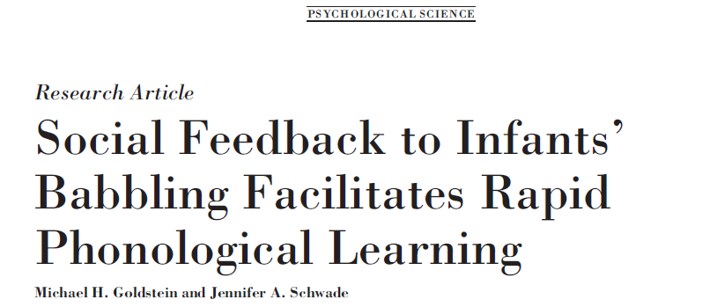
2008
Spectrograms and example vocalizations: does not work http://www.indiana.edu/~aviary/baby_vocalizaitons.htm

Slide 45
Production: Infant vocal development
Infants typically speak first words by 12 months
Learn to produce speech-like syllables (phonemes) first
Language structured according to environment
How does this occur?
    Most research emphasizes anatomical changes of vocal tract
    Social environment plays important role
    Has previously been ascribed to imitation

Slide 46
Infant vocal development
    By 8 months, infants categorize speech into phonemes congruent with native language
    Do caregivers respond to babbling and cause changes in patterns of vocalizations (contingent reinforcement)?

Slide 47
Social influences: Feedback changes structure of infant vocalizations in the moment
Caregivers respond to babbling and cause changes in patterns of vocalizations (contingent reinforcement)?
  Even though these vocalizations occur in a specific developmental order
      2008

Slide 48
Method
    General:
      60 infants, 9.5-month-olds and caregivers, playroom
      Instructions to parents through headphones
      Second session with three parts (baseline 1, social response, baseline 2) each ten minutes long
    Conditions (4): looking at types of vocal learning AND contingent reinforcement
      Contingent response with fully resonant vowels (contingent-resonant)
      Contingent response with words to introduce consonant-vowel combinations (contingent-CV group)
      Yoked control conditions for each- matched with a contingent dyad
    Coding:
      Types of vocalizations, frequency of vocalizations,

Slide 49
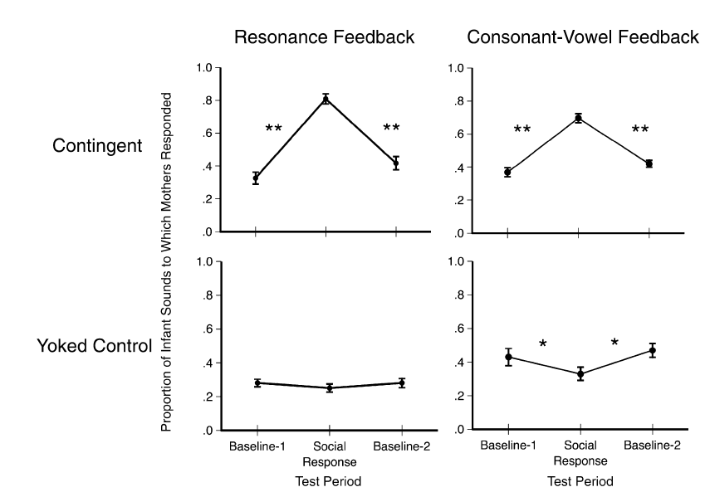
Mothers contingently responded to vowels (resonance) or babbles (consonant-vowels)
Notes:
Fig. 1. Mean proportion (1 SE) of infants’ sounds to which mothers responded in each 10-min test period. Data are reported for the contingent and
yoked control conditions in both feedback groups. Asterisks indicate a significant change from one test period to the next np < .05, nnp < .01.

Slide 50
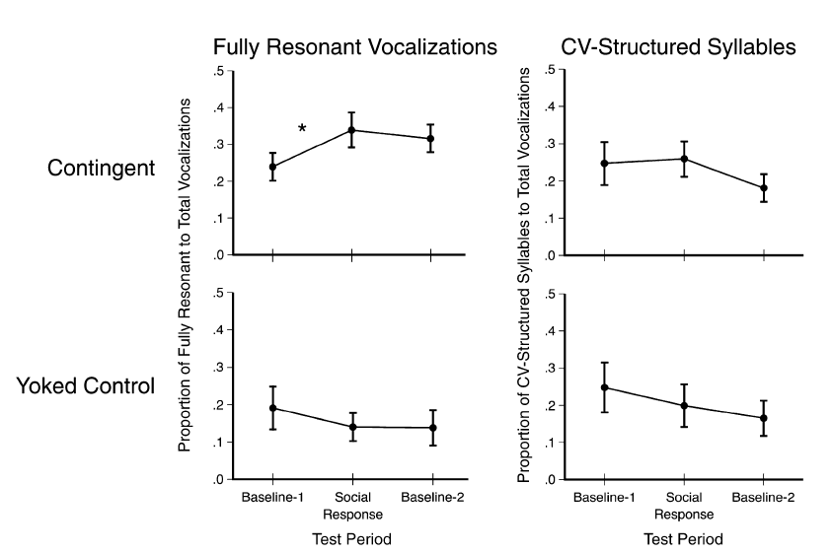
Resonance feedback promotes resonant vocalizations
Notes:
Fig. 2. Changes in vocalization quality for infants in the contingent and yoked control conditions who received feedback structured as fully resonant
vowels (resonance feedback group). Graphs in the left column indicate the ratio (mean 1 SE) of fully resonant to total vocalizations across the three
10-min test periods. Graphs in the right column indicate the ratio (mean 1 SE) of syllables with consonant-vowel (CV) structure to total vocalizations
across the three 10-min periods. The asterisk indicates a significant change between test periods, p < .05.

Slide 51
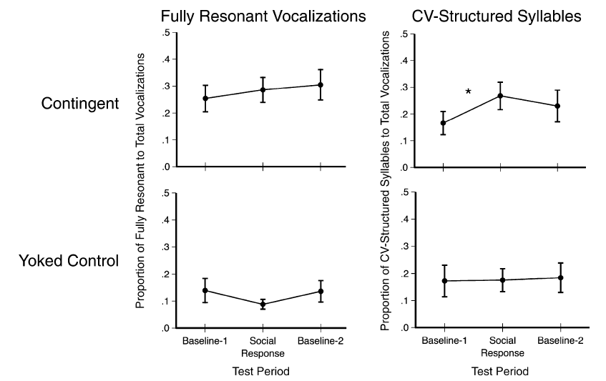
CV feedback promotes CV vocalizations
Notes:
Fig. 3. Changes in vocalization quality for infants in the contingent and yoked control conditions who received feedback structured as consonantvowel
(CV) syllables (CV feedback group). Graphs in the left column indicate the ratio (mean 1 SE) of fully resonant to total vocalizations across the
three 10-min test periods. Graphs in the right column indicate the ratio (mean 1 SE) of CV-structured syllables to total vocalizations across the three
10-min periods. The asterisk indicates a significant change between test periods, p < .05.

Slide 52
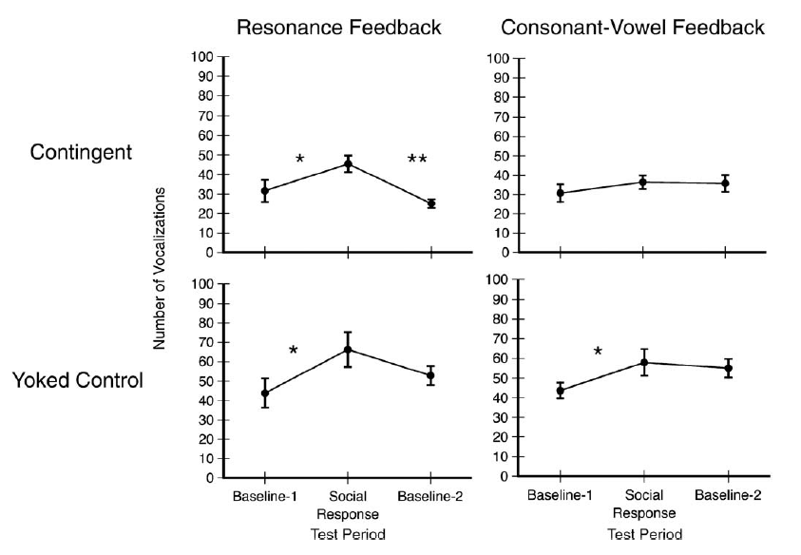
Overall infant vocalizations
?
Notes:
Fig. 4. Mean number (1 SE) of infant vocalizations produced in each 10-min test period. Data are reported for the contingent
and yoked control conditions in both feedback groups. Asterisks indicate a significant change from one test period to the next, np < .05, nnp < .01.
Volume 19—

Slide 53
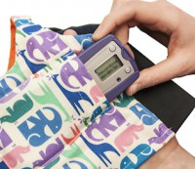
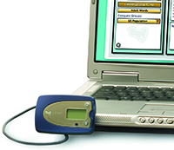
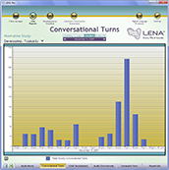
Naturalistic Recordings
232 children (106 typically developing, 49 language delayed, 77 with autism
1,486 all-day recordings from 232 children, with more than 3.1 million automatically identified child utterances
Automated Vocal Analysis of Naturalistic Recordings from Children with Autism, Language Delay, and Typical Development. Oller et al (2010)
Notes:
Automatic Language Assessment in Three Steps (Lena Foundation):
1. Insert recorder into clothing at start of day. 2. At end of recording session, plug recorder into computer. 3. Software processes the audio file, analyzes the language, and generates reports.
Records up to 16 hours of continuous speech data (for children 2 to 48 months)
This device has been used since 2006 with the three subsamples examined in this study: typically developing language, language delay, and autism.

Slide 54
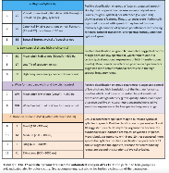
Automated Vocal Analysis
1,486 all-day recordings from 232 children, with more than 3.1 million automatically identified child utterances
Identify speech-related child utterances (SCUs)
  discard child cries and vegetative sounds
Divide SCUs into speech-related vocal islands (SVIs)
  high energy periods (salient syllables in SCUs) bounded by low-energy
SVIs were analyzed on 12 infrastructural acoustic features reflecting rhythmic/syllabic articulation and voice with roles in speech development
  4 conceptual groupings: RhSy, LtHp, BwLp, and duration
  The algorithm determined whether the SVIs had each of the 12 features
Notes:
Autism diagnosis is based heavily on “negative markers” such as joint attention deficit and associated communication deficits. Abnormal vocal characteristics would constitute a positive marker that might enhance precision of screening or diagnosis. (Oller et al, p. 13355)
Four conceptual Groupings:
rhythm/syllabicity (RhSy),
(ii) low spectral tilt/high pitch control (LtHp, designed to reflect certain voice characteristics)
(iii) high bandwidth/low pitch control (BwLp, designed to reflect additional voice characteristics)
(iv) duration
the term “meaningful speech” has been used to refer to speech- related vocalizations. The present work adopts the term “speech-related” to ensure the understanding that both speech and many prespeech vocalizations such as cooing and babbling are understood to be included under the term.

Slide 55
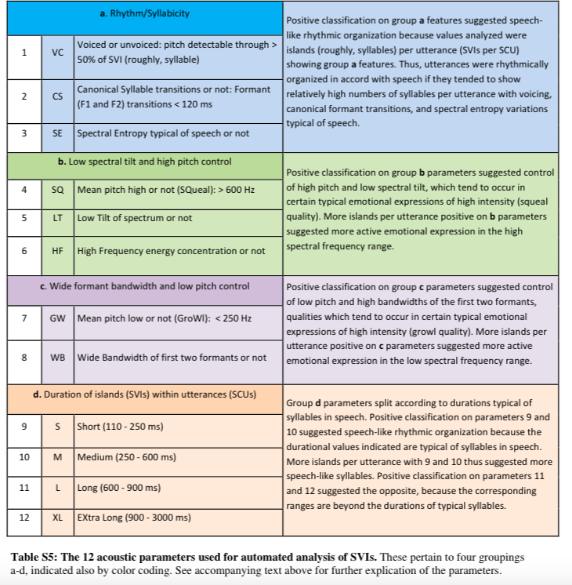

Slide 56
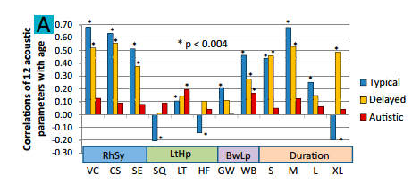
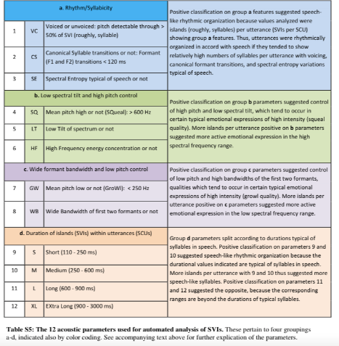
Vocal parameters change with age for typical developing/language-delayed, not ASD
Notes:
Correlations between child age and SVI/SCU ratios for the 12-parameters showed clear evidence that the automated analysis predicts development.
All 12 correlations for the typically developing sample and 7of 12 for the language-delayed sample were statistically significant after Bonferroni correction (P < 0.004).
Sample.
Participants: boys appeared disproportionately in disordered groups (language delayed, autism); mothers’ educational level was higher for children with language disorders
232 children in entire sample: 106 typically developing, 49 language delayed, and 77 autism

Slide 57
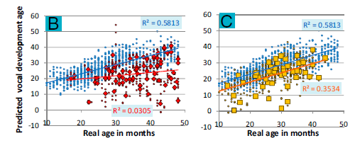
ASD children’s vocal parameters do not change with age
Blue—
Typical/Language Delay
Gold—Child Means
Blue—Typical
Red—ASD

Slide 58
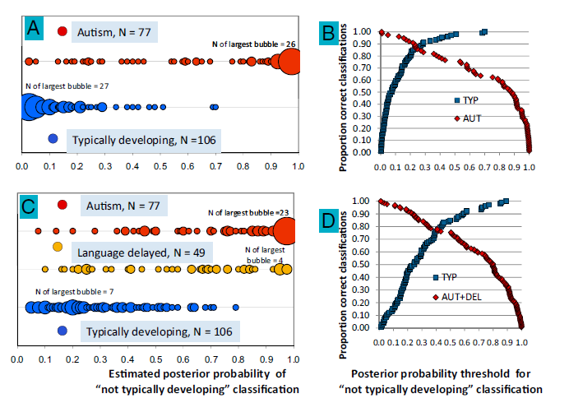
Allowing for Identification
Estimated posterior probability of
“not typically developing” classification
Posterior probability threshold for
“not typically developing” classification
Notes:
Linear discriminant analysis (LDA) used to model classification of children into the groups based on the acoustic parameters.
-> Fig A bubble graph Autism and Typically Developing: For 26/77 children with autism, probability of autism was nearly 1. For 27/106 typically developing children, probability of autism was nearly 0.
Fig B: 86% of children with autism correctly identified and 86% of typically developing children correctly identified.
Fig. 3. LDA with LOOCV indicating differentiation of child groups. Estimated classification probabilities were based on the 12 acoustic parameters. Results
are displayed in bubble plots, with each bubble sized in proportion to the number of children at each x axis location (the number of children represented by
the largest bubble in each line is labeled). The plots indicate classification probabilities (Left) and proportion-correct classification (Right) for LDA in (A and B)
children with autism (red) versus typically developing children (blue) and (C and D) a combined group of children with autism (red) or language delay (gold)
versus typically developing children (blue).

Slide 59
Developmental Tracking and Group Differentiation
Primary factor: child’s control of infrastructural features of syllabification
Differentiated between children with and without a language disorder with higher accuracy than between the two language disorder groups (autism and language delay)
Notes:
- Vocalization patterns, particularly the ability to form syllables, were a significant predictor of future language development and could distinguish children with ASD from those who were developing typically and, to a lesser degree, from those with language delay.
However, in the typically developing sample, the PC most associated with control of the RhSy parameters was highly predictive of age, but in the autism sample, no such predictiveness was found.
A typically developing child’s age can be predicted at high levels (accounting for more than two thirds of variance) based on this first attempt at totally automated acoustic modeling with all-day recordings.
Conclusions:
Informative analysis of acoustic content of infant vocalizations by automated means
Massive scale of analysis, no human intervention
Developmental tracking + Group Classification possible

Slide 60
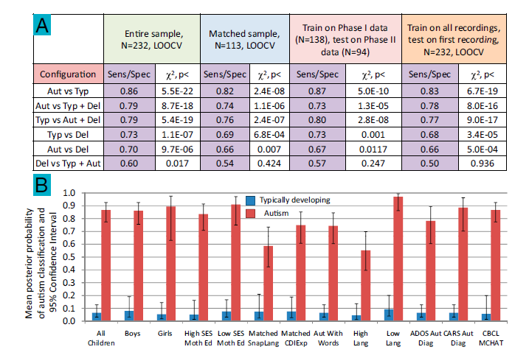
LDA Showing Group Discrimination

Slide 61
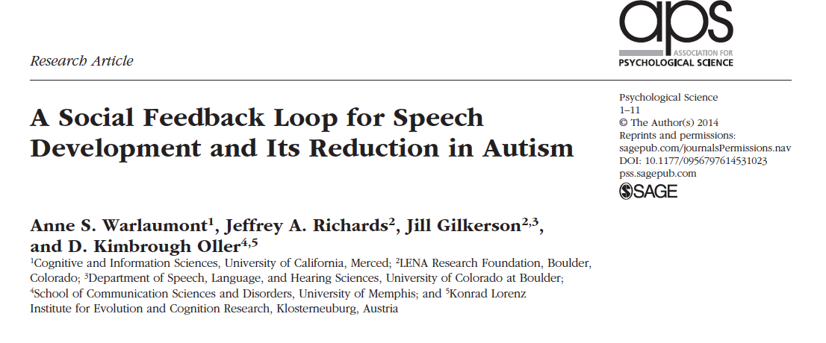
Preudhomme

Slide 62
Prior findings
Tendency to produce speech-related vocalization more frequently if caregivers’ responses are contingent of infant vocalizations
  Child’s future vocalizations tend to resemble adult contingent vocal response (more similarity to speech, more vowel resonance, or better consonant-vowel timing)
Mother’s responsiveness to infant’s communicative behaviors predicts infant’s language performance at a later age
Greater vocal coordination between infant and adult predicts better language, cognitive, and perceptual ability later
Literature focused on TD infants, with some focus on children with developmental disabilities
Preudhomme

Slide 63
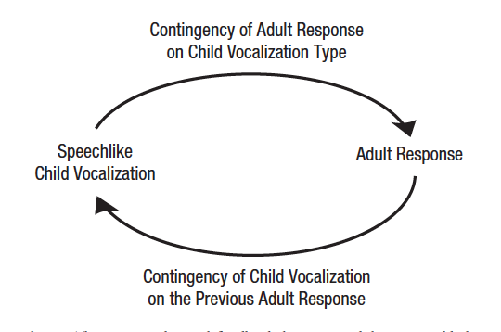
Proposed social feedback loop
Preudhomme

Slide 64
Study Aims
To determine whether speech vocalizations increase in likelihood of receiving parent response compared to non-speech vocalizations
  To determine whether a child’s vocalization will be speech related if prior speech response received an immediate response from adults
To compare typically developing and ASD children in terms of frequency of children’s vocalization and patterns of child-caregiver vocal interaction
Preudhomme

Slide 65
Additional effects tested:
1. Age of child
2.Maternal education level (SES proxy)
3. Child’s gender
Preudhomme

Slide 66
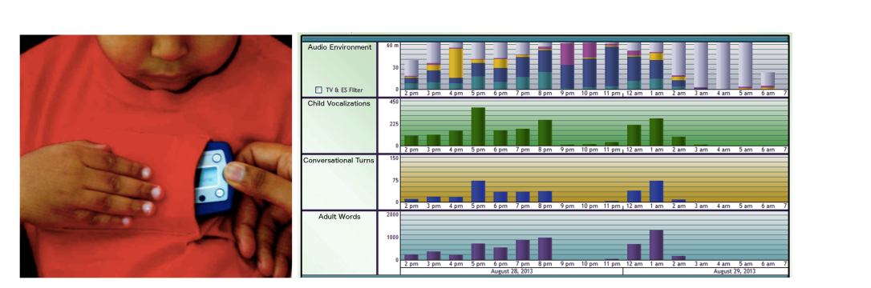

Method
Participants
  106 TD (age 8-48months, 55% female)
  77 ASD (age 16-48 months, 83% male)
Audio recordings
  Language ENvironment Analysis system (LENA) for at least 12 hours across settings (home, car, school, speech-language therapy)
  Recordings automatic segmented by sound source
    Child wearing the recorder (speech related and non-speechlike)
    Any adult
Analyses completed on main dataset and alternative dataset
Preudhomme

Slide 67
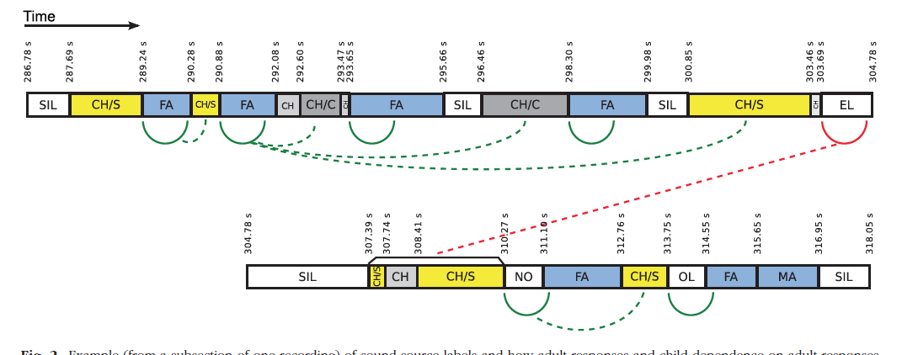
Sound-source labels and how adult responses and child dependence on adult responses were measured
child’s speech-related vocalizations
female and male adults
dashed curves:
child’s vocalization followed a previous speech-related vocalization that received an adult response (green)
or did not receive an adult response (red)

Slide 68
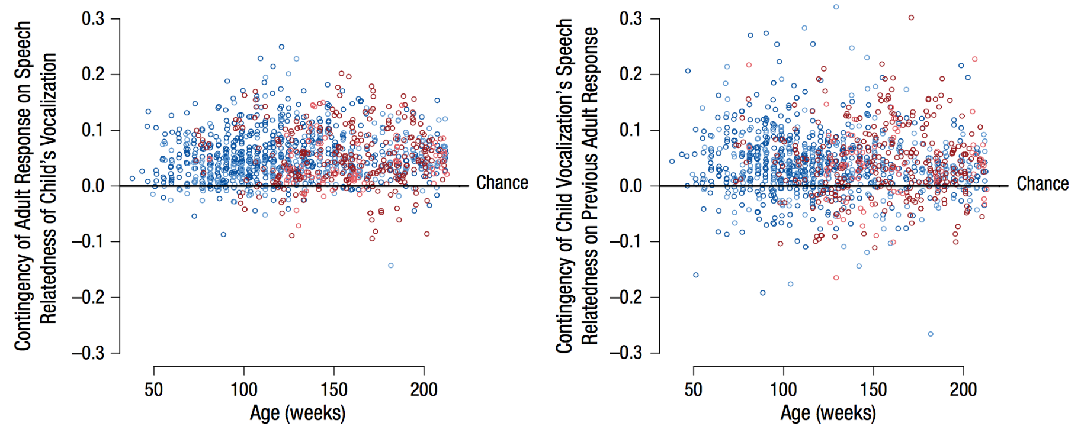
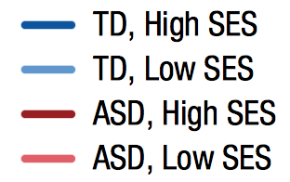
When children’s vocalizations are speech-related, they are more likely to receive a positive response from an adult
Children’s future vocalizations are more likely to be speech-related if their previous speech-related vocalizations received a positive response from an adult

Slide 69
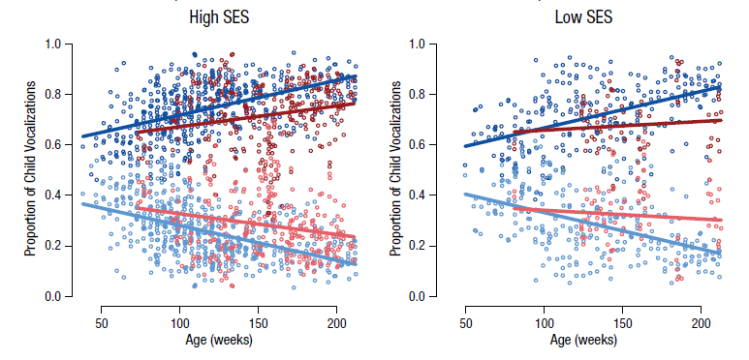
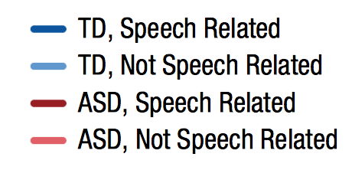
Age-related increase of speech-related vocalization slower in ASD group
Speech and non-speech related should diverge

Slide 70
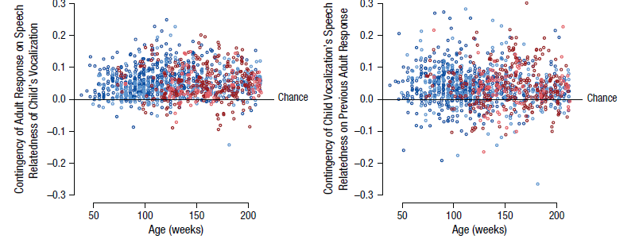
Two-way contingencies
Child speech-relatedness
→ adult response
Adult response
→ child speech-relatedness
difference between the proportion of children’s speech-related vocalizations receiving an immediate adult response and the proportion of children’s non-speech-related vocalizations receiving an adult response
Proportion significant but weaker for ASD
Proportion significant, no ASD difference
Increased likelihood of adult response when child vocalization was speech related., weaker in ASD group
Content of child’s vocalization(speech-relatedness) was related to
previous adult response , no sig difference between groups
Children’s future vocalizations are more likely to be speech-related if their previous speech-related vocalizations received a positive response from an adult
Notes:
When children’s vocalizations are speech-related, they are more likely to receive a positive response from an adult
Children’s future vocalizations are more likely to be speech-related if their previous speech-related vocalizations received a positive response from an adult

Slide 71
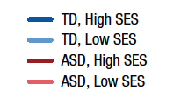
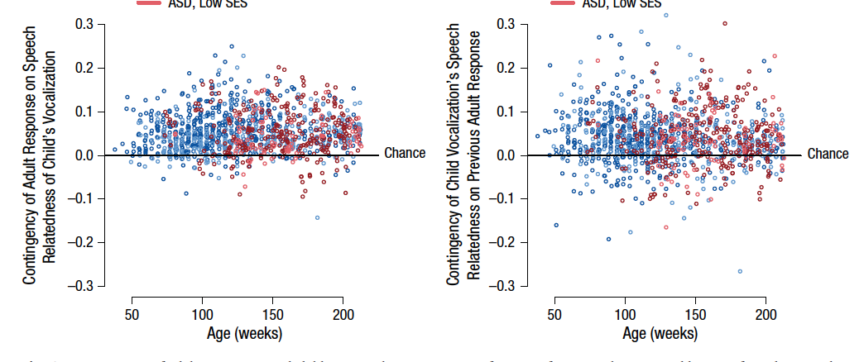
Increased likelihood of adult response when child vocalization was speech related., weaker in ASD group
Content of child’s vocalization(speech-relatedness) was related to
previous adult response , no sig difference between groups
Preudhomme
Notes:
he probability of a child’s vocalization being speech related was on average .042 (also .042 for the matched subsample) greater when the child’s previous speech-related vocalization had received a response than when it had not received a response, p < .001.

Slide 72
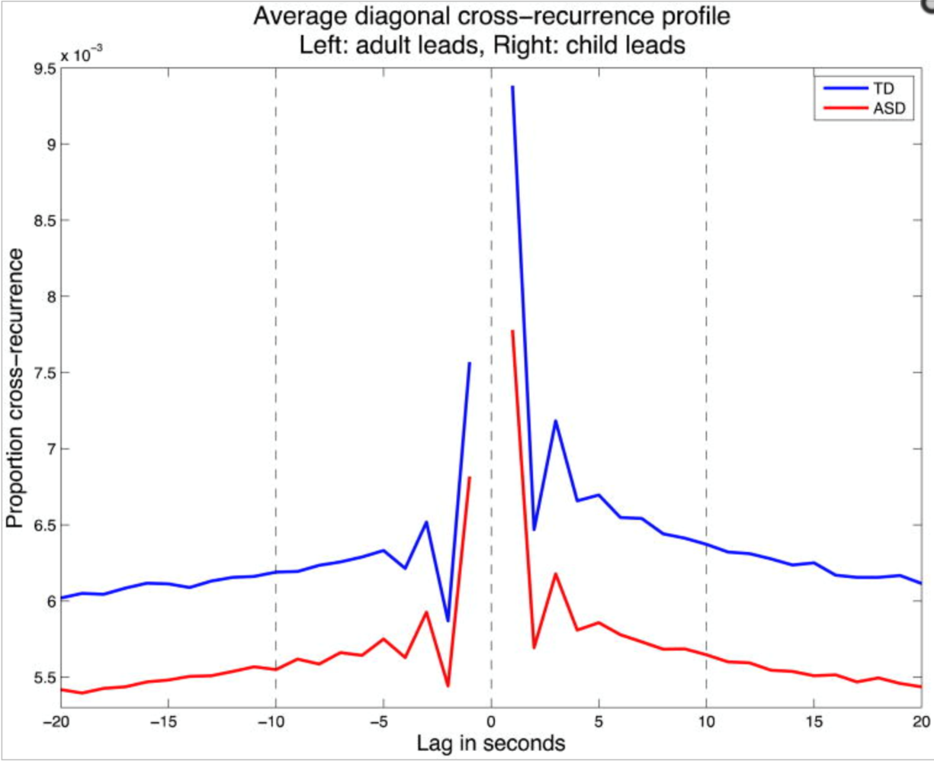
TD children higher number of child-caregiver interactions than children with ASD
Adult’s vocalization preceded the child’s
(adult leads)
Child’s vocalization preceded
the adult’s
(child leads)
ASD child lead relative deficit
Children with ASD displayed a lower ratio of leading to following than TD children
Less interaction overall between parent and child
And
Lower ratio of leading to following for children with
autism compared with TD children.

Slide 73
Role of ASD in proposed social feedback loop
Fewer vocalizations
Adult response to child vocalization less contingent on its speechlike character
Ability to learn from adults’ contingent responses
Preudhomme

Slide 74
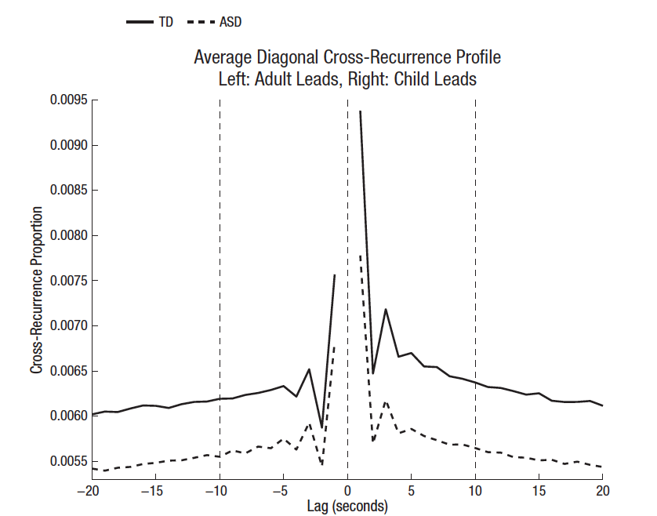

Less interaction overall between parent and child
And
Lower ratio of leading to following for children with autism compared with TD children.
Adult’s vocalization preceded the child’s
Child’s vocalization preceded
the adult’s
Preudhomme

Slide 75
Conclusions
To determine whether speech vocalizations increase in likelihood of receiving parent response compared to non-speech vocalizations
  To determine whether a child’s vocalization will be speech related if prior speech response received an immediate response from adults
    Adult response was contingent on speech relatedness of child’s response
    Findings supported proposed social feedback loop
To compare typically developing and ASD children in terms of frequency of children’s vocalization and patterns of child-caregiver vocal interaction
  Children with ASD produced fewer vocalizations than TD children (Disruption in feedback loop)
  Responses from adult were less contingent on the vocalization of child being speech-related
Preudhomme

Slide 76
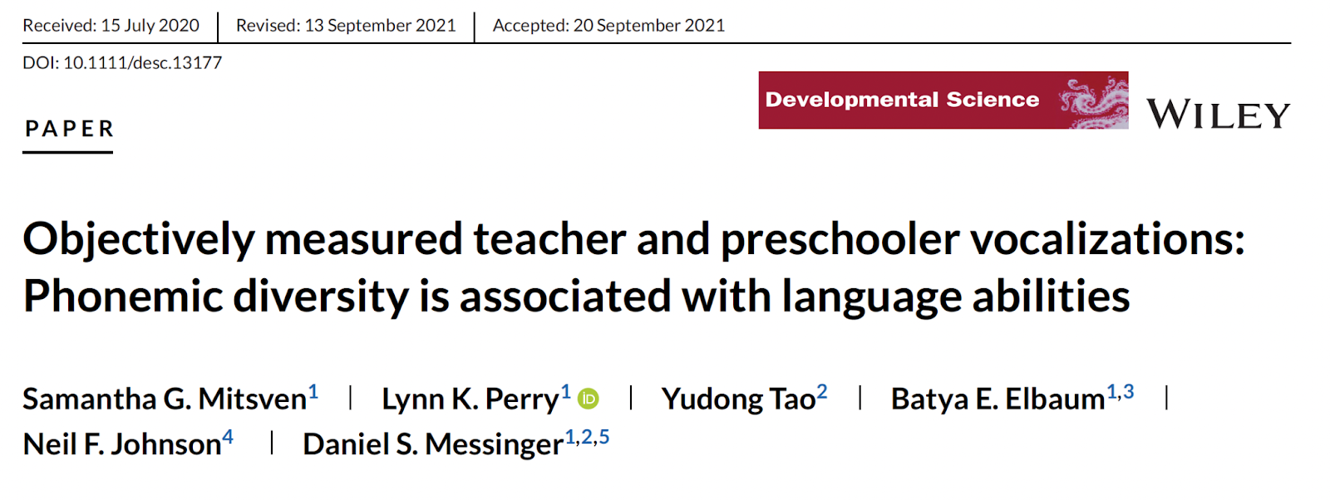

Slide 77
Future language proficiency
School readiness
Academic achievement
Language Quantity & Quality
Notes:
The quantity and quality of children’s language input is an important predictor of future language proficiency, school readiness, and academic achievement.

Slide 78
Quality Language Experiences
Diversity of input
Conversational turn-taking
Responsiveness to child vocalizations
Notes:
Features of high quality language experiences, including diversity of input, conversational turn-taking, and parental responsiveness to children’s vocalizations, are associated with more favorable language outcomes

Slide 79
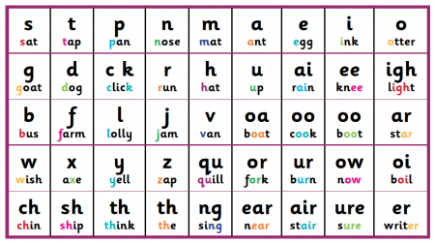
Notes:
Phonemic diversity is a measure of the number of unique consonant and vowel sounds in speech-related vocalization.
Phonemes serve as the basic building blocks of language and children who produce more recognizable phonemes have more building blocks from which to produce words.

Slide 80
Children with Hearing Loss
LANGUAGE QUANTITY
LANGUAGE QUALITY
Children with hearing loss are exposed to and produce language that is less complex and diverse than typically hearing children
Some studies report decreased language directed toward children with hearing loss and others report similar rates of input as typically hearing children

Slide 81
Current Study
Measured the quantity (rate) and quality (phonemic diversity) of children’s classroom language experiences
Does the rate/phonemic diversity of children’s language input predict the rate/phonemic diversity of their own language production
Is the rate/phonemic diversity of children’s language input/production associated to their receptive and expressive language abilities?
Does the rate/phonemic diversity of children’s own speech-related vocalizations mediate the relationship between their linguistic input and end-of-year language abilities?
1
2
3

Slide 82

Methods
Vocalizations were recorded using individual LENA recorders
Language abilities were assessed with the Preschool Language Scales, Fifth Edition (PLS-5)
Notes:
Language Environment Analysis (LENA) audio recorders and processing software, allow for the unobtrusive measurement of children’s language input and production over multi-hour timescales.

Slide 83

Results
Children exposed to more phonemically diverse vocalizations from teachers produced more phonemically diverse speech-related vocalizations themselves

Slide 84

Kids who produced more phonemically diverse speech-related vocalizations had higher receptive (Figure 2a) and expressive language abilities (Figure 2b) at the end of the school year.

Slide 85
Results
The phonemic diversity of children’s speech-related vocalizations uniquely predicted both receptive and expressive language abilities above and beyond the quantity of their vocalizations.
Greater phonemic diversity of teacher vocalizations was associated with greater language abilities, insofar as it was associated with greater phonemic diversity of children’s speech-related vocalizations.

Slide 86
Main Takeaway
Richer teacher vocalizations
Richer preschooler vocalizations
Higher language abilities

Slide 87
Discussion Questions

Slide 88
First word definitions
Function
  They are first words because they refer
  Arbitrary sound is paired with an object
  Often but not always nouns in the environment

Slide 89
First word learning
  Comprehension > Production
    Perhaps less in ASD
  Production lags behind perception
    Words as simplifications of adult forms (sip vs. ship)
      Drop unstressed syllables, repeat consonants
Notes:
Reinforced preferential learning paradigms show that comprehension preceeds production by about 2-3 months
Infants don’t have innate knowledge that words NEED to involve some spoken verbal form; (or else deaf kids would have trouble learning sign language)—also check literature on sign language learning in Typically developing kids
First words expressed based on dynamic interaction of developments; (1) ability to record sound of words; (2) ability to control vocal productions, (3) symbolic function (as represented in play, imitation, object manipulation)
Children acquire words in receptive vocabulary more than twice as fast as into their productive vocabulary
U-shaped learning processes; series of regressions and re-emergences as new forms are learned

Slide 90


Word learning
  Word learning is contextually-situated
    Socially-mediated cues
      Meaning conveyed through attentional, gestural, & postural cues from others
      Autism associated with failure to pick up on gestural and intentional cues
What a beautiful fish
Notes:
Learning of words in direct presence of the referent
INSERT PICTURE OF “SILLY ROOSTER” from Baldwin studies
Gesture, posture, intonation, and gaze used to establish shared attention for word learning
Object learning is simpler than action learning b/c direct perceptual referent for objects p.367; nouns easier than verbs; in English; but other languages (Korean, Mandarin Chinese) children produce more verbs than nouns; in these language verbs are much more likely to appear at end of utterance vs. English where last word tends to be noun; AND Korean and Mandarin mothers tend to talk about actions more than English moms; among English moms those who use more nouns tend to have infants with higher proportion of nouns in vocabulary

Slide 91



Slide 92


Cross-cultural differences in first words

Slide 93

Statistical learning: Learning patterns in the world

Slide 94


Statistical learning: Learning patterns in the words
Artificial language

Slide 96
Statistical rules → Learning

Slide 97
Word learning
  Syntactically-mediated cues (Fast-mapping)
    Meaning is derived based on surrounding words and sentence form
      Here is a pum
      Here is Pum
      I am pumming
      I pummed the duck
      I need some pum
      This is the pum one
Notes:
Fast mapping – Susan Carey= induction of word meaning from syntactic context; child quickly picks up general idea of the meaning of a new word; altough tends to be fast but shallow mapping of new words to new meanings (vs. socially-mediated this is later appearing…around 2 yrs of age)

Slide 98
Syntax = grammar
Evidence of syntax
  Nonrandom combinations
Development of syntax
  Takes place with no explicit instruction.
    Parents may teach new words but don’t teach syntax.
    `The emphasis is on what the child is saying rather than how the child says it.
Innate or modeled?

Slide 99
Children’s early comprehension of syntax
Assessment methods involving action such as
  diary studies (parents document conditions under which the child can or cannot understand)
  act-out tasks (in which the experimenter asks the child to act out a sentence using toys)
  direction tasks (in which the child is asked to carry out a direction, such as “tickle the duck”)
  picture-choice tasks (in which the child must select the picture that best represents the linguistic form being tested)
Have limitations leading to confusion about children’s comprehension abilities.

Slide 100

Children comprehend word order before they use two-word sentences
Child hears, “Cookie Monster is tickling Big Bird”
    one screen showed Cookie Monster tickling Big Bird
    one screen showed Big Bird tickling Cookie Monster.
Children at 17 months of age spent more time looking at the screen that matched the statement.

Slide 101
The duck is gorping the bunny
Verb learning is a function of observation of real-world contingencies; but observational information may be insufficient to account for vocabulary acquisition.
Children may use syntactic information to learn new verbs.
Pairs of actions were presented simultaneously with a nonsense verb in one of two syntactic structures. The actions were subsequently separated, and the children (MA = 2;1) were asked to select which action was the referent for the verb. The children's choice of referent was found to be a function of the syntactic structure in which the verb had appeared.
https://nyu.databrary.org/volume/44
Naigles, L. (1990). Children use syntax to learn verb meanings. Journal of Child Language, 17(02), 357. doi:10.1017/s0305000900013817 (external link)

Slide 102
Grammatical Development
Single words → successive single-word utterances → true word combinations
  Temporal gap decreases with experience and development
    Want cookie
    Want cookie
  Combinations require understanding of which words go together and how to coordinate sentences (breathing, pauses etc.)
    Statistical learning of likely word combinations
Notes:
Temporal gap between words shortens with development to increase flow
Chimps can form successive single-word utterances; but can’t get beyond that

Slide 103
Syntax of 2 word sentences
Emerge
  15 – 24 months, mean is 18
  Usually have 50 word vocabulary before combining words
    7 months after their first words
1st sentences typically -- nouns, verbs & adjectives
  Uses: name, locate, negate, question, etc.
  Pivot word
    frequently occurring word attached to a variety of other words
    More: Mommy, milk, hug

Slide 104

Common Errors
Overextension
  Word refers to over-large class
  “Car” = all big things with wheels
Underextension
  Word refers to particular exemplar
  “Car” = family’s car
Interplay between two yields correct word usage

Slide 105
Measuring grammatical development (MLU)
Mean length of utterance (MLU) is a measure of syntactic development.
Length in morphemes - not words
Morpheme is the smallest unit of meaning in a word
  “I running” = 3 morphemes (not 2 words)
  free morpheme: can stand as a word by itself (e.g., kind)
  bound morpheme exist only in a word (-ly, -ness, -s, -ed, ‘s)
Each new morpheme reflects new linguistic knowledge.
(Compare phonemic complexity)

Slide 106
MLU length
Children who have similar MLUs are at the same level of linguistic maturity, and their language is at the same level of complexity.
Children have MLUs of
1.0 to 2.0 1-2 years
2.0 to 3.0 2-3 years
3.0 to 4.0 3-4 years

Slide 107
Grammatical Development
Confusions in word meanings reflected in word use
  Undergeneralizations
    E.g., Car refers only to family car not all cars
    Eventually corrected based on wider range of exposure
  Overgeneralizations
    Incorrect application of smaller label to larger class
      e.g., banana = all fruit
      e.g., Ellie = all dogs
Notes:
Getting rid of undergeneralizations – each new context is compared with current meaning; features that match are strengthened; those that don’t match are weakened; when specific feature becomes sufficiently weak it drops out of schema requirement completely
Will example of undergeneralization …. Fire truck = long with ladder, otherwise = red police car
Language development generally precedes from undergeneralization to gradual generalization
Overgeneralization less frequent
b/c not yet learned the words they need to express their intentions; not that child THINKS tiger is kittie..just that they don’t have the word to express it and notices broad similarities

Slide 108

Grammatical Development
Irregular forms
  Overgeneralizations of ‘affixes’ (-ed, -ing) tend to occur after correct irregular forms are produced (went, saw vs. goed, sawed)
    U-shaped pattern of production
    Why?
Notes:
Temporal gap between words shortens with development to increase flow
Chimps can form successive single-word utterances; but can’t get beyond that

Slide 109

Parsing grammar
From MacWhinney, 2011

Slide 110
Infant directed speech
Slower rate, higher pitch, longer pauses
  Repetitive & reduplicated
Brief, grammatically correct sentences
  Use of simple syntax
Key words at end, spoken in a higher & louder voice
  Diminutive used
Vocabulary is concrete
  Objects may be over described
https://www.youtube.com/watch?v=cSCXMfeo74Q
Golinkoff, R. M., Can, D. D., Soderstrom, M., & Hirsh-Pasek, K. (2015). (Baby)Talk to Me: The Social Context of Infant-Directed Speech and Its Effects on Early Language Acquisition. Current Directions in Psychological Science, 24(5), 339-344. doi: 10.1177/0963721415595345

Slide 111
Communicative Development
Conversation takes on many forms prior to linguistic
  Used not just to get needs met but to engage as social members of dyads and groups
Parents naturally engage infants in ‘conversation’
  Model turn-taking
  Interpret/expand infant behaviors with
  words
    Scaffold verbal responses to child’s gestures
Notes:
See website on p. 379
Neena/Liam interaction
Check website on 380
Chimps can form successive single-word utterances; but can’t get beyond that

Slide 112
Communicative Development
Rudimentary forms of initiation take place by 12 mos
  RJA by 10 mos
  IJA by 12 mos
  *** ESCS video***
Early participation in conversational interactions as primary support for initial stages of language acquisition
Notes:
Find ESCS examples
See website on p. 379
Neena/Liam interaction
Chimps can form successive single-word utterances; but can’t get beyond that
Language learning depends on construction of shared intersubjective understanding of parents’ intention

