Slide 1
Advanced
Developmental
Psychology
PSY 620P

Slide 2
Adulthood/Parenting overview
Emerging adulthood
Transition to parenthood
Parenthood and happiness
Pregnancy –
  lasting changes in brain structure
    Biology of parenting Hoekzma et al.
    Women’s neuroplasticitiy—pregnancy & postpartum
  U-shaped change in grey matter volume
Fathers
  First time fathers show grey matter reductions (pregnancy)
  Father’s brain is sensitive to caregiving
  Dopamine and bonding
  Oxytocin, neuroimaging, and fathers
    Development?
Coparenting in Lesbian, Gay, & Heterosexual Couples : Adopted Children's Outcomes
  Farr & Patterson. Katie

Slide 3
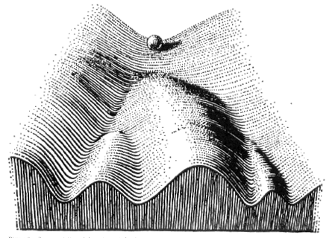
Development defined recap:
Individual change over time that:
Reorganizes
  Multiple systems (entire person)
Successive, sequential
  Crawl before you walk
Non-reversible (stable)
  You can’t go back
Normative
  Everyone’s doing it
Continues over lifespan

Slide 4

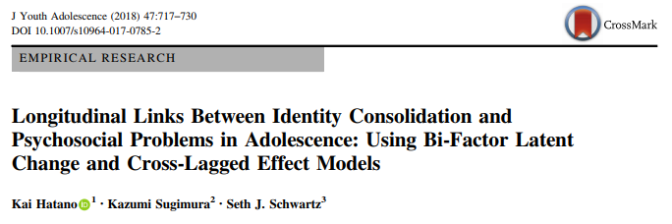


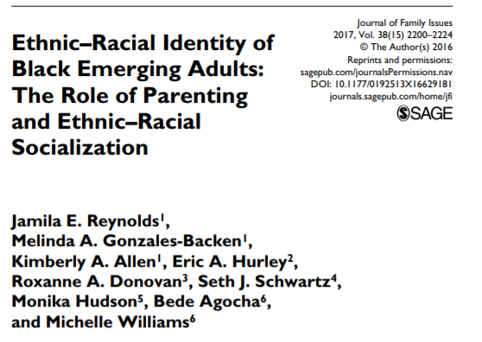
Schwartz, S. J. (in press). Turning point for a turning point: Advancing emerging adulthood theory and research. Emerging Adulthood. Download

Slide 5
Emerging Adulthood
  The age period from the late teens through at least the mid-20s (approximately age 18 – 25)
  Previously “young adulthood,” “transition to adulthood”
  Erikson conceptualized “young adulthood” as lasting from the late teens to age 40!
  More appropriate when most people were married and in a stable job by the early 20s—no longer the case in industrialized societies.
            Arnett (2007)
Why do we need a new paradigm?
E. Prince

Slide 6
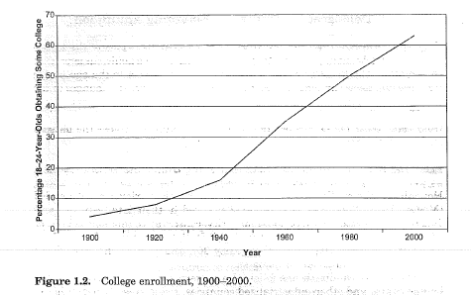
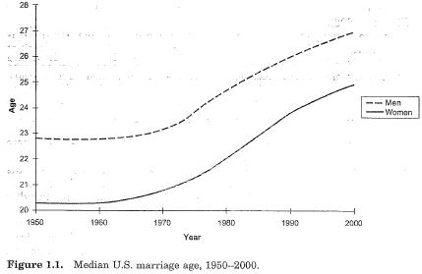
Postponing the adult role…?
68% of high school grads → college

Slide 7
Emerging Adults are now…
Getting married later
Changing jobs frequently
Pursuing postsecondary/graduate education
Having sex before marriage
Living together before marriage
But, they are still…
  Accepting responsibility for oneself
  Making independent decisions
  Becoming financially dependent (eventually)

Slide 8
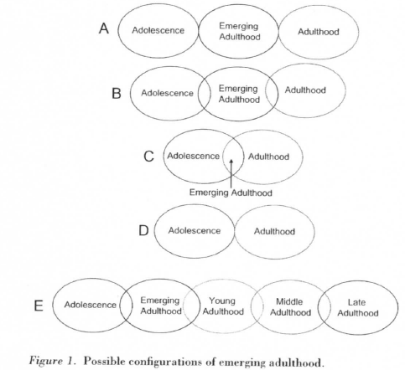
5 features & 5 conceptualizations
The age of identity exploration
The age of instability
The self-focused age
The age of feeling in-between
The age of possibilities

Slide 9
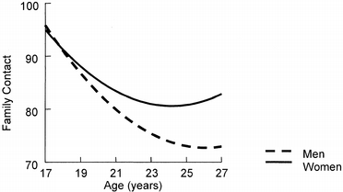
The Psychology of Emerging Adulthood (Arnett)

Slide 10

Emerging Adults & Society
Ambivalence toward taking on adult roles
  Adults are boring, have no new possibilities in life
  Adults have too many responsibilities
Emerging adults have very high expectations
  True love, amazing job
Emerging adults engage in riskier behaviors
Very few fail to grow up
By age 30….. 75% Married, 75% 1+ Child, nearly all employed and financially independent, living alone from their parents
Extended time to pursue education and job training
E. Prince

Slide 11
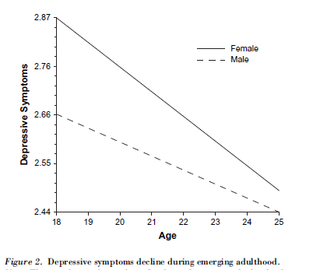
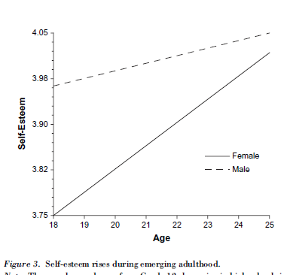
The Psychology of Emerging Adulthood (Arnett)
Generally a positive experience – on average, well-being increases

Slide 12
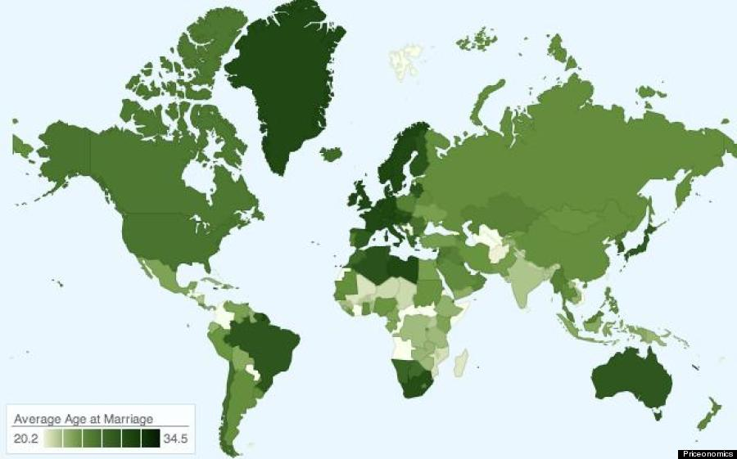
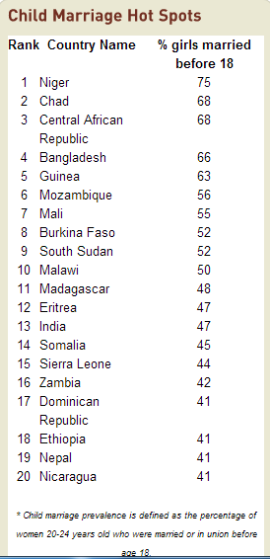
Average age at marriage
http://www.huffingtonpost.com/2013/11/22/marriage-map_n_4326504.html
http://www.un.org/en/development/desa/population/publications/pdf/popfacts/PopFacts_2011-1.pdf
http://www.icrw.org/child-marriage-facts-and-figures

Slide 13
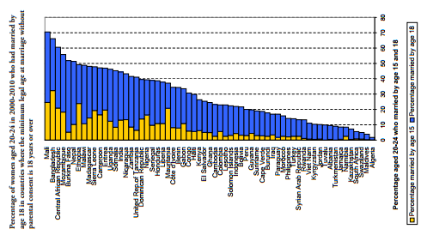
% married by 15 & 18 societal variability

Slide 14
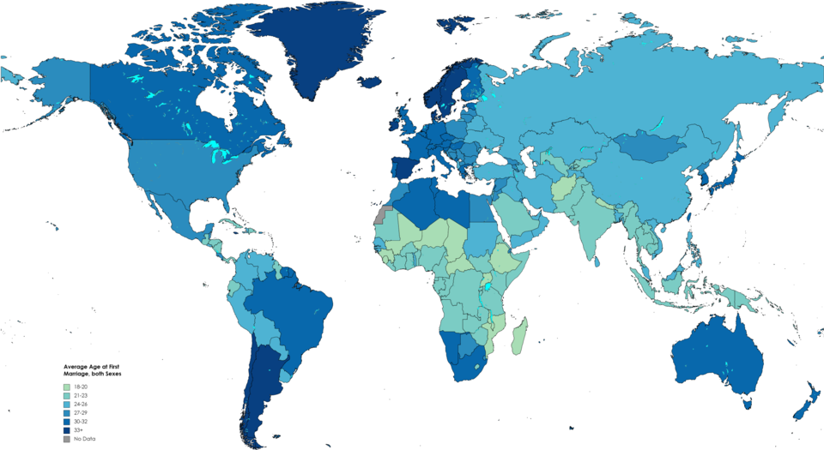

Slide 15
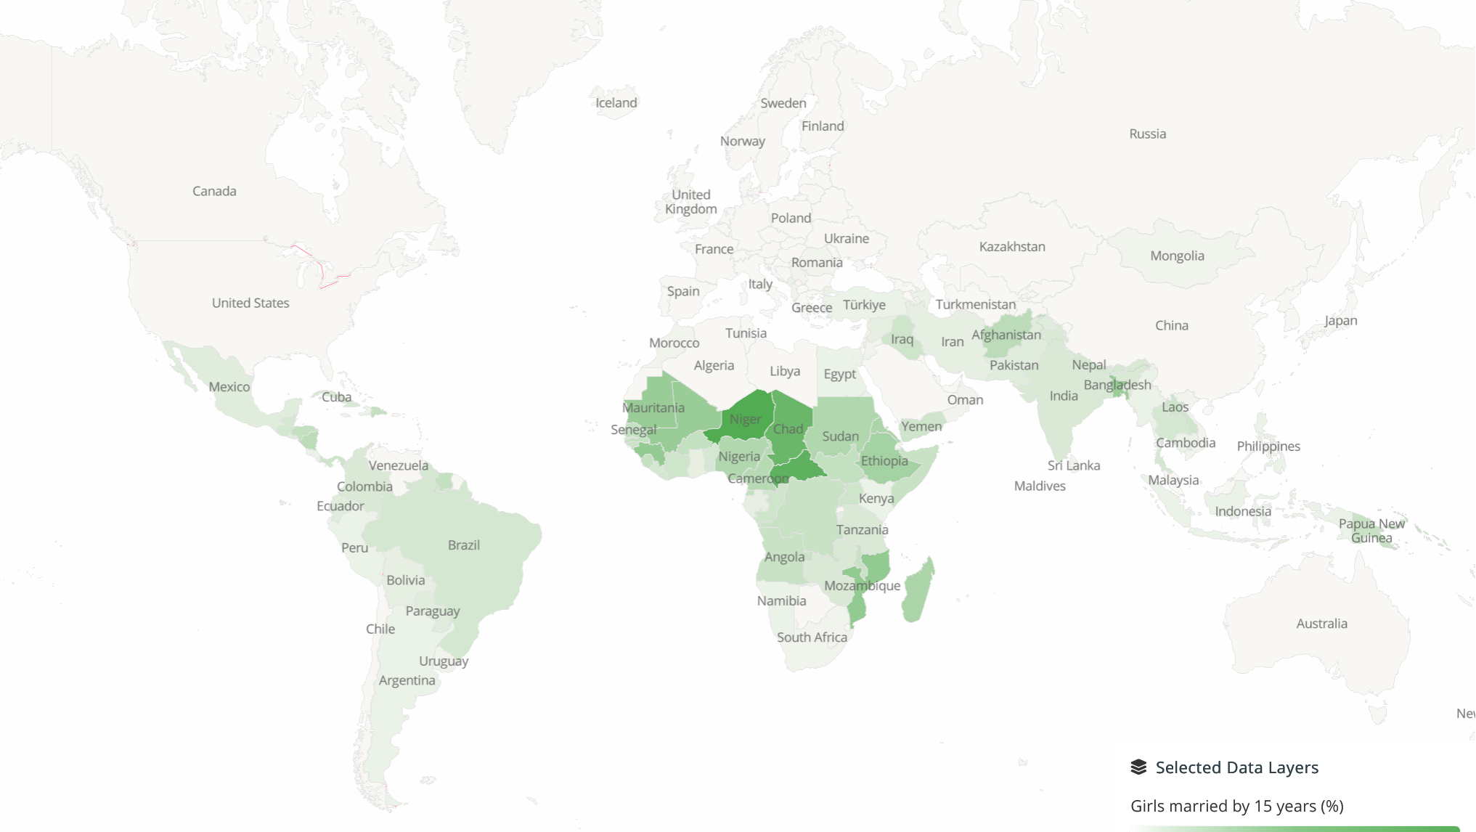
% girls married by 15 - social variability

Slide 16
Is parenting a developmental transition? For females? For males?
How can this information be applied to our understanding of developmental concepts like maternal sensitivity, coparenting, etc.?
Are we doomed by our upbringings?

Slide 17

The Effect of the Transition to Parenthood on Relationship Quality: An 8-Year Prospective Study
(Doss et al., 2009)
Parents and nonparents generally show similar amounts of decline in overall relationship functioning over the first 8 years of marriage but these changes tend to occur suddenly following the birth of the baby for parents and more gradually over time for nonparents.

Slide 18
Background
How does the transition to parenthood impact marital functioning?
Little agreement
Different methodologies have been used
Cross-sectional studies of parenthood
Longitudinal studies beginning in pregnancy
Inclusion of nonparents in longitudinal samples
Interrupted time-series (ITS) design
Isolates change that can be attributed to birth from change that was expected based on ongoing changes in the couples’ relationship.

Slide 19
Method
Relationship Variables | Marital satisfaction Observed negative communication Relationship confidence Relationship dedication Poor conflict management Problem intensity
Enduring Vulnerabilities | Demographic information (e.g., income, religiosity) Family of origin Premarital cohabitation history
Nature of Stressful Event | Child’s gender Timing of pregnancy Planned or unplanned pregnancy Financial stress
Other variables that are likely important to relationship functioning after birth?
T1
T2
T3-T10
Premarital education
Marriage
Notes:
Couples had participated in a larger investigation of relationship development and the effectiveness of pre-marital education. Recruited before marriage through religious organizations that would perform their weddings.
Study 1 (Parents): 132 couples who had their first child during first 8 years of the study
Study 2 (Nonparents): 86 couples who did not have children before or during the first 8 years of the study
-- same measures used in study 1 and study 2
Study 1: 3 couples divorced, 3 withdrew
Study 2: 18 couples divorced, 22 withdrew (this is consistent with previous research of nonparents that begins just after marriage)
Religious organizations were randomly assigned to require couples using their wedding services to receive either naturally occurring premarital education services within the religious organization or the Prevention and Relationship Enhancement Program (PREP)
At each time point completed questionnaires individually and completed a videotaped 10-15 min problem-solving discussion together
Parents were more confident about their relationships and had more years of education than nonparents (at initial assessment)
T1: Before married and before premarital education, T2: Just after education, T3-10: Yearly thereafter

Slide 20
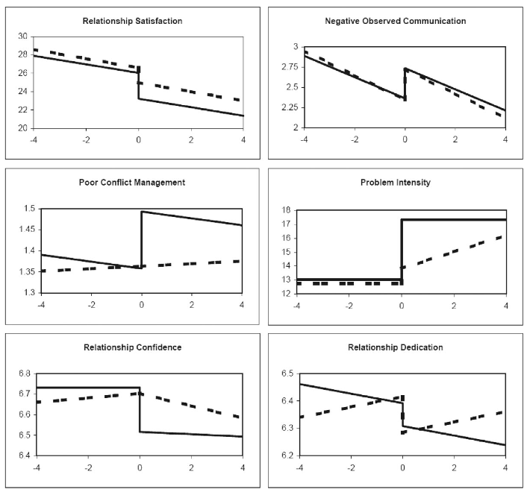
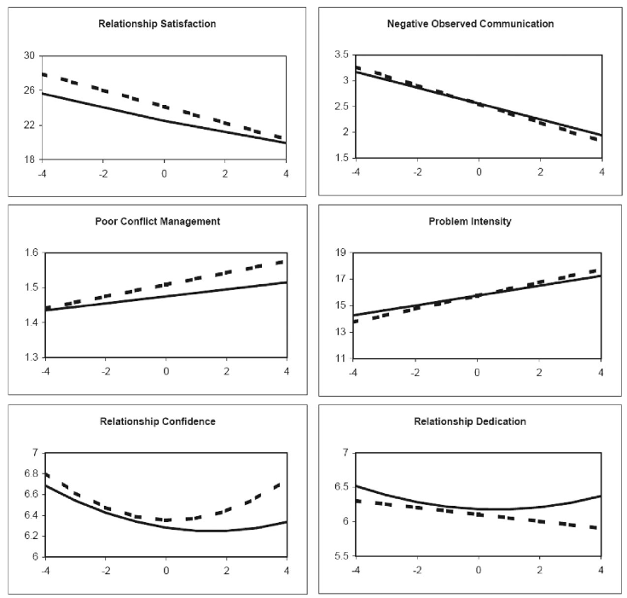
Change Patterns
Parents: dotted = fathers, solid = mothers
Nonparents: dotted = males, solid = females
Parents
Nonparents
dotted = males, solid = females
Notes:
Parents: dotted = fathers, solid = mothers
Nonparents: dotted = males, solid = females

Slide 21
Evidence of change in relationship functioning following baby’s birth?
The majority of the relationship constructs demonstrated patterns of change consistent with an immediate or delayed impact of the transition to parenthood.
    distinct from change occurring before birth
All relationship constructs that demonstrated effects of the transition to parenthood showed significant and sudden worsening of the relationship in either mothers or fathers.

Slide 22



Sudden change for parents, gradual for nonparents
Parents and nonparents generally show similar amounts of decline in overall relationship functioning over the first 8 years of marriage but these changes tend to occur suddenly following the birth of the baby for parents and more gradually over time for nonparents.
Parents showed clear increases in negativity, conflict, and problem intensity following the birth of a child, whereas nonparents did not show such changes at the same point in time, nor did they show such declines over time more generally.

Slide 23
Variability in individuals’ reactions to transition to parenthood
  For mothers and fathers, sudden changes in marital satisfaction, problem intensity, and relationship dedication varied significantly between individuals.
    Mothers’ sudden changes in poor conflict management and relationship confidence showed significant between-individual variability.
  YES, In addition to mean changes in relationship functioning after birth, there was also significant between-individual variability in many of the variables examined.

Slide 24
Predicting variability in relationship functioning after baby’s birth
Enduring vulnerabilities
History of parental divorce or conflict → larger decreases in marital satisfaction [mothers]
Living together before marriage → greater observed negative communication [mothers and fathers]
*Not predictive: ethnicity, level of religiosity
Nature of stressful event
Female children → larger decreases in marital satisfaction [mothers] and larger increases in problem intensity [fathers]
Having a child quickly after marriage → greater decreases in marital satisfaction [fathers]
Lower income (but not more financial stress) at birth → larger decreases in marital satisfaction [fathers]
* Not predictive: planned or unplanned pregnancy, financial stress before birth

Slide 25
Relationship adaptive processes
Higher marital satisfaction at birth → larger decreases in marital satisfaction after birth [mothers and fathers]
  Higher relationship confidence at birth → smaller decreases in marital satisfaction after birth [fathers]
Higher relationship confidence at birth and/or higher reported poor conflict management at birth → larger increases in problem intensity after birth [mothers and fathers]
Higher relationship confidence at birth and/or higher observed negative communication at birth → larger increases in poor conflict management after birth [mothers]
Nonparents showed no sudden changes
Gradual deterioration in marital satisfaction; Men reported sig decreases in relationship dedication over time
Negative observed communication sig improved over time

Slide 26
The Transition to Parenthood
Predictors of change:
  High negative communication
  Difficulties in mothers’ family of origin
  Shorter duration of marriage at birth
  Giving birth to a girl
Many instances where better pre-birth functioning predicted more severe negative change
    e.g., better marital satisfaction

Slide 27
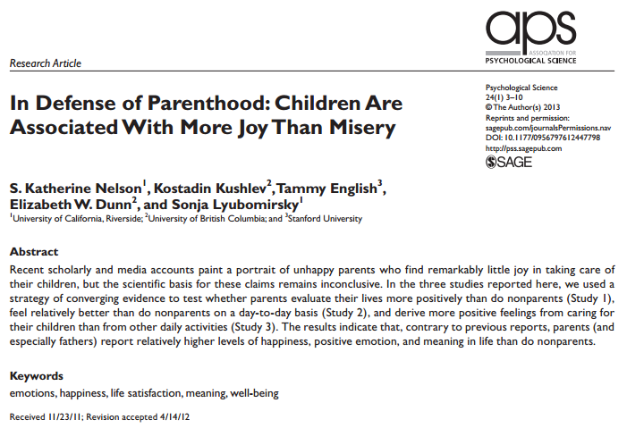
Danzi

Slide 28
Are parents happier?
Study 1. Large, nationally representative survey to assess if parents are happier overall than nonparents
    World Values Survey (n = 6,906; ages 17 – 96)
    Single-items: happiness, life satisfaction, thinking about meaning in life
Study 2. Experience-sampling to see if parents feel better moment-to-moment than nonparents
    329 adults (ages 18 – 94)
    Participants paged 5 times daily over 7 days to complete questionnaire
    Rated how much they were feeling 19 emotions on 7-point scale
Study 3. How do positive feelings derived from parenting compare to other daily activities
Danzi

Slide 29
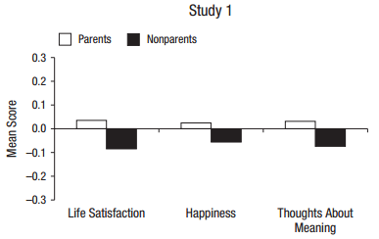
Study 1: Parents happier overall…
Parents reported higher levels of life satisfaction, happiness, and meaning in life than nonparents
Having more children was correlated with life satisfaction and meaning in life (but not happiness)
Large, nationally representative World Values Survey (n = 6,906; ages 17 – 96), single-items
Danzi
Potential factors that could affect these relationships?

Slide 30
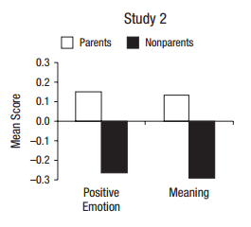
Parents reported more in the moment happiness, positive emotion, meaning in life, & fewer depressive symptoms
Parent’s gender, age, race, and SES did not moderate relationship for any variables
Study 3. Parents reported more positive emotions and more meaning when taking care of children than when not
Experience-sampling, 329 adults (ages 18 – 94), paged 5 times daily over 7 days to rated 9 emotions on 7-point scale
Danzi

Slide 31
Study 1: Are parents happier overall?
Parent gender as a moderator
  Parenthood associated with increased life satisfaction and happiness only for fathers
Marital status as a moderator
  Married parents did not differ in satisfaction or happiness from married nonparents
  Unmarried parents reported less satisfaction and happiness than nonparents
Parent age as a moderator
  Young parents (ages 17 – 25) had less life satisfaction than young nonparents
  Mid-age parents (ages 26 – 62) had more life satisfaction than mid-age nonparents
  Older parents did not differ from older nonparents in life satisfaction
  No moderating effects for happiness or meaning in life
Danzi

Slide 32
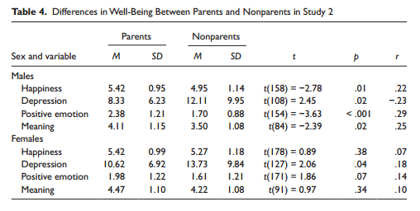
Study 2: Are fathers and mothers happier moment-to-moment?
Fathers scored better than childless men on all variables
Mothers had fewer depressive symptoms than childless women
  Other variables were not significantly different (trend for positive emotion)
Danzi

Slide 33
Study 3: Happiness higher while parenting than in other daily activities
Parents reported more positive emotions and more meaning when taking care of children than when not
  Not moderated by gender
Intended to address selection effects (e.g., people who become parents might be different from people who don’t)
  Within-subjects design
  186 parents (76% women; 24% men)
  Day reconstruction method – described previous day, episode by episode, and rated emotions and meaningfulness for each episode
    Calculated two positive emotion/meaningfulness scores – one score for episodes involving childcare and one for other activities
Danzi

Slide 34
Parental (father-favoring) conclusions
Overall, parents are happier, more satisfied, and thinking about meaning in life more than nonparents
  For fathers and mid-age parents—not for mothers, young or single parents
  Young parents and single parents less happy than nonparents
  No difference between mothers and childless women
Parents had more positive emotions and meaningfulness from moment-to-moment
  Fathers had more positive scores than childless men
  Mothers only showed less depression than childless women
Parents reported more positive emotions and more meaningfulness during childcare than other daily activities
Discuss!
Danzi

Slide 35

Pregnancy Brain: Real or Myth?
Women often report cognitive declines during pregnancy
Animal studies highlight the adaptive advantages in response to the demands of pregnancy
Why are pregnant women reporting pronounced cognitive declines?
Anderson & Rutherford (2012). Evolutionary Psychology
Notes:
Baby brain…
While human studies mainly focus on the decline of memory and attention in pregnant women, animal studies highlight…
In fact there is actually an increase in neural plasticity in pregnancy…
So why are women…
Anderson & Rutherford (2012) Evo Psych

Slide 36

Is pregnancy/birth a developmental transition?
Cognitive trade-offs of Pregnancy Brain
Pregnant women may have declines in specific aspects of cognition, but cognitive advantages in other areas.
Reallocation of cognitive resources to social safety?
Davies, S. J., Lum, J. A., Skouteris, H., Byrne, L. K., & Hayden, M. J. (2018). Cognitive impairment during pregnancy: a meta-analysis. The Medical Journal of Australia, 208(1), 35-40.
Christensen, H., Leach, L. S., & Mackinnon, A. (2010). Cognition in pregnancy and motherhood: prospective cohort study. The British Journal of Psychiatry, 196(2), 126-132.
Anderson, M. V., & Rutherford, M. D. (2012). Evolutionary Psychology. Crawley, R., Grant, S., & Hinshaw, K. I. M. (2008). Applied cognitive psychology.
Christensen, H., Poyser, C., Pollitt, P., & Cubis, J. (1999). Journal of reproductive and infant psychology.
https://elicit.com/review/7651523d-2f74-44fb-80c5-21ee969d9026
Maylott
Notes:
New perspective suggests… cognitive trade-offs… Pregnant women may experience a decline in some areas of cognition because resources are being devoted to other areas more important for the fitness of the mother and infant

Slide 37
Pregnancy leads to long-lasting changes in human brain structure
S. Gabe Hatch

Slide 38
Pregnancy is common
Most women undergo pregnancy once in their lives
Little is known about how this process affects the brain
Animal studies indicate that changes happen physiologically as well as in the endocrine system
Followed by a flood of estrogens that typically exceeds the estrogen exposure of a woman’s entire nonpregnant life
Other endocrine events involving less extreme fluctuates in hormone levels are known to render structural and functional alterations in the brain (e.g., puberty)
Even small hormonal changes have resulted to neural alterations

Slide 39
We know something about the brain during pregnancy
Women
  1909 – Enlargements of the pituitary gland was first observed in deceased pregnant women (2x as large)
  The ventricles and outer border of the brain have been contoured
  Increases in ventricular size and decreases in brain size during late pregnancy
Men
  Despite the review on brain changes for women, the introduction is completely lacking on any physiological changes among men

Slide 40
Study Goals
These authors performed a prospective neuroimaging study (before versus after pregnancy) involving first-time mothers (and fathers) and compared this group to women that have never given birth (or fathers without children)
Five ways:
  These authors wanted to see whether pregnancy is associated with change in the gray matter structure of the human brain
  The authors also tested the discriminative power of the gray matter volume changes
  Examined the gray matter volume of first-time fathers and control men without children
  Investigated a potential link to maternal attachment
  Tested the long-term persistence of pregnancy effects with a 2-year post-pregnancy follow-up session

Slide 41
Assessment Structure
Brain Scans were Obtained Before Pregnancy (Pre-conception)
If Successful, Brain Scans were Obtained After Completion of Pregnancy
Brain Scans were Obtained 2-Years Post-Pregnancy

Slide 42
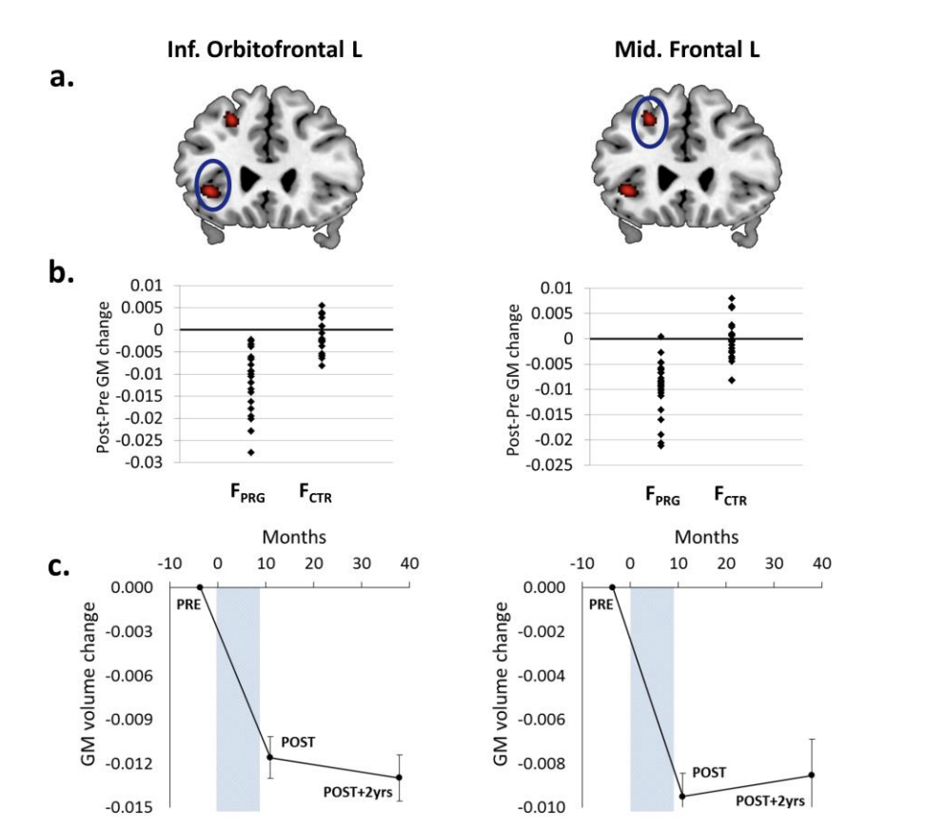
Gray Matter Volume Changes Before and After Pregnancy
gray matter (gm) volume
  No pre-existing difference in gray matter volume between the two groups
Within/between group, greater gray matter volume reductions located in the anterior and posterior midline, the bilateral lateral prefrontal cortex, and the bilateral temporal cortex
Within/between group differences were observed in cortical surface area and thickness
Null Findings
No significant changes in white matter volume across time points
Results did not differ by means of conception
Changes not associated with cognitive performance

Slide 43
Discriminative Power
Support vector machine
All women could be correctly classified as having been pregnant or not in between these sessions on the basis of gray matter changes in the brain
Changes in the right middle temporal gyrus, inferior frontal gyrus, and posterior cingulate cortex as the regions of greatest predictive power. These factors alone contributed to over 50% of the decision function
95.6% of women could be classified using measures of average gray matter volume change

Slide 44
Goal 2 – Discriminative Power, continued.
All discriminate analyses involving average surface area and cortical thickness indicated that 84.4% of women could be correctly classified as having undergone pregnancy or not
Nearly 70% could be classified on the basis or cortical thickness change
And 95.6% of women could be classified using measures of average gray matter volume change

Slide 45
Mother Attachment
Using the three dimensions of the Maternal Postnatal Attachment Scale, gray matter volume changes of pregnancy predicted the quality of mother-to-infant attachment and the absence of hostility towards their newborns in the postpartum period
The strongest neural activity in response to the women’s babies corresponded to the regions that lost gray matter volume across pregnancy

Slide 46
Father’s no changes—Mother’s change maintained
Father’s Gray Matter Changes - Null Finding
No changes in neural gray matter volumes between the two groups
Mother 2-year follow up –changes maintained
  Animal models suggest that these alterations are evidence even in old age…
All the findings except for the left hippocampal cluster were maintained over the two-year follow-up period

Slide 47
Discussion:
Pregnancy Changes the Brain Among Women
Goal 1 Implications (Gray Matter Changes): Pregnant women undergo a symmetrical pattern of gray matter volume reductions across pregnancy
Goal 2 Implications (Classification): Women can be accurately classified (i.e., pregnant versus not pregnant) based off of this information
Goal 3 Implications (Fathers): First-time fathers saw no difference in gray matter changes compared to men without children
Goal 4 Implications (Attachment): Gray matter reductions appear to be associated with attachment
Goal 5 Implications (Follow up): These results appear to be maintained over time

Slide 48
Consistencies with Other Stages of Life
During adolescence, reductions in gray matter also occur. This is regarded as a fine-tuning of connections into functional networks which corresponds to healthy cognitive, emotional, and social development
Because pregnancy is associated with similar reductions in gray matter volume, and the observed reductions are not randomly distributed but take place in higher order regions associated with social processes, the authors speculate that the female brain undergoes a further maturation or specialization. This could include enhanced emotion and face recognition

Slide 49
Conclusions
Pregnancy is associated with substantial and long-lasting alterations in brain structure. This may serve an adaptive purpose for pending motherhood.

Slide 50
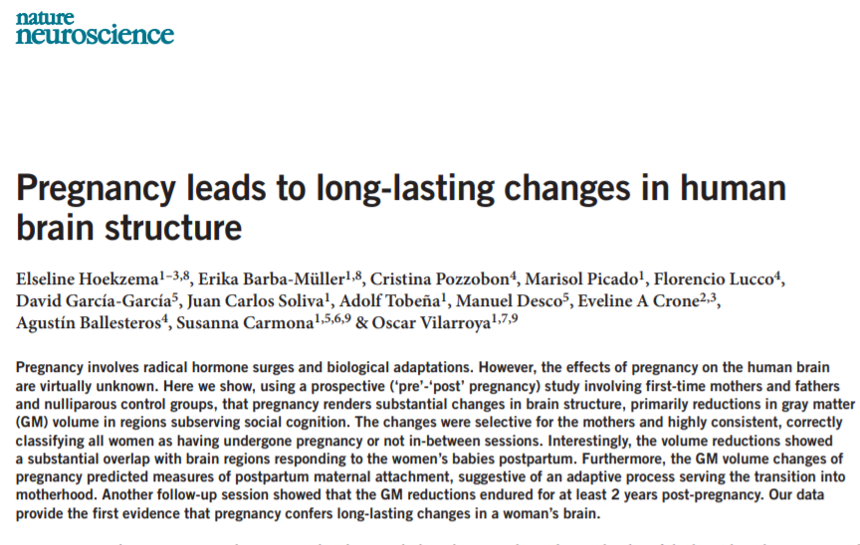

Slide 51
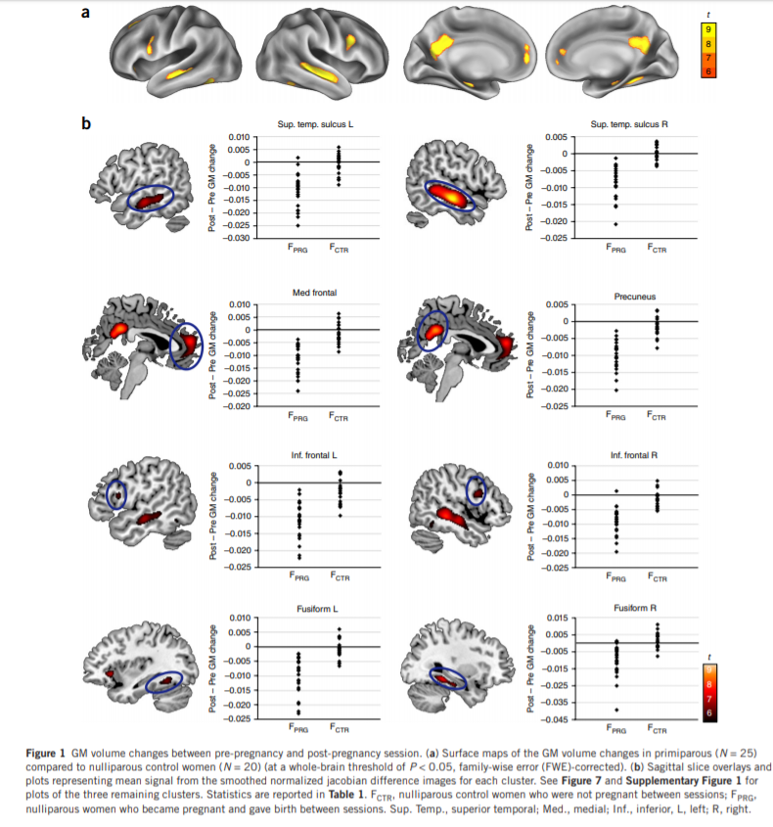
“Substantial changes in brain structure, primarily reductions in gray matter (GM) volume in regions subserving social cognition.
The changes were selective for the mothers and highly consistent, correctly classifying all women as having undergone pregnancy or not in-between sessions.”

Slide 52
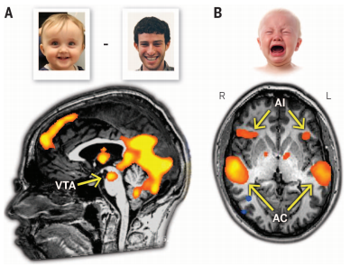

Human Moms and Dads
Infant crying triggers neural responses
  Mesolimbic dopamine system
  from ventral tegmental area (VTA) to ventral striatum, including nucleus accumbens (NAcc)
  Anterior insula (empathy)
  Prefrontal cortex (emotion regulation)
Notes:
Empathic overarousal can lead to interfering distress. Fathers with MODERATE anterior insula activation are most involved in instrumental care giving
Prefrontal cortex associated with increased sensitivity, decreased stress hormones at separation, more secure attachment

Slide 53
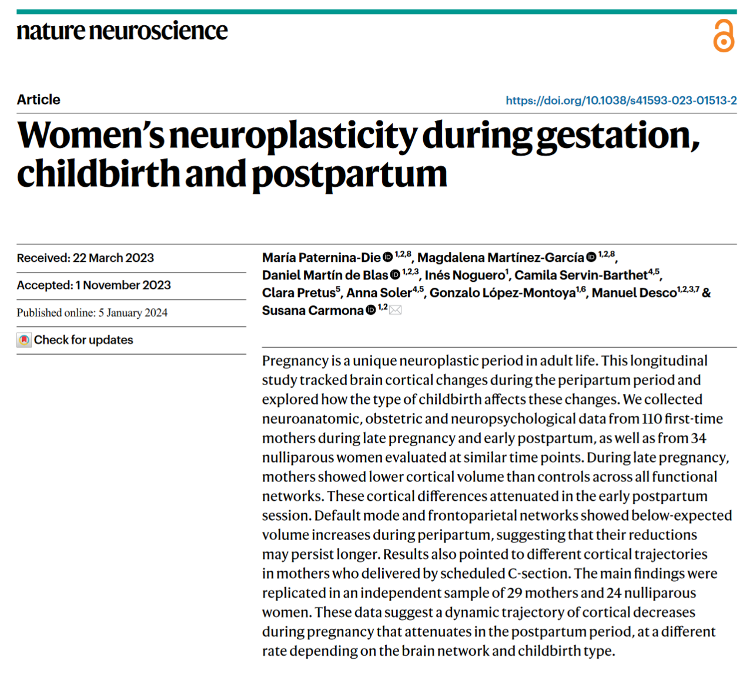

Slide 54
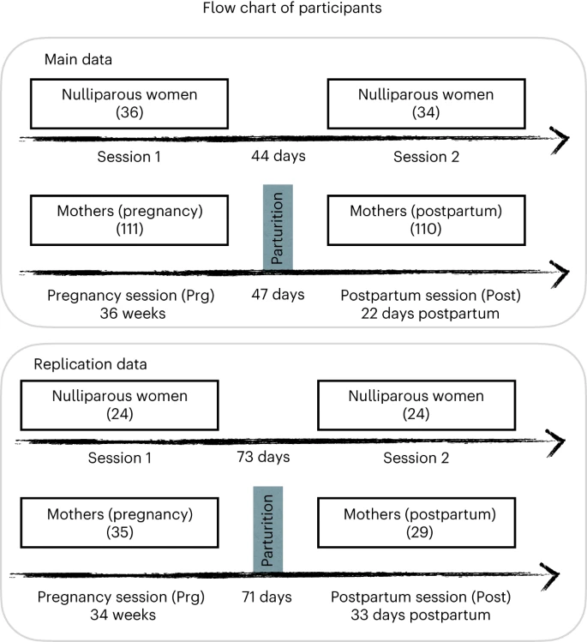
First time pregnant, never pregnant, post pregnant

Slide 55
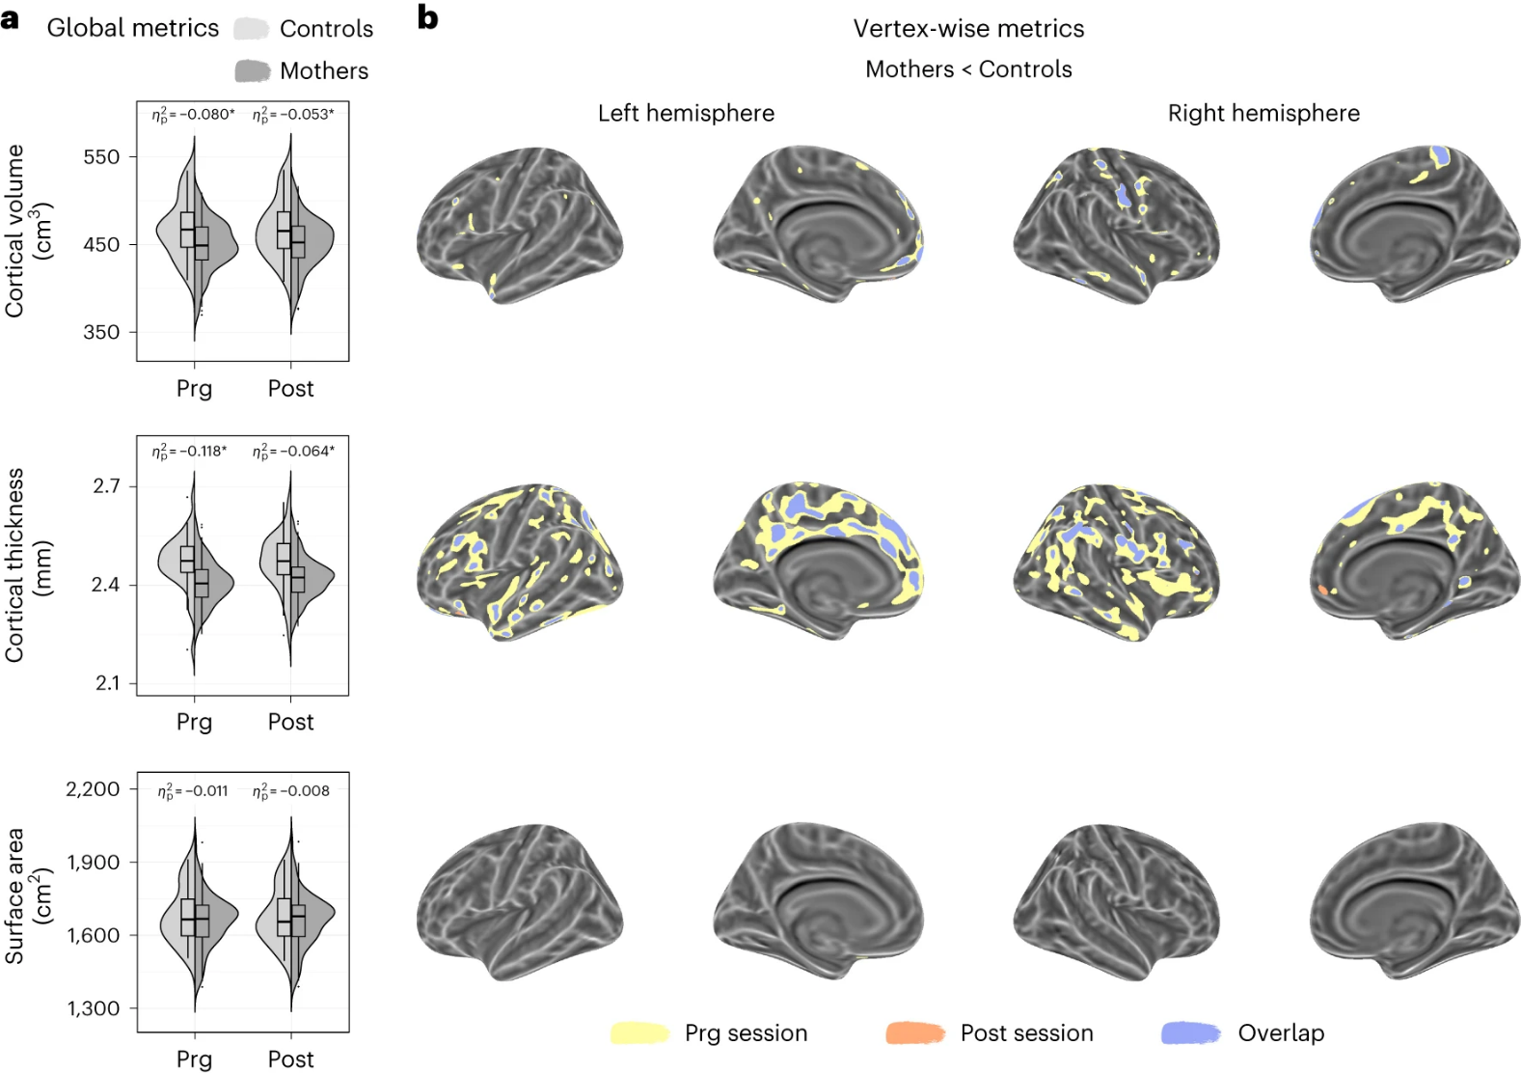
Reduced cortical volume, cortical thickness & surface area in mothers in late pregnancy, early postpartum, and (brain images)
Notes:
Group fixed effects at each session were studied through the adjusted linear mixed effect model: . a, Violin and embedded boxplots showing the distribution of the global cortical metrics at late pregnancy (Prg) and early postpartum (Post) sessions in mothers (n = 110) and controls (nulliparous women; n = 34). Effect sizes of the group differences in Prg and Post sessions were calculated as the signed partial eta squared () associated with the corresponding one-tailed Wald F-tests. Asterisks indicate those differences surviving a P < 0.05 false discovery rate (FDR) correction. Exact P values are reported in Supplementary Table 2. The center line of the boxplot represents the median, the box encloses the lower and upper quartiles and the whiskers extend to the minimum and maximum values within a range of 1.5 times the interquartile range. Of note, the high inter-subject variability in surface area might have reduced the statistical power to detect group differences. b, Vertex-wise binary maps of the significant cortical differences between groups, specifically lower values in mothers compared to controls (FDR-corrected P < 0.05). Yellow, orange and blue indicate lower cortical values during Prg and Post sessions and the overlap between both sessions. Binary maps were projected to the inflated fsaverage template provided by the FreeSurfer software.

Slide 56
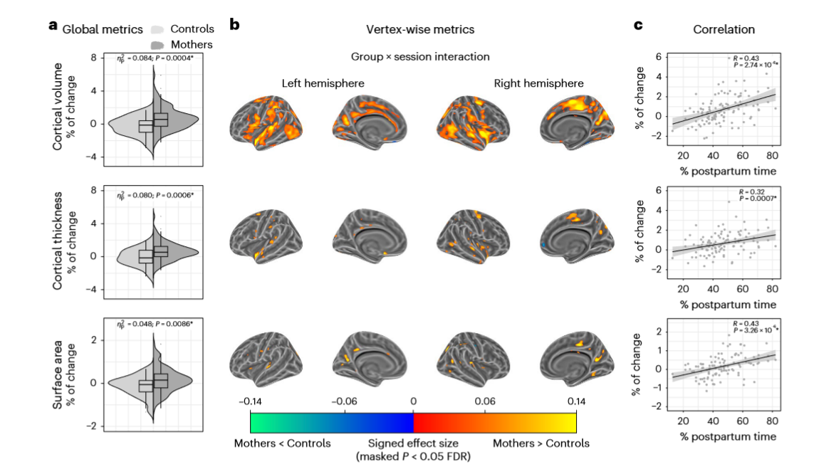
Greater longitudinal change/growth in mothers (pregnant to post)
Notes:
ig. 3 | Longitudinal changes in cortical volume, thickness and surface
area from late pregnancy to early postpartum in mothers compared to
nulliparous women. Longitudinal changes were derived from the group ×
session interaction fixed effect term of the adjusted linear mixed effect model:
Cortical Metric ∼ 1 + Group + Session + Group × Session + (1|Participant).
a, Violin and embedded boxplots showing the distribution of the percentage of
change of the global metrics in mothers (n = 110) and controls (nulliparous
women; n = 34). Effect sizes were calculated as the signed partial eta squared ( η2
p)
associated with the corresponding one-tailed Wald F-tests. Asterisks indicate
those changes surviving a P < 0.05 false discovery rate (FDR) correction. The
center line of the boxplot represents the median, the box encloses the lower and
upper quartiles and the whiskers extend to the minimum and maximum values
within a range of 1.5 times the interquartile range. b, Vertex-wise signed effect
size maps (η2
p) of the group × session interaction (FDR-corrected P < 0.05),
indicating larger decreases (blue) and larger increases (red) in mothers than in
controls. Signed effect size maps were projected to the inflated fsaverage
template provided by the FreeSurfer software. c, Correlations between the global
percentages of change in cortical metrics and the percentage of postpartum time
between sessions. The black line and the shaded area represent the least squares
regression line and the 95% confidence intervals, respectively. Asterisks indicate
two-tailed Pearson’s correlation coefficients (R) surviving an FDR-corrected
P < 0.05. Uncorrected P values (P) below the threshold of 0.0001 are reported in
exponential notatio

Slide 57
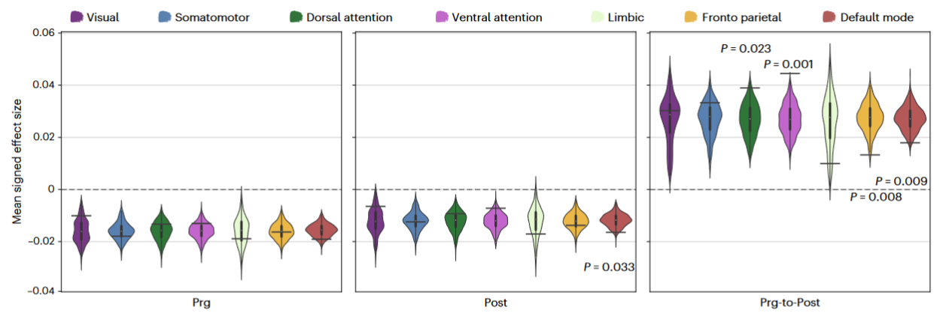
Affects all functional brain networks
Notes:
Fig. 4 | Spin testing for the mean signed effect sizes of the vertex-wise group
differences in cortical volume. Group differences between mothers (n = 110)
and nulliparous women (controls; n = 34) in cortical volume within the seven
large-scale functional brain networks 19
. Black horizontal bars represent the
observed values and the violin plots reflect the null distributions obtained using
1,000 spin-permutations of the maps. The exact one-tailed P values are reported
when P < 0.05. No multiple comparison corrections were applied. The white dot
on the center of the boxplot represents the median, the box encloses the lower
and upper quartiles and the whiskers extend to the minimum and maximum
values within a range of 1.5 times the interquartile range. Prg-to-Post, from
pregnancy to postpartum sessions.

Slide 58
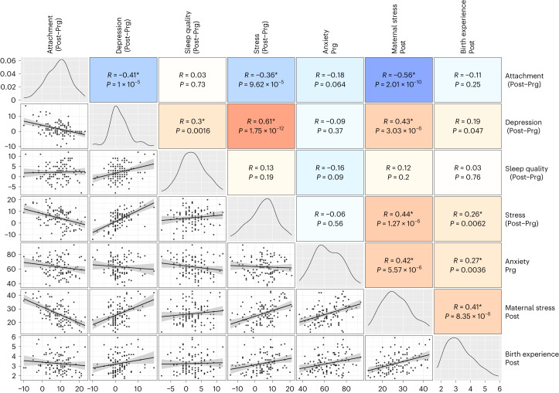
No associations between cortical change and psychological measures (which were intercorrelated)
‘cortical adaptations previously associated with maternal attachment may begin before peripartum’

Slide 59
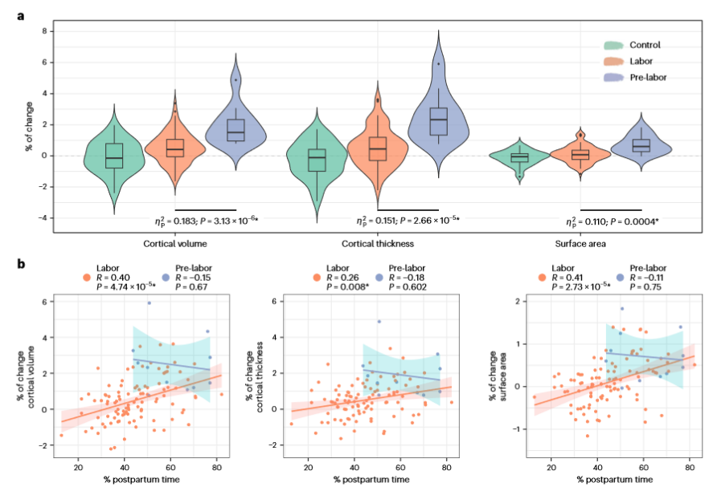
Longitudinal changes in cortical metrics in mothers who initiated labor and mothers who underwent a scheduled C-section (greater growth w C-section)
C-sections (pre-labor; n = 11)

Slide 60

Childbearing and parenting?
Suleiman, A. B., Galván, A., Harden, K. P., & Dahl, R. E. (2017). Becoming a sexual being: The 'elephant in the room' of adolescent brain development. Dev Cogn Neurosci, 25, 209-220. doi:10.1016/j.dcn .2016.09.004
Clear negative social and neurodevelopmental effects
of early parenthood (< 15)
  What about late parenthood?
Neural flexibility peaks in 30s
Men have different levels of testosterone based on relationship/parenthood status regardless of age
  What if you decouple typical neurobiological development trends from parenthood?
Overwhelming majority of people in the US and Europe have sexual and romantic relationships before committing to a single partner; similar trends beginning in Africa
  Differences between those who have multiple, high-intensity relationships and those who do not?
  Differences between those who have children at different ages?
Woodard

Slide 61
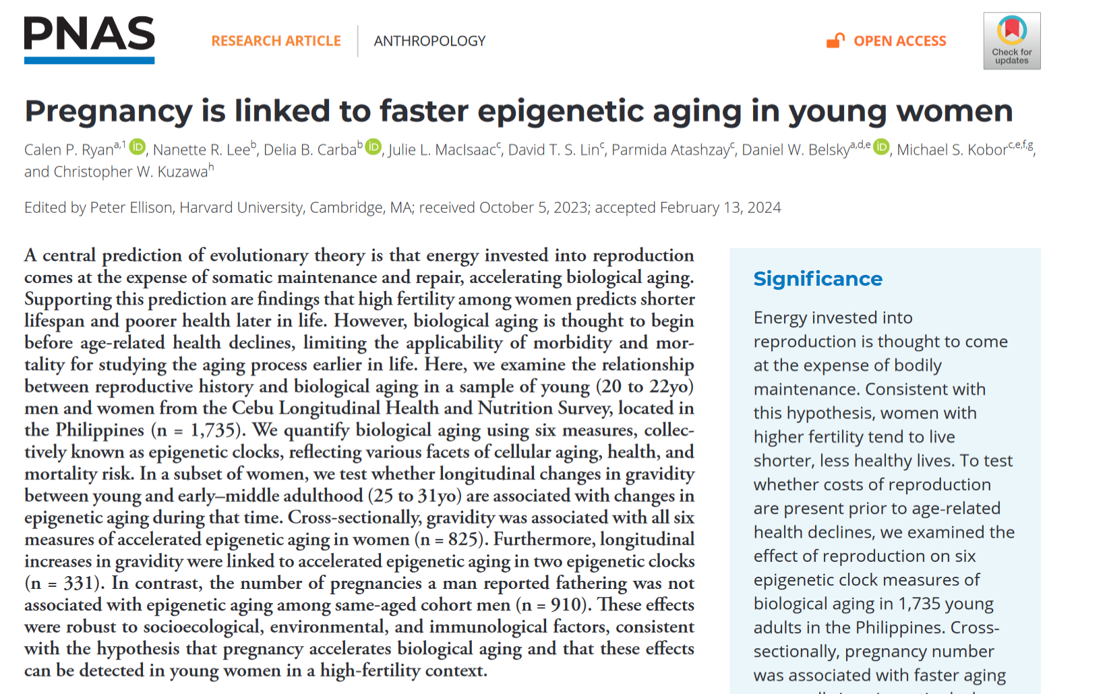

Slide 62
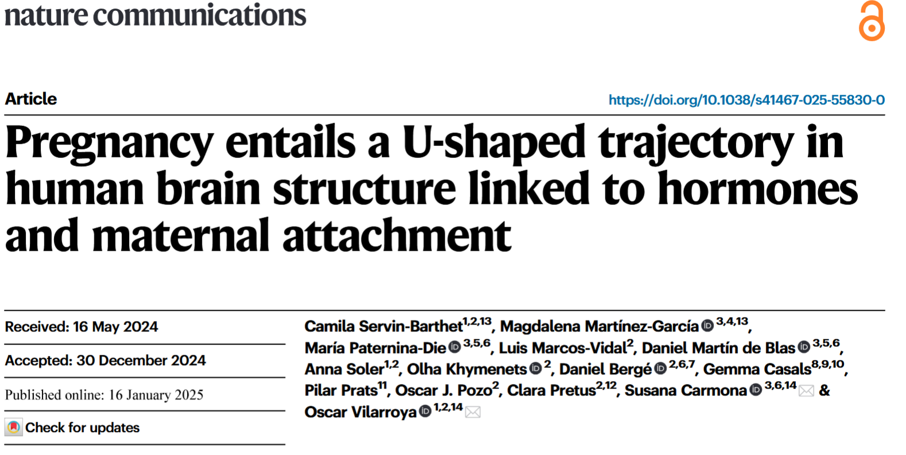
nulliparous women who were planning on becoming pregnant in the near future (i.e., gestational mothers), nulliparous women whose female partners were planning to become pregnant in the near future (i.e., non-gestational mothers), and nulliparous women without any plans of having children soon (i.e., nulliparous women)

Slide 63
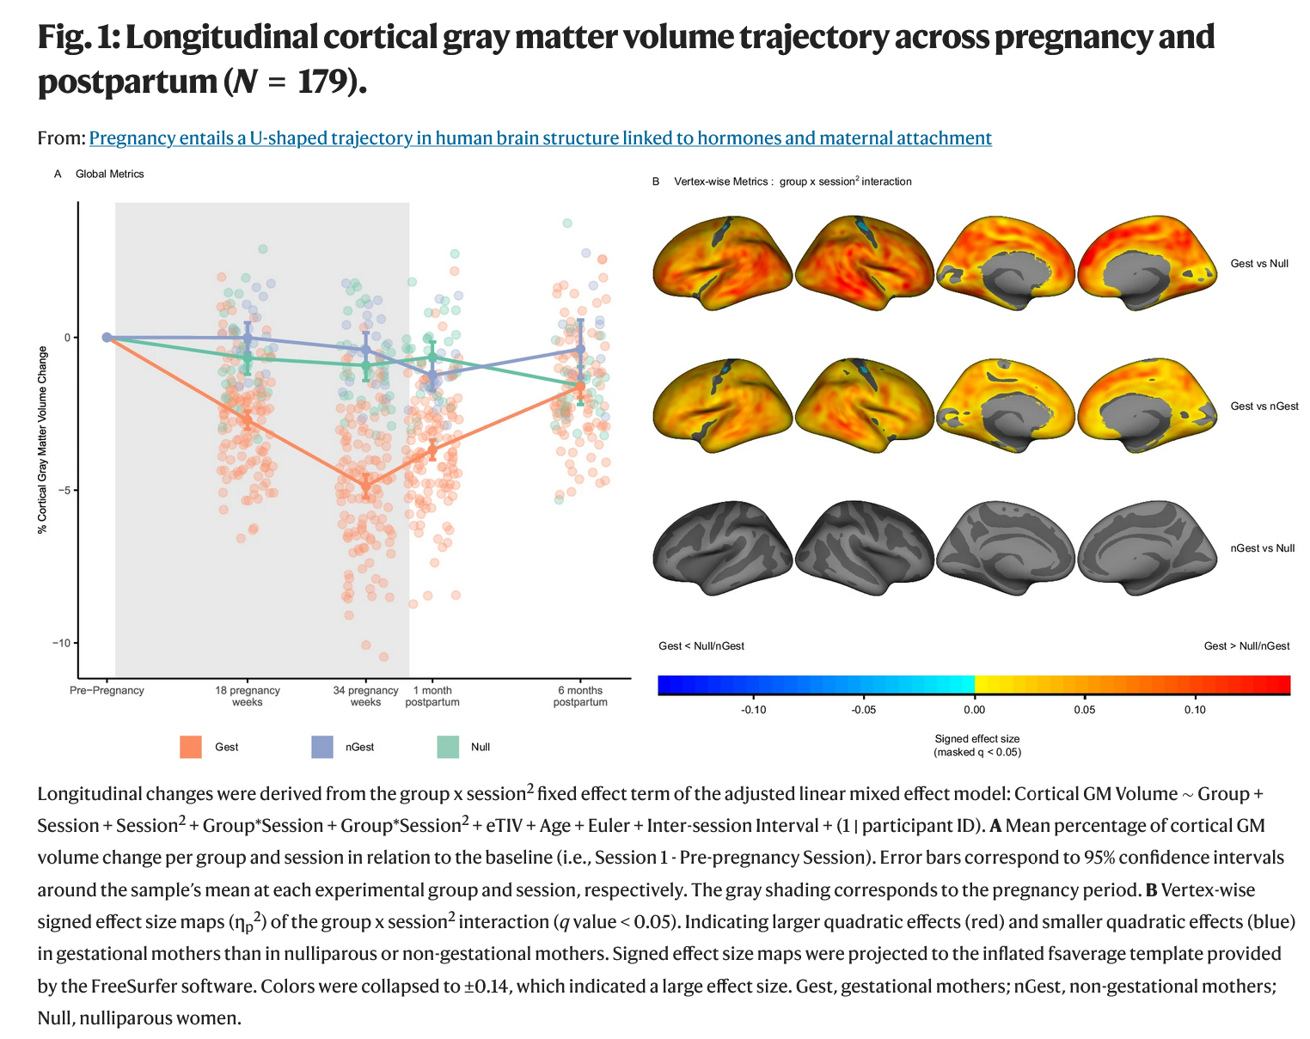

Slide 64
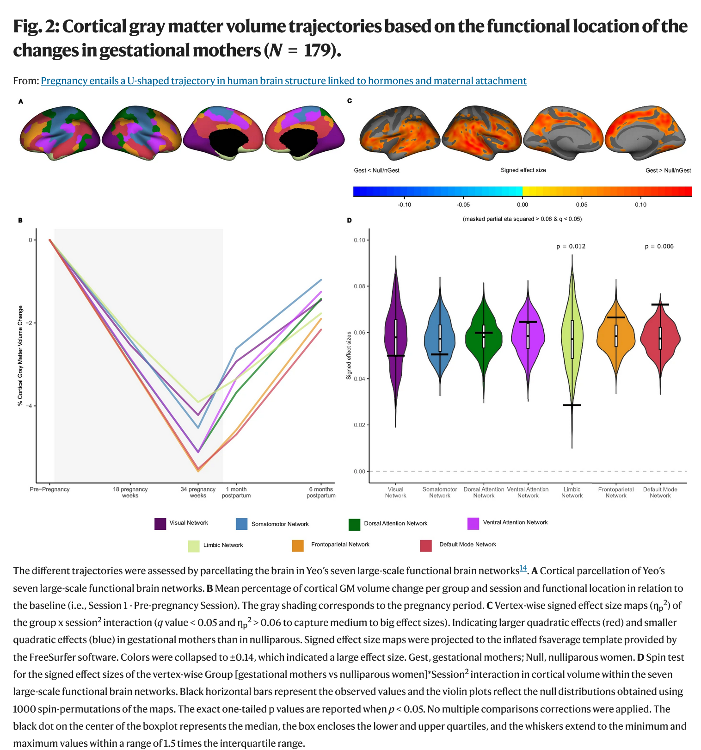
In brain areas linked to functional networks

Slide 65
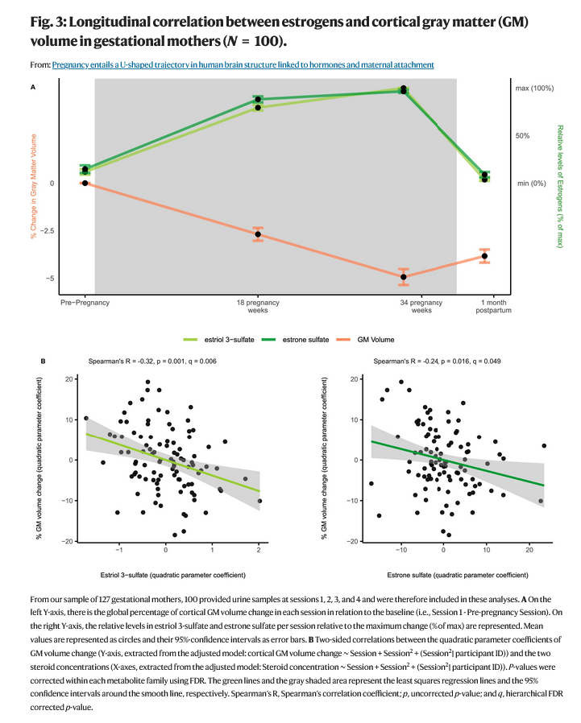
Two sulfated estrogens (estriol sulfate and estrone sulfate) – steroid metabolites
two sulfated estrogens (estriol sulfate and estrone sulfate)

Slide 66
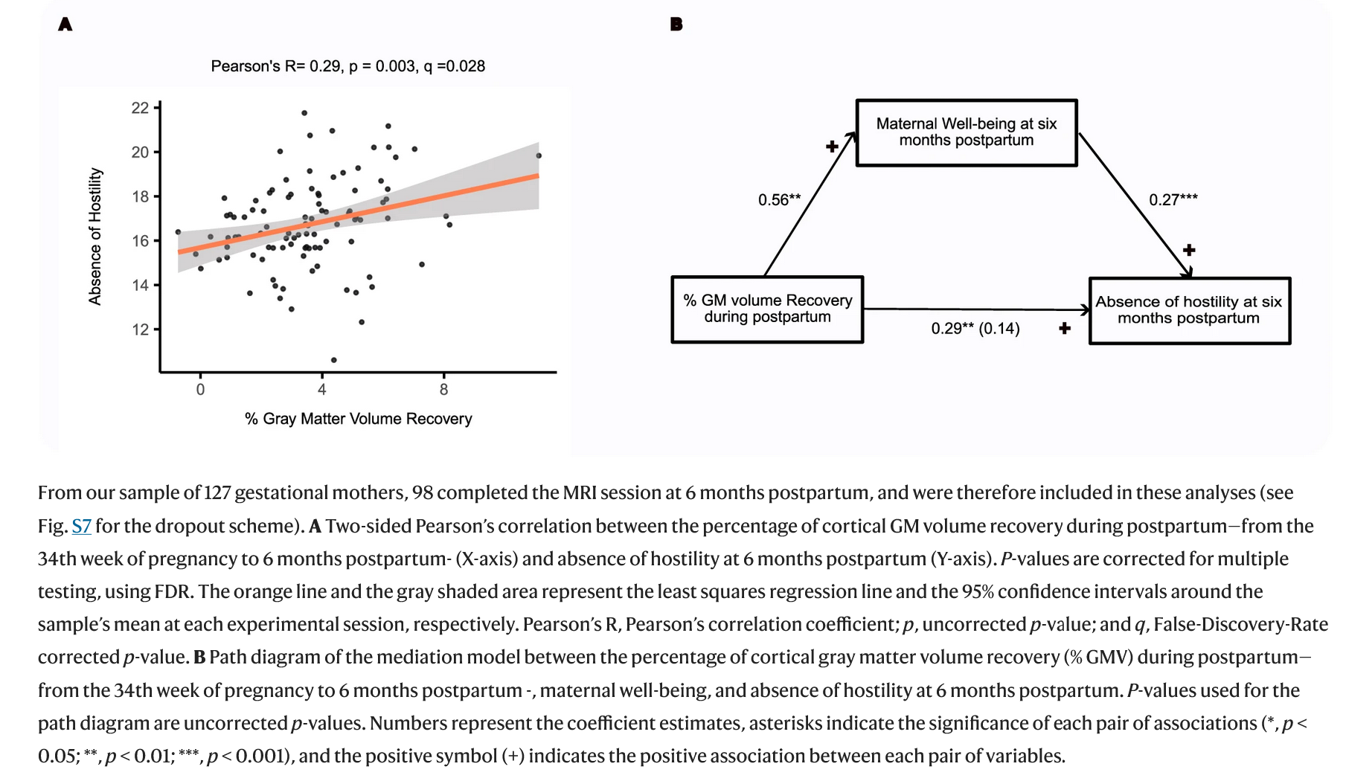

Slide 67
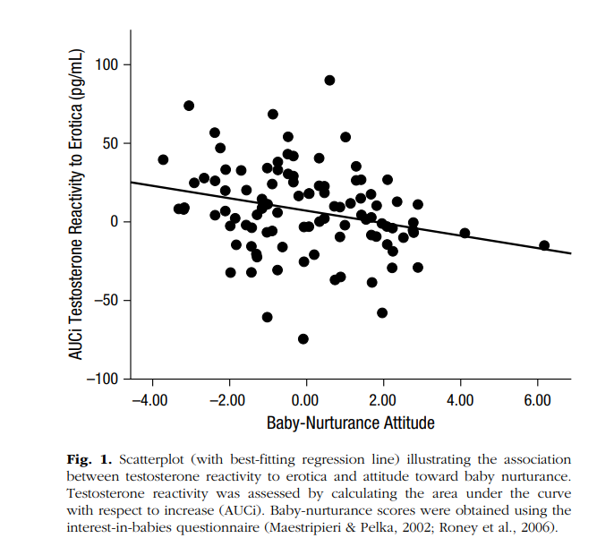
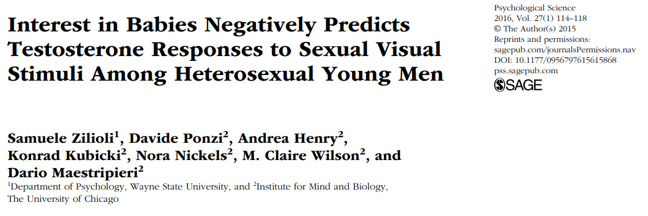
Male testosterone (& sociality)

Slide 68
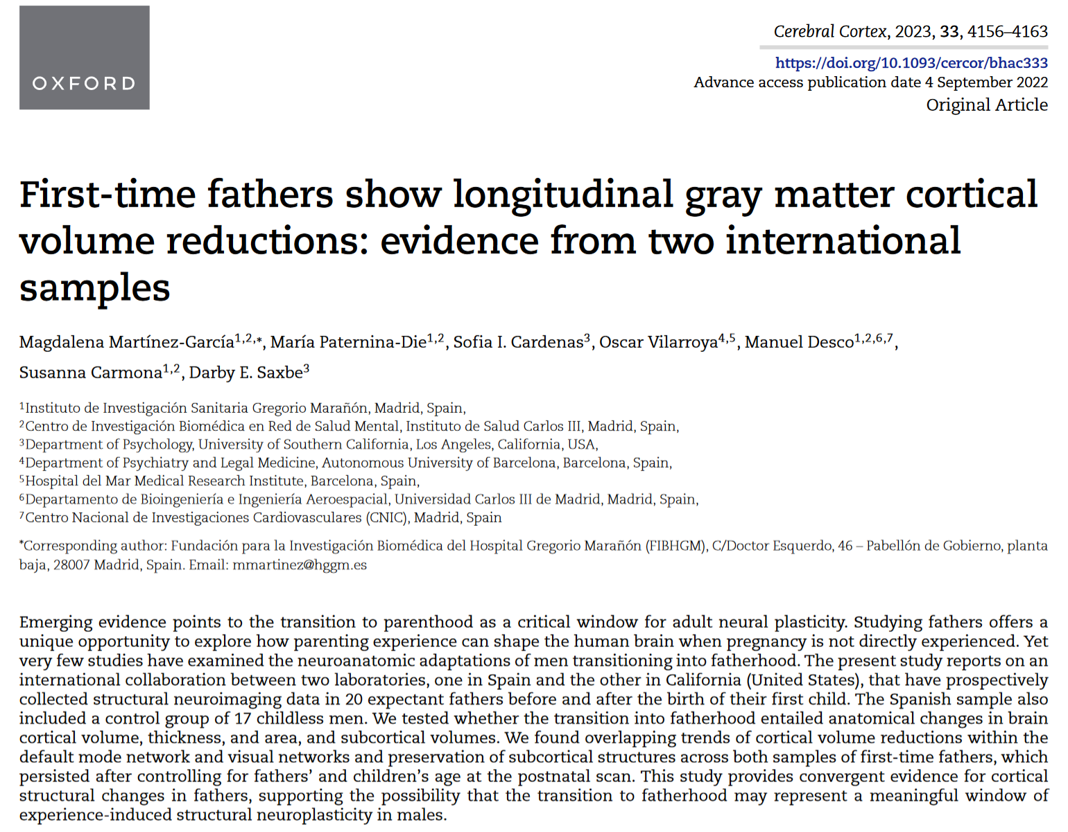
experience-induced structural neuroplasticity in males

Slide 69
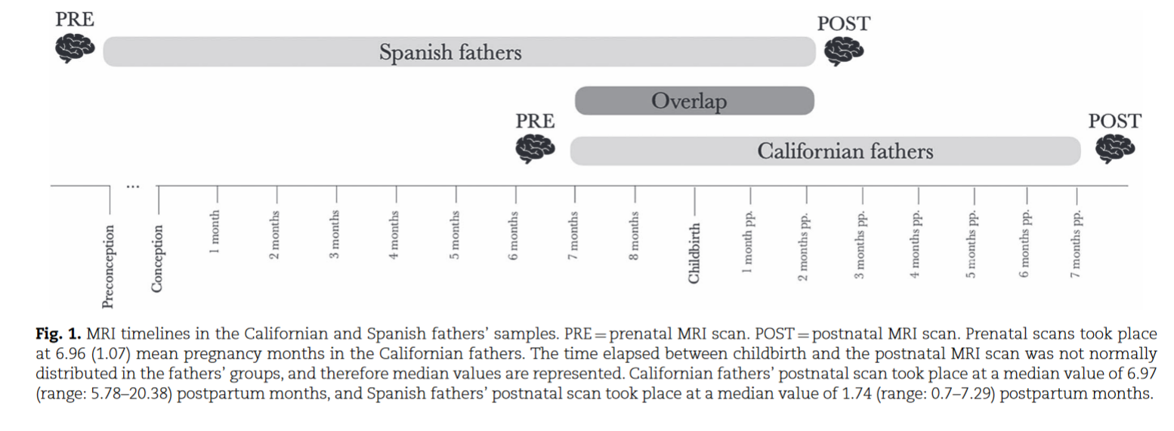
Two samples

Slide 70
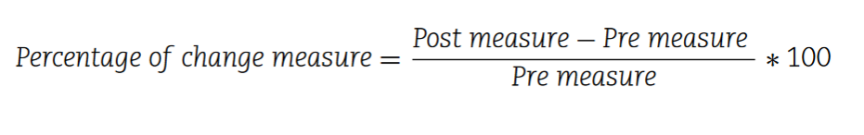
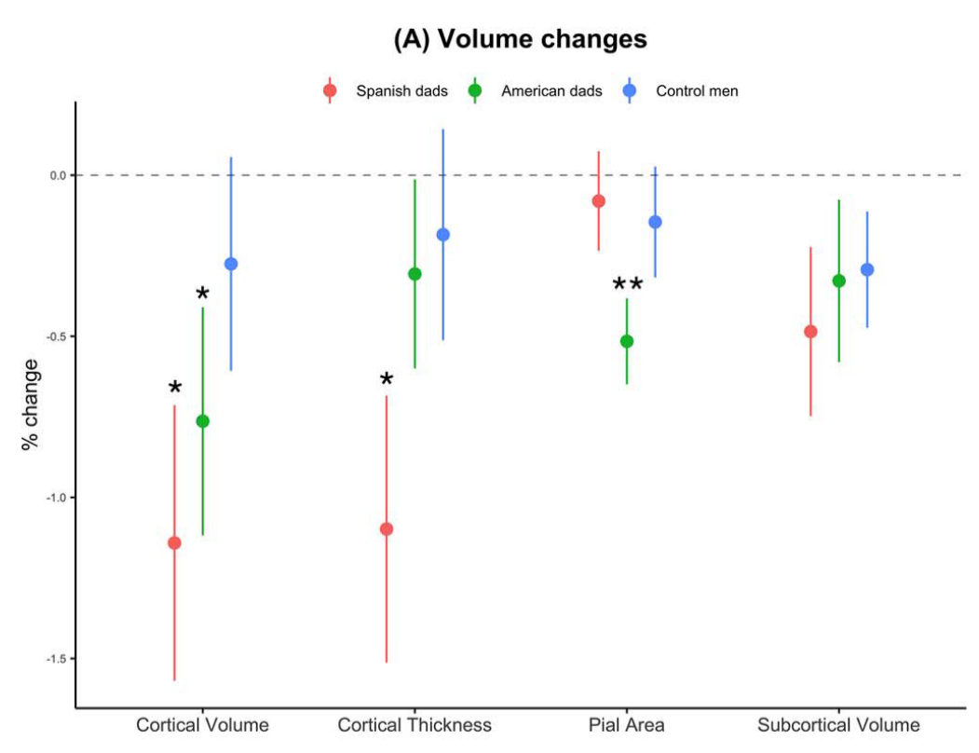
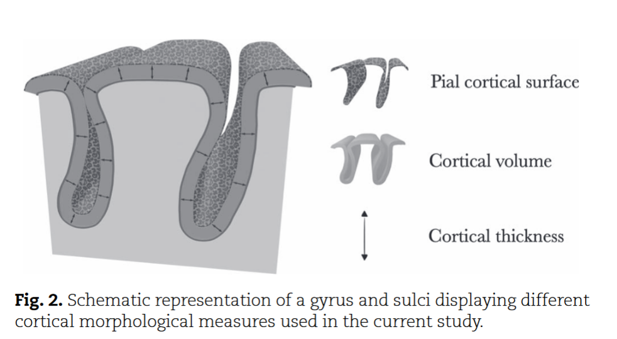
For dads, pre is higher than post

Slide 71
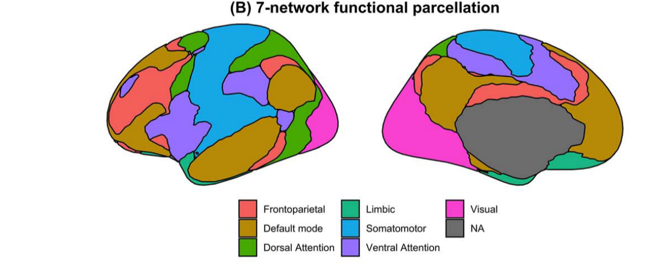
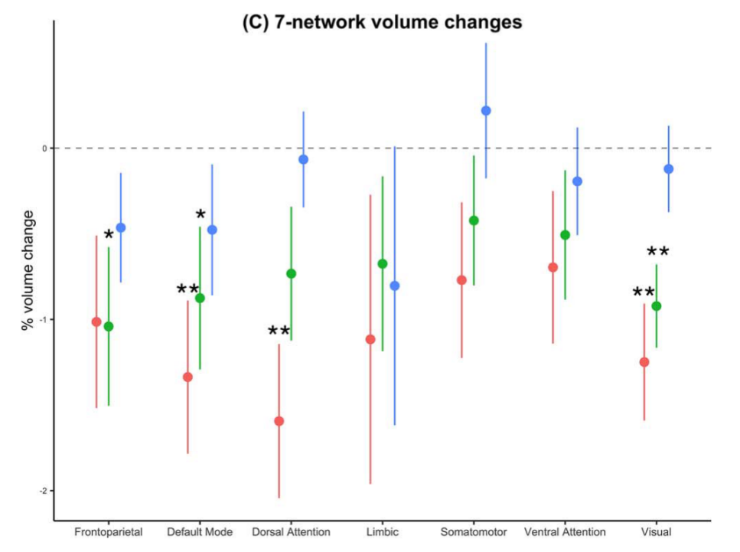
Greater dad reductions in default, dorsal, visual

Slide 72
Cortical reductions as pruning?
“Although cortical reductions sometimes reflect a process of neurodegeneration, they can also be a sign of refinement and specialization of neural circuits.
Adolescence, for instance, is a life period characterized by the continued elimination of redundant synapses (i.e. synaptic pruning) which parallels cognitive and emotional development (Selemon 2013).
In human mothers, brain volume reductions coupled with greater neural activations toward the newborns and greater mother-infant attachment (Hoekzema et al. 2017, 2020).
In the two studies tracking brain changes in human fathers, brain volume decreases were also associated with positive adaptations to parenthood.”

Slide 73
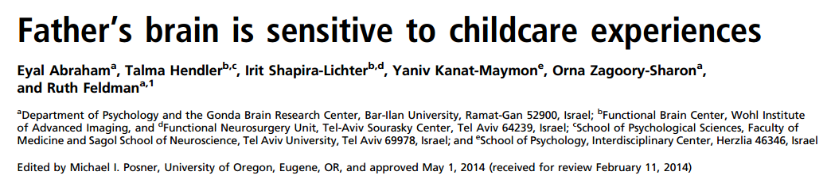
Do fathers’ brains adapts to the parental role through active involvement in childcare—gay male dads

Slide 74
Background
Socio-cultural changes have led to increased paternal involvement in childrearing, including gay male parents raising children without maternal care
It has been suggested that the human father’s brain adapts to the parental role through active involvement in childcare
Prior findings suggest distinct brain-hormone-behavior pathways may underpin maternal and paternal care, although mechanisms for human fathers’ brain adaptation are largely unknown
No study has examined the brain basis of human fatherhood when fathers are the primary care providers

Slide 75
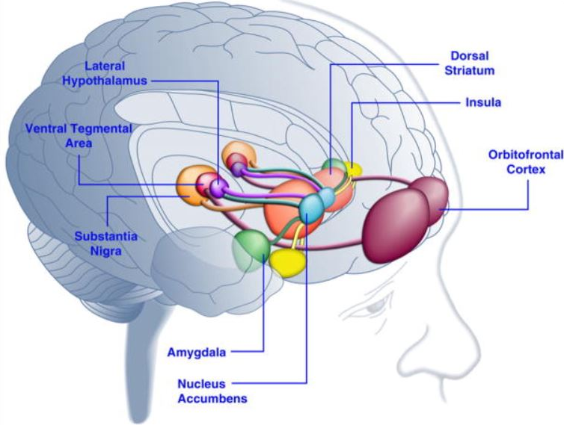
Emotional Processing Network
Ventral anterior cingulate (vACC)
Subcortical and paralimbic structures
  Phylogenetically ancient network
Emotional processing, vigilance, motivation, and reward
  Survival-related cues
Interior frontal gyrus
Abraham et al. (2014) - Walsh

Slide 76
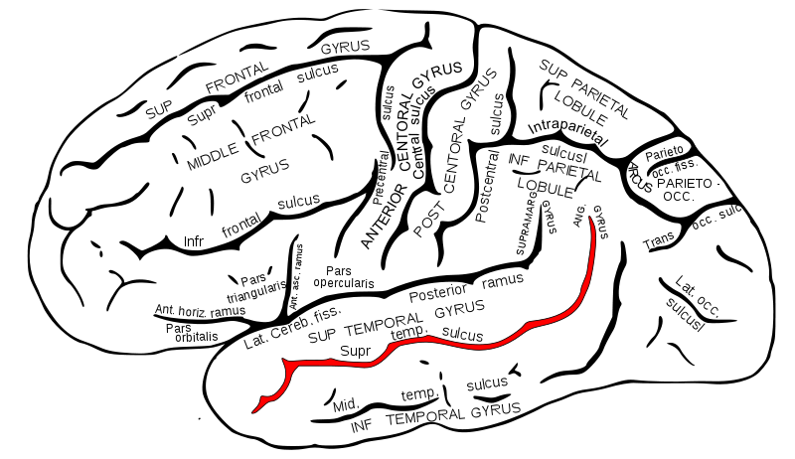
Mentalizing Network
Abraham et al. (2014) - Walsh
Medial prefrontal cortex
Frontopolar cortex
Frontopolar-medial-prefrontal-temporo-parietal structures
Involved in upper-level social understanding, cognitive empathy, and theory of mind
  Important in ability to infer mental states
  Allows parents to cognitively infer and predict infant needs
Bilateral temporal poles
Superior temporal sulcus

Slide 77
Parental Neural Networks
Emotional Processing Network
  Subcortical and paralimbic structures
    Bilateral amygdala, ventral anterior cingulate (vACC ), left insula and inferior frontal gyrus (IFG), ventral tegmental area (VTA)
  Rapidly detects motivationally salient and survival-related cues,
    enables parents to automatically identify and immediately respond to infant distress
  Associated with vigilance, affective salience, reward and motivation
  Phylogenically ancient
Mentalizing Network
  Cortical regions
    Bilateral superior temporal gyrus (STG), lateral frontopolar cortex, ventromedial prefrontal cortex (vmPFC), and temporal poles
  Involved in social understanding, theory of mind, and cognitive empathy
  Plays role in parents’ ability to infer mental states from behavior, cognitively represent infant states, predict infant needs, and plan caregiving
  Activated in parents’ first weeks of parenting
Notes:
Animal studies demonstrate mammalian mothering is supported by evolutionary ancient structures. Human studies: similar areas, also paralimbic insula=cingulate structures imbue infants with affective salience, ground experience in the present moment, enable maternal simulation of infant states
Implicate a phylogenetically ancient network of emotional processing that rapidly detects motivationally salient and survival related cues
Enables parents to automatically identify and respond to infant distress → maximizing survival
In humans, this emotional processing network is complimented by:
Network of frontopolar-medial-prefrontal-temporo-parietal structures involved in social understanding, theory of mind, cognitive empathy, including the medial prefrontal cortex (mPFC), frontopolar cortex, superior temporal sulcus (STS), and temporal poles
Plays role in individuals ability to infer mental states from behavior, already activated in parents first weeks of parenting, enables parents to cognitively represent infant states, predict infant needs, plan future caregiving

Slide 78
Neural networks implicated in parenting
  Cortical: Bilateral superior temporal gyrus (STG), lateral frontopolar cortex, ventromedial prefrontal cortex (vmPFC), and temporal poles
  Subcortical and paralimbic structures: Bilateral amygdala, ventral anterior cingulate (vACC), left insula and inferior frontal gyrus (IFG), ventral tegmental area (VTA)
Notes:
Animal studies demonstrate mammalian mothering is supported by evolutionary ancient structures. Human studies: similar areas, also paralimbic insula=cingulate structures imbue infants with affective salience, ground experience in the present moment, enable maternal simulation of infant states
Implicate a phylogenetically ancient network of emotional processing that rapidly detects motivationally salient and survival related cues
Enables parents to automatically identify and respond to infant distress → maximizing survival
In humans, this emotional processing network is complimented by:
Network of frontopolar-medial-prefrontal-temporo-parietal structures involved in social understanding, theory of mind, cognitive empathy, including the medial prefrontal cortex (mPFC), frontopolar cortex, superior temporal sulcus (STS), and temporal poles
Plays role in individuals ability to infer mental states from behavior, already activated in parents first weeks of parenting, enables parents to cognitively represent infant states, predict infant needs, plan future caregiving

Slide 79
Aims
To examine the brain-basis of human fatherhood, its comparability with the maternal brain, its relationship with oxytocin and parent-infant synchrony, and sensitivity to caregiving experiences
  Utilizing a “natural experiment”, afforded for the first time in human history (i.e., two-father families raising children without maternal involvement)

Slide 80
Experiment in nature
Participants: 89 first-time parents
  41 heterosexual biological parents
    20 Primary Care (PC) heterosexual Mothers
    21 Secondary Care (SC) heterosexual Fathers
    48 Primary Care (PC) homosexual fathers
      Child through surrogacy
Researchers visited families at home between 4-8 pm
  Videotaped each parent interacting with infant
  Coded for parent-infant synchrony
    Parent’s careful adaptation of caregiving behavior to infants’ social signals
    Coding Interactive Behavior (CIB) manual
  Salivary samples collected for oxytocin measurement
Within a week, parents went in for fMRI scanning in response to watching video of themselves interacting with their infant
Notes:
Not clear why both PC father’s considered primary, while hetero couples father’s considered secondary

Slide 81
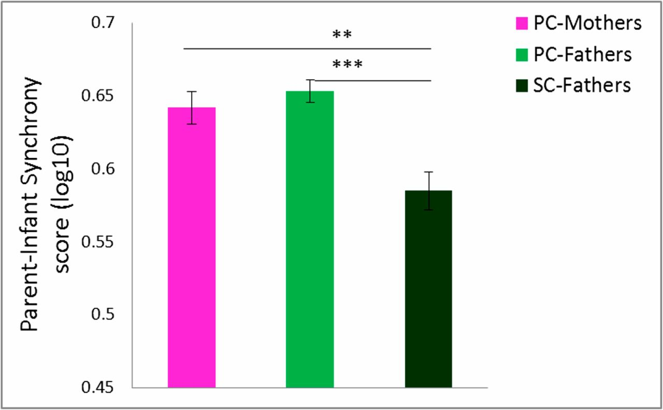

Group Differences in Parent-Infant Synchrony: PC>SC

Slide 82
Patterns of Neural Activation—
Similar with differences
Activation of a “parental caregiving” network
Across all parents, regardless of group, fMRI indicated similar patterns of activation, mapping on to both the emotional processing and mentalizing networks
Group differences in ROI activation
“Although activity in most brain areas was comparable across parents, two areas showed group differences”
  Amygdala
  STS

Slide 83

PC-Mothers greater amygdala activation than SC-Fathers
SC-Fathers greater STS activation than PC-Mothers
PC-Fathers high amygdala activation similar to PC-Mothers,
with high STS activation similar to SC-Fathers
Notes:
Whole-brain conjunction analysis (Self–Infant Interaction > Self ∩ Self–Infant Interaction > Unfamiliar Parent–Infant Interaction) revealed two brain systems: the emotional processing network (yellow line around activation) included bilateral amygdala, vACC, left insular cortex and IFG, and VTA, and the mentalizing network (purple line around activation) included bilateral STS, lateral frontopolar cortex, vmPFC, and temporal poles. Random, n = 87, P < 0.05 FDR-corrected, cluster size > 3 × 3³. (B) Bar plots present averaged percent signal change for Self–Infant Interaction minus Unfamiliar parent–infant interaction contrast for PC-Mothers (pink, n = 20), PC-Fathers (bright green, n = 47), and SC-Fathers (dark green, n = 20). (Tukey post hoc comparisons; *P < 0.05). vmPFC, ventromedial prefrontal cortex; vACC, ventral anterior cingulate cortex; IFG, inferior frontal gyrus; VTA, ventral tegmental area; L, left; R, right.
STS = superior temporal culcus

Slide 84

Regional Associations with Parent-Infant Synchrony and Oxytocin
PC-Mothers
PC-Fathers
SC-Fathers
Notes:
-Significant correlations between brain activity and parent–infant synchrony scores for PC-Mothers in bilateral amygdala, but not for PC-Fathers or SC-Fathers
-For both PC-Fathers and SC-Fathers, significant correlation was found in the bilateral STS but not for PC-Mothers
-Maternal oxytocin did not correlate with the amygdala but
-PC mothers showed correlation between oxytocin and the vACC ; no such association was found in PC or SC fathers
-Oxytocin correlated with PC-Fathers and SC-Fathers in bilateral STS but not for PC-Mothers (
Overall, there are notable mother versus father diffs. While the authors discuss these regional differences as reflecting network diffs, caution is prob warranted

Slide 85

Functional connectivity in relation to primary caregiving experience
Amygdala and STS were significantly interconnected during Self–Infant interaction, only among PC-Fathers (not PC mothers or SC fathers)
For ALL fathers, time spent in direct childcare correlated with amygdala-STS connectivity during viewing of the Self-Infant interaction

Slide 86

2 paths to synchrony
*P < 0.05; **P < 0.01; ***P < 0.001.
Path model leading from the parents' role in caregiving to parent–infant synchrony as mediated by brain activation and oxytocin levels.
Notes:
Path model leading from the parents' role in caregiving to parent–infant synchrony as mediated by brain activation and oxytocin levels. *P < 0.05; **P < 0.01; ***P < 0.001.
Parent-infant synchrony is parent’s careful adaptation of caregiving behavior to infants’ social signals
-The caregiving role had a direct path to synchrony, primary caregivers exhibiting greater synchrony
-Caregiving role had a sig. indirect effect on synchrony via amygdala activation, moderated by sex
Indirect effects of the primary caregiving role on synchrony through increased amygdala activation were significant for females, but not males
-Amygdala and STS activity were bidirectionally correlated
-STS had a sig. direct effect on synchrony
-STS indirectly associated with parent-infant synchrony via higher levels of oxytocin

Slide 87
Conclusions
PC mothers showed greater activation in subcortical emotion processing structures (i.e., amygdala), while SC fathers showed greater activation in cortical socio-cognitive circuits (i.e., STS).
  These differing patterns of activation were each correlated with higher levels of oxytocin and parent-infant synchrony.
PC fathers exhibited high amygdala activation (like PC mothers), alongside high STS activation (like SC-fathers).
Only PC fathers demonstrated functional connectivity between amygdala and STS, suggesting recruitment/integration of both the emotional processing and mentalizing networks to enable a full range of parenting behaviors.
Among ALL fathers, time spent in direct childcare was linked with degree of amygdala-STS connectivity, suggesting malleability of fathers’ brains to caregiving activities.
Overall, findings indicate a neural basis of parental care (alloparenting substrate) that can flexibly activate through responsive caregiving via brain-hormone-behavior pathways, even among fathers lacking the neurobiological cues associated with pregnancy and childbirth.

Slide 88
Father’s brain is sensitive to childcare experiences
Eyal Abraham, Talma Hendler, Irit Shapira-Lichter, Yanic Kanat-Maymon, Orna Zagoory-Sharon, & Ruth Feldman
Emily Walsh
April 15, 2021

Slide 89

Primary Caregiving & Brain Structure
Socio-cultural changes have led to increases in paternal childrearing involvement in heterosexual and male same-sex couples
Studies offer evidence for distinct brain-hormone-behavior pathways that govern caregiving in mothers and fathers
Animal and human models exist to demonstrate the pathway in primary caregiving mothers
Yet no study has examined the brain basis of primary caregiving in fathers
Abraham et al. (2014) - Walsh
Notes:
It is more common in recent decades for men to be the primary caregiver either in a heterosexual or same sex male relationship

Slide 90
Study Hypotheses:
1. All parents would express activation in both brain networks.
2. Mothers would have greater amygdala activation and fathers would have greater neural-cognitive activation
3. Maternal care would center on the emotional processing network and paternal care would center on the socio-cognitive network
4. Fathers would express greater variability in brain response, mediated by actual caregiving behaviors, and would include both neural networks in primary caregiving fathers
5. Oxytocin levels and brain activation would mediate the relationship between the parental primary caregiving role and infant-synchrony
Abraham et al. (2014) - Walsh

Slide 91
Methods
Participants: 89 first-time parents
  20 Primary care heterosexual mothers (PC-Mothers)
  21 Secondary care heterosexual fathers (SC-Fathers)
  48 Primary care homosexual fathers (PC-Fathers) - child through surrogacy
Researchers visited families at home between 4-8 pm
  Videotaped each parent interacting with infant and the infant interacting with a stranger
  Coded for parent-infant synchrony (Coding Interactive Behavior manual)
  Salivary samples collected for oxytocin measurement
Within a week, parents went in for fMRI scanning in response to watching video of themselves interacting with their infant (neutral to positive affective videos)
Abraham et al. (2014) - Walsh
Notes:
Authors note several novel aspects of this work – methodology, direct comparison, naturalistic approach

Slide 92
Results: Descriptive Group Differences
Coded parent-infant synchrony was greater among PC-mothers and PC-fathers than SC-fathers
Oxytocin levels did not vary by group
Abraham et al. (2014) - Walsh
Notes:
Parent-infant synchrony was greater among PC-mothers and PC-fathers than SC-fathers
Oxytocin levels did not vary by group
No differences in oxytocin between biological and adoptive PC-fathers

Slide 93
Finding 1: As hypothesized, all parents express activation in both brain networks
Abraham et al. (2014) - Walsh
Notes:
All parents would express activation in both brain networks.
STS: Superior temporal sulcus

Slide 94
Finding 1: As hypothesized, all parents express activation in both brain networks
Emotional
Processing
Network
Mentalizing
Network
Abraham et al. (2014) - Walsh
Notes:
All parents would express activation in both brain networks.
STS: Superior temporal sulcus

Slide 95
Finding 2: As hypothesized, mothers would have greater amygdala activation and fathers would have greater neural-cognitive activation
Abraham et al. (2014) - Walsh
Notes:
1. All parents would express activation in both brain networks.
2. Mothers would have greater amygdala activation and fathers would have greater neural-cognitive activation

Slide 96
Finding 2: As hypothesized, mothers would have greater amygdala activation and fathers would have greater neural-cognitive activation
Abraham et al. (2014) - Walsh
Notes:
1. All parents would express activation in both brain networks.
2. Mothers would have greater amygdala activation and fathers would have greater neural-cognitive activation
3. Maternal care would center on the emotional processing network and paternal care would center on the socio-cognitive network
4. Fathers would express greater variability in brain response, mediated by actual caregiving behaviors, and would include both neural networks in primary caregiving fathers
5. Oxytocin levels and brain activation would mediate the relationship between the parental primary caregiving role and infant-synchrony

Slide 97
Finding 2: As hypothesized, mothers would have greater amygdala activation and fathers would have greater neural-cognitive activation
Abraham et al. (2014) - Walsh
Notes:
1. All parents would express activation in both brain networks.
2. Mothers would have greater amygdala activation and fathers would have greater neural-cognitive activation
3. Maternal care would center on the emotional processing network and paternal care would center on the socio-cognitive network
4. Fathers would express greater variability in brain response, mediated by actual caregiving behaviors, and would include both neural networks in primary caregiving fathers
5. Oxytocin levels and brain activation would mediate the relationship between the parental primary caregiving role and infant-synchrony

Slide 98

Finding 3: Amygdala Activity
Abraham et al. (2014) - Walsh
Brain activity in the amygdala and parent-infant synchrony scores correlated for PC-mothers but neither father group
PC-Mothers
PC-Fathers
SC-Fathers
Notes:
1. All parents would express activation in both brain networks.
2. Mothers would have greater amygdala activation and fathers would have greater neural-cognitive activation
3. Maternal care would center on the emotional processing network and paternal care would center on the socio-cognitive network

Slide 99
Finding 3: Amygdala Activity
Abraham et al. (2014) - Walsh
Brain activity in the amygdala and parent-infant synchrony scores correlated for PC-mothers but neither father group
PC-Mothers
PC-Fathers
SC-Fathers
Notes:
1. All parents would express activation in both brain networks.
2. Mothers would have greater amygdala activation and fathers would have greater neural-cognitive activation
3. Maternal care would center on the emotional processing network and paternal care would center on the socio-cognitive network

Slide 100
Finding 3: Superior Temporal Sulcus (STS) Activity
Abraham et al. (2014) - Walsh
STS brain activity and parent-infant synchrony correlated in both father groups but not for PC-mothers
PC-Mothers
PC-Fathers
SC-Fathers
Notes:
1. All parents would express activation in both brain networks.
2. Mothers would have greater amygdala activation and fathers would have greater neural-cognitive activation
3. Maternal care would center on the emotional processing network and paternal care would center on the socio-cognitive network
4. Fathers would express greater variability in brain response, mediated by actual caregiving behaviors, and would include both neural networks in primary caregiving fathers
5. Oxytocin levels and brain activation would mediate the relationship between the parental primary caregiving role and infant-synchrony

Slide 101
Finding 3: Oxytocin and Ventral Anterior Cingulate Cortex (vACC)
Abraham et al. (2014) - Walsh
vACC brain activity and OT correlated for PC-mothers, neither father group
PC-Mothers
PC-Fathers
SC-Fathers
Not shown: PC-mothers OT did not correlate with amygdala
Notes:
1. All parents would express activation in both brain networks.
2. Mothers would have greater amygdala activation and fathers would have greater neural-cognitive activation
3. Maternal care would center on the emotional processing network and paternal care would center on the socio-cognitive network
4. Fathers would express greater variability in brain response, mediated by actual caregiving behaviors, and would include both neural networks in primary caregiving fathers
5. Oxytocin levels and brain activation would mediate the relationship between the parental primary caregiving role and infant-synchrony

Slide 102
Finding 3: Oxytocin and Ventral Anterior Cingulate Cortex (vACC)
Abraham et al. (2014) - Walsh
STS brain activity and OT correlated for both PC and SC fathers, not PC-mothers
PC-Mothers
PC-Fathers
SC-Fathers
Not shown: PC-mothers OT did not correlate with amygdala
Notes:
1. All parents would express activation in both brain networks.
2. Mothers would have greater amygdala activation and fathers would have greater neural-cognitive activation
3. Maternal care would center on the emotional processing network and paternal care would center on the socio-cognitive network
4. Fathers would express greater variability in brain response, mediated by actual caregiving behaviors, and would include both neural networks in primary caregiving fathers
5. Oxytocin levels and brain activation would mediate the relationship between the parental primary caregiving role and infant-synchrony

Slide 103

Finding 4: The PC-Father Brain
Abraham et al. (2014) - Walsh
Only PC-Fathers had significant connectivity of the amygdala (emotional network) and STS (mentalizing network) while watching self- infant interaction videos
Notes:
1. All parents would express activation in both brain networks.
2. Mothers would have greater amygdala activation and fathers would have greater neural-cognitive activation
3. Maternal care would center on the emotional processing network and paternal care would center on the socio-cognitive network
4. Fathers would express greater variability in brain response, mediated by actual caregiving behaviors, and would include both neural networks in primary caregiving fathers
5. Oxytocin levels and brain activation would mediate the relationship between the parental primary caregiving role and infant-synchrony
-Significant correlations between brain activity and parent–infant synchrony scores for PC-Mothers in bilateral amygdala, but not for PC-Fathers or SC-Fathers
-For both PC-Fathers and SC-Fathers, significant correlation was found in the bilateral STS but not for PC-Mothers
-Maternal oxytocin did not correlate with the amygdala but
-PC mothers showed correlation between oxytocin and the vACC ; no such association was found in PC or SC fathers
-Oxytocin correlated with PC-Fathers and SC-Fathers in bilateral STS but not for PC-Mothers (
Overall, there are notable mother versus father diffs. While the authors discuss these regional differences as reflecting network diffs, caution is prob warranted

Slide 104
Finding 4: The PC-Father Brain
4. Fathers would express greater variability in brain response, mediated by actual caregiving behaviors, and would include both neural networks in primary caregiving fathers
5. Oxytocin levels and brain activation would mediate the relationship between the parental primary caregiving role and infant-synchrony
Abraham et al. (2014) - Walsh
Connectivity of these two networks was positively correlated to time spent alone with their child
Notes:
-Significant correlations between brain activity and parent–infant synchrony scores for PC-Mothers in bilateral amygdala, but not for PC-Fathers or SC-Fathers
-For both PC-Fathers and SC-Fathers, significant correlation was found in the bilateral STS but not for PC-Mothers
-Maternal oxytocin did not correlate with the amygdala but
-PC mothers showed correlation between oxytocin and the vACC ; no such association was found in PC or SC fathers
-Oxytocin correlated with PC-Fathers and SC-Fathers in bilateral STS but not for PC-Mothers (
Overall, there are notable mother versus father diffs. While the authors discuss these regional differences as reflecting network diffs, caution is prob warranted

Slide 105
Finding 5: Role and Synchrony Mediation
Abraham et al. (2014) - Walsh
Primary caregivers had greater synchrony

Slide 106
Finding 5: Role and Synchrony Mediation
Abraham et al. (2014) - Walsh
Indirect effect of role on synchrony via amygdala activation, moderated by gender – only mothers
Notes:
1. All parents would express activation in both brain networks.
2. Mothers would have greater amygdala activation and fathers would have greater neural-cognitive activation
3. Maternal care would center on the emotional processing network and paternal care would center on the socio-cognitive network
4. Fathers would express greater variability in brain response, mediated by actual caregiving behaviors, and would include both neural networks in primary caregiving fathers
5. Oxytocin levels and brain activation would mediate the relationship between the parental primary caregiving role and infant-synchrony

Slide 107
Finding 5: Role and Synchrony Mediation
Abraham et al. (2014) - Walsh
Amygdala (emotional network) and STS (mentalizing network) were correlated
Notes:
1. All parents would express activation in both brain networks.
2. Mothers would have greater amygdala activation and fathers would have greater neural-cognitive activation
3. Maternal care would center on the emotional processing network and paternal care would center on the socio-cognitive network
4. Fathers would express greater variability in brain response, mediated by actual caregiving behaviors, and would include both neural networks in primary caregiving fathers
5. Oxytocin levels and brain activation would mediate the relationship between the parental primary caregiving role and infant-synchrony

Slide 108
Finding 5: Role and Synchrony Mediation
Abraham et al. (2014) - Walsh
STS indirect effect on synchrony via increases in OT
Notes:
1. All parents would express activation in both brain networks.
2. Mothers would have greater amygdala activation and fathers would have greater neural-cognitive activation
3. Maternal care would center on the emotional processing network and paternal care would center on the socio-cognitive network
4. Fathers would express greater variability in brain response, mediated by actual caregiving behaviors, and would include both neural networks in primary caregiving fathers
5. Oxytocin levels and brain activation would mediate the relationship between the parental primary caregiving role and infant-synchrony

Slide 109
Finding 5: Role and Synchrony Mediation
Abraham et al. (2014) - Walsh
No differences found in femininity and masculinity between homosexual and heterosexual fathers
Notes:
1. All parents would express activation in both brain networks.
2. Mothers would have greater amygdala activation and fathers would have greater neural-cognitive activation
3. Maternal care would center on the emotional processing network and paternal care would center on the socio-cognitive network
4. Fathers would express greater variability in brain response, mediated by actual caregiving behaviors, and would include both neural networks in primary caregiving fathers
5. Oxytocin levels and brain activation would mediate the relationship between the parental primary caregiving role and infant-synchrony

Slide 110
Conclusions: Adaptation of the Paternal Brain
Abraham et al. (2014) - Walsh
Findings support distinct maternal and paternal brain-hormone-behavior networks
PC fathers exhibited high amygdala activation (like PC mothers), alongside high STS activation (like SC-fathers)
Among all fathers, time spent caregiving was linked with the degree of neural network overlap (more time, more connectivity between networks)
Overall, findings indicate a neural basis and adaptation of parental care that can be activated through responsive caregiving via brain-hormone-behavior pathways
Notes:
Authors note several novel aspects of this work – methodology, direct comparison, naturalistic approach

Slide 111
Discussion
Abraham et al. (2014) - Walsh
The present study lacked a control group (e.g., male non-fathers). How might this have improved the study? What other groups might you add to enhance the study?
The authors use the Bem Sex Role inventory to measure feminine and masculine traits of all fathers, and no differences were found between groups. What other life experiences are the authors missing that could have contributed to the parenting synchrony or brain activity results found?
How might the results look in two-mother families? Adoptive versus biological mothers?
How generalizable are the results to all “fathers”?
Only first-time parents were included; how might the results change if the couples had more children or twins?

Slide 112
Dopamine in the medial amygdala network mediates human bonding
Atzil et al. (2017)

Slide 113

Bonding Network
Mother-child Synchrony – Dopamine level in Striatum
Atypical maternal behavior – attenuated striatum responses
Atypical maternal behavior – disrupted amygdala & PCC
Amygdala

Slide 114
Current Study
Participants: 19 mother (21-42 yr) - infant (4-24 mo) dyads
Procedures:
  2-min interactions at home: coded for mother-infant synchrony
    Vocalization, gaze ,affect, touch
  Scanning: own infant vs. unfamiliar infant play (twice)
    PET: Dopamine responses
    fMRI: functional connectivity

Slide 115

Mother–Infant Synchrony
Vocalization Synchrony
Maternal Attunement

Slide 116

Vocalization Synchrony - Dopamine

Slide 117

Maternal Attunement - Connectivity

Slide 118

Dopamine – Connectivity (own infant)

Slide 119
Main Findings
Dopamine is involved in mother-infant bonding positively.
NAcc and pallidum serve the regulatory function of dopamine of bonding behavior.
Regions work as a network for bonding.

Slide 120

PRIORITY COMMUNICATION:
Oxytocin administration to
parent enhances infant physiological and behavioral readiness for social engagement
2016
O. Weisman, O. Zagoory-Sharon, & R. Feldman
    From the Department of Psychology
    & the Gonda Brain Sciences Center,
    Bar-Ilan University, Ramat-Gan, Israel

Slide 121
Background
Experimental intranasal (IN) OT administration related to prosocial changes in humans
  In the individual
    Increased empathy
    Increased theory of mind
    Increased trust
    Increased altruism
  In the dyad
    Increased positive communications between romantic partners
  In the disorder context
    Improved social functioning in autism
    Improved social functioning in schizophrenia
Implications for intervention research on social dysfunction
Parental OT dysfunction and child OT dysfunction in socially strained early environments
Post-partum depression (mom)
Early abuse
Early neglect

Slide 122




Overview
Can exogenously administered OT increase parent social engagement with their infant?
    If parent social engagement changes, is there parallel change observed in the infant?
Lingering Questions
Evaluate difference in social affiliation across OT and placebo for infant and father measuring three domains:
    Hormone levels
    Autonomic regulation
    Social affiliation behaviors
Aims
Administered intranasal OT or placebo to father
  Condition order counterbalanced and double-blind
Design
Collected for within-subjects comparison in infants and fathers using measures collected during:
  Pre-interaction
  Face-to-Face Still-Face interaction
  Post-interaction
Data

Slide 123
Hypotheses
Father IN OT ↑
Serum OT thought to be correlated with cerebral OT concentrations
Resting Sinus Arrhythmia (RSA) is a measure of heart rate variability that describes sensitivity in autonomic regulation
Social engagement behavior (Social Bx) reflects species-typical pro-social behaviors for fathers (fBx) and infants (iBx)
Hormonal
Autonomic
Behavioral
Serum OT
RSA
Social Bx
Father ↑
Father ↑
Father ↑
Infant ↑
Infant ↑
Infant ↑
Father IN OT ↑

Slide 124






Methods and Data Collection
(Weisman et al., 2012)
Father RSA
T₃
Post-FTFSF
    2 more OT samples to see return to baseline
T₄
Father self-administration 24 IU OT/placebo
Return to Baseline
Father affect from PANAS
    Infant reunited with father
    EEG placed
T₂
Pre-FTFSF
Father OT
Father OT
Father OT
Infant OT
Infant OT
40 minutes
20 minutes
T₁
T₂
T₃
T₄
Father RSA
20 minutes
    Free play 3 min
Pre-study
    FTFSF Paradigm measured RSA for 3 time intervals
Infant RSA
    Still face 2 min
    No caffeine
    No alcohol
    2 hr fast
Father bx
    Reunion 2 min
    Social Engagement Behavior
    Coded post-hoc from video analysis
    Infant & parent separated
    Father self-sprays OT/placebo
Infant bx
T₁
Study Arrival
Father OT
Infant OT
Theresa
2015

Slide 125
Methods
One week between 2 study visits
Excluded for birth complications (infant), any medication usage (both)
Procedure
  Father and infant separated on arrival
    Father collected baseline salivary OT and baseline RSA before rejoining infant
    Father administered OT or placebo with 40 minutes for absorption
  Infant and father reunited
    Electrodes placed
    Initial OT sample taken for infant (2nd sample for father)
  Face-to-face still-face paradigm
    3 min free play
    2 min still face
    2 min reunion
  Post-measurement at 20 and 40 minutes post-interaction
    Post-interaction refers to the start of the interaction, so latency of measurement is less than 20/40 min

Slide 126
Social Engagement
Offline coding of father-infant interaction
For each measure:
  Mean duration
  Latency of behavior event
Evaluated touch synchrony as a dyadic measure of engagement
  Touch by father while infant maintains eye contact with him
Fathers | Infants
Social gaze | Social gaze
Positive affect | Positive affect
Father vocalizations | Exploratory play
Parental touch

Slide 127

Results of OT

Slide 128

RSA Results

Slide 129

Results of Social Behavior
Positive affective expression?

Slide 130
Conclusions
Enhances parent’s physiological and behavioral systems that facilitate parent-child interaction
  Increased salivary OT
  Higher RSA during free play
  Parenting behavior (touch, social reciprocity)
Has parallel effects on infant
  Increased salivary OT
  Higher RSA during free play
  Greater social engagement (social gaze, exploration)

Slide 131
Discussion
Methodology:
  4 father vs. 3 infant measures (OT, RSA)
  Do the statistical tests match the hypothesized model? How can the tests be improved?
How can we fix the problems with analyses used in this study?
  (for example, the correlation analysis between fathers/infants)
Would we expect the same results for mothers?
How useful is it to index cardiovascular function in a sample with no medication use, smoking, physical illness, or mental illness?

Slide 132

‘Commercially available EIA assays without extraction two orders of magnitude higher than conventional RIA methods with extraction’
http://www.psy.miami.edu/faculty/mmccullough/Papers/McCullough-Churchland-Mendez-Final.pdf
‘commercially available EIA assays without extraction…guaranteed to obtain values…two orders of magnitude higher than... conventional RIA methods with extraction
Notes:
Using
commer-
cially
available
EIA
assays
without
extraction,
one
is
guaranteed
to
obtain
values
that
are
two
orders
of
magnitude
higher
than
those
obtained
using
conventional
RIA
methods
with
extraction

