Slide 1
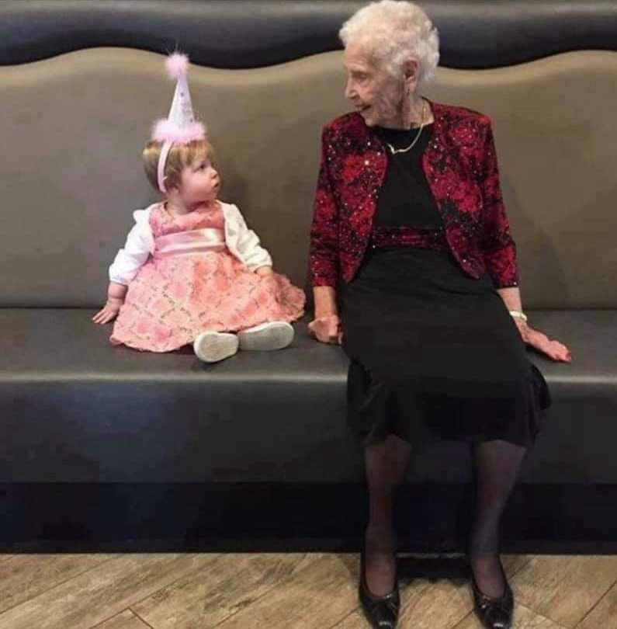
Advanced Developmental
Psychology
PSY 620, Daniel Messinger

Slide 2
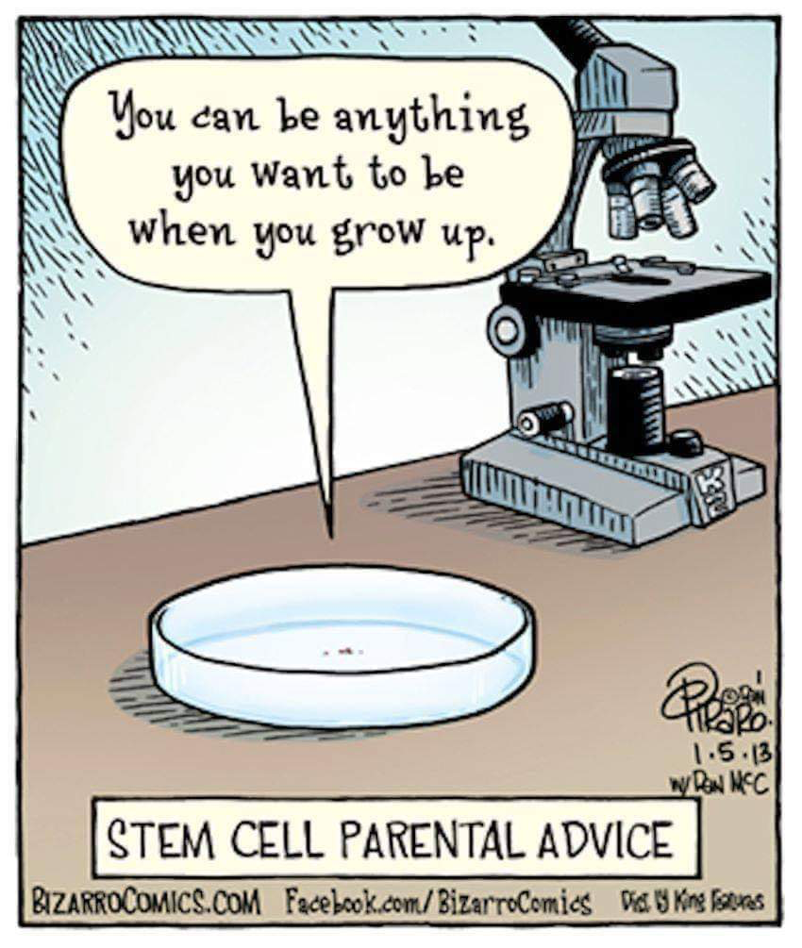
Introduction
Course overview and syllabus
  introductions
Watching development
Defining development
Bioecological
  Bronfenbrenner
Dynamic systems
  And other concepts

Slide 3
Children over developmental time
Sign in
0:17 / 1:56
My Birthdays. Vince 0 to 19 (In normal speed)
Sign in
0:48 / 1:56
My Birthdays. Vince 0 to 19 (In normal speed)
Sign in
1:29 / 1:56
My Birthdays. Vince 0 to 19 (In normal speed)
Natalie Time Lapse: 0 to 10 years 1:25 (stills)
    https://www.youtube.com/watch?v=ejbNVWES4LI
Lotte
  0 to 20 years
    https://www.youtube.com/watch?v=yfqpqiTMUEg (0-22)
  0 to 18 years in 5:30 video
    https://www.youtube.com/watch?v=nPxdhnT4Ec8
      Lotte, 0 to 13 years in 3:30 (video). Original.
        https://www.youtube.com/watch?v=nN_jcom8TR4
Vince,
  1:29 / 1:56: My Birthdays. Vince 0 to 19 (In normal speed)
    https://www.youtube.com/watch?v=IhYElAlrnnc
  0 to 14 years in 4 min
  https://www.youtube.com/watch?v=mXjFMX-uhzk
    Vince - 0 to 11 years in 4:00. Original, video
      https://www.youtube.com/watch?v=NQxyfOpZmAQ
Photo A Day For 15 Years (Age 13 to 28)
    https://www.youtube.com/watch?v=Jbk-O9u4gvc
photo taken every day for 30 years - 11,000 images (too much background)
  https://www.youtube.com/watch?v=OMc1LlPYmHU
Notes:
Removed: Annie : 0 to 18 Years Old
https://www.youtube.com/watch?v=_15bT8fGr2A

Slide 4
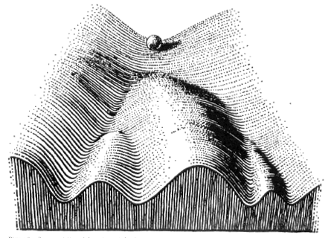
Developmental canalization
Time
(Waddington)
Notes:
which developmental trajectories are becoming more fixed (canals are becoming deeper); said another way, the probability distributions of potential outcomes are becoming more peaked (likely outcomes are ever more likely).

Slide 5
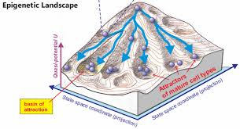
Quantitative to qualitative

Slide 6
Development defined:
Individual change over time that:
Reorganizes
  Multiple systems (entire person)
Successive, sequential
  Crawl before you walk
Non-reversible (stable)
  You can’t go back
Normative
  Everyone’s doing it
Continues over lifespan

Slide 7
Is development increasing functionality in all things?
  Loss of perceptual acuity in non-native languages between 6 & 12 months
  Old-age
  Adolescence
    “Training yielded some improvement in performance on the numerosity-discrimination task, but only in older adolescents or adults.”
            Knoll, L. J., Fuhrmann, D., Sakhardande, A. L., Stamp, F., Speekenbrink, M., & Blakemore, S.-J. (2016). A Window of Opportunity for Cognitive Training in Adolescence. Psychological Science, 27(12), 1620-1631. doi: doi:10.1177/0956797616671327

Slide 8
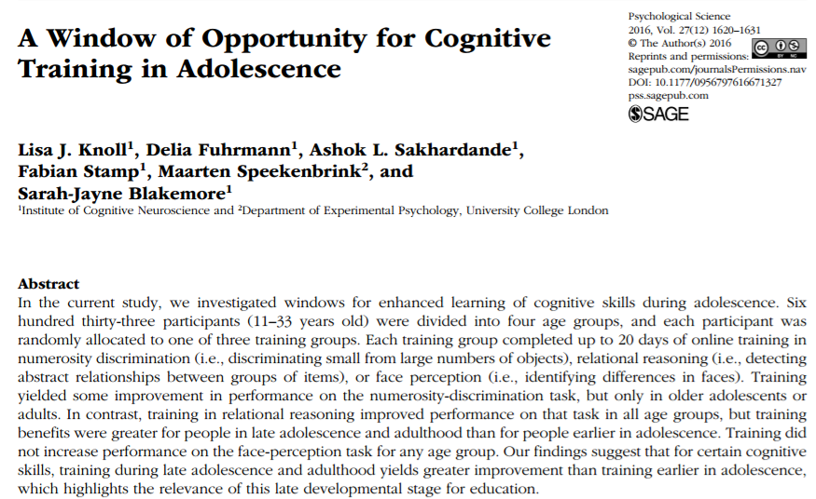

Slide 9
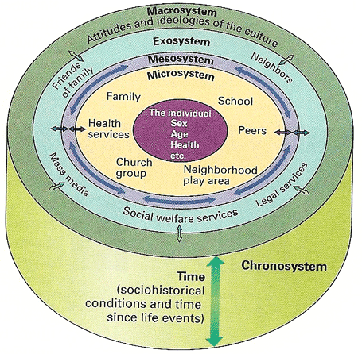
Bronfenbrenner’s Bioecological
Theory of Development
Bidirectional relations between levels of organization
Limitations of model

Slide 10
How does your work relate…..
Describe the level at which you are currently anchoring
your own research and/or professional work?
Describe a level you are not currently examining but are
interested in?

Slide 11
Children over developmental time redux
Natalie Time Lapse: 0 to 10 years 1:25 (stills)
    https://www.youtube.com/watch?v=ejbNVWES4LI
Lotte, 0 to 16 years in 4:30 video
    https://www.youtube.com/watch?v=-Plk7TLNmsU
  Lotte, 0 to 13 years in 3:30 (video). Original.
      https://www.youtube.com/watch?v=nN_jcom8TR4
Vince, 0 to 14 years in 4 min
  https://www.youtube.com/watch?v=mXjFMX-uhzk
  Vince - 0 to 11 years in 4:00. Original, video
      https://www.youtube.com/watch?v=NQxyfOpZmAQ

Slide 12
Developmental Systems Perspective
Four essential components
  Systematic change with relative plasticity
  Integration of levels of organization
  Historical embeddedness and temporality
  Limits of generalizability, diversity, & individual differences

Slide 13
Mechanistic explanation versus holistic description
“In essence, the concepts of historical embeddedness and temporality indicate that a program of developmental research adequate to address the relational, integrated, embedded, and temporal changes involved in human life must involve multiple occasions, methods, levels, variables, and cohorts (Baltes, 1987; Baltes, Lindenberger, & Staudinger, 2006; Schaie & Strother, 1968).” Lerner et al., p. 12

Slide 14
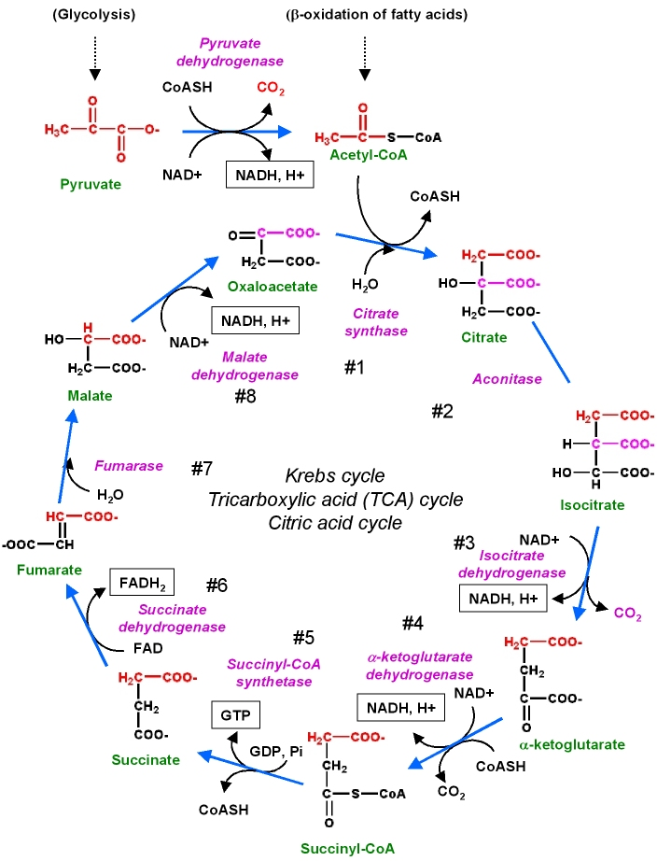
Hand-wringing about complexity
Krebs cycle
  Cellular respiration
    evolved…

Slide 15
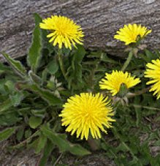

Rethinking nature & nurture
Individual differences in sensitivity to environment (nurture)!
Differential-susceptibility hypothesis: some individuals are more susceptible than others to both positive & negative environments
  dandelion
orchid
(Belsky & Pluess, 2009)
Notes:
Differential-susceptibility hypothesis: some individuals are more susceptible than others to both positive & negative environments
A good analogy is to think of different types of flowers…
Dandelions are like weeds, in that they grow really well (thrive) in a variety of environments. They’re less influenced by their environments.
Orchids, in contrast, can be really beautiful, but only in the perfect environment. In most environoments they’d struggle. Very sensitive to environment.
---
‘risk genes’ for behavior and mental problems magnify not just maladaptive responses to bad environments but advantageous responses to good environments. That is, these “risk genes” confer not just vulnerability, but greater responsiveness, sometimes to bad effect, sometimes to good

Slide 16
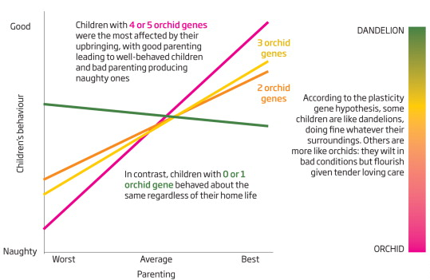
Example: Parenting & child’s behavior
Low plasticity
(resilient but less responsive)
High plasticity
(greater vulnerability but also greater responsiveness)
(Dobbs, 2012)
Notes:
The effects of parenting on child’s behavior depends on how plastic a child is. Some children are like dandelions, doing fine whatever their surroundings. Others are more like orchids, they wilt in bad conditions, but flourish in tender loving care.
Highly plastic children are the most effected by their upbringing, for better or for worse (pink) – good parenting made children well-behaved and bad parenting produced naughty kids.
In contrast, kids with fewer orchid genes (less plastic) behaved about the same regardless of their home life (orange)
So what determines plasticity???
Evolutionarily speaking, these individual differences are quite interesting because, in fact, prior to birth a fetus can detect information about the postnatal environment, based on things like the mother’s stress, nutrition, etc, and based on this information the fetus can make a “good guess” about whether the outside world is a good place or a tough place. If good, it’s best to be an orchid (be plastic); if bad, it’s best to be a dandelion (resilient, less plastic)
It’s not one-size-fits all.
So think of yourself… are you more of a dandelion or an orchid?

Slide 17
Dynamic Systems Theory
Focus on change, emergence of new forms, self-organization
  Static System x_{t} = f (a,b,c….)
vs.
  Dynamic System x_{t} = f (x_{t-1},a,b,c….)
Dominant behaviors as attractors
  Arousal + negative emotional valence→?

Slide 18
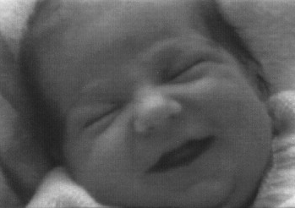
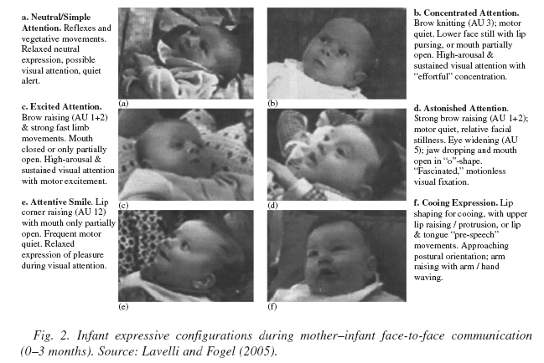
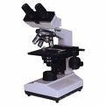
Real time → Developmental time
Smile
(sleep/drowsy)
Attentive Brow
(awake)
Smile
(awake)
Messinger, Dondi, et al., 2002; Dondi, Messinger et al., 2007
Messinger,, et al., 2002; Dondi, et al., 2007

Slide 19
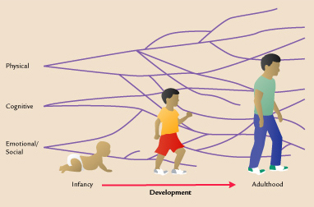
20 Years of Dynamic Systems Theory
Spencer, Perone, & Buss, 2011
Change occurs within and between complex systems which interact over time

Slide 20
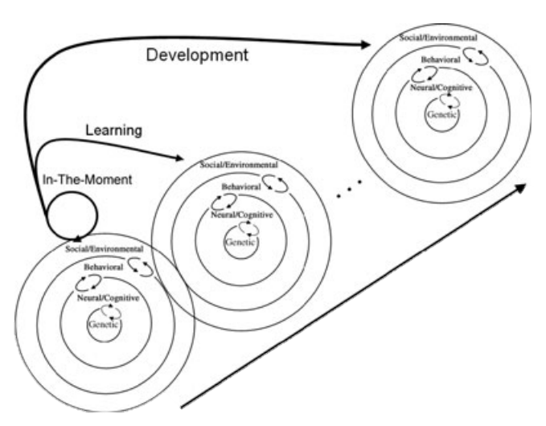
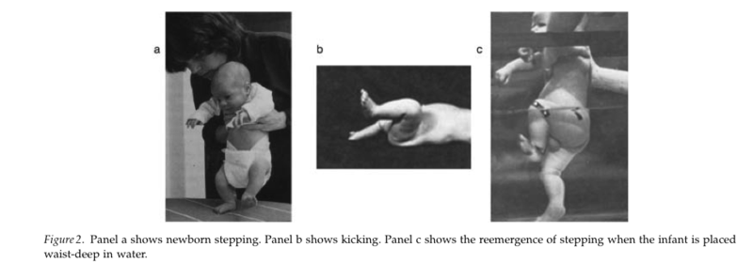
Now what…..?
How do we identify or define “cause”?
How do we integrate levels across multiple time points?
Research
methods
Amiel

Slide 21
Causes of individual differences
proximate/mechanism (how)
ultimate/evolutionary (why)
Notes:
In considering individual differences in any given behavior or ability, we can think about the causes in 2 ways:
the proximate cause, which refers to HOW something works. What neural, hormonal, or sociocultural systems are involved.
We can also think about the ultimate cause or the evolutionary causes, which refers to WHY something is the way it is. How natural selection may have operated to produce the variability that we observe.
Such a view can provide novel insights…

Slide 22
A Perspective on Development
Focus on mechanisms underlying change
  How/why rather than what of development
Move away from “either / or” attempts to isolate/quantify relative contributions
  How does development proceed?
    Nature – Nurture
    e.g., is shyness innate or learned?

