Slide 1
Advanced Developmental Psychology
PSY 620
Daniel Messinger, PhD

Slide 2
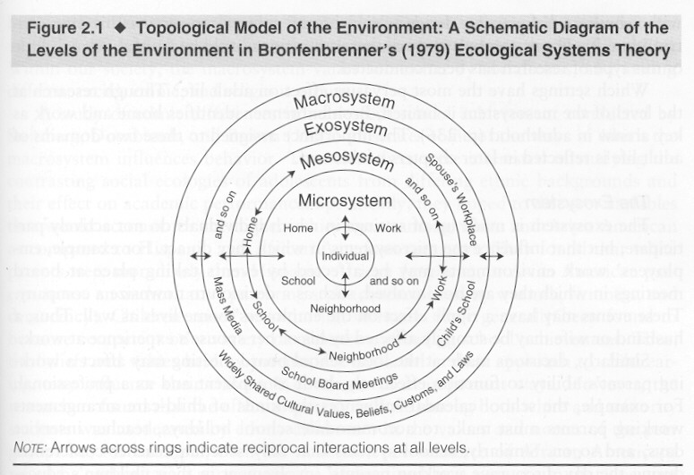
Domains of Development
Perception
Cognition
Language
Social/Emotional

Slide 3
Cognition
Individual
Differences
Learning mechanisms
  Neonatal imitation
    Later social (over)imitation
  Classical conditioning
  Operant conditioning
  Habituation
    Can infants count (habituation)?
  Machine learning via deep neural networks?
Brain-body loops
  Sticky mittens
Piaget (vs. habituation) through development
Social learning mechanisms
  Ostensive communication
Innate versus constructivist
  Yu & Smith?
  Attention
  Joint attention/joint engagement/language
Spatial processing in infancy predicts

Slide 4
Fundamental question:
How do children know?
Infants have innate knowledge of essential properties of world
  Nativist account: the mind produces ideas that are not derived from external sources
    Infants have an inborn conception of what objects are
Infants must construct knowledge of essential properties of world
  Constructivist or empiricist account: experience, especially of the senses, is the only source of knowledge.
Individual
Differences

Slide 5
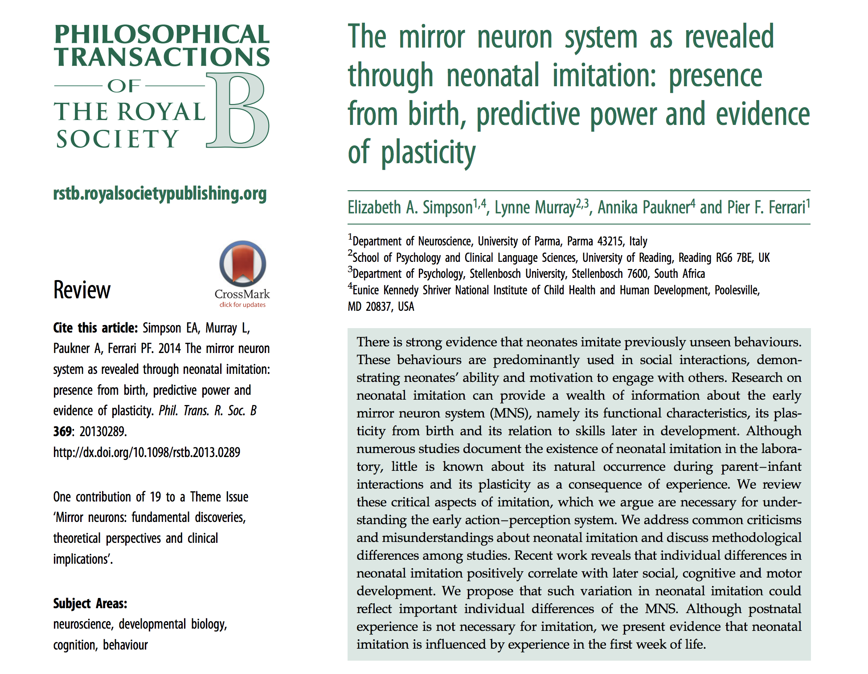
Nativist or constructivist?
Maylott

Slide 6
Background
Mirror neuron system (MNS):
  Action-perception system
  Activated during observations and imitation
  Mu rhythm—desynchronization during the observation and imitation of facial gestures
Neonatal Imitation
  Ability of infants to match others’ actions in the first four weeks of life
Maylott

Slide 7
Macaque Example
Maylott

Slide 8
Human Example
Maylott

Slide 9
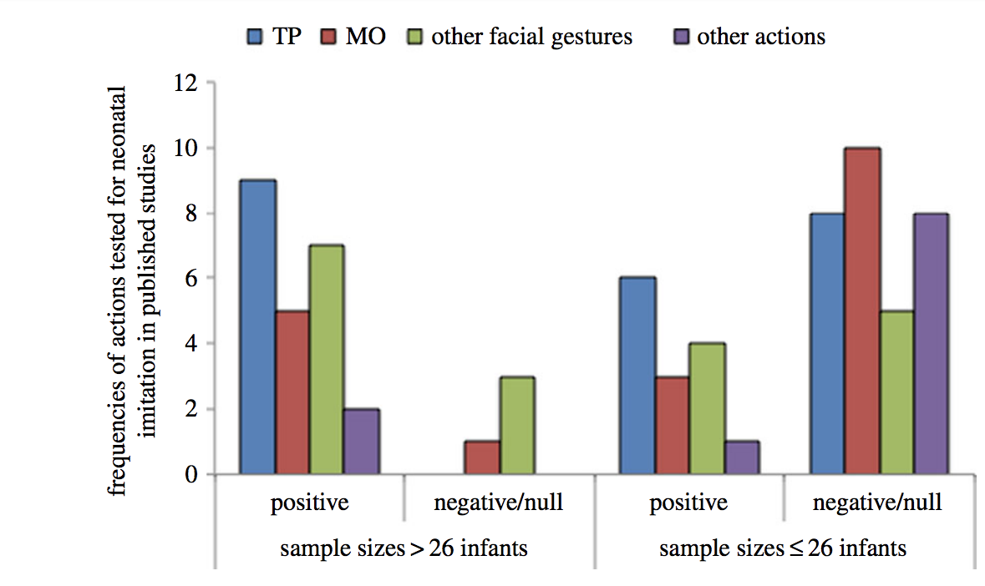
Bigger samples, stronger evidence?
Use of pacifiers
Not counting infant imitation during gesture period
Low sample sizes
Maylott

Slide 10
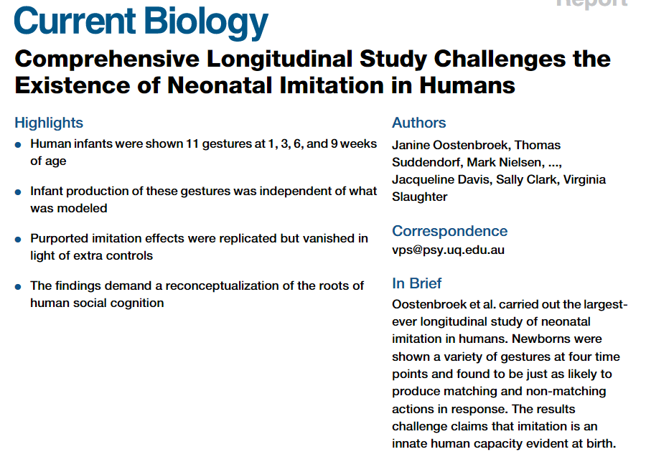
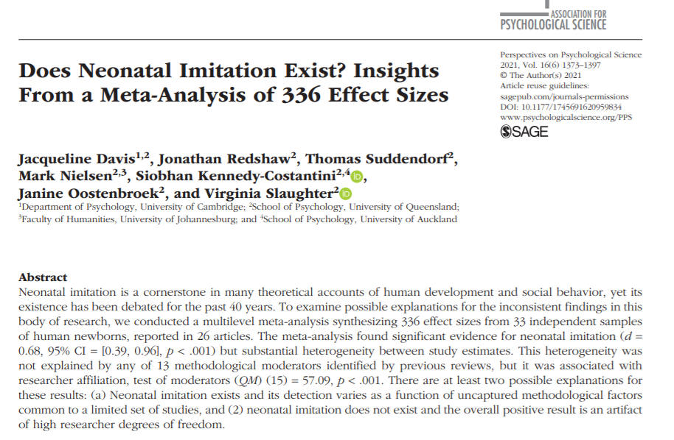
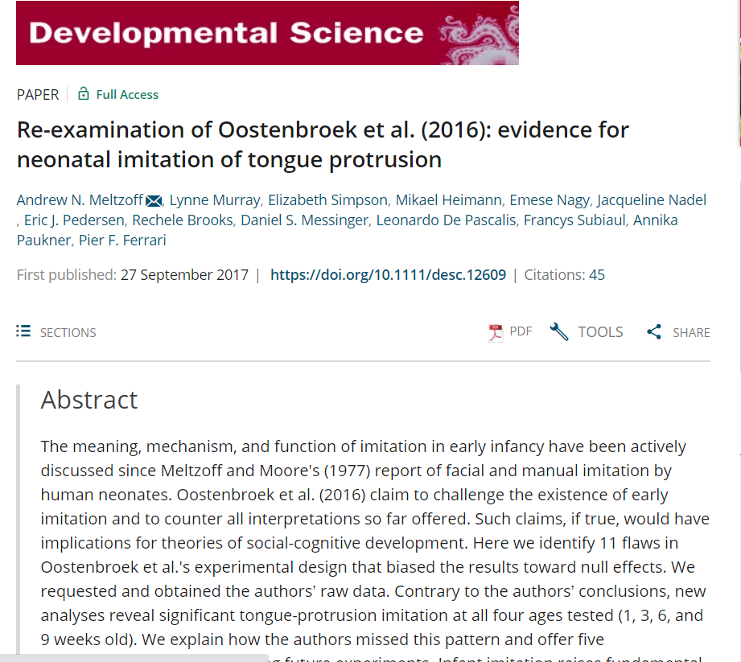

Controversy

Slide 11
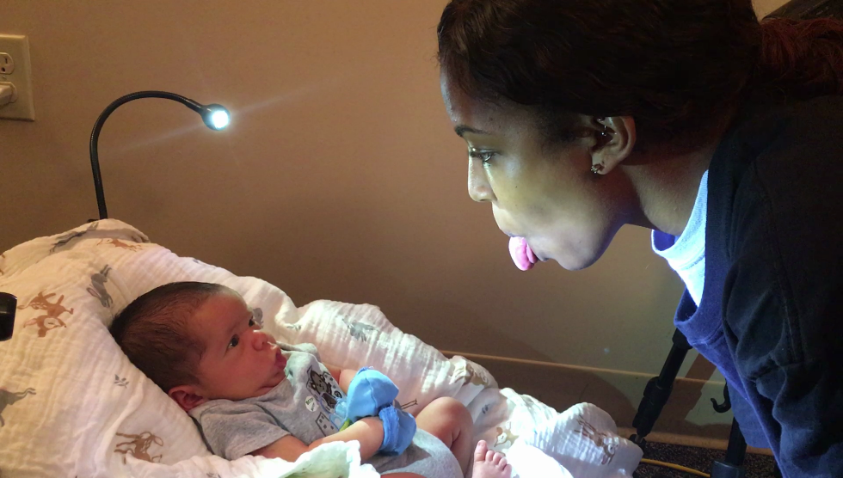
Misunderstandings about neonatal imitation (NI)
Is NI a reflex?
  Never before seen actions are matched and corrections are made to initial attempts
Is NI due to arousal?
  Even when controlling for arousal, TP is present
Does imitation decline after the first month?
  Imitation does not decline but changes as infants develop
Does NI depend on learning?
  NI is seen minutes after birth
Maylott

Slide 12
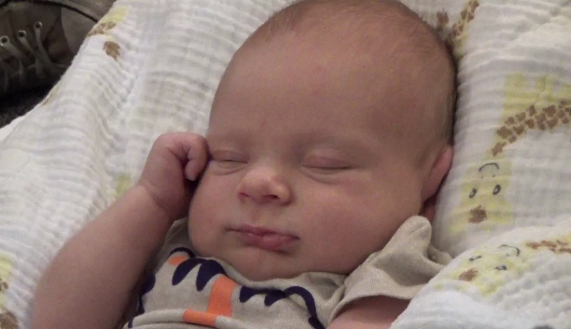
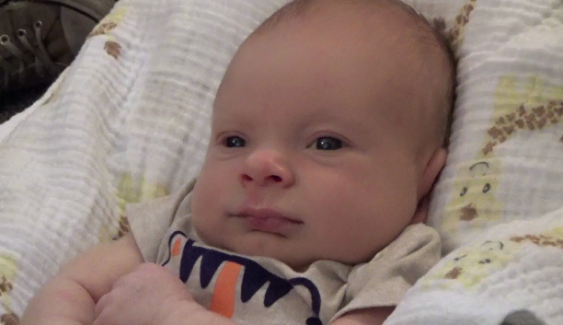
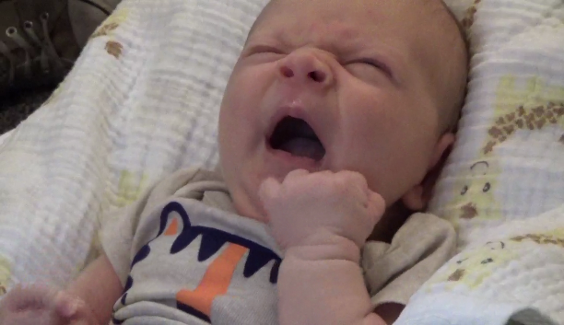
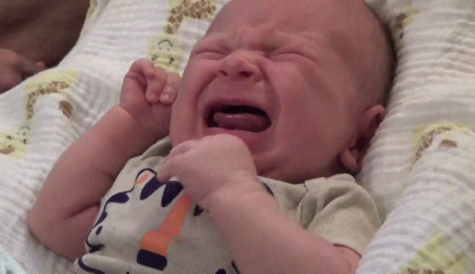
Standardizing methodology
Sensitivity to infant states
Appropriately modeled actions
Modeling more than one actions
Testing for individual differences
Sufficient power
Using control sessions
Maylott

Slide 13

Imitation Predicts:
Visual attention at 3 months (imitators had fewer looks away during face-to-face interactions)
Superior reaching-grasping abilities and greater attention to the eyes
Advantage in voluntary motor and social-cognitive skills
Nativist or constructivist?
Maylott

Slide 14
Discussion questions
Neonatal imitation has been heavily criticized. Are you convinced that it is a real phenomenon?
If so, are you convinced that mirror neurons are underlying this neonatal imitation?
This article strongly highlights the methodology to elicit neonatal imitation. Do you agree that we need standardized methodology across labs in order to fully understand neonatal imitation?
Maylott

Slide 15
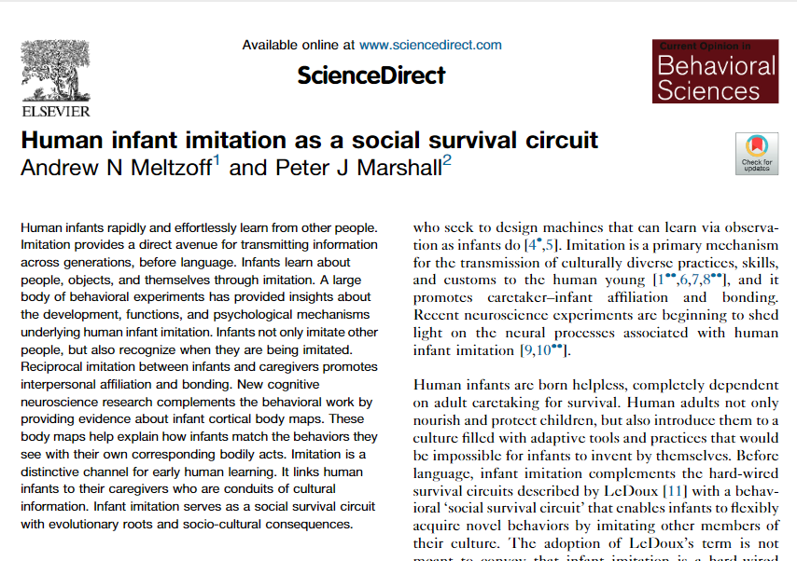
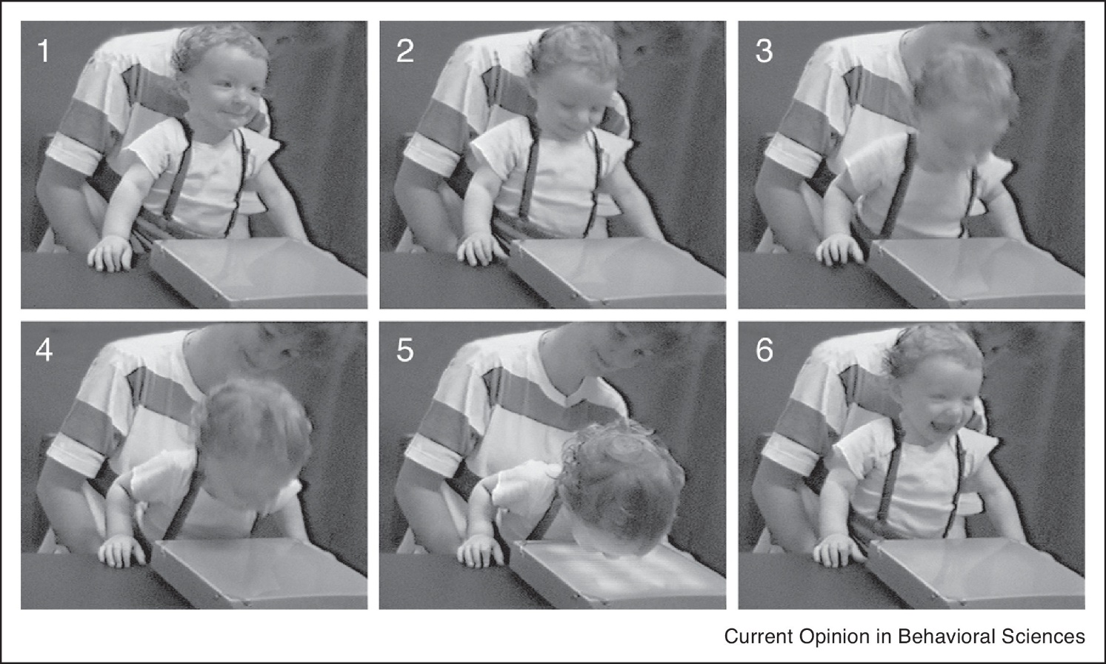
2018

Slide 16
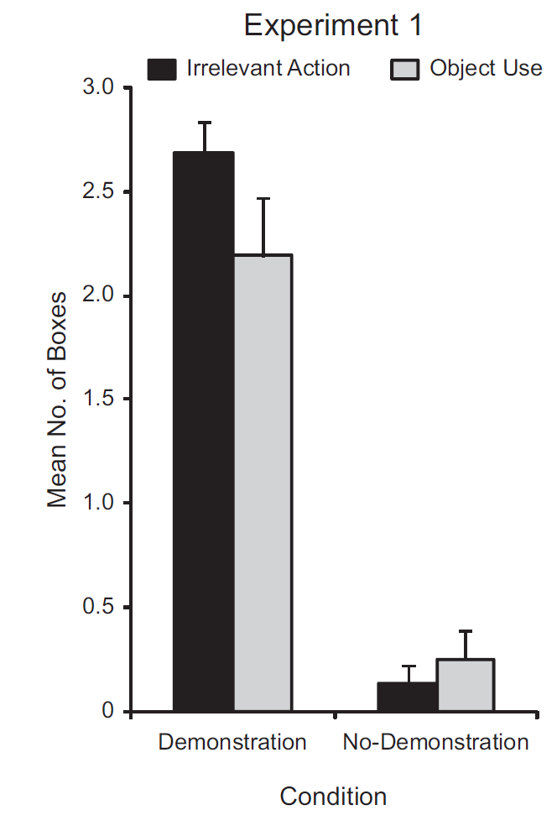
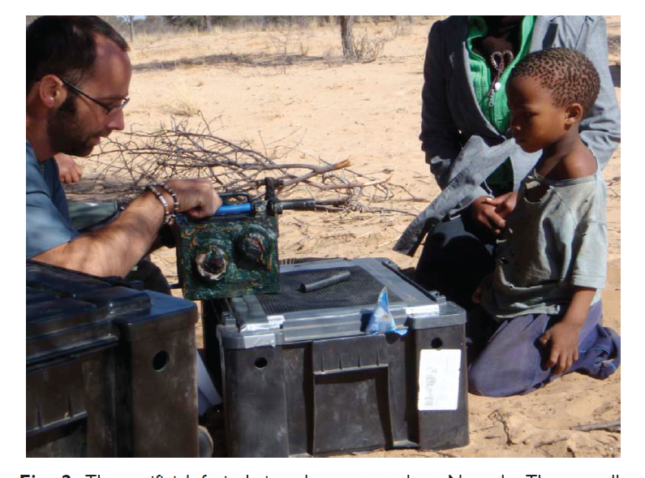
Functional significance of later imitation?
  Cultural differences in children’s tendency to overimitate?
Nielsen & Tomasello (2010)
Notes:
2-6 yrs old; between subjects design with 2 conditions demonstration (irrelevant action vs. causally related by unnecessary action vs. no demonstration
Blue box (open door with knob), switch box (slide switch to open mallet provides distraction), artificial fruit
DVs = perform irrelevant action; use object to open box

Slide 17
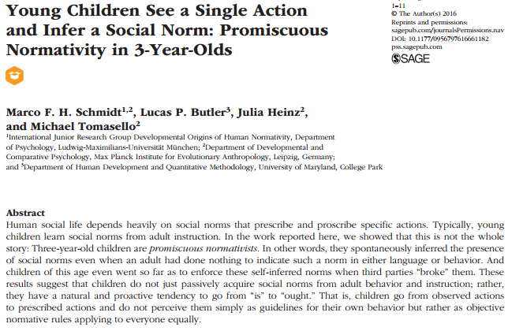
Promiscuous normativity

Slide 18
Cognitive Development
Theories of Cognitive Development
  Conditioning and habituation
  Piaget
  Neo-Piagetian Theory
  Vygotsky
Psychometric Approaches
  Structure of Intelligence?
Systems Theories
  Sternberg Triarchic Theory
  Gardner’s Multiple Intelligences

Slide 19
Basic learning mechanisms
  Imitation
Classical Conditioning
  infant responds to a stimulus
Operant Conditioning
  Infant action changes the likelihood that an event will occur.
Habituation (and Dishabituation)
  Deep neural networks
    From http://www.cogs.susx.ac.uk/users/alisonp/dev1/lecture2.html

Slide 20
Classical Conditioning
With repeated pairings of neutral stimulus (conditioned stimulus) and unconditioned stimulus, the infant begins to respond to the neutral stimulus, a conditioned response.
Classical conditioning motivates infants to understand which events “go together,” to anticipate what happens next.
Classical conditioning of reflexes
Nativist or constructivist?

Slide 21
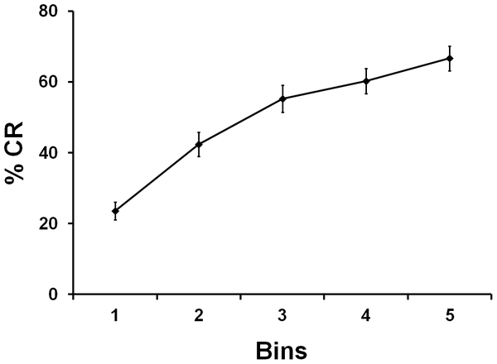
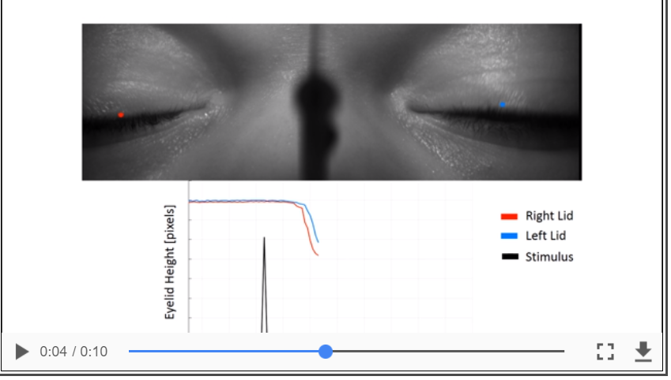

Classical conditioning curve for sleeping one-month-old infants
https://www.ncbi.nlm.nih.gov/pmc/articles/PMC5739534/bin/jtehm-gavideo-2782669-pmcvs_normal.mp4
Reeb-Sutherland BC, Levitt P, Fox NA (2012) The Predictive Nature of Individual Differences in Early Associative Learning and Emerging Social Behavior. PLoS ONE 7(1): e30511. doi:10.1371/journal.pone.0030511
http://127.0.0.1:8081/plosone/article?id=info:doi/10.1371/journal.pone.0030511

Slide 22
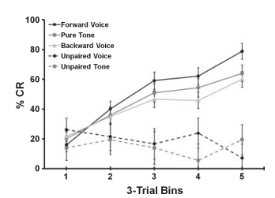
Stimulus generality & specificity
Infants conditioned to the 'social’ (voice) stimulus showed increased learning compared to infants conditioned to non-social stimuli.
  Learning increased regardless of stimulus type.
Sleeping infants presented with 'social' (voice) or non-social stimulus (tone or backward voice) followed by an air puff to the eyelid.

Slide 23
Operant conditioning
A behavior followed by a stimulus that changes the likelihood of the behavior recurring
  Reinforcer—stimulus that makes a behavior more likely to recur.
    Two kinds of reinforcers:
      presentation of a desired stimulus
      removal of an unpleasant stimulus.
  Punishment--makes a behavior less likely to recur.
    Two kinds of punishment:
      removal of a desired stimulus
      presentation of an unpleasant stimulus.
Albanese’s aversive noise
ABA Masters & certificate program

Slide 24
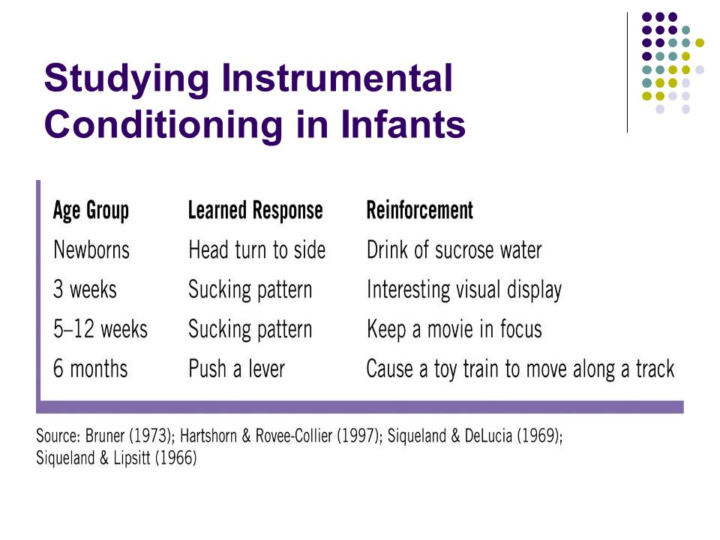
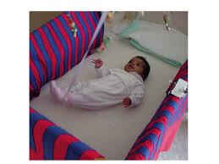
Kicking
https://www.youtube.com/watch?v=5aSSM89ivJw
Contingenent condition at 40 s
Rovee-Collier
Nativist or constructivist?
http://slideplayer.com/slide/7036825/

Slide 25
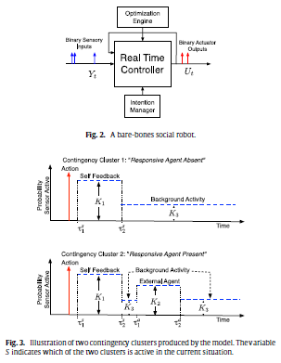
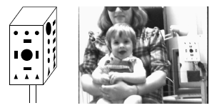
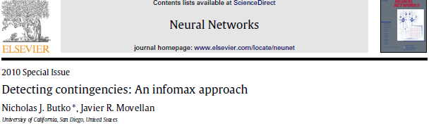
Complex reinforcement:
Designing rewards for young robots
http://www.sciencedirect.com/science?_ob=ArticleURL&_
“use the reduction of uncertainty (information gain) as a reward signal. The result is an interesting form of learning … the learner rewards itself for conducting actions that help reduce its own … uncertainty”
{Butko, 2010 #Butko, N. J., & Movellan, J. R. (2010). Detecting contingencies: An infomax approach. Neural Networks, 23(8–9), 973-984. doi: http://dx.doi.org/10.1016/j.neunet.2010.09.001

Slide 26
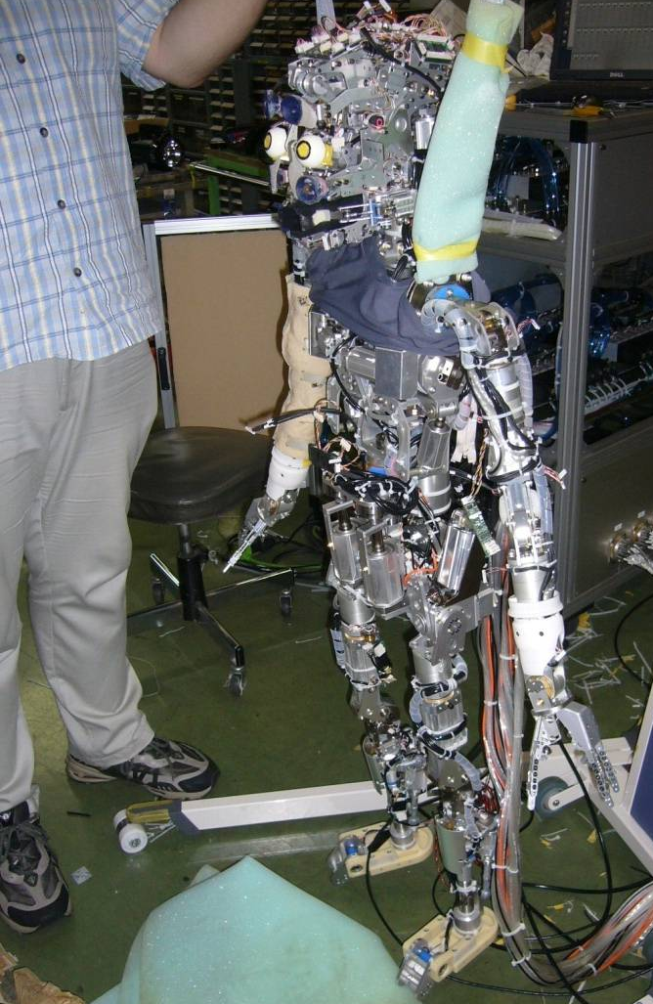
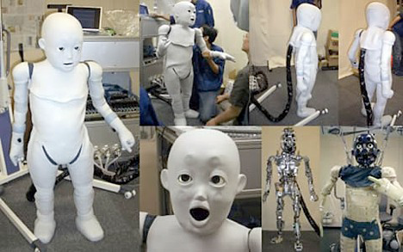
Operant conditioning in robotics?
“A new approach to reinforcement learning for control problems which combines value-function approximation with linear architectures and approximate policy iteration.” Lagoudakis & Parr, 2003

Slide 27
Habituation
Infants who gaze longer
  Lower IQ at 18 years
Infants who gaze shorter
  Higher IQ at 18 years
Fixation duration and IQ
  r(91) = -.36, p < .0002

Slide 28
Stimulus

Slide 29
Infant habituation →child intelligence
‘Habituation and recognition memory in first year of life predict IQ between 1 and 8 years
  Weighted (for N) mean correlation of .36
  Raw median correlation of .45.
  Similar for habituation & recognition memory.
  Predictions higher than for standardized infant tests of general development for nonrisk but not for risk samples.
    For nonrisk samples, predictions not consistently higher than predicting from parental education and socioeconomic status!
Nativist or constructivist?
                A Meta-Analysis of Infant Habituation and Recognition Memory Performance as Predictors of Later IQ Robert B. McCall, Michael S. Carriger Child Development, Vol. 64, No. 1 (Feb., 1993), pp. 57-79

Slide 30
Habituation as a measure of cognitive function?
A measure of learning and memory:
  habituation implies that the infant has encoded some of its properties & retained them.
Habituation rate is linked to later achievement.
  Individual differences in speed of habituation relates to later IQ scores (Fagan & Singer, 1983).
        www.cogs.susx.ac.uk/users/alisonp/dev1/lecture2.html
Bored faster → Brighter??

Slide 31
Why does Infant Attention Predict Intelligence?
Three Theories
  Speed or efficiency of information processing
    Inhibition of responses to uninformative/familiar
      Sigman et al., 1991
  Fixation taps processing
    Sigman, Cohen, Beckwith, 1997

Slide 32
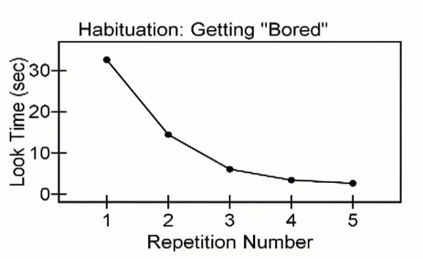
Bored faster → Brighter??
        http://www.youtube.com/watch?v=dlilZh60qdA from 1:30

Slide 33
Using habituation: Can infants count?
“Humans innately possess the capacity to perform simple arithmetical calculations......... Infants possess true numerical concepts: they have access to the ordering of numerical relationships between small numbers. They can calculate the results of simple arithmetical operations of small numbers of items” Wynn (1992).
        from Tony J. Simon “Explaining Apparent Infant Numerical Competence in Terms of Object Representation”
Notes:
2
3
Claim resulted from data gathered from following expt
carried out with 5 Mo old babies.

Slide 34
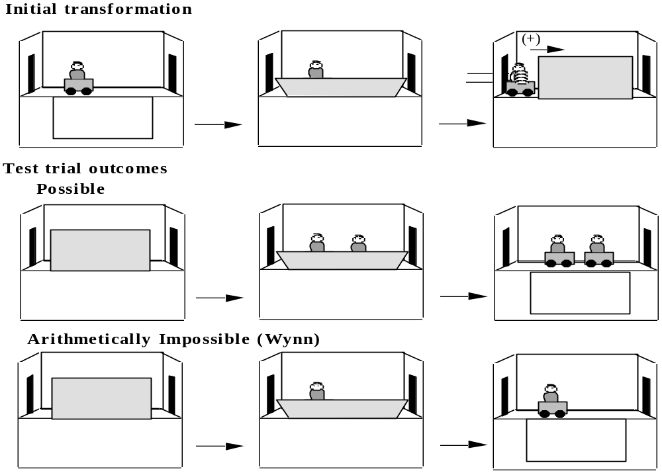
The Task
https://www.youtube.com/watch?v=2XLe2HFO3ZY
Notes:
3
4
Describe ACTIVELY (as ìEventsî)
Desribe Screen drop in lines 2 & 3

Slide 35

More looking to impossible results
13
12
1+1=1
11
2-1=2
"Addition"
10
Looking time
"Subtraction"
9
8
1+1=2
2-1=1
7
6
1 object
2 objects
Simon et al. (1995)
Replication of Wynn (1992)
Number of Objects Remaining
Notes:
4
6
1st process in devíing theory to explain this is see if beh reliable
so carried out our own replicaitons
SHOW GRAPH
However my hypoth was incíd LT NOT based on Num abilities
Instead could be explained by Phys Impossibility
in all imposs outcomes object magically appears/disappears
something infants appear to detect as imopssible
So created IDENTITY condition
outcome has correct # of objects but still phys imposs

Slide 36
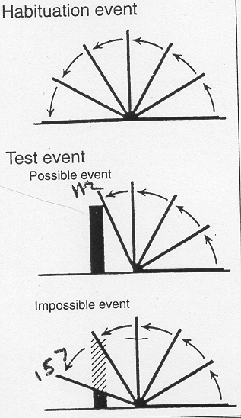
Habituation suggests some knowledge of invisible objects
Another test of object permanence
Drawbridge experiment
  4.5, 5.5, and most 3.5 month olds look longer at impossible event, suggesting they believe the “object” “behind” the drawbridge should really be there.
    Baillargeon et al. (1985)
  Different solid object from 1:10. https://www.youtube.com/watch?v=hwgo2O5Vk_g
Baillargeon internal video (DVD

Slide 37
Does baby know where object is?
Object search (A_not_B) says no
  Baby searches in first location
    Home
      http://www.youtube.com/watch?v=jZDtfnRB-jI&feature=related
    Lab
      https://www.youtube.com/watch?v=lhHkJ3InQOE
Drawbridge experiment says yes
  Infants look longer at impossible event
How can this be?

Slide 38
Task analysis
Search task asks for motor action
  Recall memory
Drawbridge task asks for longer looking
  Recognition memory

Slide 39
Experimental resolution
What about a non-search A_not_B task?
  an A_not_B task?
Infants look longer at the impossible event
  Look longer at A
    Even after 15 seconds of delay
Even when they search in the wrong place
  either infants have knowledge but can’t use it
  or the knowledge does not exist in usable form

Slide 40
Put yourself in infant’s place
  Where do you look for your car keys?
  The more times the object was hidden at A, the more the infant is likely to search incorrectly at A
  The longer the delay, the more likely the infant is to search B
  Error may relate to a strongly formed motor pattern

Slide 41
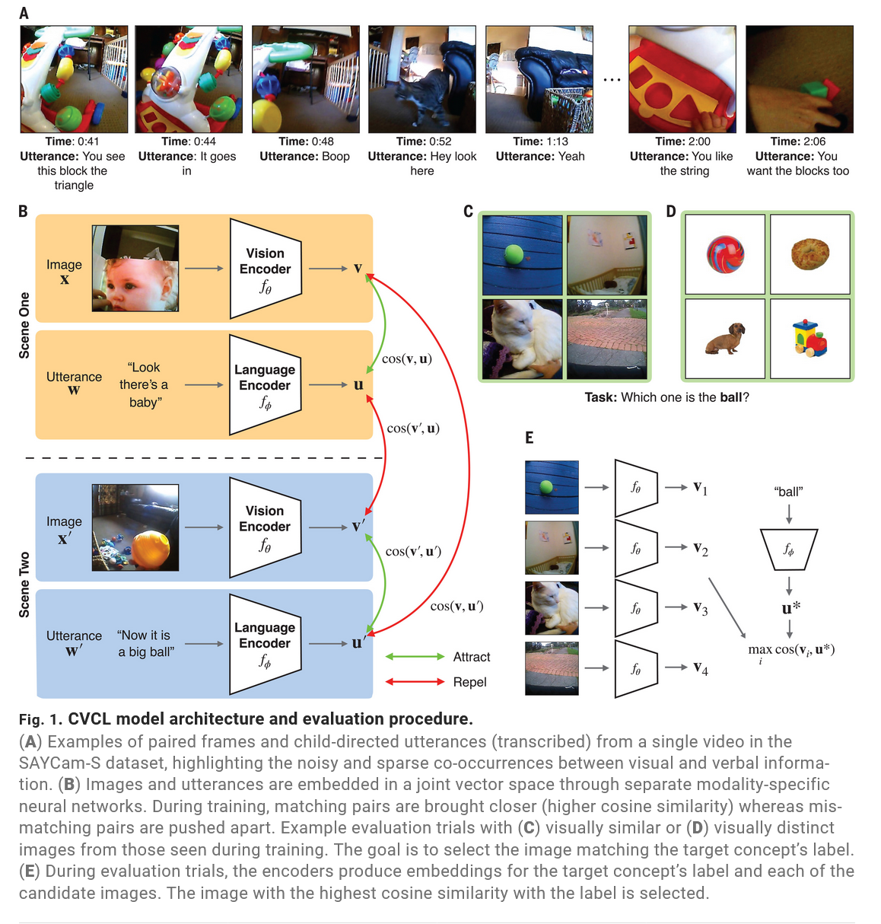

Slide 42
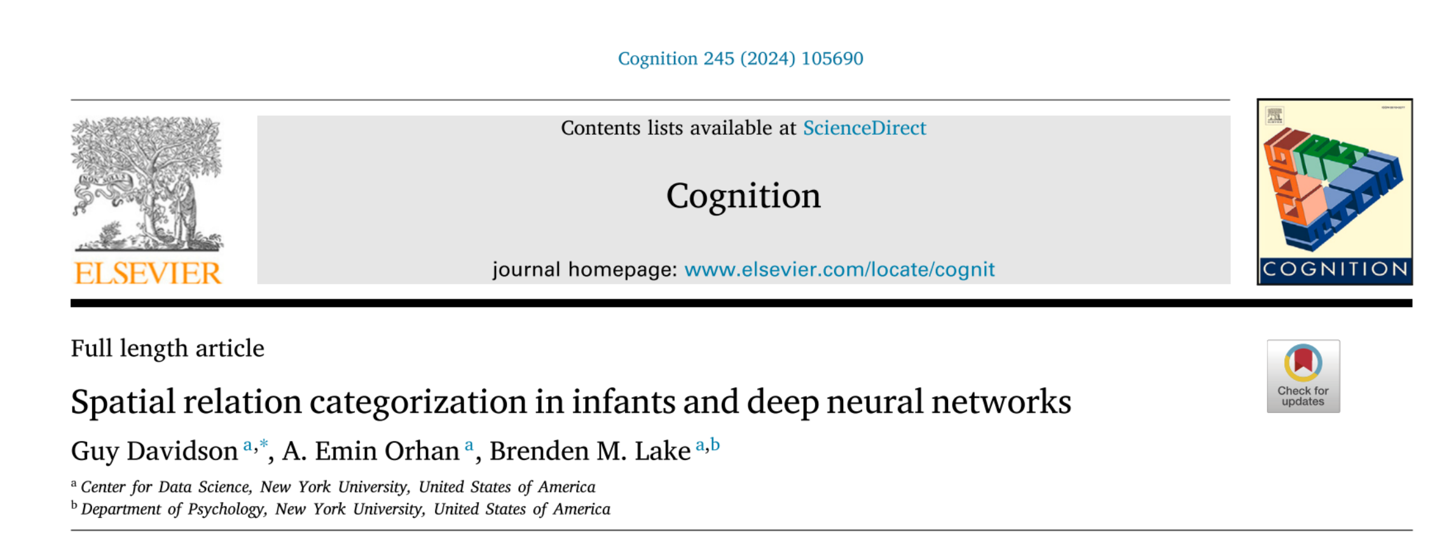
Cognition; Kelsey Macdonald

Slide 43
Background
Deep neural networks are a machine learning model designed on the human brain
Made up of multiple layers of interconnected nodes (e.g., “neurons”) that are connected by links (e.g., “synapses”).
  Hierarchical organization
  Each link has a weight attached and this determines the strength of the relationship
All neural networks have 3 layers:
  Input – receives initial data like sensory organs receive stimuli
  Hidden – information travels through this
  Output – a result is produced (decisions, predictions, or pattern recognition)
Macdonald
Notes:
They are adaptive and mimic how human brains communicate and process information
Can learn from experience and improve on a task over time
Great for pattern recognition and perception studies
Also being used for emotion and personality research
Can handle complex and nonlinear relationships
Can generalize what they learn and apply it to new situations
Con of artificial networks is that they are simplified compared to actual biological network. Artificial networks get basics (general overview)
Can help with recognizing faces, interpreting visual scenes, and processing language. Related to the concept of distributed representation in psychology, where information is spread across multiple nodes in the brain rather than stored in a single location.
Recurrent neural networks = designed for processing incoming signals sequentially, so they are useful for studying cognitive processing with dynamic context

Slide 44
Convolutional Neural Network
A convolutional neural network (CNN) =regularized, type of feedforward neural network that learns features by itself through filter optimization.
  Feedforward means each “neuron” in one layer is connected to all neurons in the next layer
  This makes overfitting data common, so the network is regularized by penalizing parameters during training or trimming connectivity
Connectivity pattern resembles the organization of the animal visual cortex
They are proven as useful for studying cognition
Macdonald
Notes:
Neural network functions:
Activation Functions: Each node has one and this function decides if the node should fire
“All-or-None” principal – neuron either fires or doesn’t
Weight Adjustments: Weights are adjusted during learning
Strengthening and/or weakening “synapses” during real life learning
backpropagation

Slide 45
Overall Goals
AIM 1: Try to see how well the model replicates past findings on the development of infant relation categorization
AIM 2: Identify useful methodological insights and research gaps for future work
Notes:
1. By 3-4 months: infants can categorize “above vs below” but not between. After familiarization, infants look longer at ‘other relation’. By 6-7 months: infants can categorize between
2. infants can categorize relations with specific objects before the same relations with varying objects. Similar results happen when the category relations change between familiarization and test. Result was that changing the object required the infant to be older to show novelty preference (3-4 to 6-7 months for above vs below; 6-7 to 10-12 months for between vs outside
3. Even when controlling for the degree of object collusion, infants find test probes depicting the containment relation as most similar to familiarization probes according to looking time—this is seen as evidence that infants have constructed a category representation of containment

Slide 46
General Methods
Experiment: Based on the novelty-preference methodology: where longer looking time is seen as a evidence for unfamiliar/novel stimuli – no looking time is involved
3 model architectures and 2 training datasets are used (for comparison)
  Comparison is also done with the DINO algorithm
  They also explore randomly initialized versions of the same architectures.
Output: Accuracy of result is defined as the similarity of the familiarization embedding to the embedding of the test probe
Macdonald
Notes:
Unlike infants, neural networks don’t get bored or less attentive
Infants see stimuli at the same time, so they look longer at the stimuli that is unfamiliar compared to the familiarization
Similarity of 2 stimuli is computed using vector representations in a high dimensional space
The datasets differ in how the images are collected, image quality, perspective, and subject matter

Slide 47
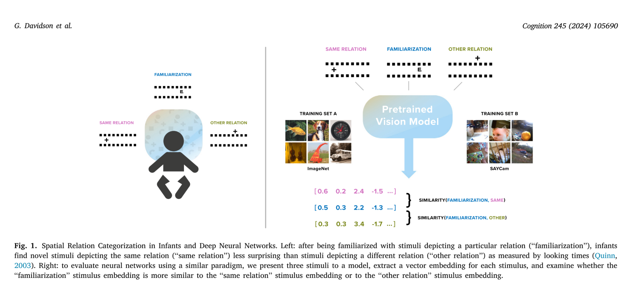
Comparison to other infant research
Macdonald
Notes:
Babies were familiarized w/ stimuli like what is seen here. The infants were then shown the same relation and other relation stimuli. To establish the existence of category representation, studies measured time spent looking at the stimulus for other relation, divided by total looking time at both test stimuli. Higher % = stronger novelty preference which means there is more for a categorical representation of the familiarization relation.
Pre-trained neural networks were not explicitly trained on spatial relations
Pre-training is seen as proxy for prior visual experience

Slide 48
Vector Embeddings
Vectors (in programming) are a series of numbers)
A vector embedding is a series of numbers that represents input data
We can use them to give structure to data that is unstructured
  Converts unstructured data into a series of numbers → we can then perform math operations in the input data
Necessary for finding semantic similarity (useful for categorization)
Embeddings =
  Internal representation of input data in a deep learning model
  The data that is fed to the neural networks predictive layer
Notes:
Test probes are similar to trial attempts

Slide 49
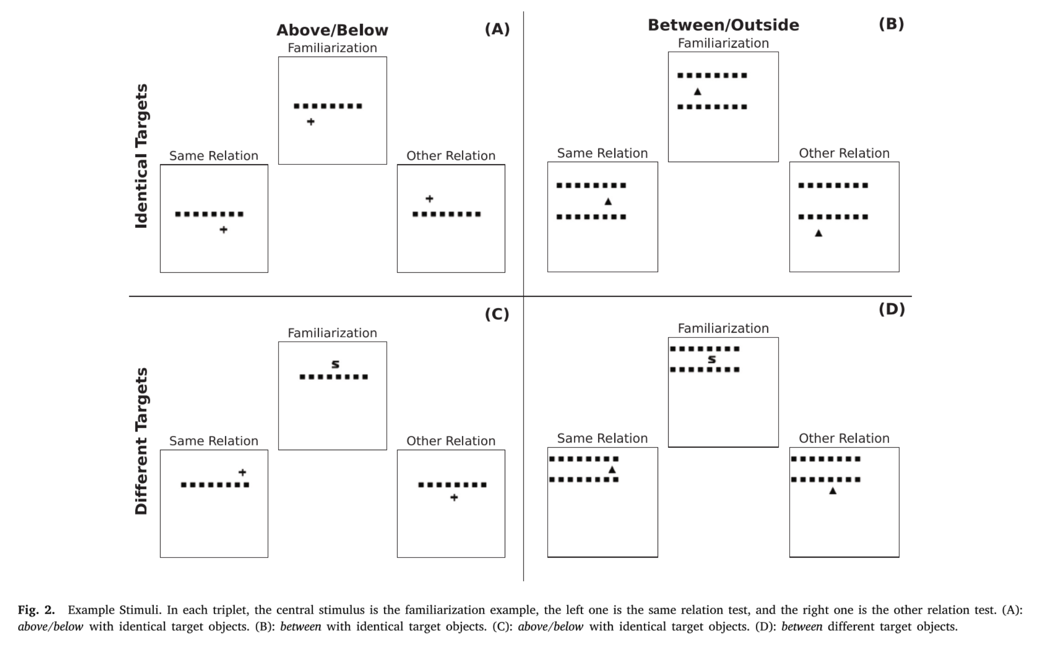
Example stimuli for Experiment
Macdonald

Slide 50
Experiment 1
Stimuli: 2D representation
Past research they were testing fit with:
  By 3-4 months: infants can categorize “above vs below” but not between. After familiarization, infants look longer at ‘other relation’. By 6-7 months: infants can categorize between
  Also, relation categorization is seen younger when using specific target objects, but appears later when using different target objects
This study:
  Found that the model was successfully able to capture previous research using above/below and between relations; and also research about using different vs the same target objects
Different mode architectures and pretraining approaches were compared
  Found that representations trained on developmentally-realistic data seem to promote relational info more than others
Macdonald

Slide 51
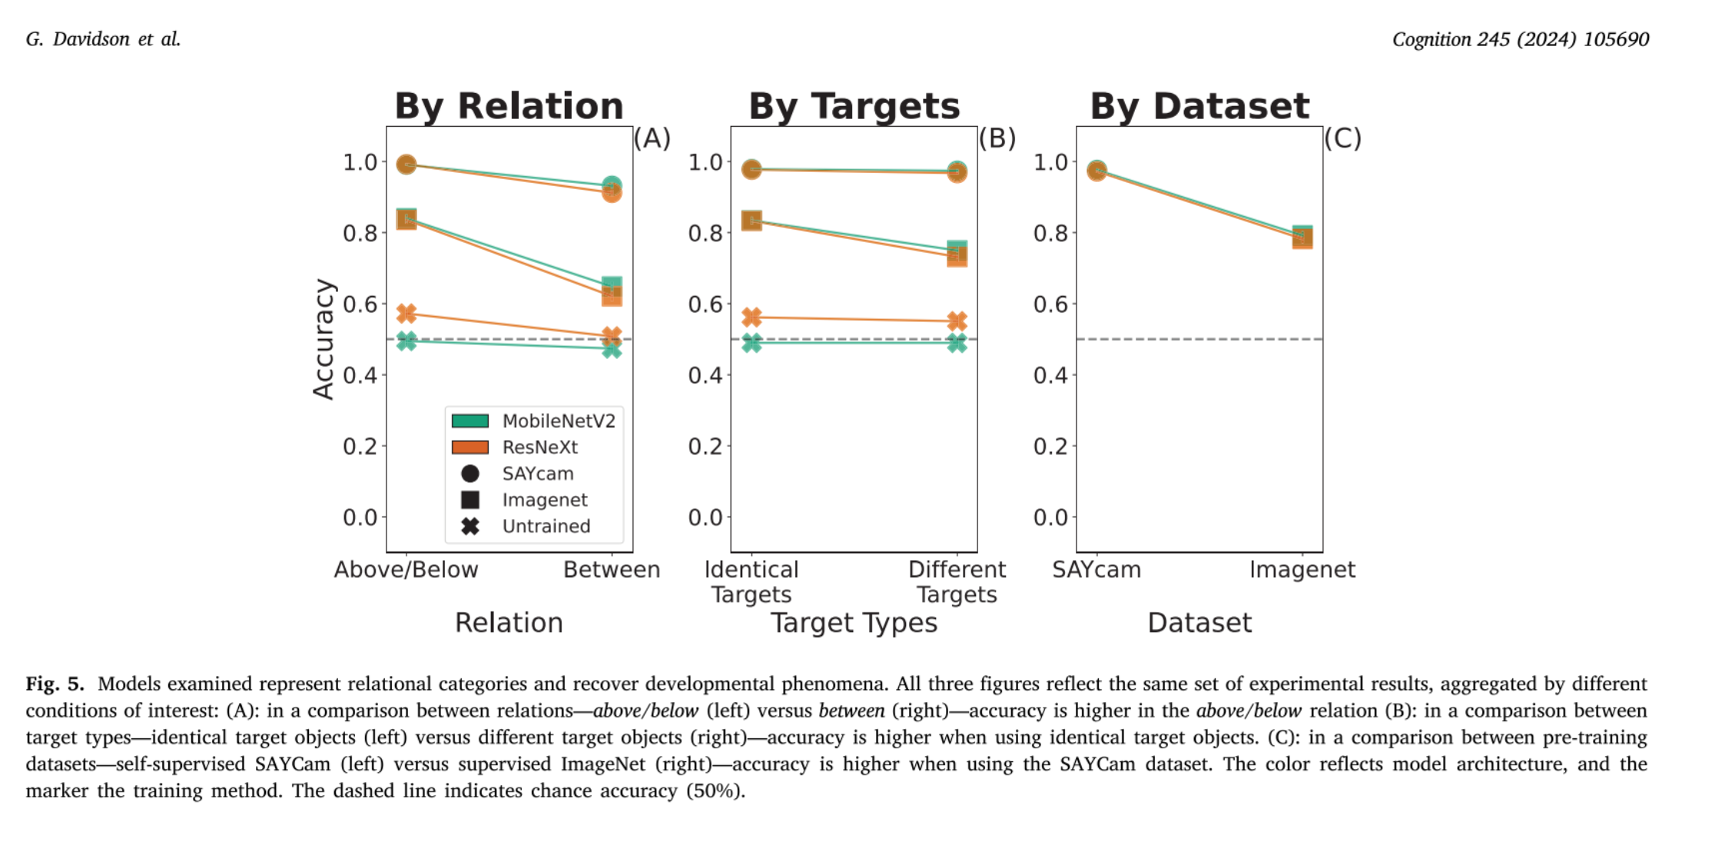
This suggests that models trained on infant visual experience develop stronger relation features. But this might be due to confound factors involved in the dataset ( e.g., collection method, subject matter, image quality, etc.).
Macdonald
Notes:
By Dataset: the SAYCam-trained models got their perceptual features from visual experience of young children
ImageNet-trained models get their perceptual features from categorizing objects curated using a web search.
This result is interesting because it suggests that models trained on infant visual experience develop stronger relation features, but this can’t be concluded due to other confound factors involved in the dataset ( e.g., collection method, subject matter, image quality, etc.). Also both models were trained using different approaches and that might be the reason for the difference

Slide 52
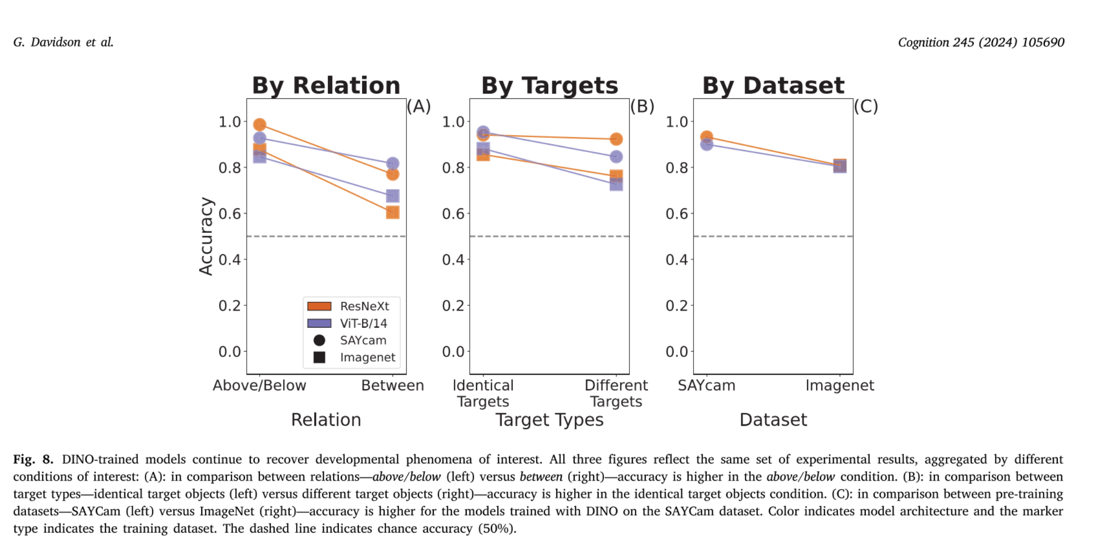
DINO trained datasets
Learning Algorithms (e.g., DINO)
  These guide how the network adjusts its weights to minimize error and increase accurate outputs
Results are similar, so the algorithm used isn’t the cause of the finding
Macdonald
Notes:
DINO is a self-supervised learning algorithm. It doesn’t need labels so it can be used with both of dataset
Generates “multiple views of each input image through data augmentations and learning representations that are similar between different views of the same image, but different for views of different images”
This was done to control for the algorithm used.
Results are similar

Slide 53
Experiment 2
Stimuli: 2D representation
Goal:
  Trying to fit model to previous research about left/right, between (sideways)
This study:
  Found that the initial model was not able to capture previous research
So they: found model training choices that could explain this and allow them to recover findings from original research
  Data augmentation
Macdonald
Notes:
Data augmentation = techniques used to modify input data to a deep neural network while its being trained in an attempt to help the network learn representations that generalize and transfer better using limited data
Horizontal axis flipping is most commonly used augmentation method
Experiment 2b: compared 3 networks—not flipped, horizontal flipped, vertical flipped
Augmentations were only active during pretraining

Slide 54
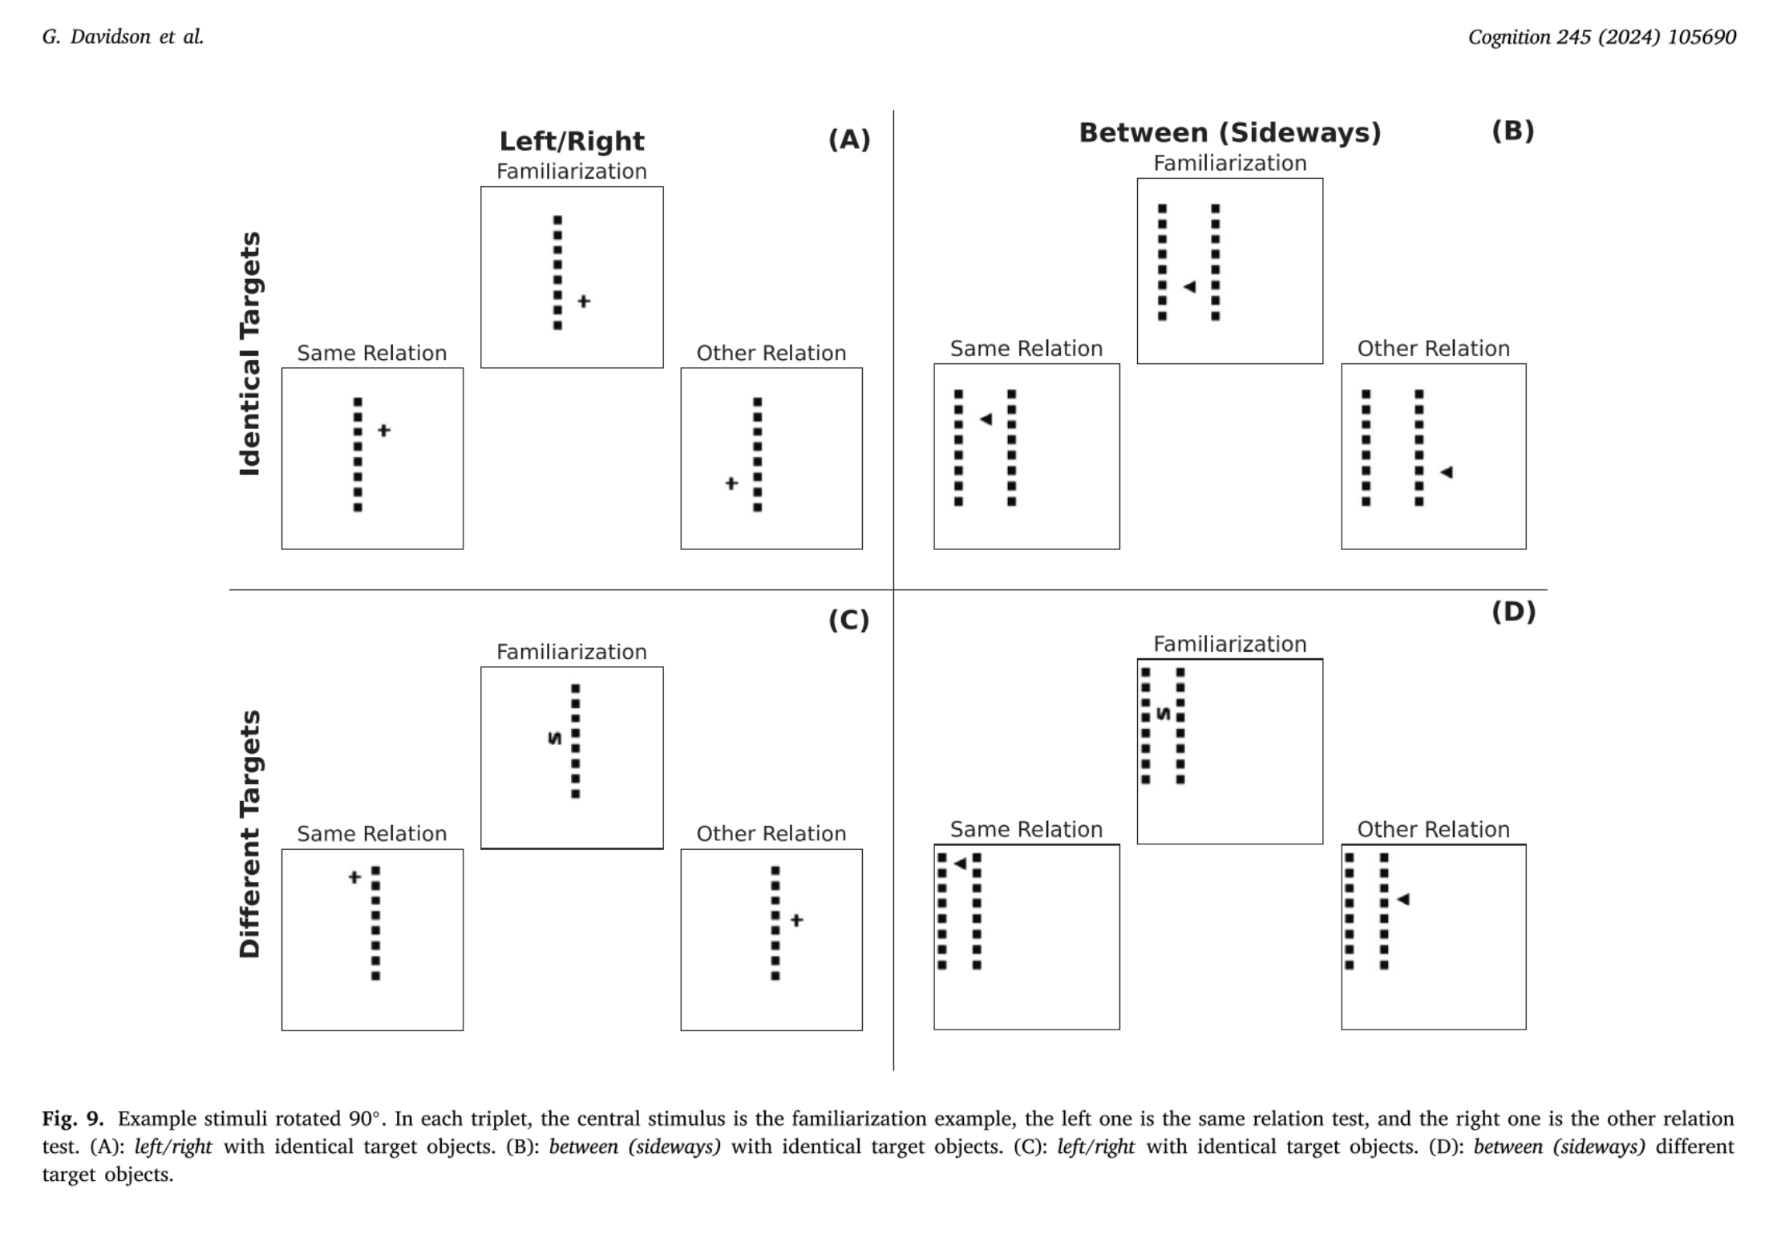
Experiment 2 Stimuli
Macdonald
Notes:
Experiment 1’s stimuli was rotated 90 degrees

Slide 55
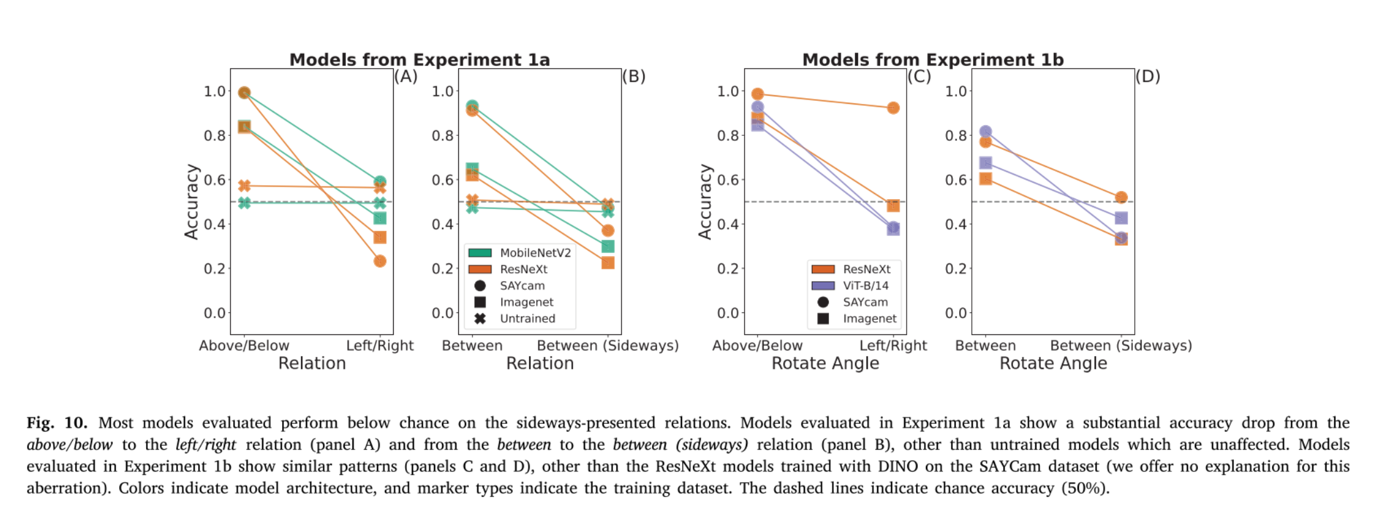
The lower results for left/right and between (sideways) is likely an artifact caused by data augmentation
Take-away: Results suggest that pre-trained computer vision neural networks can model infant relation categorization developmental findings, but some caution is needed (for choice of model and training)
Macdonald
Notes:
Comparison of Experiment 1 results and Experiment 2 results. There’s a significant decrease in accuracy when above/below is switched to left/right and when between is switched to sideways
The
ResNeXt model trained with DINO on SAYcam dataset –no explanation was given for why this differs from non-DINO trained.
pre-trained computer vision neural networks can model important aspects of infant relation categorization, our findings suggest that some care and caution are required in the choice of model and training setup.

Slide 56
Experiment 3
Stimuli: 3D representation
Goal: Testing the extent that the network’s representations can handle different types of stimuli by generating more complex 3D scenes that are more realistic to real life
Result
  Found they could replicate the findings of interest in Experiment 1
    The task was harder for the network though
      Accuracy was lower
Macdonald
Notes:
The 3D images are more similar to the training images, so this lets them check the extent that model embeddings organize by categorical representations in more realistic data

Slide 57
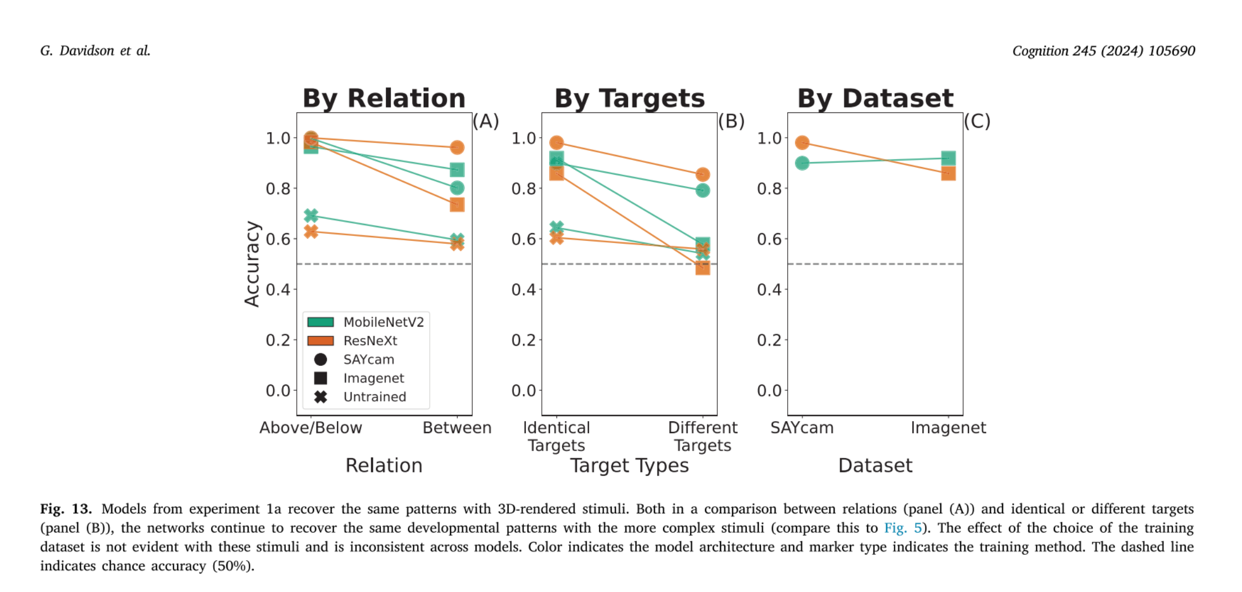
Macdonald
Notes:
Higher for above/below;
higher for identical vs different
Higher for Saycam

Slide 58
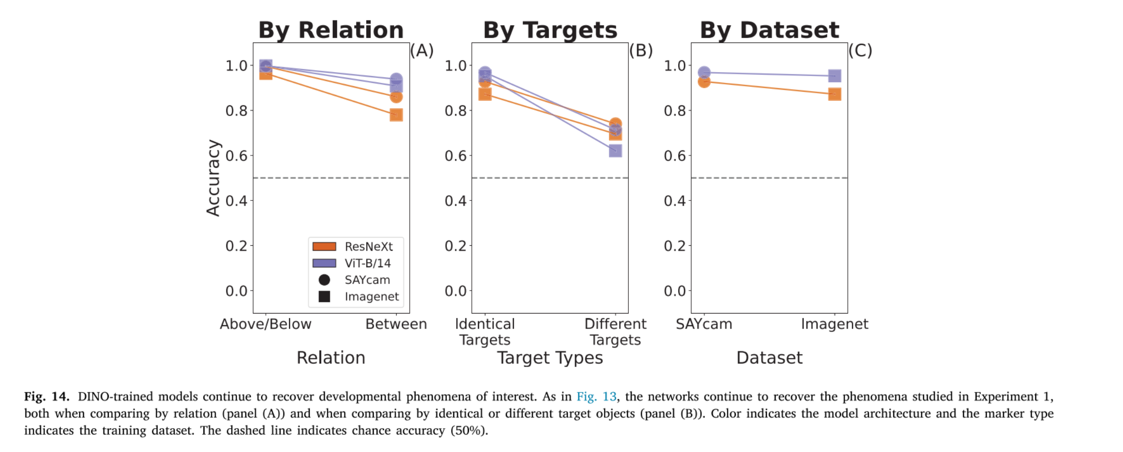
Macdonald

Slide 59
Experiment 4
Stimuli: 3D representation
Goal: We were able to replicate the findings in Experiment 1 with more complicated stimuli, but can we also replicate findings for more complicated spatial relations?
  Trying to fit model to previous research about containment, behind and support
This study:
  Found that this networks struggled to replicate previous research from Casasola et al., 2003
So they: examined how the model embedded information about the more complex relations
  Found that the information was still present and linearly decodable even when models struggled using a generic similarity metric
Macdonald
Notes:
3. Even when controlling for the degree of object collusion, infants find test probes depicting the containment relation as most similar to familiarization probes according to looking time—this is seen as evidence that infants have constructed a category representation of containment
Findings from Casasola et al 2003
Infants were habituated to a short video depicting a hand placing an object inside a container, that is, in a containment relation
The test probes varied 2 ways: relation (whether or not they also depicted a containment scene; same relation vs other relation) and occlusion (what fraction of the target object is visible at the end of the video).
Test probes use higher camera angle than familiarization video, which results in similar occlusion but object being placed in a novel relation in respect to container
Final test probe was a control where it was neither other relation or similar relation

Slide 60
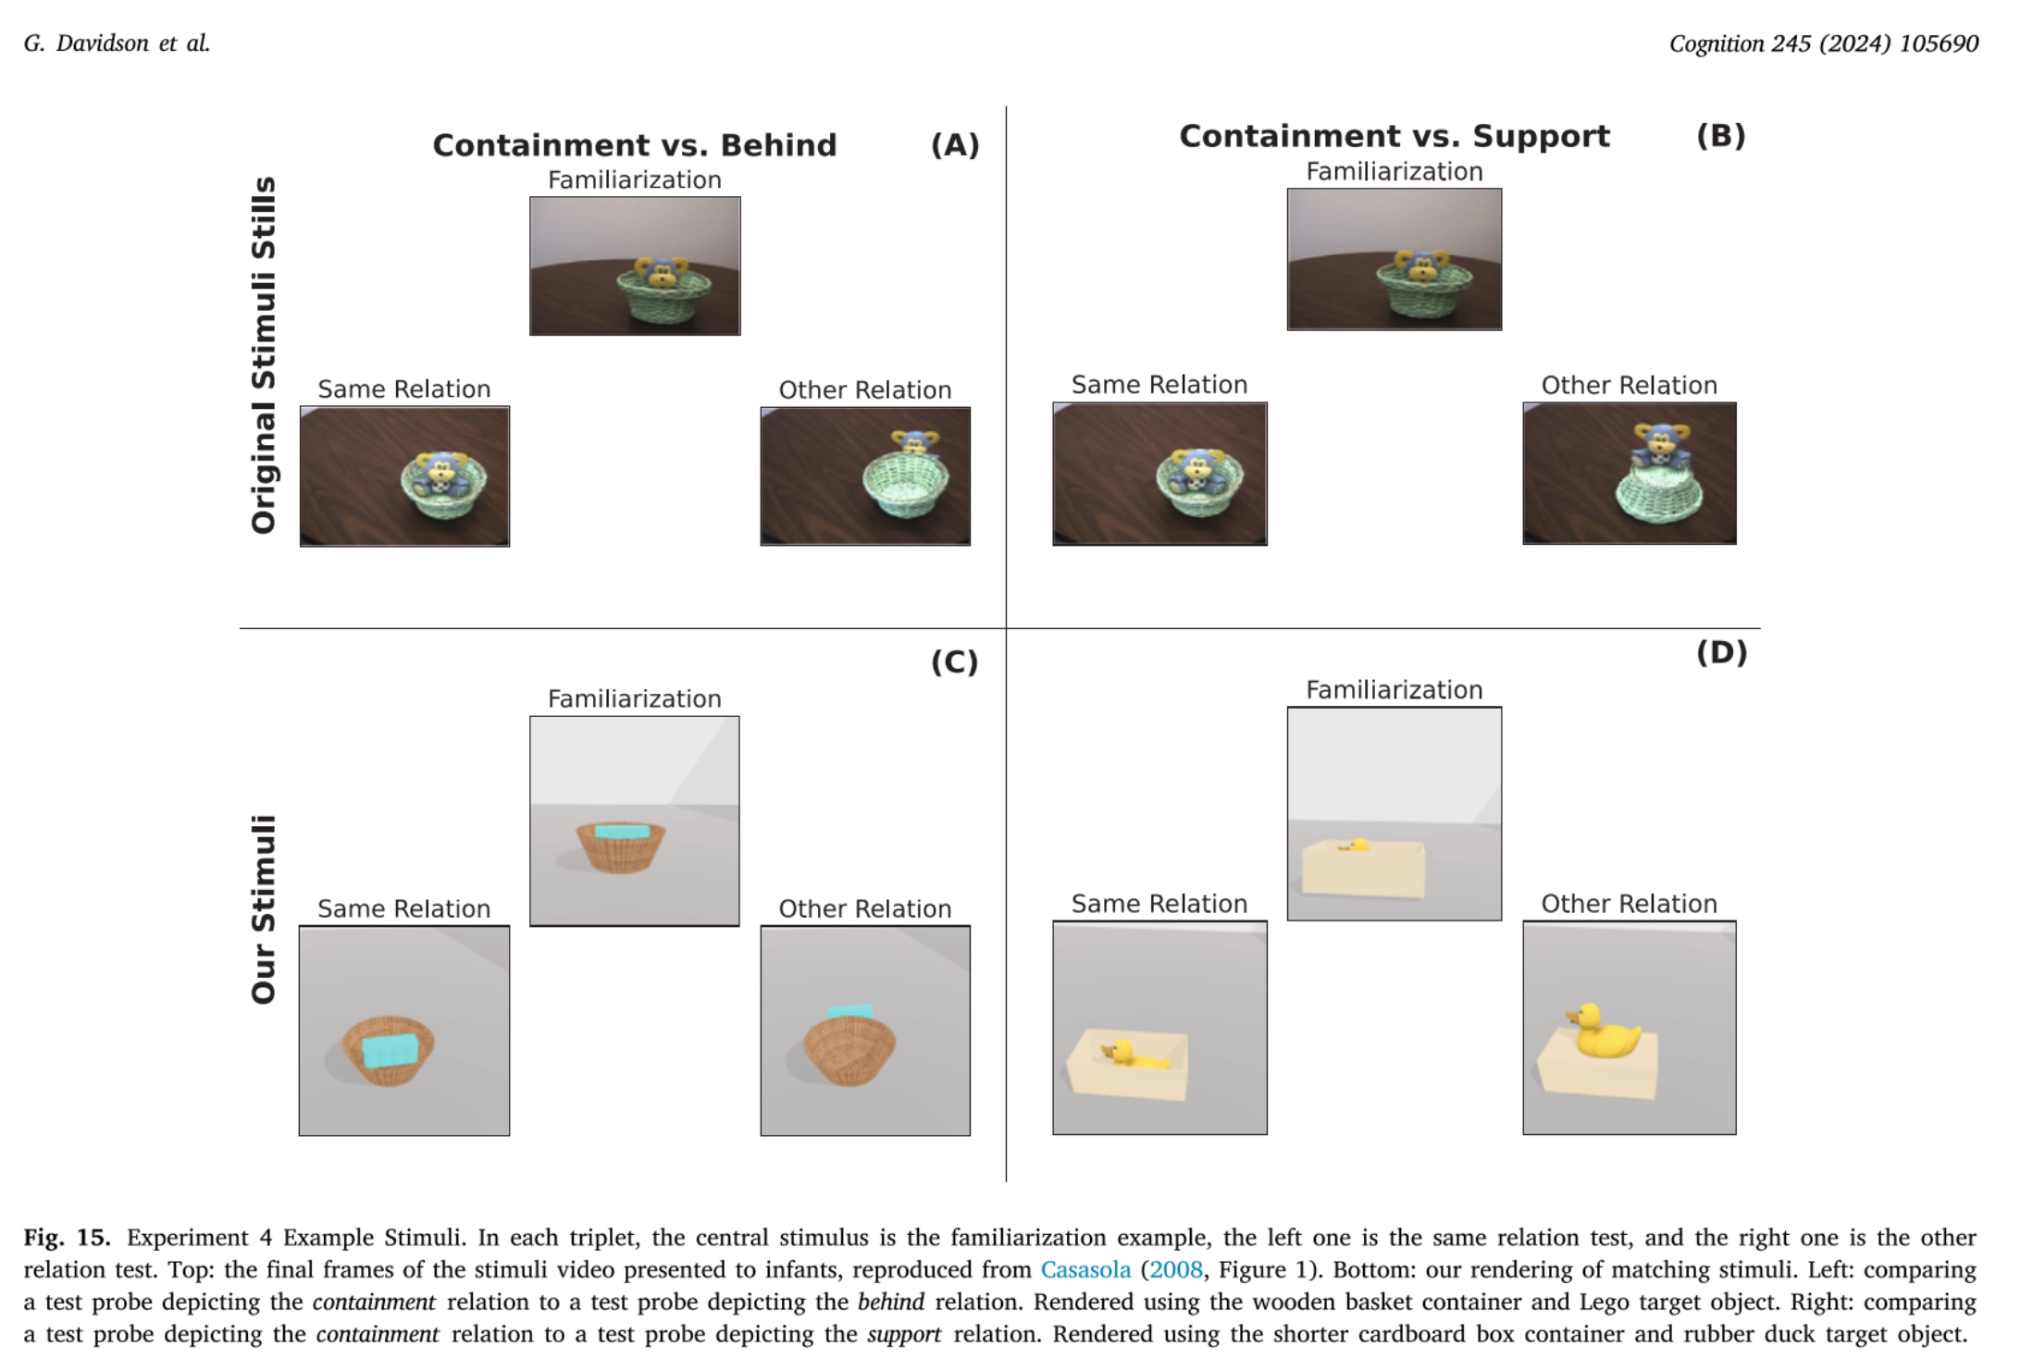
Macdonald
Notes:
Containment test probes (with novel occlusion degrees) elicited significantly shorter looking times stimuli for ‘behind’ (which had novel relation with similar degrees of occlusion to the familiarization stimulus)
They were basing the previous research off Casasola et al. 2003 which used video. But this study used images only.

Slide 61
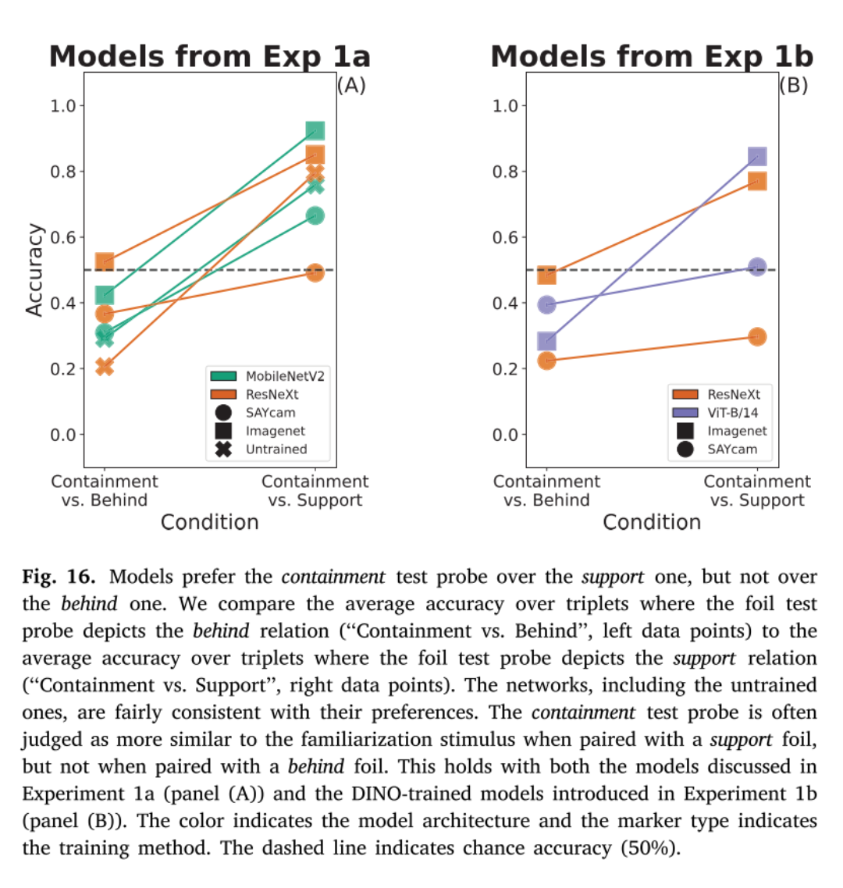
Models prefer the ‘containment’ test over the ‘support’, but not over ‘behind’
  Also found Imagenet trained dataset models performed better
  And there is a consistent preference present in randomized initialized model where there are lower accuracies in ‘containment vs behind’ compared to ‘containment vs support’
  This goes against past research results, so they explored why
    Possible reason:
      The pooling operation that happens before a similarity embedding is extracted collapsed information
      →Extracting similarity judgements before pooling increased accuracy
    Take-away: similarity in the model embeddings is driven by perceptual features—lower-level and higher-level relational features.
Macdonald
Notes:
Compares average accuracy where the other relation test probe depicts the behind relation to the average accuracy where the other relation test probe depicts the support relation
Models had higher accuracy when ‘containment’ is seen with ‘support’ than it is when seen with ‘behind’
This is because most test probes found the ‘behind’ test probes (matching in occlusion but nit relation) matched more with the familiarization stimuli
In 2 architectures (but not ViT-B/14), the final 2D representation of each input is pooled to create an embedding vector. This collapses a lot of the spatial information, which could mean more information is kept about the degree of occlusion (which roughly corresponds to # of pixels of the target object visible) than the spatial relation.
The lower level perceptual features are the first driver of similarity in the model embeddings

Slide 62
Discussion
Q1: Past research suggests that the results found in Experiment 4,(where the model was not able to successfully replicate previous findings) would be different if the familiarization stimuli was a video. Outside of a computer model, why would a video familiarization stimuli lead to more habituation in infants?
Q2: This study was completed using a CNN based on the visual cortex. The authors also admit that this generic network may not have been the best fit as networks use different features than humans when perceiving visual stimuli. Do you think a CNN is the most accurate replication of a human infant’s brain and/or the best choice for learning relation categorization? Is the visual cortex the only part of the brain involved in learning relation categorization?
Q3: Pretraining on image datasets was used as a stand-in for previous visual experience. Do you think these datasets are an accurate representation of previous infant visual experience?
Macdonald

Slide 63
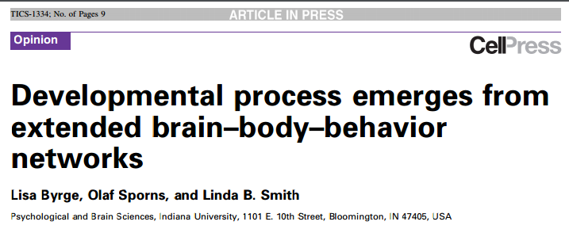
Cognition and behavior results from interconnected structural and functional brain networks
Changing brain connectivity causes AND results from developmental changes in behavior

Slide 64
Brain-Body-Behavior Networks
Brain-Body-Behavior networks
  Explain interaction between neural connectivity, behavior, sensorimotor experiences
  “Actively select and create information that in turn modifies the brain’s internal structure”

Slide 65
Structural and Functional Links
Functional networks:
  Remain connected even when not specifically engaged
  Are constrained by structural connectivity
Notes:
There are specialized regions BUT we now know that there’s a high level of cooperation.
Found during resting state task-free brain studies

Slide 66
Brain←→Behavior
  Finding your hands
  Visual information is generated that supports visual object recognition
Brain Networks
Behavior
https://www.youtube.com/watch?v=65OxY1jizBI
TIME
Nativist or constructivist?
Notes:
Behavior in turn evokes neural activity that changes connectivity
Longer tasks produce longer perturbations, reverberations. Juggling (practice)

Slide 67
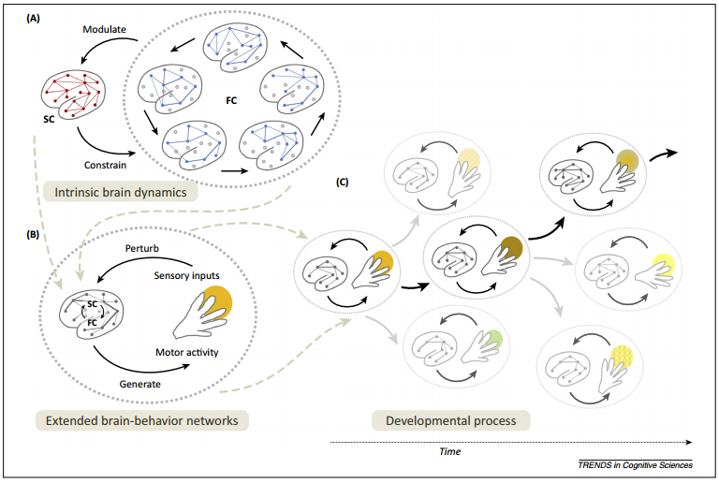
(Brain←→Behavior)→(Brain←→Behavior)

Slide 68
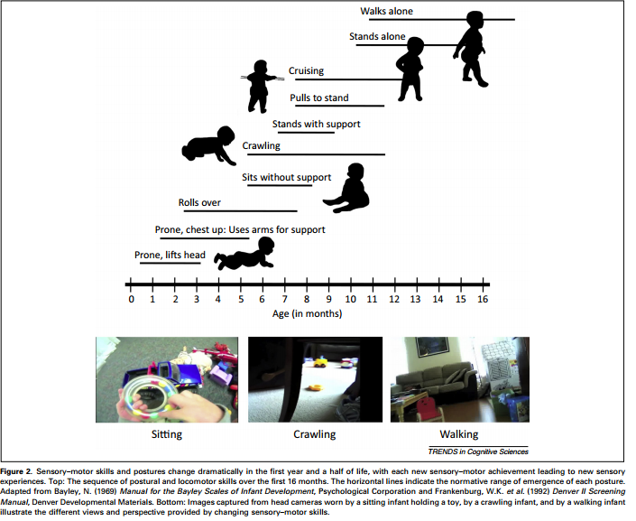
All aspects of the circular process change with time
Notes:
Other examples: literacy

Slide 69
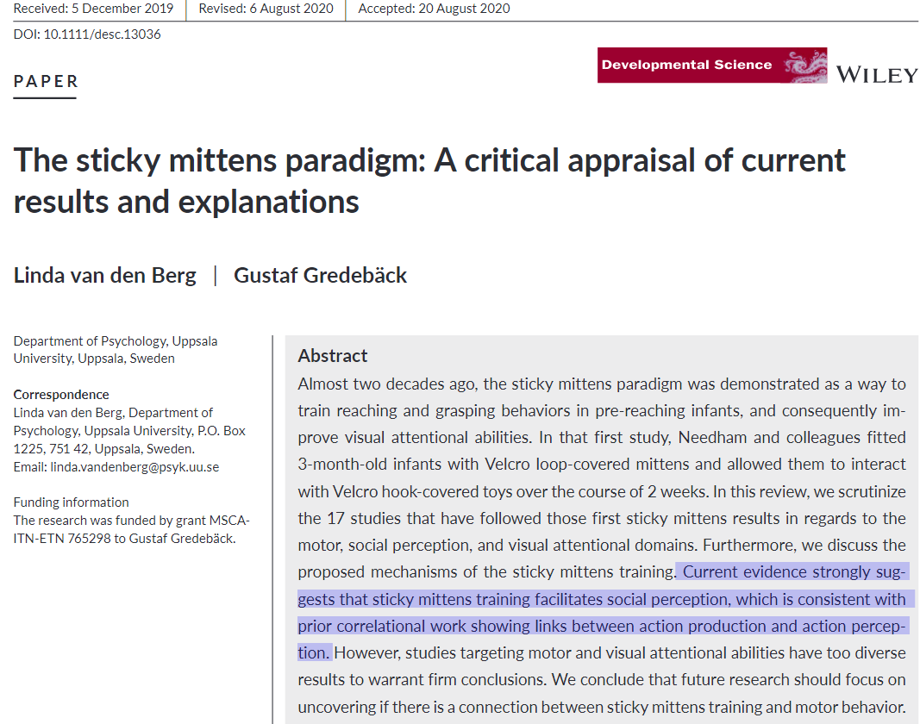
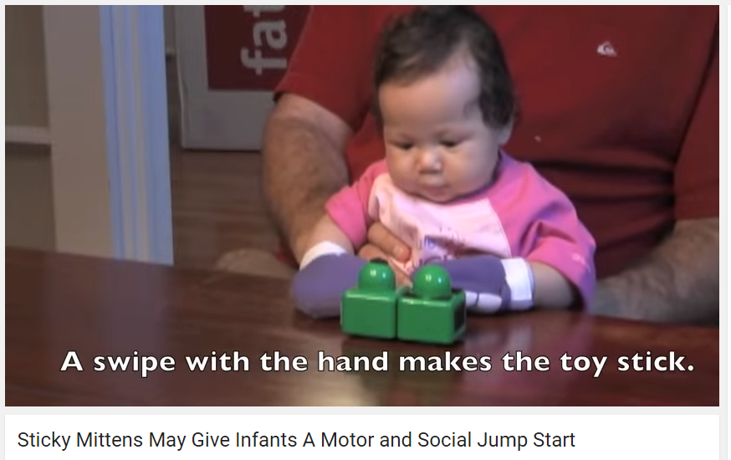
Experimental example
Precocious reaching experience:
  Infants wore Velcro mittens
  Early experience leads to increases in later visual attention to objects and oral exploration of objects
Databrary: https://nyu.databrary.org/search?q=mittens
https://www.youtube.com/watch?v=hJGRM4LFJjU
Notes:
Hypo: increased reaching increases functional coupling btwn neural networks for vision, spatial orienting of attn, and manual action. Strengthens structural connectivity

Slide 70
Experimental example
Infants and precocious reaching experience:
  Infants wore Velcro mittens
  Early experience leads to increases in later visual attention to objects and oral exploration of objects
https://www.youtube.com/watch?v=hJGRM4LFJjU
Notes:
Hypo: increased reaching increases functional coupling btwn neural networks for vision, spatial orienting of attn, and manual action. Strengthens structural connectivity

Slide 71
Definitions
Structural networks: anatomical connections linking cortical and subcortical brain regions
Functional networks: Set of connections among brain regions derived by observing neural activity during tasks and rest

Slide 72
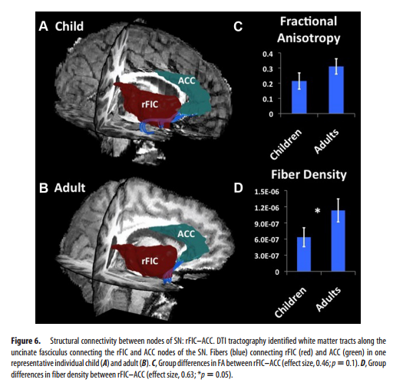
  Dynamic Reconfiguration of Structural and Functional Connectivity Across Core Neurocognitive Brain Networks with Development. Uddin, et al., 2011
’Right fronto-insular cortex (rFIC) is a component of a salience network (SN) mediating interactions between large-scale brain networks involved in externally oriented attention [central executive network (CEN)] and internally oriented cognition [default mode network (DMN)].
The causal influence of the rFIC on nodes of the SN and CEN was greater in adults than children.

Slide 73
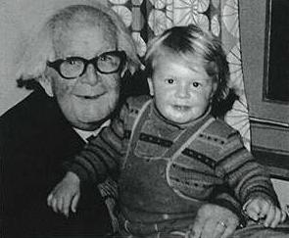
Piaget’s Cognitive-Developmental Theory
Infant as an active constructor of knowledge by interacting with environment
Organizing and integrating knowledge over time
Development involves qualitatively different stages
Most influential developmental psychologist ever?
    The origins of intelligence in children, p. 335
Notes:
1896-1980 theory based on observations of own kids
Focused on biological maturation rather than environmental influences
rained in psychometric tradition; focused on children’s errors in reasoning as way of determining current logical systems (& their limitations) underlying thought processes
Intelligence as biological adaptation to environment
Emphasized development of deductive and inductive reasoning

Slide 74
Piaget’s insights
Children are active builders of knowledge
  little scientists who are constantly creating and testing their own theories of the world.
Not empty vessels to be filled with knowledge
  as traditional pedagogical theory had it
Children don't think like grownups.
        http://www.time.com/time/time100/scientist/profile/piaget.html

Slide 75
Piaget Overview
The development of knowledge takes place as a result of an individual’s interaction with his or her environment.
Children themselves drive cognitive development by actively manipulating and exploring their environment.

Slide 76
Adaptation
Assimilation:
  Events in the external world are incorporated into existing schema.
    An infant who sucks on a bottle can adjust to a pacifier with slight modifications.
    Peg goes into pre-existing hole
Accommodation:
  Schema are adjusted or created to produce a better fit with events.
    An infant who sucks on a bottle and pacifier must accommodate in order to learn to drink from a cup.
    Make or find a new whole
Nativist or constructivist?

Slide 77
The origins of intelligence in children
At 1;4 (5) Laurent is seated before a table and I place a bread crust in front of him, out of reach. Also, to the right of the child I place a stick about 25 cm. long. At first Laurent tries to grasp the bread without paying attention to the instrument, and then he gives up. I then put the stick between him and the bread; it does not touch the objective but nevertheless carries with it an undeniable visual suggestion. Laurent again looks at the bread, without moving, looks very briefly at the stick, then suddenly grasps it and directs it toward the bread. But he grasped it toward the middle and not at one of its ends so that it is too short to attain the objective.
Laurent then puts it down and resumes stretching out his hand toward the bread. Then, without spending much time on this movement, he takes up the stick again, this time at one of its ends (chance or intention?), and draws the bread to him. He begins by simply touching it, as though contact of the stick with the objective were sufficient to set the latter in motion, but after one or two seconds at most he pushes the crust with real intention. He displaces it gently to the right, then draws it to him without difficulty. Two successive attempts yield the same result.
Piaget.

Slide 78

The origins of intelligence in children
Laurent tries to grasp the bread without paying attention to the stick, & gives up.
I put the stick between him and the bread… an undeniable visual suggestion.
Laurent again looks at the bread, without moving, looks very briefly at the stick,
Then he suddenly grasps it and directs it toward the bread.
But he grasped it toward the middle … too short to attain the objective.
He takes up the stick again—at one of its ends—and draws the bread to him.
He begins by simply touching it but then pushes the crust with real intention.
Two successive attempts yield the same result.
The Origins of Intelligence in Children (1952)
Piaget’s son Laurent (16 months) in The Origins of Intelligence in Children (1952)

Slide 79
Sensorimotor Substages
Reflexive Schemes | Birth –1 month | Newborn reflexes
Primary Circular Reactions | 1 – 4 months | Simple motor habits centered around own body
Secondary Circular Reactions | 4 – 8 months | Repeat interesting effects in soundings
Coordination of Secondary Circular Reactions | 8 – 12 months | Intentional, goal-directed behavior; object permanence
Tertiary Circular Reactions | 12 – 18 months | Explore properties of objects through novel actions
Mental Representations | 12 months – 2 years | Internal depictions of objects or events; deferred imitation
http://www.youtube.com/watch?v=ue8y-JVhjS0&feature=related Object permanence
https://www.youtube.com/watch?v=5aSSM89ivJw Rovee-Collier
Notes:
Play as assimilation (rehearse current schemes for pleasure
Imitation as accommodation (copy and learn behaviors not in current inventory of schemes)
Mental representations – words as representations of objects; speech explosion between 12 and 24 months when mental representations are beginning to be formed
Rovee Collier video

Slide 80
Piaget’s Theory of Cognitive Development (cont)
Constellation of similar schemes at a developmental time point = STAGE
Sensorimotor (birth – 2 years)
Preoperational (2 – 7 years)
Concrete-Operations (7 – 11 years)
Formal-Operations (11+ years)
Notes:
Reflexes as innate schemes
Most other schemes are based largely on experience
Schemes = psychological structures
Stages reflect gradual reorganization of basic cognitive processes and operations; stages become progressively more efficient

Slide 81
Sensorimotor Stage
(birth – 2 years)
Sensorimotor Stage (birth – 2 yrs)
    Infants think with their eyes, ears, hands, feet etc.
    Action-based learning
6 substages of sensorimotor stage
  Primary, secondary & tertiary circular reactions
        What changes? How are they different?
Play and imitation
  Relations to schema development?
Notes:
Circular reactions strengthen into a scheme; reactions originate by accident; trial and error used to try to repeat; begin inward focused and become outward focused with increasing intentionality
Circular reactions – what changes? Inward → outward; increasing intentionality
Play consolidates old schems (via rehearsal of current schemes for pleasure) = assimilation
and imitation facilitates development of new schemes (accommodation) imitation = copy and learn behaviors that are not in their inventory of schemes = accommodation
**e.g., Sam reading chapter books**
Play = assimilation
Imitation = accommodation

Slide 82
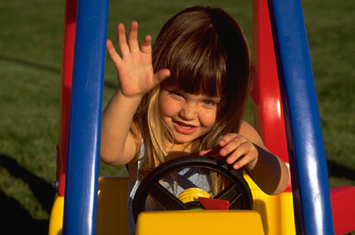
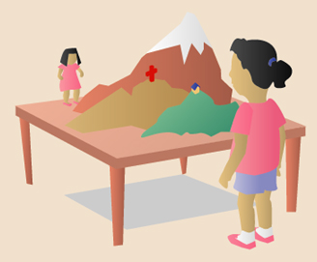
Preoperational Stage
(2 – 7 years)
Rapid increase in representational abilities
  Language
  Pretend Play
    Changes with development?
Thinking and reasoning is still rigid and egocentric
http://www.youtube.com/watch?v=OinqFgsIbh0&feature=related
Notes:
Represent states mentally
Rigid thinking b/c thought is still directly tied to actions, focus exclusively on one aspect of a situation
PLAY changes, more detached from real-life situations, less self-centered, more complex (e.g., sociodramatic play)
Individual differences; high levels of sociodramatic/pretend play associated with increased social competence, imagination and creativity

Slide 83

Conservation
http://www.youtube.com/watch?v=B65EJ6gMmA4&playnext=1&list=PL62740F6BA40AC105
https://www.youtube.com/watch?v=YtLEWVu815o

Slide 84
Concrete-Operational Stage
(7 - 11 years)
Thinking and reasoning becomes more flexible, logical, & organized
Ability to internally manipulate mental representations
  E.g., perspective taking
  E.g., conservation
Thinking/reasoning dependent on concrete information
  not yet extended to abstract information

Slide 85

Do the weights balance?

Slide 86
Do the weights balance?

Slide 87
Formal-operational Stage
(11+ years)
Capacity for abstract, scientific thinking
  Ability to operate on operations
Characterized by
  Hypothetico-deductive reasoning
  Propositional thought
May not be a universal stage like previous stages
  Many (well-educated) people do not reach this stage
  Domain specificity based on expertise
  Map examples? Computation examples? Others?
Notes:
HYPOTHETICO-DEDUCTIVE REASONING IS:
a problem-solving strategy
begin with a general theory of all possible factors that could affect an outcome
deduce specific hypotheses
test hypotheses systematically
About 40 to 60 percent of college students fail Piaget’s formal operational problems
Propositional thought = if A then B logic
People are most likely to think abstractly in situations in which they have had extensive experience
In many village and tribal societies, formal operational tasks are not mastered at all
Critics claim that Piaget’s theory is unclear about how individuals make the transition from concrete to formal operational thought

Slide 88

Role of context

Slide 89

Task analysis

Slide 90
The social basis of cognition – Vygotsky
Cognition originates in social interaction
  Development facilitated by social interaction and collaboration
    Vygotstky’s point
  Intersubjectivity =
  Zone of proximal development =
  Scaffolding =
    How should nature and degree of guidance change over course of learning task?
Notes:
In contrast to Piaget – very focused on social context
Intersubjectivity = process whereby two participants begin a task with different understandings but arrive at a shared understanding
Vygotsky – cognition is gradually internalized
Self-directed speech vs. Piaget

Slide 91
Natural Pedagogy
Gergely Csibra and Gyorgy Gergely
The specific aspects of human communication that allow and facilitate transfer of generic knowledge
  We use specific, episodic information to form generalized knowledge
Human communication is specifically adapted to fulfill the function of transmitting generic knowledge
Nativist or constructivist?

Slide 92


Evidence for natural pedagogy
Preferential attention for sources of signals
  Faces with direct gaze
  Preference for “motherese” and “motionese”
Referential Expectation
  Gaze-following as communication
    Only follow gaze-shifts when preceded by eye-contact or greeting
    Expectation to find referent/object
Interpretation bias for generalizability
  Expectation to learn something generalizable
    Emotions towards object as information about the object
      When communicated ostensively
  Permanent v. transient features
    Attend to features that allows identification of other objects of same kind
    Neglect information about location (transient)
      When communicated ostensively
  A-not-B task
    Error due to expectation of generalizable information
Infants display receptivity to ostensive communication before they show evidence of learning

Slide 93

Ostensive signals → Gaze following

Slide 94

Ostensive signal → Encode object identity

Slide 95
Uniquely human?
‘Seven long-tailed macaques cleaning the spaces between their teeth in the same manner as humans.
They spent double the amount of time flossing when they were being watched by their infants.’
      https://www.ncbi.nlm.nih.gov/pubmed/17253621
http://news.bbc.co.uk/2/hi/asia-pacific/7940052.stm

Slide 96
The Psychometric Approach to Defining Intelligence
Intelligence as ability to adapt successfully to one’s environment
Hierarchical nesting of abilities
  General factor “g”
  Differentiable but variously related mental abilities (e.g., verbal vs. visual-spatial)
Cattell (1971)
  Fluid vs. crystallized intelligence
Notes:
Based on correlational approach; primarily a descriptive approach
Used to map the range of different abilities but doesn’t inform understanding of intellectual processes involved
Focus on adaptation to environment is same as Piaget idea
(see Tomasello reading human vs. chimp)
Fluid intelligence = skill in reasoning in novel ways (e.g., Raven’s progressive matrices)
Crystallized = a broad mental ability that develops through the investment of “g” into learning through education and experience (specific learned behaviors)
Intelligence fixed somewhere between 5 & 10 years of age

Slide 97
The Psychometric Approach to Defining Intelligence (cont)
Can analytical abilities alone adequately account for individual differences in multiple real-world environments?
  Creative intelligence
  Social intelligence
  Emotional intelligence
Notes:
Example from temperament and social problem solving task
Psychometric approach too narrow to account for variation in real-world performance; many cases of disconnect between IQ and adaptive functioning

Slide 98

Systems Theories of Intelligence
Sternberg’s developing expertise model
  Triarchic theory of successful intelligence
    Analytical Intelligence
      Adapt, shape, select environments to meet goals
    Practical Intelligence
      General skills → apply strategies, self-regulation
    Creative Intelligence
      Approach to dealing with novel problems
Notes:
Belief that traditional intelligence tests focusing exclusively on analytical abilities don’t capture this complexity
Idea that intelligence can be developed
Success requires balance of all 3

Slide 99

Systems Theories of Intelligence
Gardner’s theory of multiple intelligences
Notes:
Against the idea of “g”
Profile of skills facilitates educational and career decisions

