Slide 1
Advanced
Developmental
Psychology
PSY 620P

Slide 2
Example exam question
Nomi et al. describe decreasing MSSD over the lifespan for a large set of brain areas and networks, increasing MSSD for areas of insula and VTC, and quadratic effects for thalamus and VTC. Design a study which rectifies any sampling issues with Nomi et al, and expands Nomi et al by including a specific measure of behavior. What analyses would be employed to increase understanding of neural and cognitive flexibility?

Slide 3
Overview
Cross-cultural vs. cultural psychology
The Efe and the self
African infants’ caregiving contexts
  Mother’s cry contingencies
Smile contingency differences
Toddler object ownership differences
Dyadic task-completion

Slide 4
Overview
Cross-cultural (comparative) psychology
  Problems in context
VS
Cultural (embedded) psychology
  Observation exercise
  Efe and the cultural veto
  Guatemalan toddlers
    Toys and learning
Language development exploration
  Tsimane reduced language input
  Tsimane reduced non-word phoneme reproduction presentation/discussion
  Language intervention in rural Senegal
  Bergelson
Synthesis of cross-cultural and cultural psychology?
  African caregiving (Otto et al.)
  Smile divergence (Wormann et al.)
‘Mixed blessings’: religiousness, parenting, and children in global perspective
  Cross-cultural or cultural (embedded) psychology

Slide 5
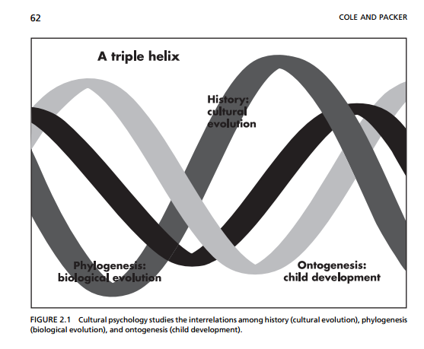
Individual development is how cultures continue

Slide 6
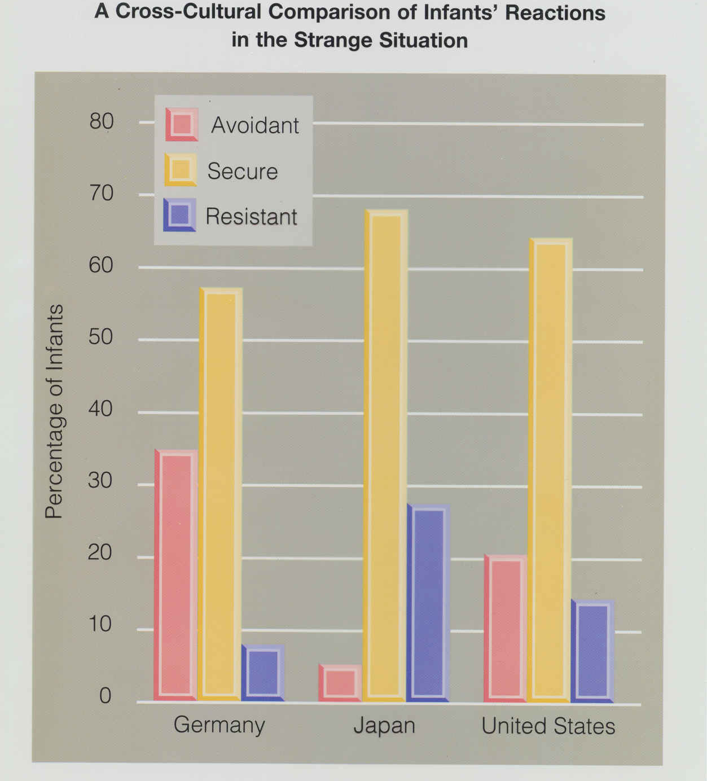
Cross-cultural research:
Goals and methods
Culture as an independent variable that ‘acts on’ people
  Examples from your research
Previously developed and standardized research methods are applied to various cultures (e.g., Piagetian tasks, Strange Situation)

Slide 7
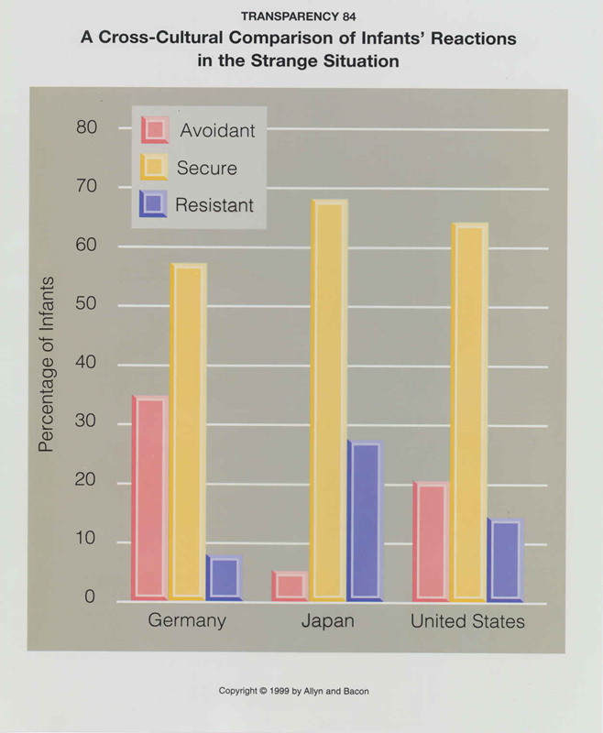
Culture specific versus universal features of development
  Attachment
    Cultural variations in rates of insecure attachment forms, but across all cultures secure attachment is predominant style (van IJzendoorn & Sagi, 2001)
    Attachment classifications have been consistently coded across cultures.
      Van IJzendoorn MH, Kroonenberg PM: Cross-cultural consistency of coding the strange situation. Infant Behavior & Development 1990, 13:469-485.

Slide 8
Cross-Cultural Patterns of Attachment

Slide 9
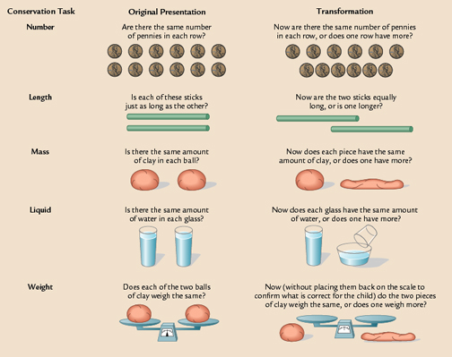
Cognitive Development
Piaget’s concrete operational stage

Slide 10
Culturally-Mediated Learning (cont)
Piaget’s formal operational stage
  Formal operational stage
    capacity for abstract, scientific thinking
    Ability to engage in propositional thought and hypothetico-deductive reasoning
      begin with a general theory of all factors that could affect an outcome
      deduce specific hypotheses
      test hypotheses systematically
Is this a universal stage (like previous stages)?

Slide 11
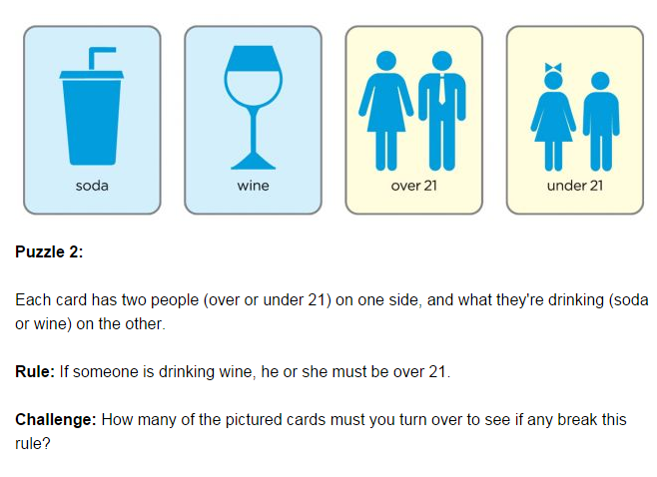
https://www.psychologytoday.com/articles/201203/pt-puzzle-card-logic

Slide 12
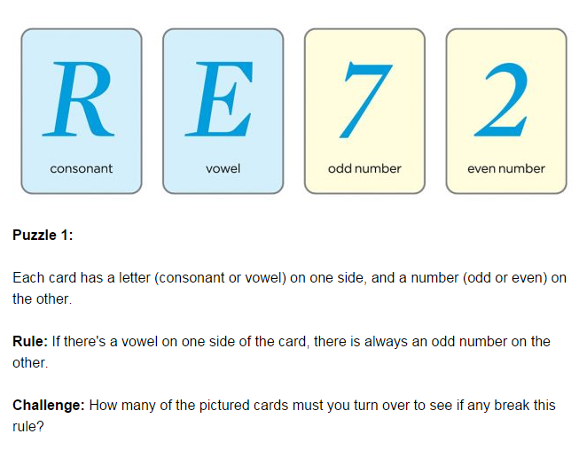
Role of context

Slide 13
Culturally-Mediated Learning (cont)
Data on formal operational stage:
    Not everyone (including highly educated people) reach this stage
    More likely in cultures that have developed notation systems
    Formal operations are domain specific within an individual
Conclude that opportunity to engage with environment in abstract ways is necessary for development
  culturally-mediated

Slide 14
Cross-cultural research:
Problems with interpretation
Relevance and applicability of measure to daily living and survival in different cultures
  Understanding of language and concepts applied
  Cannot easily account for heterogeneity within cultures; therefore cannot isolate causal associations
Notes:
(e.g., which tools matter?)

Slide 15
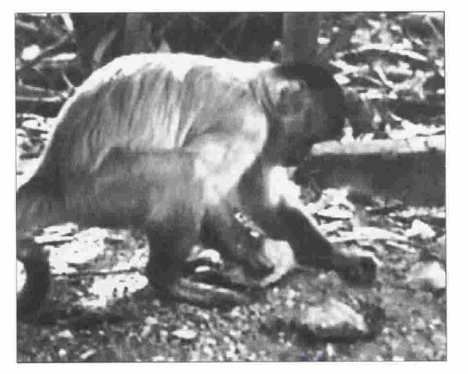
Culture defined…
Accumulation of artifacts, knowledge, beliefs, and values over many generations
    Artifacts = tools, clothing, words
    Knowledge = ways to construct and use artifacts
    Beliefs = understandings about the world
    Values = ideas about what is worthwhile, right, wrong
Socially inherited body of past human behaviors and accomplishments
Cole, 1996; Cole, Cole & Lightfoot, 2005

Slide 16
Cultural Psychology
All social and emotional development occurs in a cultural context
Culture involves shared beliefs and practices which unite communities and differentiate them from other communities
What may appear to be a universal feature of development, is often one of myriad, cultural solutions to a problem

Slide 17
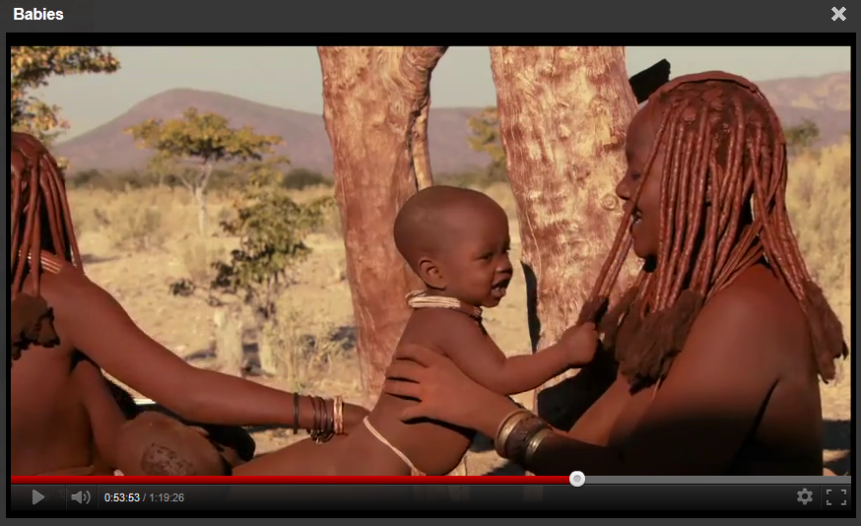
Cultural Psychology
Babies Namibia interaction (describe first 45 s)–
https://www.youtube.com/watch?v=vB36k0hGxDM
Namibia clip (trailer style)
https://www.youtube.com/watch?v=LpLHuE2Fymg
Full movie Babies–
https://play.google.com/movies#zSoyz
Babies (Africa, Japan, San Francisco, Mongolia)

Slide 18

Efe People
(Tronick et al. 1987)
Ituri forest of Zaire
Small communities of a few families
Leaf huts face a communal space
High mortality rates, low fertility
High work load; most gathering is communal
Multiple caregivers, infants engaged with
others half the time
Methods
Naturalistic, one community at both points
Data gathered at different times
Researchers living in these camps
Some variation in when the observations were made

Slide 19

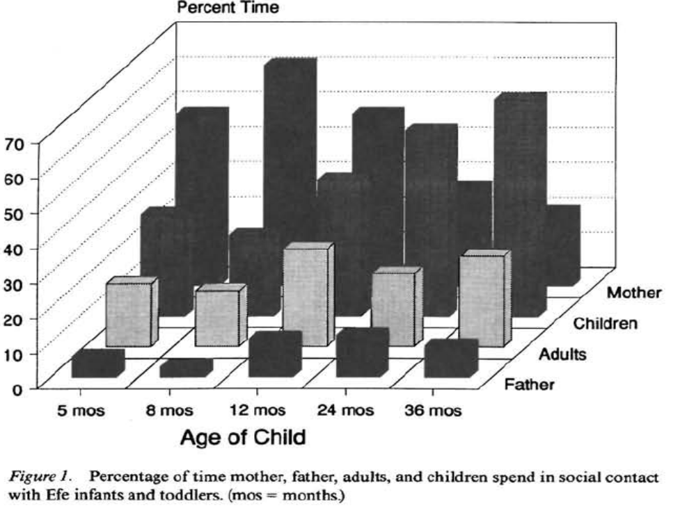
Efe infants have multiple, simultaneous relationships
Influenced by physical, social ecological, cultural factors
→ sense of self incorporating other people
  Not initially focused on one person that progresses to other relationships.
    Tronick, E. Z., Morelli, G. A., & Ivey, P. K. (1992). The Efe forager infant and toddler's pattern of social relationships: Multiple and simultaneous.
Notes:
Developmental Psychology, 28(4), 568-577.

Slide 20
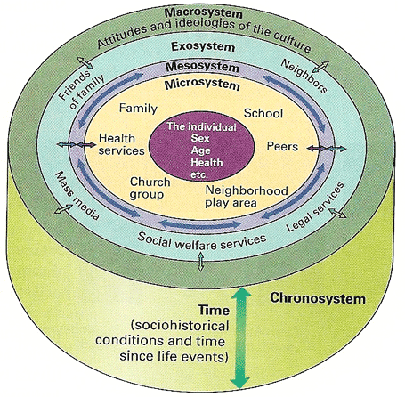
Reducing Bronfenbrenner Boundaries
The cultural veto

Slide 22
Cultural Psychology (Cole, 1996)
Culture does not act on people but instead is the “medium of human life”
An individual is fully embedded within his/her culture
Measurement must be based on locally derived procedures

Slide 23
Cultural psychology situations
What to do when baby cries
Where should baby sleep
Who should play with baby
Who should take care of baby
What about rambunctious toddlers

Slide 24
Privileged Treatment of Toddlers: Cultural Aspects of Individual Choice and Responsibility.
The study:
  16 Mayan families from San Pedro, Guatemala
  16 middle class families from Salt Lake City, Utah
  Interactions between toddlers (14 to 20 mo) and siblings (3 to 5 yrs)
  Interview with mother about child-rearing, social behavior, etc.
  Given 9 objects to toddlers and siblings to manipulate, with mother’s help
Which sibling should have the desired object?
What should be done if the toddler bops the older sibling with the desired object?
Christine Mosier and Barbara Rogoff (2003)
Collectivism v. Individualism?
Treatment of toddlers: Special treatment or same rules for sharing?
Age of understanding
Emphasis on individuality and choice promotes cooperation that is voluntary as opposed to guided by parental control

Slide 25
Access to Desired Objects
How 3- to 5-year-old siblings and mothers handled access to objects desired by the siblings and toddlers, in Mayan families of San Pedro, Guatemala, and middle-class families in Salt Lake City, Utah.
We observed whether toddlers (14–20 months) were accorded privileged access to objects that their siblings also desired or whether toddlers and slightly older siblings were held to similar expectations.
Christine Mosier and Barbara Rogoff (2003)

Slide 26
Proportions of Events Regarding Access to an Object
Event | Salt Lake City | San Pedro
Toddlers eventually gained access to the object | .59 (.20) | .87 (.09)
Mothers endorsed toddler’s privileged position | .43 (.24) | .63 (.22)
Mothers endorsed toddler’s nonprivileged position | .25 (.13) | .04 (.05)
Siblings endorsed toddler’s privileged position | .45 (.19) | .80 (.09)
Siblings endorsed toddler’s nonprivileged position | .54 (.21) | .19 (.09)
Mosier and Rogoff (2003)

Slide 27
Guatemalan Mayan mothers
“almost never overruled their toddlers' objections to or insistence on an activity—they attempted to persuade but did not force the child to cooperate toddlers were not compelled to stop hitting others.
[Toddler] hitting was not regarded as motivated by an intent to harm because they were expected to be too young to understand the consequences of their acts for other people.”
  Mosier & Rogoff, 2003

Slide 28
A hefty 15-month-old…
walked around bonking his brothers and sisters, his mother, and his aunt with the stick puppet that I had brought along. The adults and older children just tried to protect themselves and the little children near them, they did not try to stop him. When I asked local people what this toddler had been doing, they commented, “He was amusing people; he was having a good time.”
Was he trying to hurt anybody? “Oh no. He couldn't have been trying to hurt anybody; he's just a baby. He wasn't being aggressive, he's too young; he doesn't understand. Babies don't [misbehave] on purpose.” (p. 165)
Notes:
(When the little guy got close to me, I took the puppet out of his hand, and he gave me an indignant look. His mother hurriedly gave him a wink that meant I was just teasing, and he relaxed. What I had done was socially inappropriate—I had forced him to stop what he was doing.)

Slide 29
Maternal education (acculturation)
San Pedro mothers’ schooling related negatively to their privileged endorsements (r .50, p <.05) and related positively to their nonprivileged endorsements (r .56, p < .05).
Notes:
and uninvolvement (r .57, p < .05)

Slide 30
Attention to Interactions Directed to Others
Cultural variation in children’s attentiveness
  Indigenous vs. westernized learning styles
Guatemalan Mayan & European American
Pueblo basic vs. Mexican high school
  Maternal education level and cultural traditions
Toy construction paradigm
Correa-Chavez & Rogoff, 2009
Notes:
Correa-Chavez, M., & Rogoff, B. (2009). Children's attention to interactions directed to others: Guatemalan mayan and european american patterns. Dev Psychol, 45(3), 630-641. doi: 2009-05916-003 [pii]. 10.1037/a0014144

Slide 31
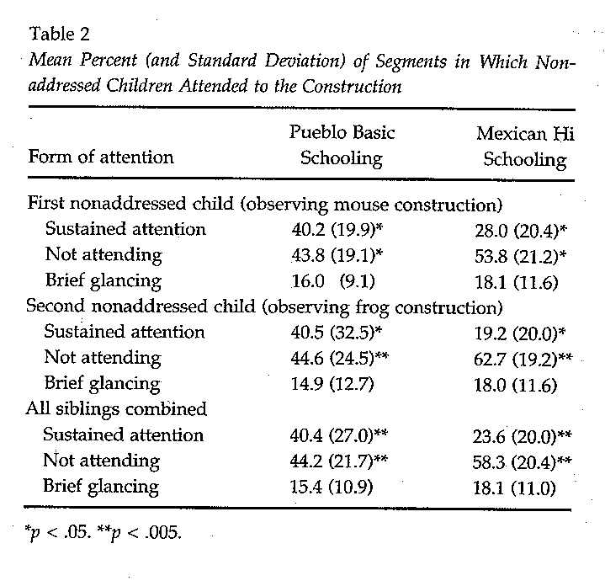
Kids’ Attention to Interactions Directed to Others—parental education effects
Correa-Chavez & Rogoff, 2009

Slide 32
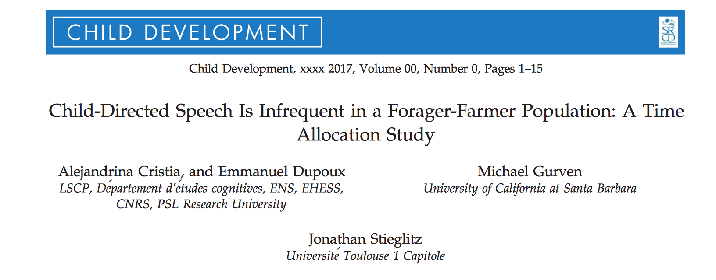
Notes:
Chi-Mann-e

Slide 33
Aims
  From whom
    Do children aged 0-11 years receive one on one verbal input among Tsimane forager-horticulturalists of lowland Bolivia?
  To better understand potential cross-cultural variability in linguistic experiences of children

Slide 34
Adult verbal input (quality and quantity of child-directed speech) shapes children's language development
  “A child has more opportunities to hear the forms of words in a meaningful social context, which may facilitate learning of word-to-meaning pairings” (Hoff & Naigles, 2002)
  “Less directed input during early childhood…may result [in] not only lower levels of explicit knowledge (e.g. smaller vocabularies) but also less efficient speech processing” (Weisleder & Fernald, 2013)

Slide 35
Industrialized context
Environmental factors’ (e.g. SES) influence verbal skills (receptive or productive vocab size and speed of word recognition)
  Hart & Risley (1995) argue that this effect can be traced back to the verbal input between birth and 3 years
    Professional parents’ children heard three times as many words than peers in homes of parents on welfare
Studies controlling for SES also find this effect of child-directed speech
Studies find child-directed speech is more effective in verbal engagement and lexical development than overheard speech
  Particularly when uttered in one-on-one conversations
  With adults rather than children

Slide 36
Caveat
Most evidence on early language development comes from small populations— “Western, educated, industrialized, rich and democratic”
Why does that matter?
  Preindustrial populations have larger families
  Live in smaller family-based clusters, sharing spaces
    Resulting in regular contact with extended family which may increase number and diversity of conversational partners
    Decrease number of one on one conversations

Slide 37
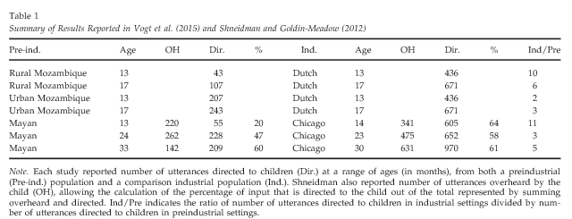

Preindustrial children hear less directed speech at early ages
Overall differences of talkativeness across cultures
Cross-cultural differences disappear around 33 months (2.75 years old) [when looking at proportion of directed speech)

Slide 38
Bckground contrast:
Sentences uttered around children
13 month olds
  Mayan children
    60% from other children
    31% from mother
    9% from other adults
    90% of the sentences come from children by age 3
14 month olds
  American children
    8% by other children
    79% from mother
    13% from other adults
    10% of the sentences come from children by age 3
(Shneidman, 2010)

Slide 39
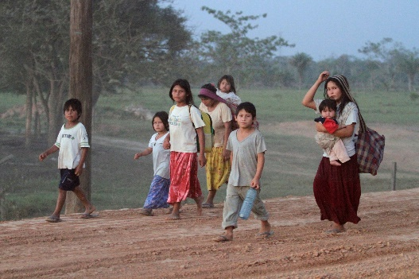
Tsimane forager horticulturalists of lowland Bolivia
Community
  90 villages (between 50-550 individuals within each)
  Villages have extended family clusters (each 3-4 households)
  Tsimane language used, Spanish when speaking to non-natives –merchants)
  Mothers provide 80% of direct child care in the 1st 6 months, 70% in 1st 6 years
Observational technique to systematically monitor behavior (not just verbal)
Looked at residential clusters from 6 villages
  43,903 direct observations of individuals aged 0-85 years
  Recorded in 2-3 hour blocks
  Between 7am-7pm
  Single observer (advanced anthro students—PhD or honors thesis)
  Every 30 min coded up to 2 concurrent activities of all individuals

Slide 40
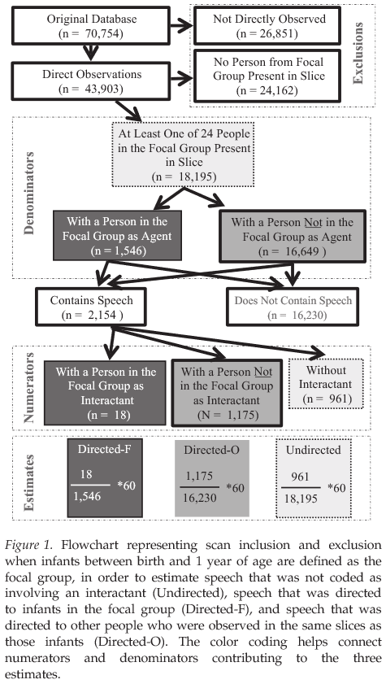
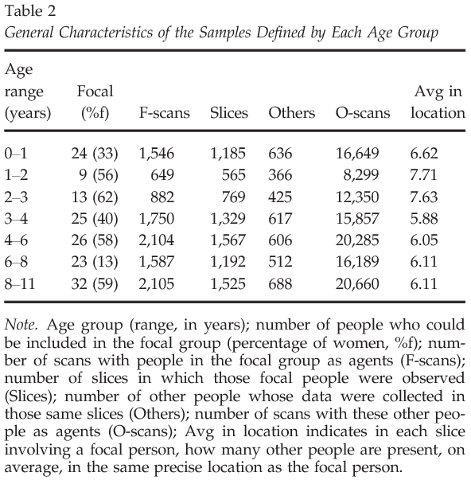

Slide 41
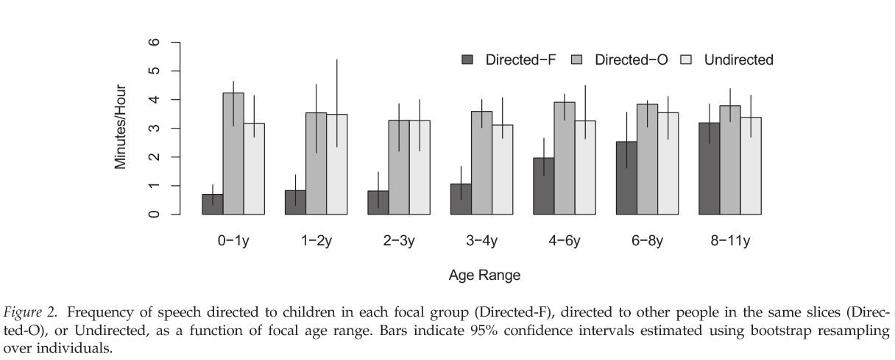
Low (increasing) levels of child-directed speech
Lopez

Slide 42
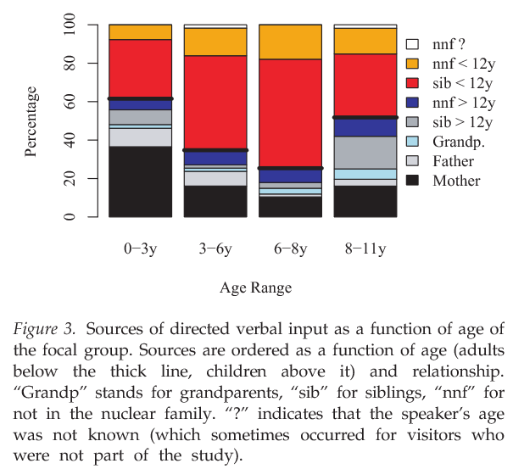
Speech from moms, then sibs…
Lopez

Slide 43
Conclusions
Infants and young children were engaged in one-on-one verbal interactions less than older individuals
The amount of child-directed speech increased with child’s age with directed and non-directed speech equaling out around 8-11 years old
The actors who engaged in child-directed speech varied as a function of the child’s age
Lopez

Slide 44
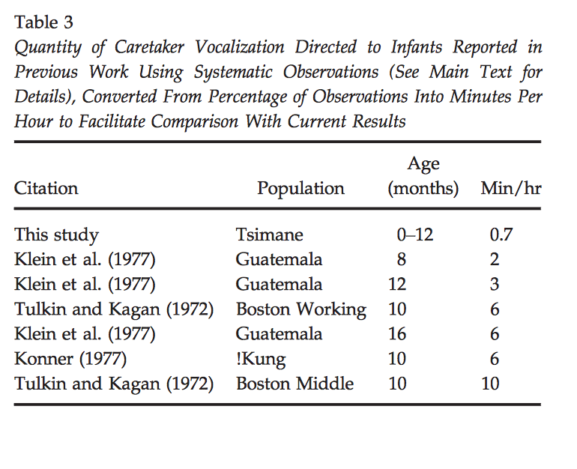
Comparisons with previous work
Lopez

Slide 45


Comparisons with previous work
Lopez

Slide 46
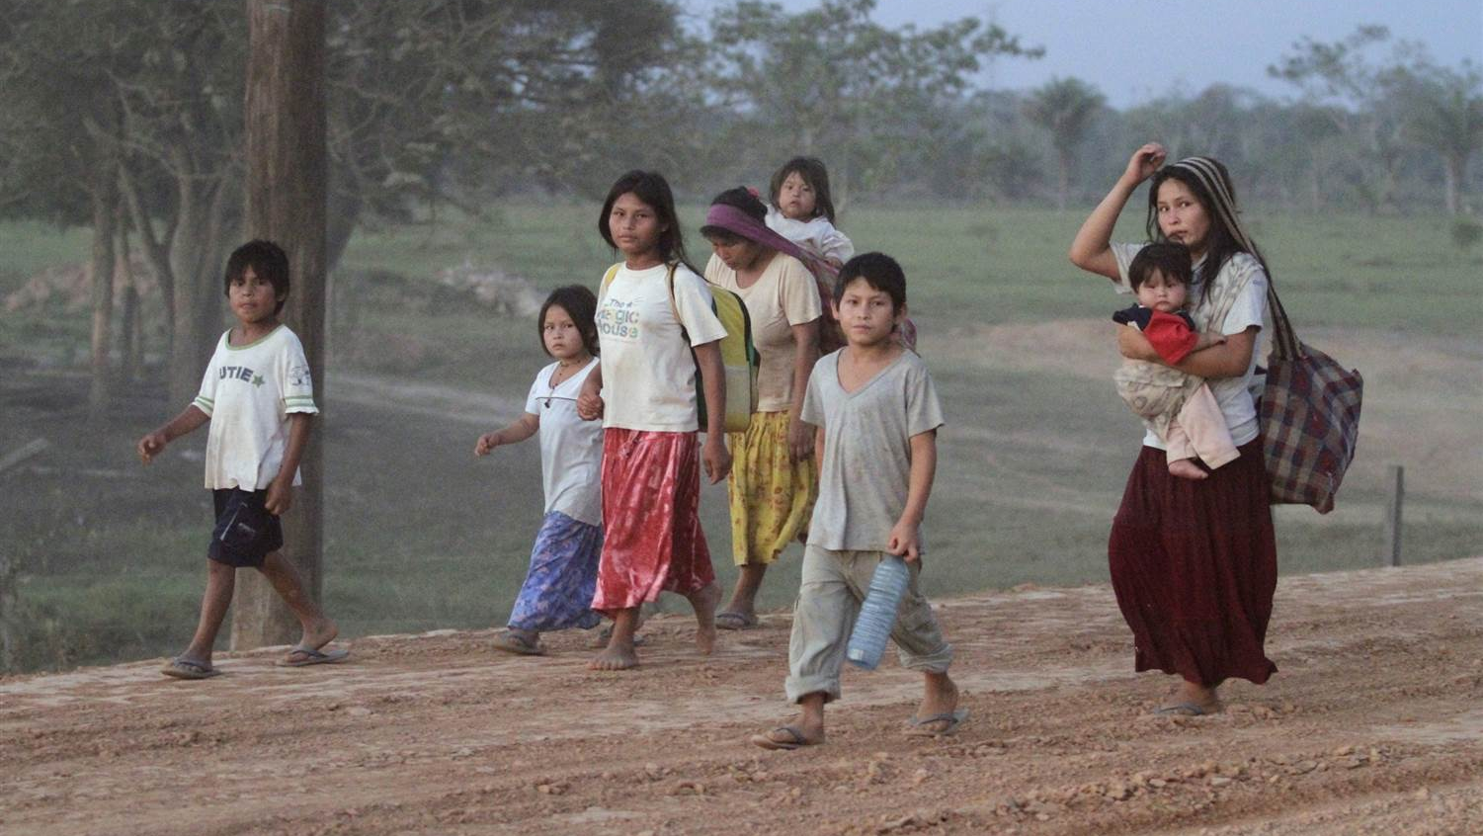
Infant-directed input and literacy effects on phonological processing: Non-word repetition scores among the Tsimane’
Cristia, A., Farabolini, G., Scaff, C., Havron, N., & Stieglitz, J. (2020). PloS one, 15(9), e0237702.
Manuela Jaramillo
February 9, 2021

Slide 47
Infant-directed input and literacy effects on phonological processing: Non-word repetition scores among the Tsimane’
Terminology
Infant directed input = Talking to infants
Literacy effects = Effect of going to school/being able to read
Phonological processing = The ability to process sounds (i.e. phonemes) in one’s own language
Non-word repetition = A way to measure phonological processing that involves repeating back spoken “non-words”
  Example of an English non-word = beng; you say beng, can I pronounce beng back correctly?
  Example of a Tsimane’ non-word = fisek; you say fisek, can I pronounce fisek back correctly?
Tsimane’ = Indigenous group in Bolivia that is known for only speaking to their infants an average of 1 minute per hour AND only 18% of them are literate (i.e. go to school/can read) AND they ONLY speak Tsimane’
Notes:
So, here is the title of the paper again… and if you’re anything like me, with absolutely no background in developmental psychology, when you heard or read the title for the first time, you were like uhhhh… what? So, I made a terminology slide to break down the title a bit so it sounds less scary.
Essentially, [CLICK] infant Infant directed input means talking to infants, [CLICK] literacy effects means the effect of going to school and/or being able to read, [CLICK] phonological processing is essentially a measure of lingual ability. However, specifically, it is the ability to use the sounds of one's language, also known as phonemes, to process spoken and written language. Then, next in the title we have, [CLICK] Non-word repetition which is a paradigm used commonly in developmental psychology to measure phonological processing. This paradigm involves repeating spoken “non-words” An example of an English non-Word is beng and an example of a Tsimane’ non-word is fisek. What makes beng “English” and fisek “Tsimane’” is that it uses the phonemes of those languages, or the sounds already commonly used in those languages. However, it is a word that does not exist in these languages. Finally, [CLICK] and very importantly, the Tsimane’ is an idigenous group in Bolivia that is known for three unique things relevant to this research: First, they only speak to their infants an average of 1 minute per hour, second, only 18% of them are literate, which means that only 18% can read and went to school, and third, Tsimane’ are monolingual, which means that they ONLY speak Tsimane’, and not Spanish, or any other languages.
So essentially, what these authors are interested in, is assessing whether –one- talking to infants and -two- going to school to become literate, plays a role on phonological processing. In this case, phonological processing is measured as an individuals’ ability to correctly pronounce and repeat back a non-Word... such as beng or fisek. Any questions?

Slide 48
Does linguistic processing vary across cultures?
Maybe! Possibly as a function of 1) infant-directed input and 2) schooling and literacy.
When learning to speak and to perceive language, humans (likely) develop “short-hand-like” phonological representations to make the process of phonological processing very efficient.
  Q for Dr. M: What does short-hand-like mean?

Slide 49
Infant-directed input
Something happens in the mind/brain of infants whereby phonological processing is rendered more efficient through EXPERIENCE
  Thus- a basis for why talking to infants and babies is important!
To what extent and how does infant-directed input impact adult phonological processing efficiency, though? To what extent= is one of the goals of this paper.
How?
Some theorists argue that lexical development may play a role in phonological processing. As a mediator, of sorts.
Thus, some argue that child-directed input → lexical processing (ability to process words) → phonological processing (ability to process sounds)
If we talk to babies more, they acquire more experience to new words.
Notes:
Some theorists argue that lexical development may mediate the relationship between infant-directed input and phonological processing because there is a strong relationship between child-directed input and lexical development. If we talk to babies more, they acquire more experience to new words.

Slide 50
Critical period of infant-directed input
Unclear if there is a critical period for infant-directed input to play a major role on phonological processing.
Therefore:
  Assess schooling to see if that changes anything
  Assess adults vs children in the same culture to see if phonological processing improves with time

Slide 51
Schooling/literacy training
Does schooling/literacy only affect performance on the conscious manipulation of speech (e.g. say as many words as you can that start with the letter P) OR does it ALSO affect phonological processing (reminder: this is the ability to process sounds)?
Past research (n=6 studies) on relationship between NWR and literacy shows insufficient evidence to support that literacy training/schooling leads to development of short-hand-like phonological representations
  We need more studies! This one is interesting because done with Tsimane’
Furthermore, SES = there is too weak of an effect between SES and NWR to say that they are related
Notes:
The authors of this paper seem to use the words schooling and literacy interchangeably, mean

Slide 52
NWR (non-word repetition)
“Imitation game”
Task where participants hear phonologically grammatical but meaningless words and are asked to repeat them back, out loud
This task is a robust predictor of later literacy
This task also correlates with lexical development (which as a reminder, means vocabulary)
Example of an English non-word = beng
Example of a Tsimane’ non-word = fisek

Slide 53
Aims
Assess the long-term effects of low infant-directed input on phonological processing
Assess the JOINT effect of low infant-directed input AND low literacy on phonological processing
Assess the phonological processing underlying non-word repetition by comparing three subsets of the Tsimane’ sample
  Children vs. adults
  Readers vs. non-readers (self-reported)
  Completed more school grades vs. completed less school grades
Notes:
There are three primary goals in this paper. I will show those goals, and then delve a little bit more into the background literature addressed in the introduction of the paper. The authors’ first goal [CLICK] was to assess the potential long-term effects of low infant-directed input on phonological processing. The second goal [CLICK] was to sssess the JOINT effect of low infant-directed input AND low literacy, essentially schooling and reading, on phonological processing. Finally, the third goal [CLICK] was to assess the phonological processing underlying non-word repetition by comparing three subsets of the Tsimane’ sample [CLICK] Children vs. adults [CLICK] self-reported Readers vs. self-reported non-readers and [CLICK] individuals who Completed more school grades vs. those that completed less school grades

Slide 54
Methods
NWR task conducted with both Tsimane’ children (n= 17; 1-12y) and adults (n= 13; 18-60y)
N=9 groups total; 3-9 participants per group
Task took between 1 and 7 minutes per group
Procedure of NWR task (example fisek)
Researcher says “fisek” to the Spanish-native Tismane’-speaking research assistant (RA)
Tsimane’-speaking RA says “fisek” to the group
  Groups average 1-3 people; usually of the same family; at most, 2 families
Group of either adults or children say “fisek” back, all together
  Audio recorder used: RA and researchers later listened to the audio tapes and provide a score as percent of non-words pronounced correctly
    Example; 7/20 non-words pronounced correctly, then score is 35%
Notes:
Many trials went into this, and authors didn’t think that it would need to be done in groups but it didn’t work otherwise. So, this is considered an explanatory study because it deviated from the pre-registration methods.

Slide 55
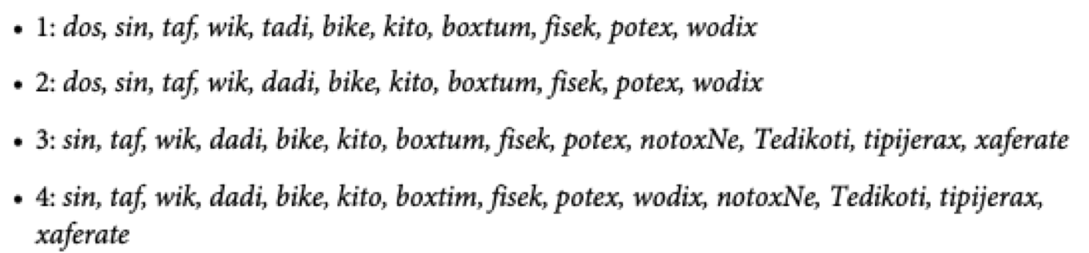
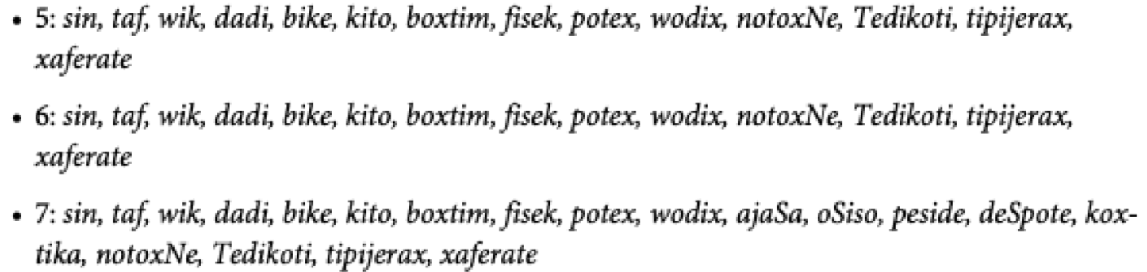
Stimuli
Notes:
Many trials went into this, and authors didn’t think that it would need to be done in groups but it didn’t work otherwise. So, this is considered an explanatory study because it deviated from the pre-registration methods.

Slide 56
Results: Literacy
What was your highest grade completed?
  Among children = M=1.12 (range = 0 to 3)
  Among adults = M=2.31 (range = 0 to 5)
On a 3-pt scale: can you read and write?
  (1)Not at all= 71% of children; 54% adults
  (2)A little= 29% of children; 23% of adults
  (3)Yes= 0% of children; 23% of adults

Slide 57
Results: Group variation
Group size did NOT influence NWR scores (p=.11)
One person in the group mispronouncing a word did NOT influence the following persons repetition score
NWR varies as a function of NW complexity (defined as 1- word length and 2- stimulus complexity)
Notes:
It is important to understand what ”average” NWR scores among individuals who 1) DO receive infant-directed input and 2) ARE literate and go to school

Slide 58
Phonemes--Non word repetition (NWR)
Children average NWR score = 55%
  Children who do not read = 55%
  Children who read a little = 60%
Adults average NWR score = 60%
  Adults who don’t read = 54%
  Adults who read a little or yes = 67%
  Adults who never went to school = 55%
Scores were not different as a function of age – lack of significant increase from children to adults is surprising
These averages are descriptively lower than those reported in all previous work among non-readers and illiterate people
  May say something about the lack of child-directed input seen among the Tsimane’
Notes:
Differ between word scores (total pronunciation) and phoneme score (more specific phonemic pronunciation). I will only report phonemic pronunciation averages in this presentation, as I think it’s the most indicative
phoneme score (more specific phonemic pronunciation), and score when # of syllables (complexity) in words are considered

Slide 59
Discussion: Tsimane’ participants’ NWR scores were lower than in all previous work
Must be cautious in interpretations due to sample size and 3 other considerations
  Were these words phonologically more complex than those employed in other past studies?
  Did the group-method affect outcome? (even though statistically it shows it did not? Also, side note- kids were shy and many did not answer anything)
  Allophony in Tsiname’ language: multiple ways to pronounce the same word. Tsiname’ has unique asalization, two series of central vowels, and4 lingual contrasts (dental, palatal, etc.)
  Auditory abilities of Tsimane’

Slide 60
Lower infant-directed input correlates with lower NWR score
What about schooling/literacy?
  Trend that children and adults who could read had higher NWR scores than those who could not
  Non-sig moderate correlation between highest grade completed and NWR score
Authors cannot tease apart the effects of input and literacy
Again, caution in interpreting these findings. This does not show causality as it’s only one study

Slide 61
Overview
Observation exercise
Cross-cultural (comparative) psychology
  Problems in context
VS
Cultural (embedded) psychology
  Efe and the cultural veto
  Guatemalan toddlers
    Toys and learning
In depth
  Tsimane reduced language input
  Tsimane reduced non-word phoneme reproduction presentation/discussion
  Language intervention in rural Senegal
Synthesis of cross-cultural and cultural psychology?
  African caregiving (Otto et al.)
  Smile divergence (Wormann et al.)

Slide 62
(Exam) Question
Cristia et al. demonstrate low levels of child-directed speech through age 3 in the Tsimane. How would you ascertain the impact of child-directed (and other-directed and non-directed) speech in the Tsimane?

Slide 63
EVERYDAY LANGUAGE INPUT AND PRODUCTION IN 1,001 CHILDREN FROM SIX CONTINENTS
Bergelson et al (2023) | Presented by Lang Duong

Slide 64

BACKGROUND
Previous research suggests linguistic development varies depending on various factors, such as gender and SES.
Limitations of previous studies include:
Relying heavily on WEIRD samples and methodologies
Making (or striving to make) binary conclusions regarding these factors
Notes:
Previous research has suggested that children’s linguistic abilities vary depending on different factors, such as gender and SES.
However, limitations of previous studies include:
1) relying heavily on WEIRD samples and methodologies -> leading to assumption that language development is uniform
2) making binary conclusions regarding these factors (i.e., do they impact language development or not versus how much do they impact language development)

Slide 65
SPECIFIC AIMS
How well do specific individual- and family-level factors predict variation in how much speech young children produce?
Do systematic differences in children’s lives have measurable links to their language production?
Notes:
After aim 2: If so, what are the strengths of these relationships, and how are they related to one another?

Slide 66
METHODS
SAMPLE
DATA COLECTION
FACTORS
1,001 participants
Ages 2 to 48 months
Across 18 countries
10 primary languages
33 total languages
Utilized wearable recorders
LENA system
> 40,000 hours of audio across the span of > 2,500 days
Factors w/ “Undeniable Effects”
Age
Language-relevant clinical risks and diagnoses
Individual- & Family-Level Factors
SES (i.e., maternal education)
Gender
Language input quantity
Multilingual background

Slide 67
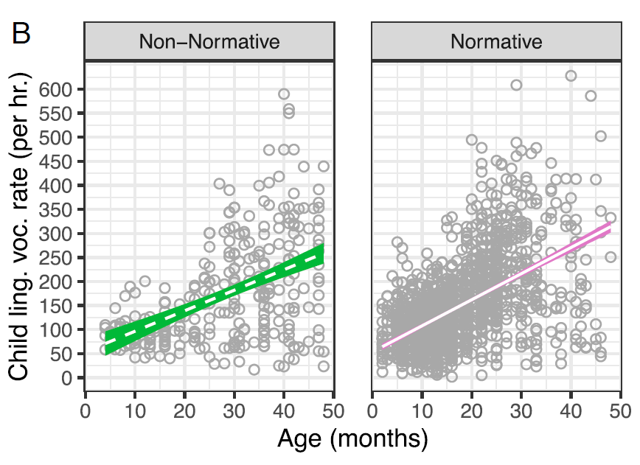
BOTH AGE AND NORMATIVE STATUS HAD EFFECTS ON CHILD SPEECH PRODUCTION
Non-Normative: children with language delays or a diagnosis of a language disorder or are at high risk for them.
Notes:
Older children produced more speech than younger children.
66 more vocalizations per hour with each year of life.
Children experiencing nonnormative development produced less speech than children with normative development. This was strengthened by age (as seen in the image here).
20 fewer vocalizations per hour. Difference grew by 8 vocalizations per year.
Older kids are more likely to have an actual diagnosis than younger kids as opposed to a risk factor.

Slide 68
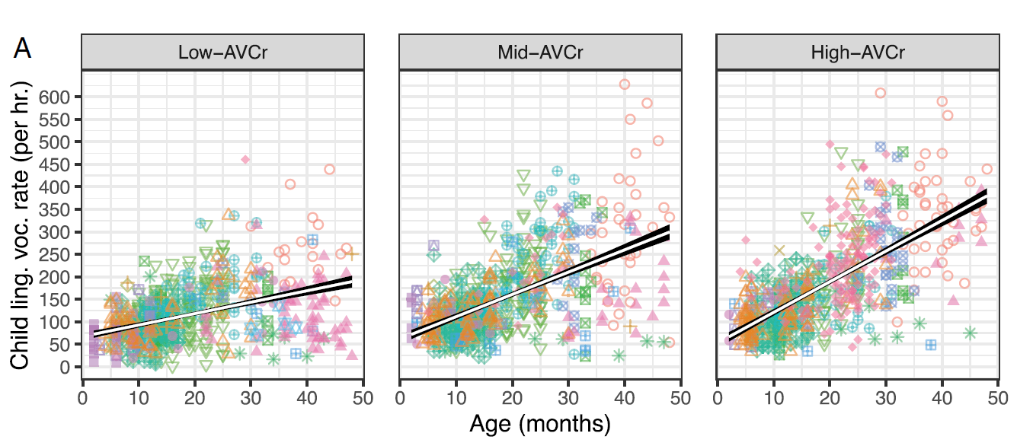
ADULT SPEECH PRODUCTION WAS SIGNIFICANTLY POSITIVELY CORRELATED WITH CHILD SPEECH PRODUCTION PRODUCTION
Notes:
Researchers split adult speech production into low, middle, and high tertiles.
For every 100 adult vocalizations/hour, children produced 27 more vocalizations/hour.
This also strengthened with age in that child speech production grew by 16 vocalizations/year.
Children age and normative status were not significant predictors of adult talk; therefore, children talking more did not elicit more talk from adults, which strengthens the finding.

Slide 69
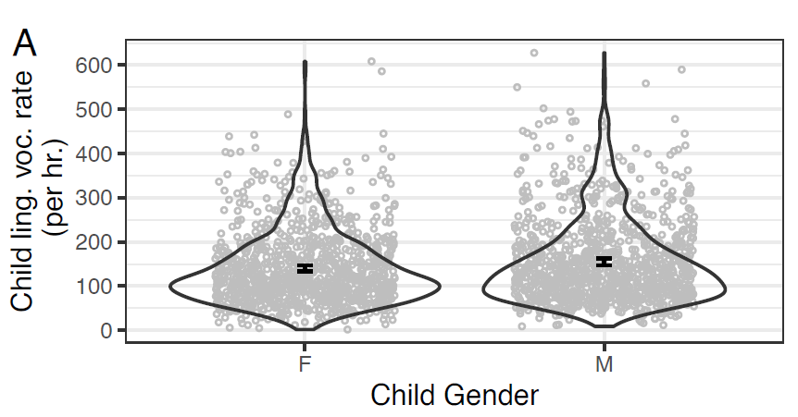
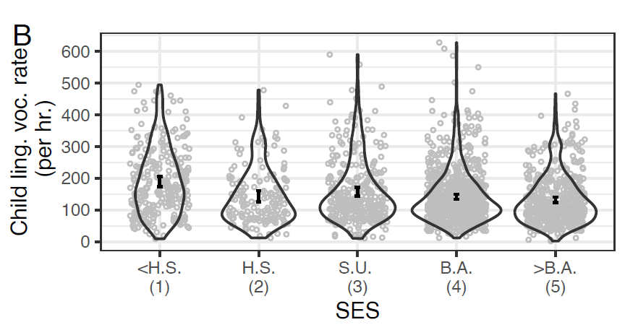
GENDER, SES, AND MONOLINGUAL STATUS DID NOT EXPLAIN SIGNIFICANT VARIATION IN CHILD SPEECH PRODUCTION
Notes:
We see that there is some suggested trend but the null effects found may be due to the non-significant difference between <HS and >BA.

Slide 70
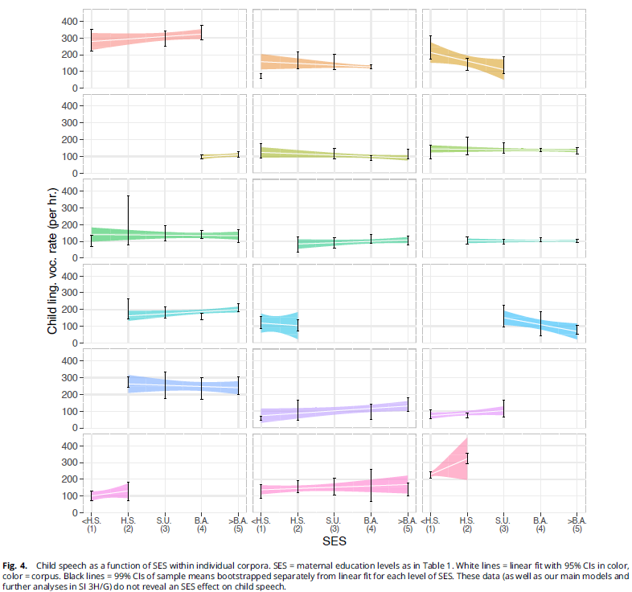
FOLLOW-UP ANALYSES ON SES
Notes:
Conducted random slope analyses by corpora and found no relationship between SES and child speech by each corpus.
However, important to note that sample sizes by corpora was small with 7 corpora having sample sizes < 20.

Slide 71
DISCUSSION QUESTIONS
LANG’S:
DANIEL’S:
What are your thoughts on the use of maternal education as a proxy for SES? Do you think it was appropriate?
What are potential reasons that SES was not seen as a primary factor for speech language development across cultures?
If the study were to look at the quality of linguistic development rather than the quantity, how do you think these findings would change?
Did this paper adequately define adult speech with respect to who was providing the speech (e.g., mom, dad, neighbor over the age of 18)? Does this matter? If so, how?
Notes:
Said they did this (maternal ed) because
Available information
Most commonly used SES proxy in language acquisition research
Many theories have pathways that include maternal education as a predictor of children’s language experience
Multilingualism -> quality versus quantity

Slide 72
Everyday language input and production in 1,001 children from six continents
Bergelson et al., 2023

Slide 73
Purpose & Theoretical Foundation
Purpose
  How well do specific individual- and family-level factors predict variation in how much speech young children produce?
  Do systematic differences in children’s lives have measurable links to their language production?
    If so, what are the strengths of these relationships and how are they related to one another
Foundation (results reinforced foundation)
  “There are factors with undeniable effects on early language production, namely, child age and language-relevant clinical risks and diagnose

Slide 74
Study Overview
Simultaneous study of individual variation and speech production over early development
Western Focused Research
  Led to believe language development is uniform
  Variation →Sex, SES, Disadvantaged
Sample
  1001 participants , (2 months – 48 months)
  18 countries; 10 “primary languages; 33 total languages
  Over 40,000 hours of audio; over 2500 days
  Data collection - Used Wearables – LENA system

Slide 75
Sample
1001 participants , (2 months – 48 months)
18 countries; 10 “primary languages; 33 total languages
Over 40,000 hours of audio; over 2500 days

Slide 76
Meaningful Findings
No monolithic language development process
“SES”is not a primary factor
Adult Talk, Age, Normative Development = sole significant predictors
Gender & Multilingual
  Did not explain how often children vocalized
  Did not show differences in adult talk between cultures

Slide 77
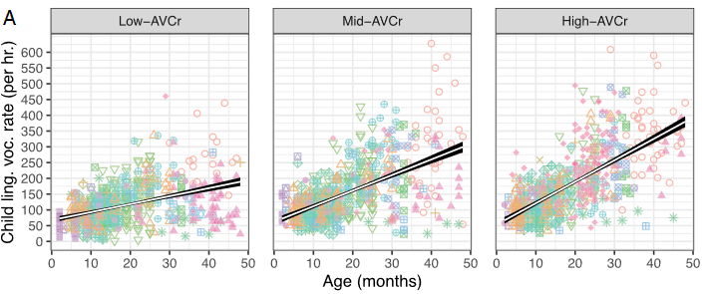
Adult Talk
Increasing Adult Talk significantly increases child vocalization

Slide 78
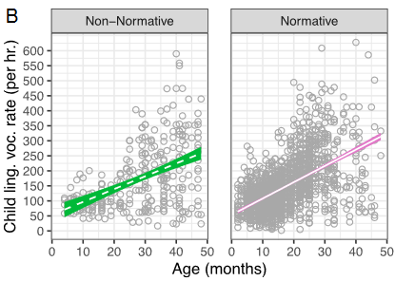
Normative vs Non-Normative
Non-Normative (definition)
Children with various diagnoses of language delays and disorders, as well as those at high risks for them
Children with nonnormative development produced significantly less speech than normative development

Slide 79
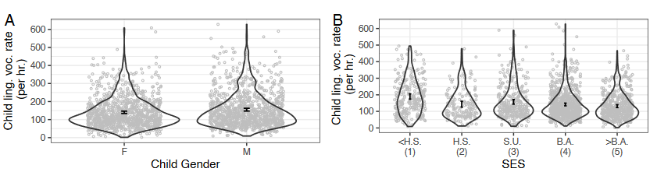
Gender & SES as Null Predictors
Null effects of Child Gender & SES
SES may indicate directionality (appears to be non-significant increase moving from parents with less than high school degrees to those with post secondary study.

Slide 80
SES Within Corpora
Increasing Adult Talk significantly increases child vocalization

Slide 81
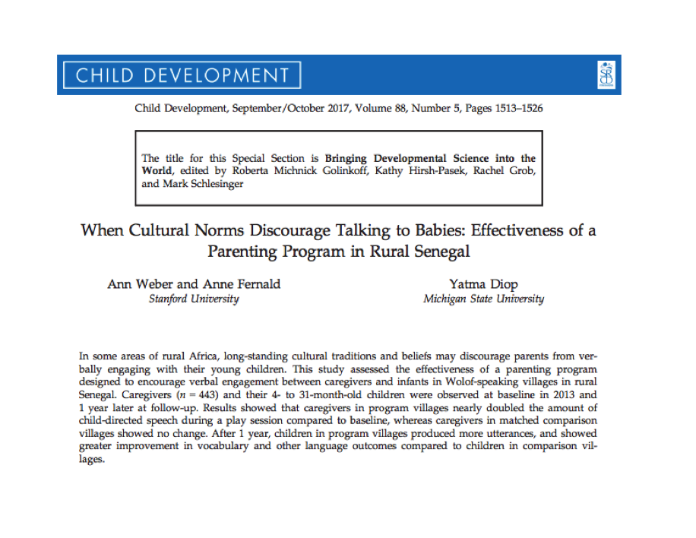
Westwright

Slide 82
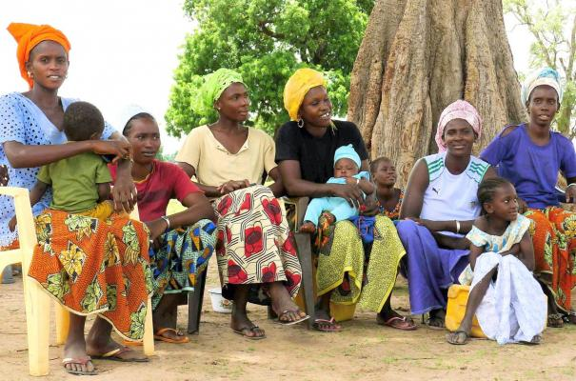
Background
Children who hear more rich and varied speech from caregivers have better language outcomes
Most research conducted in Western countries
In many non-Western, low-income, subsistence cultures, talking to babies is less common and in some cases discouraged
Westwright

Slide 83

Intervention and Hypotheses
Intervention designed by a NGO (Tostan) in rural Senegal and evaluated by independent researchers
Primary aim: Increase caregiver’s verbal engagement with their children
Hypotheses:
  Caregivers who participated in the program would have improvements in verbal engagement and knowledge of child development
  Children of program participants would show greater language improvements relative to children who did not receive the program
Westwright

Slide 84
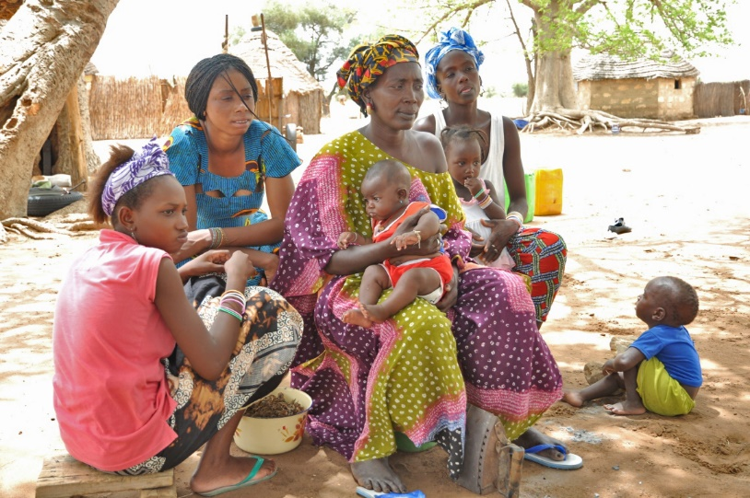
Participants and Setting
43 group sessions and bimonthly home visits over 9-10 months for children age 0-6
12 program and 12 comparison (wait list) Wolof-speaking villages
Content included infant brain development, role of parenting practices, discussion of traditional parenting practices
Measures:
  Structured play session videos
  All-day audio recording of speech
  Parent knowledge questionnaires
Westwright

Slide 85
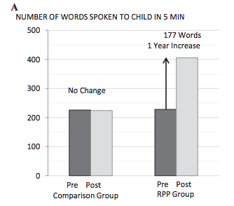
Caregiver Outcomes
Program and comparison villages comparable at baseline
Program caregivers increased speech to their child by 78% (no change in comparison caregiver speech)
  Program caregivers had greater improvements in knowledge of child development relative to comparison caregivers
Westwright

Slide 86
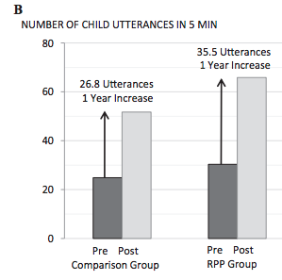
Results – Child Outcomes
32% increase in utterances relative to control
Greater gains in language milestones and expressive vocabulary
Small, non-significant improvement in child vocalizations/conversation turns in all-day audio recordings
Quantity of caregiver speech during play session and caregiver knowledge of child development mediated changes
Some evidence for dose effect
Westwright

Slide 87
Key Contributions and Limitations
Showed efficacy of a program to improve parenting practices in a rural African community, despite cultural barriers
Cross-cultural evidence for the effect of child-directed speech on children’s language development
Study lacked random assignment, was limited to a subset of villages, and limited to one of the three intervention languages
Despite program encouragement to share knowledge, effects seem limited to primary caregivers
  Culturally common for parent to spend less time with young children as they become more independent
Westwright

Slide 88
(Exam) Question
Weber et al. assess an intervention aimed at increasing child-directed speech. What were its effects? Design a follow-up intervention and assessment designed to assess the impact of child-directed speech in Rural Senegal. Incorporate and discuss culturally relevant measures of optimal and non-optimal outcome that be impacted by the intervention (h/t Liz C.).

Slide 89
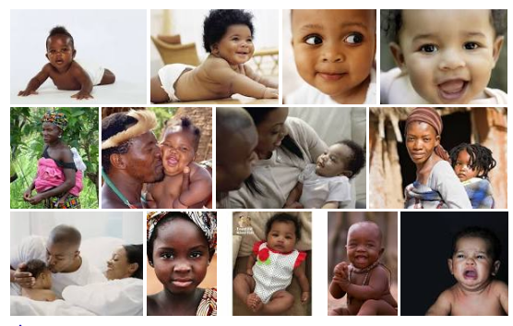
Infants’ Social Experiences in Three African Sociocultural Contexts. Otto et al., 2016
Explore social experiences of infants (3 month old) in peri-urban context of poverty and adversity in Africa
Focus on three sociocultural contexts in Africa (N = 76)
  Prototypical urban middle-class sample- 25 mothers
  Prototypical rural traditional subsistence-based sample- 22 mothers
  Peri-urban context (rural-urban transition zone)- high levels of poverty and adversity- 29 mothers

Slide 90
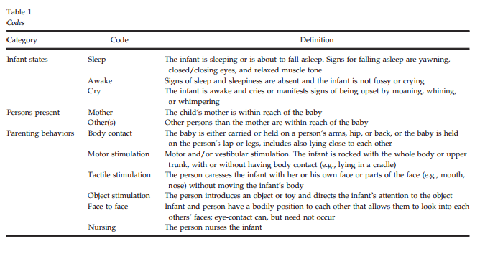
Spot observations
NOWLAN

Slide 91
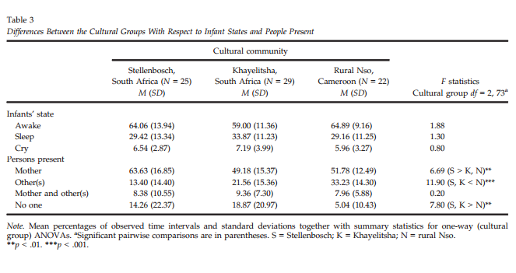
Who is present? Other care is high in non-urban settings
Notes:
Mothers were more frequently present in middle-class, urban sample when compared to the peri-urban and rural samples
Others were more often caretakers in the rural context compared to the other two samples
Urban and peri-urban infants were more often alone than rural infants
No difference in the groups in the time they spent in presence of both mothers and others

Slide 92
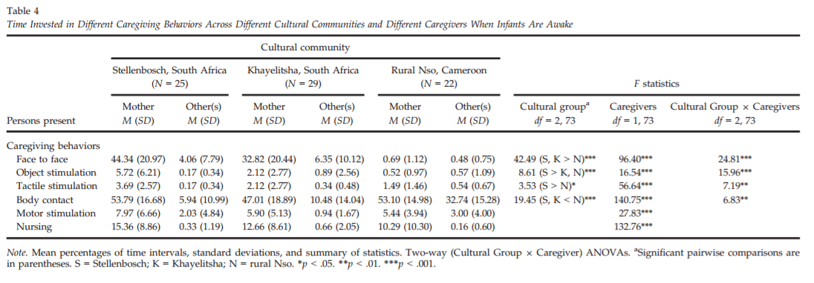
What is happening when awake?
Face-to-face high in urban setting;
other care body contact non-urban
Notes:
Rural infants were in body contact with others significantly more than the other two contexts
Urban (middle-class) mothers used objects sig. more than other two samples
Infants had more face-to-face contact in urban and peri-urban samples than the rural context
Peri-urban infants had more face-to-face contact than rural infants
Tactile stimulation was greater in urban than rural mother, however, others used more tactile stim than in rural context than they did in the urban

Slide 93
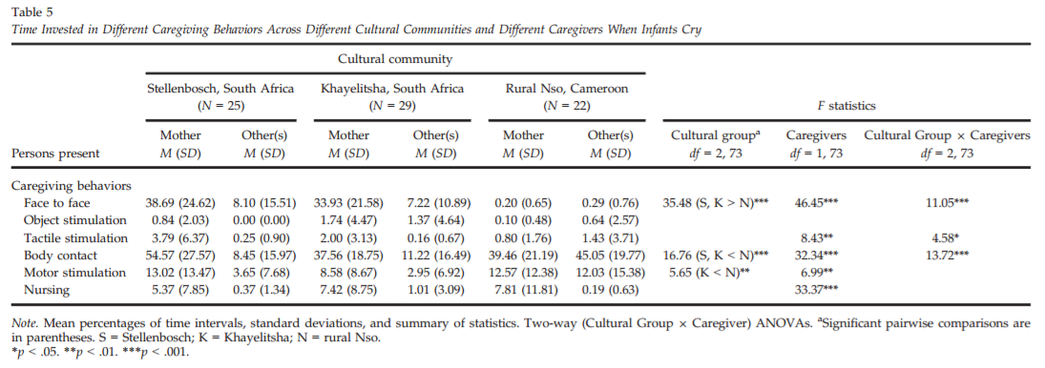
What is happening when infants are crying?
Notes:
Crying urban infants had more body contact with their mothers than peri-urban infants
Crying rural infants had body contact with others more often than other two samples
Face-to-face interaction was significantly greater in urban and peri-urban mothers and others compared to rural mothers
Urban mothers used tactile stimulation more than rural mothers
Rural others used tactile stim more than the other two contexts
Sleeping:
Rural infants had more body contact and nursing than other groups
In general, mothers invested more time in body contact and nursing

Slide 94
Optimal blend of embedded and comparative description?
Context impacts development through caregiving
Urban and rural contexts follow prototypical child care models
Infants in peri-urban settings have different socioemotional experiences
  minimal caretaking style, not prototypical

Slide 95
Background
Social smile first sign of socio-emotional development
Emerges around second month of life
Maternal emotional behavior acts as a mechanism
Differs based on culture
  Independent
  Interdependent

Slide 96
Method
Purpose: Understand the mechanisms underlying social smiling across sociocultural contexts at 6, 8, 10, and 12 weeks
N=24 mother-infant pairs from the Nso group
N=20 mother-infant pairs from the Munster group
Mothers interacted freely with infants for 10 minutes and videotaped

Slide 97
Background
Social smile first sign of socio-emotional development
Emerges around second month of life
Maternal emotional behavior acts as a mechanism
Differs based on culture
  Independent
  Interdependent

Slide 98
Method
Purpose: Understand the mechanisms underlying social smiling across sociocultural contexts at 6, 8, 10, and 12 weeks
N=24 mother-infant pairs from the Nso group
N=20 mother-infant pairs from the Munster group
Mothers interacted freely with infants for 10 minutes and videotaped

Slide 99

Nso Village (Cameroon) vs. Munster, Germany
      Caregivers from INDEPENDENT cultures (North America and Europe) socialize their infants toward independence, self-actualizing, and emotional expression.
        Mothers establish a lot of face-to-face interactions – mutual gazing and use imitation of infant smile to promote and maintain happy expression and emotion
      Caregivers from INTERDEPENDENT cultures (rural Africa, India, Palestine) socialize their infants towards relatedness (i.e. obey parents, share, social harmony), thus they:
        Attempt to minimize negative emotions (do not necessarily promote positive emotions); foster a “calm” infant
    Hypothesis 1: During 6th week of infant’s life- the relationship:
      Mutual Gaze->Duration of Social Smile is MODERATED by Maternal Smiling during this gaze
    Hypothesis 2: During weeks 8,10,12 of an infant’s life- the relationship:
      Infant imitation of mom smile -> duration of infant smile is MODERATED by mom imitating the child’s smile
        But moderation expected only in one culture (Nso or Munster) Ideas?
MK Clennan

Slide 100
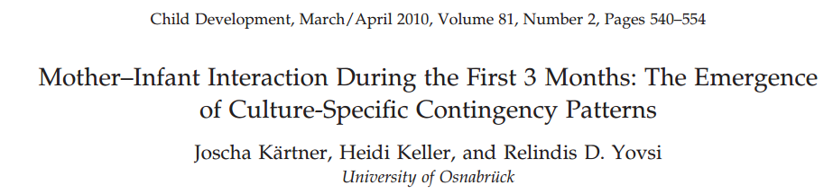
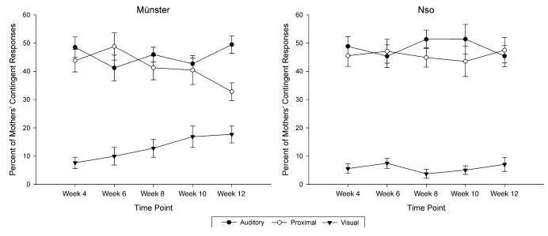
The development of mothers’ contingencies

Slide 101
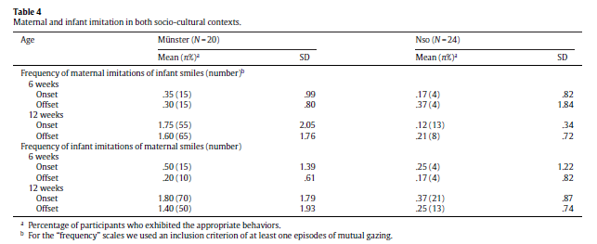
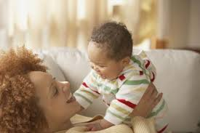

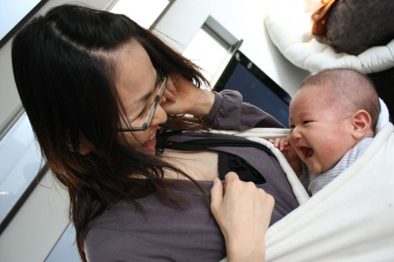
Smile imitation differs by 6 weeks and diverges through 12 weeks
(Germany and Cameroon)
Wörmann, V., Holodynski, M., Kärtner, J., & Keller, H. (2012). A cross-cultural comparison of the development of the social smile: A longitudinal study of maternal and infant imitation in 6- and 12-week-old infants. Infant Behavior and Development, 35(3), 335-347. doi: 10.1016/j.infbeh.2012.03.002
Notes:
1

Slide 102
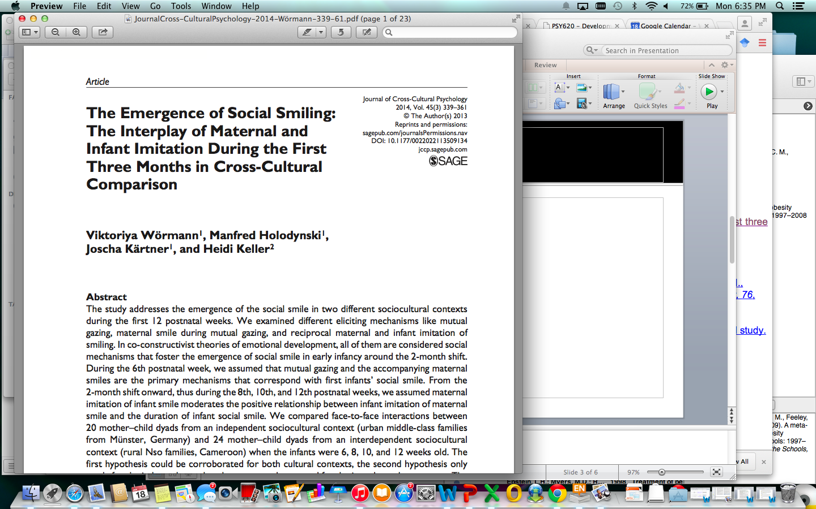

Wormann et al- Social Smiling Cross- Culturally
Research shows that, in infants as young as 6 weeks: 1. Mutual gazing is predecessor for infant smiling and 2. Mother’s smile during mutual gaze is the second predecessor for infant smiling
      Studies also show that infants 8-12 weeks are able to discriminate different emotional expressions and respond with their own imitations
      Therefore the FIRST MECHANISM of infant social smiling linked up with infant smile is: infants imitation of mom smile
      And, the SECOND MECHANISM is: mother imitation of smiling
    Purpose of the Study: Examine what mechanisms contribute to infant social smiles in 6,8,10,12 weeks infants cross culturally
MK Clennan

Slide 103
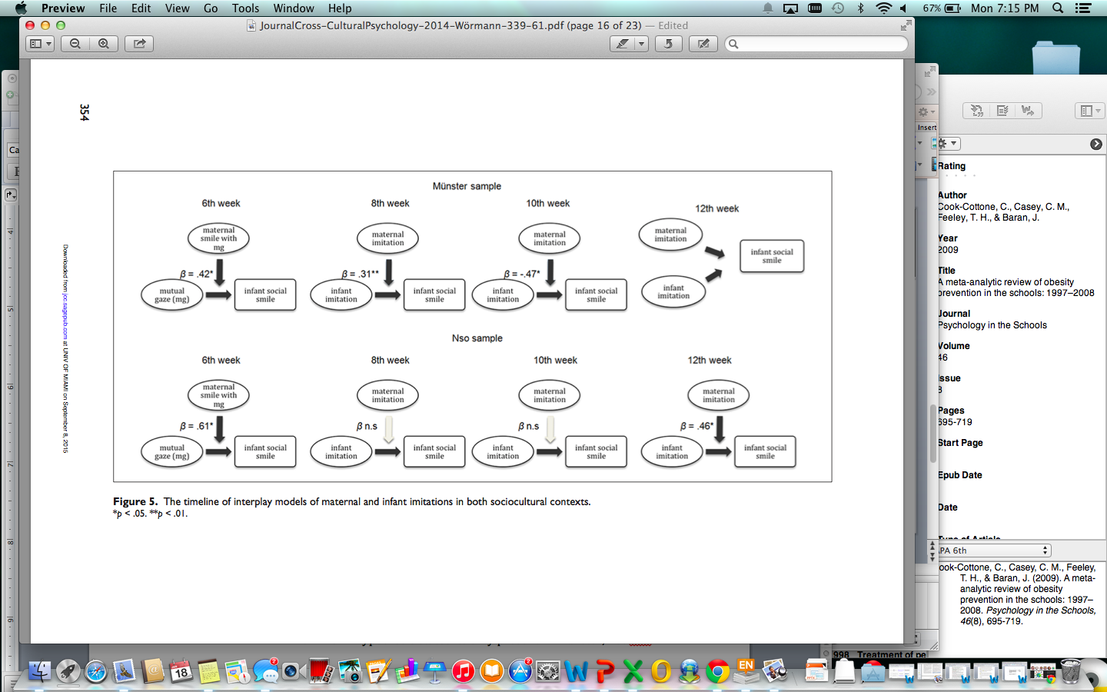
Social Smiling Cross- Culturally
Wormann et al., 2014-
MK Clennan
    At 6 weeks, mutual gazing → duration of infant smile enhanced by maternal smiling in both cultures
    Later, infant imitation of mom smile → duration of infant smile is enhanced (moderated) by mother smile imitation in German before Cameroon sample
Notes:
: 1- socially bid for mothers smiles by smiling more (Still-face parading); 2- first signs of coyness at this age? Smiling gaze aversion has been shown in 10 weeks before; 3- other developmental patterns may be overlapping (ex attention to other things)

Slide 104

Wormann et al- Social Smiling Cross- Culturally: Discussion/Limitations
    To conclude…
      Both cultures have similar emergence of social smile at 6 weeks old due to mother infant gaze AND maternal smiling (which is reinforcing infants smiling).
      But, overall, there are differential developmental pathways of infants social smile during the first 3 months cross-culturally
        Culture specific mother-infant patterns (i.e. maternal emotional behavior during face to face interactions)
Limitations/Discussion:
Note: Small sample size, authors stated that socio-demographic differences were not controlled for as they were “accounted for by culture”, fathers were not included in study…
Anything not controlled for in the study that can effect behaviors of mothers and in turn, infant smiles?
What about fathers cross-culturally?
Do these findings support and/or add to the Dynamic Systems Theory?
MK Clennan
Notes:
1- For example, Bigelow 2009 found that infants of depressed mothers adapt to this and are unresponsive when (at the age of 3 months) interacting with non-depressed adults
Could SES, health, occupation be effecting the imitation of infant smiles (as opposed to culture alone)?
Urban vs. Rural (Munster population- 300,000; 80% white color jobs….City that Nso villiage is outside of- 80,000)

Slide 105
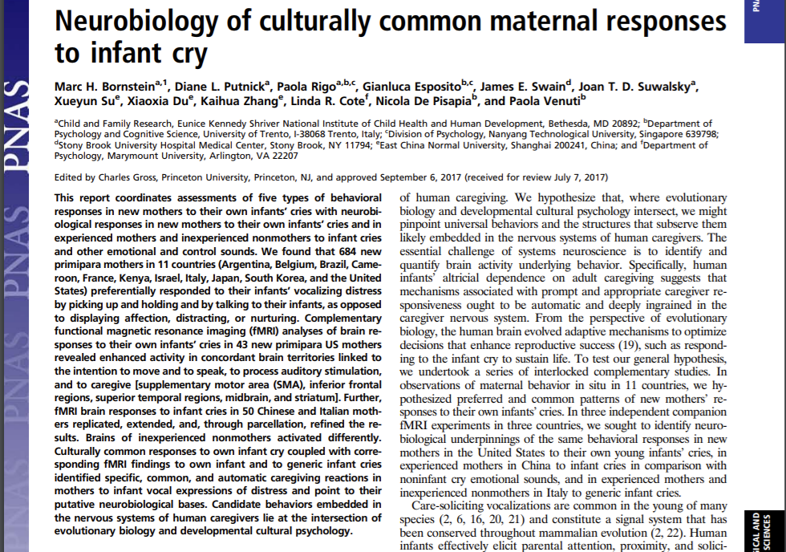

Slide 106
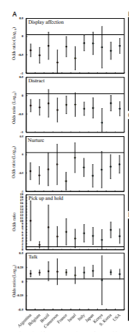

General responses to cry:
Pick up & hold, Talk
Bornstein, et al. (2017). Neurobiology of culturally common maternal responses to infant cry. Proceedings of the National Academy of Sciences of the United States of America, 114(45), E9465-E9473. https://doi.org/10.1073/pnas.1712022114

Slide 107
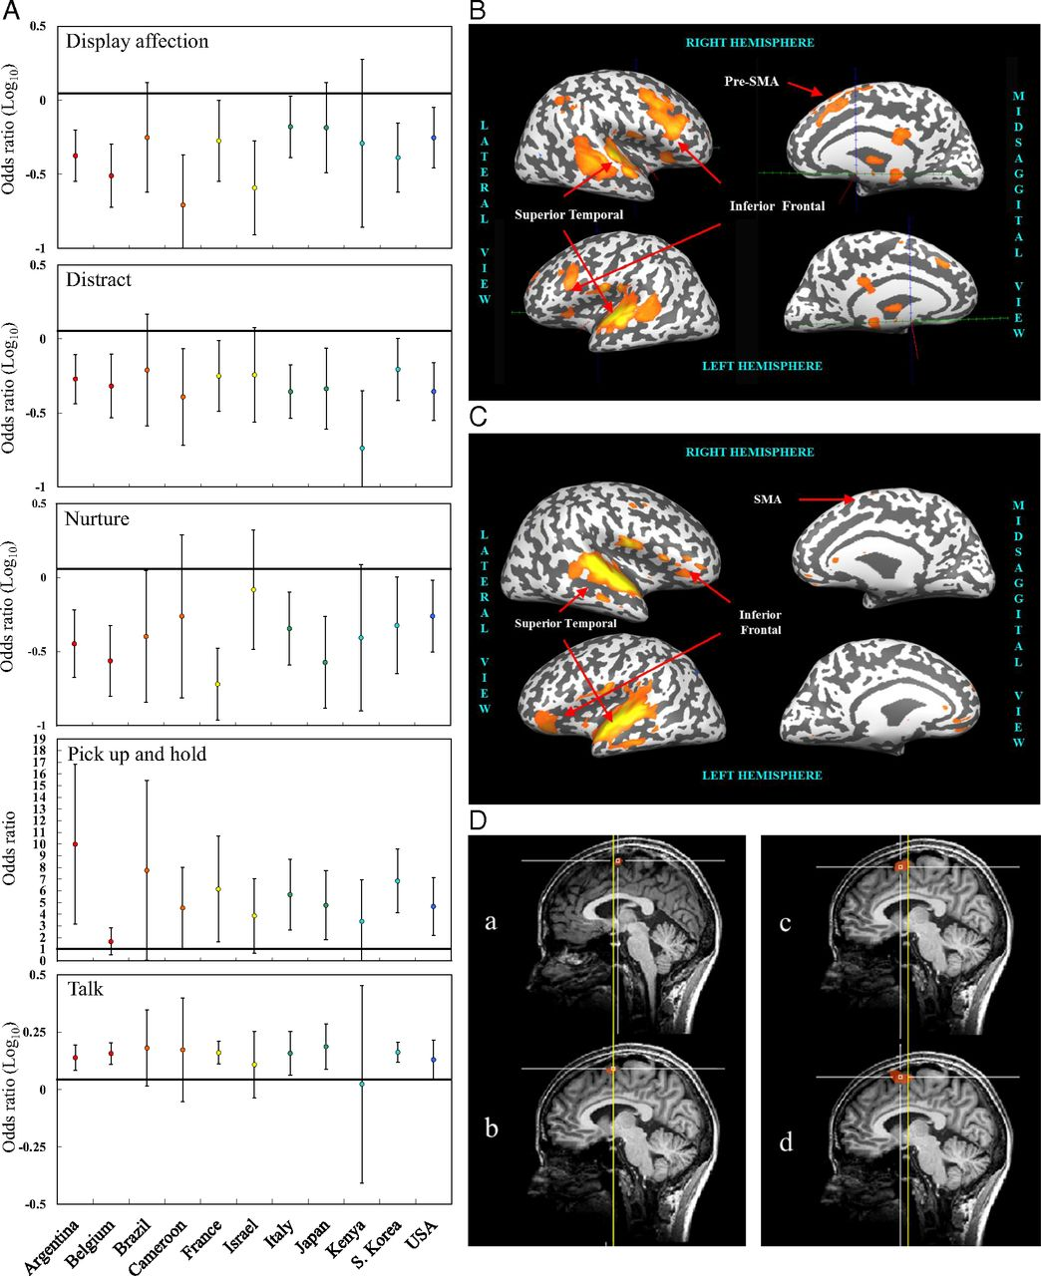

Marc H. Bornstein et al. PNAS 2017;114:45:E9465-E9473
Behavioral and fMRI responses to human infant cries.
©2017 by National Academy of Sciences
Notes:
Behavioral and fMRI responses to human infant cries. (A) Five types of maternal contingent responses to infant vocal distress in 11 countries. Display affection: Physical behaviors (kissing) or verbal statements (“I love you”). Distract: Encouraging the infant’s attention to a property, object, or event in the environment physically or verbally. Nurture: Feeding, burping, wiping the infant’s face or hands, or diapering the infant. Pick up and hold: Lifting and supporting some or all of the infant’s weight with the body. Talk: Vocalizing directed toward the infant. Reference lines for statistical significance are drawn. Except for talk, which has an absolute minimum of −1, abscissae mark the absolute minima for transformed ORs. Means and 97.5% CIs. (B) US mothers. Graphical representation of brain regions resulting from the contrast own-infant cry vs. control noise in the whole group of new mothers at 3.5 mo postpartum. The top of the figure refers to the right hemisphere, the bottom to left hemisphere, the left to lateral views, and the right to midsagittal views. (C) Chinese mothers. Graphical representation of brain regions resulting from the contrast infant cry vs. control noise in the whole group of mothers at 7 mo postpartum. The top of the figure refers to the right hemisphere, the bottom to the left hemisphere, the left to lateral views, and the right to midsagittal views. (D) Chinese mothers. Sagittal brain views of pre-SMA and SMA-proper activation peaks (white squares) in the following contrasts (and coordinates): (a) IC vs. NCS (x = 3, y = −4, z = 64), (b) IB vs. NCS (x = 6, y = −1, z = 61), (c) AC vs. NCS (x = 6, y = 5, z = 58), and (d) IL vs. NCS (x = 6, y = 5, z = 61). The vertical anterior commissure (VAC) line (y = 0) is indicated in yellow.

Slide 108
General responses to cry:
Pick up & hold, Talk
Marc H. Bornstein et al. PNAS 2017;114:45:E9465-E9473
Behavioral and fMRI responses to human infant cries.
©2017 by National Academy of Sciences
Notes:
Behavioral and fMRI responses to human infant cries. (A) Five types of maternal contingent responses to infant vocal distress in 11 countries. Display affection: Physical behaviors (kissing) or verbal statements (“I love you”). Distract: Encouraging the infant’s attention to a property, object, or event in the environment physically or verbally. Nurture: Feeding, burping, wiping the infant’s face or hands, or diapering the infant. Pick up and hold: Lifting and supporting some or all of the infant’s weight with the body. Talk: Vocalizing directed toward the infant. Reference lines for statistical significance are drawn. Except for talk, which has an absolute minimum of −1, abscissae mark the absolute minima for transformed ORs. Means and 97.5% CIs. (B) US mothers. Graphical representation of brain regions resulting from the contrast own-infant cry vs. control noise in the whole group of new mothers at 3.5 mo postpartum. The top of the figure refers to the right hemisphere, the bottom to left hemisphere, the left to lateral views, and the right to midsagittal views. (C) Chinese mothers. Graphical representation of brain regions resulting from the contrast infant cry vs. control noise in the whole group of mothers at 7 mo postpartum. The top of the figure refers to the right hemisphere, the bottom to the left hemisphere, the left to lateral views, and the right to midsagittal views. (D) Chinese mothers. Sagittal brain views of pre-SMA and SMA-proper activation peaks (white squares) in the following contrasts (and coordinates): (a) IC vs. NCS (x = 3, y = −4, z = 64), (b) IB vs. NCS (x = 6, y = −1, z = 61), (c) AC vs. NCS (x = 6, y = 5, z = 58), and (d) IL vs. NCS (x = 6, y = 5, z = 61). The vertical anterior commissure (VAC) line (y = 0) is indicated in yellow.

Slide 109

Cultural Psychology: A recent example
Gebauer et al., 2012 Psychological Science

Slide 110
‘Mixed blessings’: parental religiousness, parenting, and child adjustment in global perspective
Bornstein et al., 2017
Presented by Merranda McLaughlin

Slide 111
Study Background
Religion impacts the norms, beliefs, practices, and lives of communities.
The majority of people in the word identify with a religion.
Previous literature demonstrates positive and negative mental/physical health outcomes associated with religion.
Religious parents tend to engage with religion around and with their child(ren), which influences their development.
Ream

Slide 112
Sample
1,198 families (1,198 children, 1,198 mothers, and 1,075 fathers; N = 3,471)
9 countries represented:
  Jinan, China;
  Medellín, Colombia,
  Naples and Rome, Italy,
  Zarqa, Jordan
  Kisumu, Kenya
  Manila, the Philippines
  Trollhättan/Vänersborg, Sweden
  Chiang Mai, Thailand
  Durham, North Carolina, United States
Ream
Notes:
--Note the benefits of how they grabbed this sample.
Issue of heterogeneity within culture
So many cultural differences within countries that I like that they grabbed diverse samples within a specific city.

Slide 113
Procedure
Data collection followed the age of the child.
Age 8
  Parents report: demographic information about the family, religiousness, and religious affiliation.
Age 9
  Child reports: their perceptions of their mothers' and fathers' parenting behavior
  Parent reports: parenting behavior, parental efficacy, social desirability bias, and their child's social competence, school performance, and behavior problems
Age 10
  Parent reports: child's social competence, school performance, and behavior problems.
Ream
Notes:
Love that this study is longitudinal. Love that they didn’t grab data solely from one source, and account for social desirability, as cultures may influence how much families are willing to acknowledge the strengths and difficulties of their child.

Slide 114
Constructs and Measures
Parental Religiousness
  The same parent answered two religiousness questions on a scale from 1, not at all, to 5, very important/much: ‘How important would you say religion is in your life?’ and ‘How much would you say your religious beliefs influence your parenting?’
Parental Efficacy
  Four items on parents self‐reported feelings of about how much they can do to affect their children at school, at home, and outside the home.
Parenting Behavior
  Parental Acceptance‐Rejection/Control Questionnaire‐Short Form
Child Social Competence Scale
Child School Performance & Child Internalizing/Externalizing Behaviors
  Child Behavior Checklist
Notes:
Important to critically examine these measures in light of concerns about language, underlying constructs,
Doesn’t fully capture religiousness. Great measures out there that help researchers demarcate positive and negative aspects of religiousness.
HOWEVER, this measure in its simplicity
Always going to be some limitations. Looking at a child’s school performance and “difficult” behaviors is one way to think about development but is likely conceptualized and rooted in the author’s ideas about children. How well would this apply to other tribes, rural areas, etc?

Slide 115
Results
Child-Reported Parenting
  Greater parental religiousness at age 8 was associated with higher parent‐reported parental efficacy at age 9, which was in turn associated with increases in child social competence and school performance from age 9 to age 10.
  Greater parental religiousness at age 8 was also associated with higher child‐reported parental control and rejection at age 9, which were, in turn, related to increases in child internalizing and externalizing from age 9 to age 10.

Slide 116
Results
Parent-Reported Parenting
  Greater parental religiousness at age 8 was associated with higher parent‐reported parental efficacy and warmth at age 9, and parental warmth (but not efficacy) was, in turn, related to increased child social competence and school performance from ages 9 to 10
    Higher parent‐reported parental efficacy (but not warmth) was also associated with decreased child internalizing problems from ages 9 to 10.
  Greater parental religiousness at age 8 was associated with higher parent‐reported parental control at age 9, which was, in turn, related to increased child internalizing and externalizing from ages 9 to 10.

Slide 117
Results
Authors used multigroup path models to test whether any paths of the model differed based on any groups: religion, region, mother/father, boy/girl.
The relationship between parental religiousness and parental efficacy seemed to emerge as a result between its strong association by Italian Catholics (was positive and significant only for Catholics in religious group models and only for Italians in site models).
Notes:
Loved this analysis, because it allows for potential nuance.

Slide 118


Slide 119
Discussion
How does one measure child development cross-culturally? Was this study’s balance of school outcomes and psychological symptoms adequate?
Did the study adequately account for the heterogeneity problem? Was region-based samples helpful in this case?
This study utilized 9 regions, had a more-than-adequate sample size, and used proper statistical approaches to examine how these relationships differed across groups. Do you feel confident that the results reflect a developmental “truth” as to how religion impacts child development? Why or why not?
What aspects of religiousness likely promote parental efficacy? What additional cultural factors may be involved?
In the parent reports there was an association between being more religious and being warmer, but this was not found in the child reports. Why might this be different? (e.g. what microsystems are they comparing to?)
Do you think the ”mixed blessing” of parental religiousness is due to measurement (i.e. religiousness is multidimensional, but parents likely engage in both positive and negative forms), or do you think there are other factors at play that determine the developmental impact of parental religiousness (i.e. child religiousness, community factors)?
Notes:
In regards to warmth: what is the baseline the parent is comparing to? (other religious folks) What is the baseline children 8-10 comparing to? (parents of other kids at school regardless of religion, maybe in comparison to teachers).

